Slide 1
CADIA DEI ACCELERATOR PROGRAM:
Capstone Group #5 DEI Toolkit for Managers

Slide 2
DEI Challenge & the WHY
Challenge: Middle managers often aren't equipped to lead DEI discussions or incorporate DEI initiatives into the everyday workplace.
Why: For DEI to be a success and the efforts to make an impact, ALL levels of the company have to make a commitment. Middle managers are crucial to this effort. They interact with employees daily and are responsible for running meetings, delegating tasks, hiring, reviewing and promoting employees, and more. Managers can transform a company value from intention to meaningful action and have a positive impact on the employee experience.
Solution: Create a toolkit to provide middle managers with DEI resources along with a blueprint for implementation.

Slide 3
DEI Toolkit for Managers

Slide 4
DEI Toolkit for Managers
Business case for DEI
DEI Definitions
DEI Topics and Learning material
Unconscious Bias
Microaggressions
Code Switching
Conversation Starters
Inclusive Leadership
DEI Change Management Roadmap/Tips

Slide 5
Business Case for DEI
The WHY behind DEI

Slide 6
Business Case for DEI
Diverse and inclusive workplaces create better performing teams, which leads to better financial performance.
DEI is a powerful tool for attracting and retaining talent
Diversity of perspectives yields innovation
Understand that DEI is not a silver bullet to better financial performance. You must be willing to do the work and change power structures to harness diversity.

Slide 7
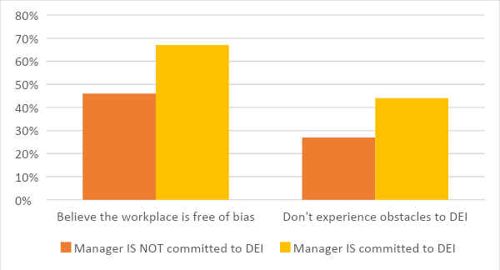
Managers and DEI
It is critical to have managers’ support for Diversity, Equity, and Inclusion initiatives.
Managers interact with their employees daily and are responsible for running meetings, delegating tasks, reviewing and promoting employees, and more. Each of these are opportunities to champion company culture and DEI initiatives. When it comes down to it, managers are change agents in all aspects of business.
Studies show that when managers are committed to diversity, equity, and inclusion, there is less bias and fewer obstacles for minority employees.

Slide 8
Managers and DEI
Managers benefit from DEI initiatives, too.
Not only are managers supporting their employees when they commit to DEI principles, they also stand to benefit by having more cohesive, committed, and effective teams.
Inclusive companies are more likely to hit financial goals, which often correlate to bonuses and raises for all employees. DEI helps your employees feel safe and valued, so they can share their opinions and are more likely to stay with the company for longer.
Diverse teams are more innovative, make better decisions, and are more engaged.
Bottom line: DEI makes teams more effective and efficient.

Slide 9
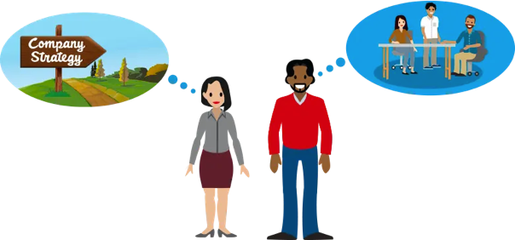
Guidelines for using this toolkit
Managers:
Use the toolkit to learn about DEI
Use each “lesson” in the toolkit as a blueprint for talking to your team about DEI
Practice inclusive leadership
Work on implementing DEI change management within your own teams
Leadership:
Use the toolkit to learn about DEI
Encourage your managers to use the toolkit as a resource when speaking to their teams about DEI
Practice inclusive leadership
Incorporate the DEI change management strategy into your organization
Image: salesforce
This is a RESOURCE to help LEARN and INCORPORATE DEI into your organization.

Slide 10
DEI Definitions
Concepts to improve understanding

Slide 11
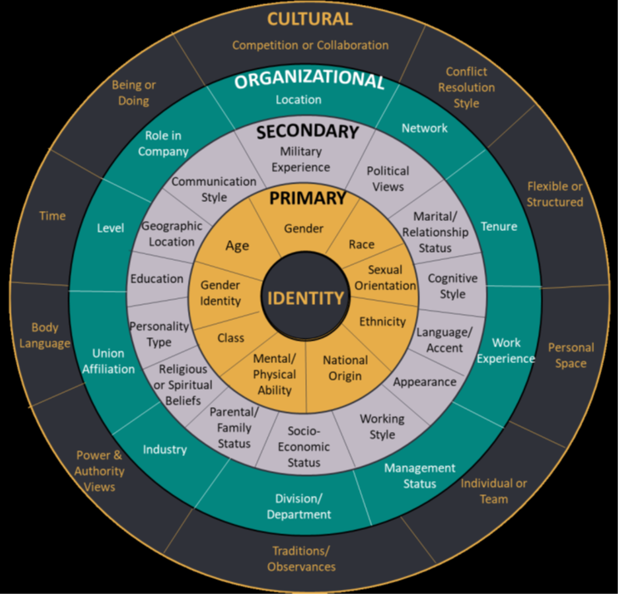
Diversity
Diversity is the range of human differences, including but not limited to race, ethnicity, gender, gender identity, sexual orientation, age, social class, physical ability or attributes, religious or ethical values system, national origin, and political beliefs.
•Watch: https://youtu.be/7G0OUHnCudw
Diversity is not one-dimensional
Intersectionality - The concept of intersectionality describes the ways in which systems of inequality based on gender, race, ethnicity, sexual orientation, gender identity, disability, class and other forms of discrimination “intersect” to create unique dynamics and effects.
Notes:
Respect & Inclusion at Deloitte video

Slide 12
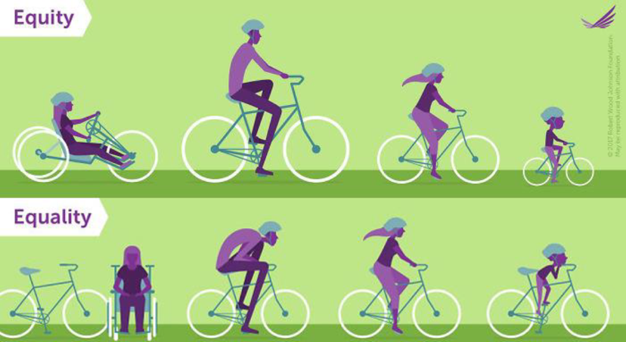
Equity
The term “equity” refers to fairness and justice and is distinguished from equality: whereas equality means providing the same to all, equity means recognizing that we do not all start from the same place and must acknowledge and adjust imbalances. The process is ongoing, requiring us to overcome intentional and unintentional barriers arising from bias or systemic structures.
•Equity can be understood as the means, and equality as the end. Equity leads to equality.
Equity is not going to happen organically. It takes intention, perseverance and constant evaluation.

Slide 13
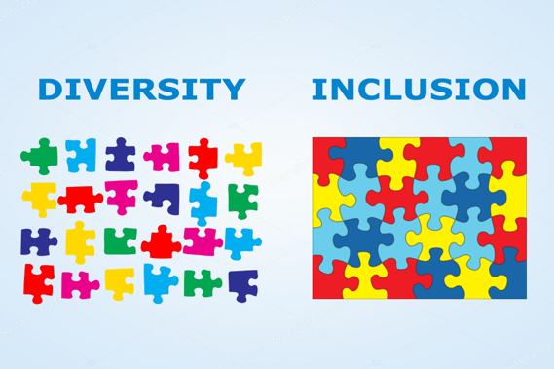
Inclusion
Inclusion is the culture in which the mix of people can come to work, feel comfortable and confident to be themselves, work in a way that suits them and delivers your business needs. Inclusion will ensure that everyone feels valued and importantly, adds value.
Inclusive leadership - leaders who are aware of their own biases and preferences, actively seek out and consider different views and perspectives to inform better decision-making.
The traits which define an inclusive mindset include respect for others, open-mindedness, curiosity, cultural competence, kindness, lack of ego, and empathy.
A good way to think about inclusion is that it is active, intentional and ongoing engagement with diversity in ways that increase awareness, content knowledge, cognitive sophistication and empathic understanding of the complex ways individuals interact within systems and institutions. It is the act of creating involvement, environments and empowerment in which any individual or group can be and feel welcomed, respected, supported and valued to fully participate.
Notes:
“Imperfect people acting in inclusive cultures are more likely to act inclusively than perfect people in broken systems.”

Slide 14
“Diversity is a FACT. Equity is a CHOICE. Including is an ACTION. Belonging is an OUTCOME.”
DEI Strategist Arthur Chan
Notes:
Diversity and inclusion are not issues that need to be addressed sometimes. They are always issues that need to be constantly cultivated, supported, and reinforced.

Slide 15
DEI Topics & Learning Material
Concepts to improve understanding

Slide 16
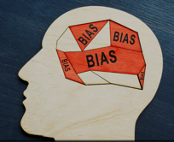
Unconscious Bias
Social stereotypes about certain groups of people that individuals form outside their own conscious awareness. Everyone holds unconscious beliefs about various social and identity groups, and these biases stem from one's tendency to organize social worlds by categorizing.
Watch: Unconscious Bias At Work
https://www.youtube.com/watch?v=NW5s_-Nl3JE
Watch: Worlds Apart
https://www.youtube.com/watch?v=etIqln7vT4w
Watch: The Look
YouTubehttps://www.youtube.com/watch?v=H_KipNvujKo
Unconscious Bias assessments
https://implicit.harvard.edu/implicit/takeatest.html
Use these links to review the material and reflect on your own unconscious bias and explore how the brain functions to develop quick judgements.
Next Steps: Share the learning material with your team and have them pre-watch the videos and also take two of the unconscious bias assessments prior to coming back together as a team. They should be encouraged to have personal reflection on the feedback at the end of the assessments, however results should remain private unless they choose to share. This is to be a supportive and open discussion with your employees to listen and learn together. It is about growing and understanding, not about test results.

Slide 17
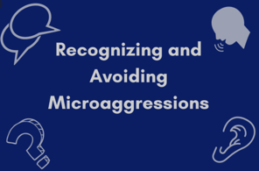
Microaggressions
A term used for commonplace daily verbal, behavioral or environmental slights, whether intentional or unintentional, that communicate hostile, derogatory, or negative attitudes toward stigmatized or culturally marginalized groups.
These videos and article introduce and explain acts of microaggressions and the impact they make on those affected by the often unintentional comments/actions.
Through understanding of this topic, the hope is that each person will be more thoughtful and educated in their communication and approach with one another.
Watch: Implicit Bias and Microaggressions: The Macro Impact of Small Acts.
Watch: Eliminating Microaggressions: The Next Level of Inclusion
Read: When and How to Respond to Microaggressions - Harvard Business Review
Notes:
Pause and ask yourself if the

Slide 18
Code Switching
The practice of adjusting one’s style of speech, appearance, behavior, and expression in ways that will optimize the comfort of others in exchange for fair treatment, quality service, and employment opportunities.
If you are among those that don’t need to code-switch, then here are four steps you can take:
Build empathy and mindfulness
Check your bias
Offer affirmations
Be an active ally – beyond being an ally, challenge yourself to be an “accomplice” – meaning we are intentionally and actively involved in helping, rather than just cheering from the sidelines.
Watch: TEDx - The Cost of Code Switching - Chandra Arthur https://www.youtube.com/watch?v=Bo3hRq2RnNI
Read: The Costs of Code-Switching
https://hbr.org/2019/11/the-costs-of-codeswitching
https://burrelles.com/code-switching-in-the-workplace-being-authentic-and-building-resilience/
Notes:
The expectation of code switching threatens real diversity

Slide 19
DEI Conversation Starters

Slide 20
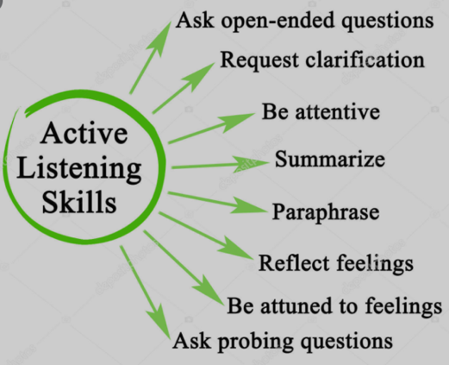
DEI Conversation Tips
As you begin the DEI journey with your team, it is important to remember you are not leading a strategic team meeting, you are supporting an open discussion. Create a safe space where everyone can be heard and respected. Come ready to LISTEN and ask questions to learn and understand; ask your team to do the same.
A few tips to help you lead meaningful discussions with your team:
Start each conversation by encouraging openness, respect, and honesty
Allow employees to share their thoughts and feelings without judgement
Do not compel employees from marginalized groups to share traumatic experiences.
Do not shy away from difficult subjects but rather embrace the discomfort surrounding an opportunity for growth.
Be prepared to follow up. If there is any confusion or follow-up needed (for the team or individuals), determine how that next touchpoint or conversation will happen.

Slide 21
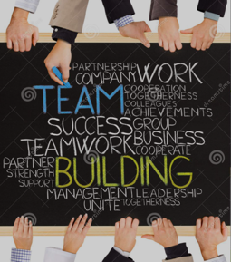
Conversation Starters to Foster Inclusion and Team Cohesion
The below conversation starters can be used year-round to help promote diversity and inclusion. More than just raising awareness, meaningful conversations can leverage employees’ unique experiences, perspectives, and viewpoints for the collective benefit of all. As we continue to work in remote environments, cultivate an office culture that encourages meaningful conversations to facilitate relationship building, trust, and real connections.
Below are a few conversation starters that may help you form connections with your colleagues/team and see them as individuals with unique experiences and stories to share:
What does your name mean? Is there a story behind your name?
What is the most memorable lesson you learned from a parent, guardian, or childhood mentor?
What personal passion project are you working on right now?
If you could start a charity, what would it be for?
Share a time someone made you feel welcomed and accepted in a social group?
What are some of your favorite childhood traditions or general celebrations?
What culture would you like to learn more about?
How would you describe the place you were born?
What languages are spoken in your family?
What historical event has most affected your life?
What did you spend most of your time as a child?
What three events in the last 5 years have greatly impacted you?

Slide 22
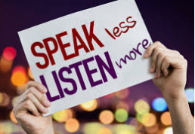
DEI Training Follow Up Conversation Starters
A key component of DEI training is the work that happens afterwards. Use this time to grow as a team together and share insights. After your team completes various DEI trainings, hold team meetings to regroup and discuss what was learned, how the trainings impacted associates, any light-bulb moments, key takeaways, etc.
The questions below can help get the conversation going:
What surprised you most about what you have learned?
How did you feel watching the videos?
What ideas do you have about how we can impact our culture at work?
What areas do you feel you still need to learn more about?
How can we better support our colleagues in this area?
What can we do to be more inclusive as a team?
How might you broaden your thinking to be even more inclusive of diverse perspectives?
What might you do to bring people “inside” and increase a sense of belonging?
What strategies might you rely on to mitigate the impact of bias in the workplace?

Slide 23
“Meaningful insights come from meaningful dialogue.”

Slide 24
Inclusive Leadership

Slide 25
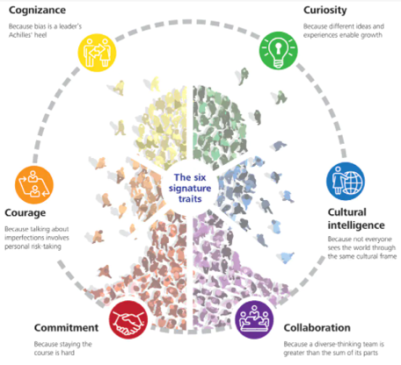
Six Traits of Inclusive Leaders
Being an inclusive leader and having empathy are some of the most critical management skills needed in today’s workplace. Read Deloitte’s Six Signature Traits of Inclusive Leadership and think about how you can embody these traits, and their various elements, as you continue growing as a leader.
Read: Six Signature Traits of Inclusive Leadership
https://www2.deloitte.com/us/en/insights/topics/talent/six-signature-traits-of-inclusive-leadership.html

Slide 26
Creating an inclusive working environment
Common steps to take in your organization to foster an inclusive environment include:
Diversity training (unconscious bias workshops, etc.)
Recruiting pipeline targets
Encouraging a culture of open feedback
Conducting regular workplace culture surveys
Supporting employee resource groups
Providing mentoring and coaching opportunities
Studies have shown a link between mentoring programs and retention of talent
Tips to make the hiring process more inclusive:
Hire for talent, not a resume
Review language used in job descriptions for bias
Remove names from resumes
Ensure candidate pool and interview panel is diverse
Building relationships among a diverse workforce helps to build understanding, value of differences, and ultimately, inclusion.

Slide 27
Inclusive Management Tips
Make time for connecting with your team
Prioritize transparency - even if it makes you look bad
Empower your team - use opportunity as your primary development tool
Foster competition and collaboration amongst your team
Ask your team for input on how to improve your company’s D&I in the workplace
Provide a safe space for honest feedback
Listen to, act on and reward feedback to foster trust
Incorporate regular shout-outs into your staff meetings to recognize achievements publicly
Lead by example - People pay attention to what leaders do, not just what they say

Slide 28
DEI Change Management Roadmap/Tips

Slide 29
DEI Change Management Roadmap
Although there are clear benefits to implementing Diversity, Equity and Inclusion initiatives, it is essential to recognize that these initiatives involve significant change, and should be implemented using a formal Change Management Approach.
Create Short-Term Wins
Anchor the Changes in Corporate Culture
Form a Powerful Coalition
Communicate the Vision
2
4
6
8
1
3
5
7
Create Urgency
Create a Vision for Change
Alleviate and Remove Barriers
Build on the Change
Executive Leadership
Middle Managers
https://www.kotterinc.com/8-step-process-for-leading-change/

Slide 30
Change Management Roadmap/Tips
Because middle managers ultimately shape the environment and daily experiences of employees, they play a key role starting with Step 4 shown in this model: Communicate the Vision for Change.
Step One: Create Urgency
In this step, we determine the need for a DEI intervention. First, there needs to an understanding that the intervention is a necessity. A comprehensive audit that includes focus groups, questionnaires, record assessment, cultural competency continuum, and a SWOT analysis can accomplish this. Next, after completing the audit, a compelling business case will need to be presented. The business case should include the potential business impact, return on investment and the risk of not implementing the intervention.
Step Two: Form a Powerful Coalition
This step involves building a team of diversity champions, leaders, and sponsors. These are the individuals who will help gain buy-in from others in the organization. They will serve as influential DEI change agents that are needed for the change. They may also assist in creating and implementing the DEI intervention.
Step Three: Create a Vision for Change
In this step, a vision should be created for the DEI initiative. Where do you see the intervention going, and how will it make a difference in the organization? The vision should consider those who will disrupt the organization with the change and those who the change will impact. Without this, there can be an increased chance of resistance within the organization.

Slide 31
Change Management Roadmap/Tips
Step Four: Communicate the Vision
When sharing any change, ensure the message includes information that shows the change is purposeful, desirable and feasible. Because of the possible uncomfortable environment creating a DEI intervention can invite, communicating the vision appropriately is imperative. It is not only essential to communicate the change correctly, but also just as vital to have the suitable person share the vision. The message should be consistent, from the Executive Level, to people leaders, to all employees.
Step Five: Alleviate and Remove Barriers
Not understanding the need for a DEI intervention, not wanting the intervention and resisting the intervention are a few barriers middle managers may face when attempting to implement a new DEI intervention. Ask questions, utilize the resources available, and be transparent about what can and can’t be accomplished.

Slide 32
Change Management Roadmap/Tips
Step Six: Create Short-Term Wins
Rolling out a new DEI intervention can be an enormous task, so celebrating the quick, small wins can lead to momentum. This is especially relevant for an incremental change that has various steps. Be sure to communicate your successes with stakeholders within the organization.
Step Seven: Build on the Change
The small wins are just the start. In this step, repetition is critical. Take the momentum from the small victories and build on it. Continue to communicate the vision within your team and the organization. Continue to celebrate small wins. Additionally, this is the opportunity to adapt to the change to “make it stick.”
Step Eight: Anchor the Changes in Corporate Culture
In this step, the DEI intervention is part of the lived corporate culture. All employees are adjusting to the change. The vision is implemented, behaviors are changing and impact is taking place.

Slide 33
Reminders / Takeaways
Leadership’s DEI Responsibility -
Set the tone (be change agents)
Ensure DEI strategy is aligned with business goals
Promote and encourage DEI initiatives
Be transparent about what can and can’t be accomplished
Model inclusive behavior
Call in/ out behavior
Hold people managers accountable
DEI is not “one size fits all”
Tailor the approach to your staff/company
Invest resources and budget - but more importantly time, attention and focus
Value progress > perfection
Multi-year journey
Set goals and expectations
Understand DEI is a marathon, not a sprint

Slide 34
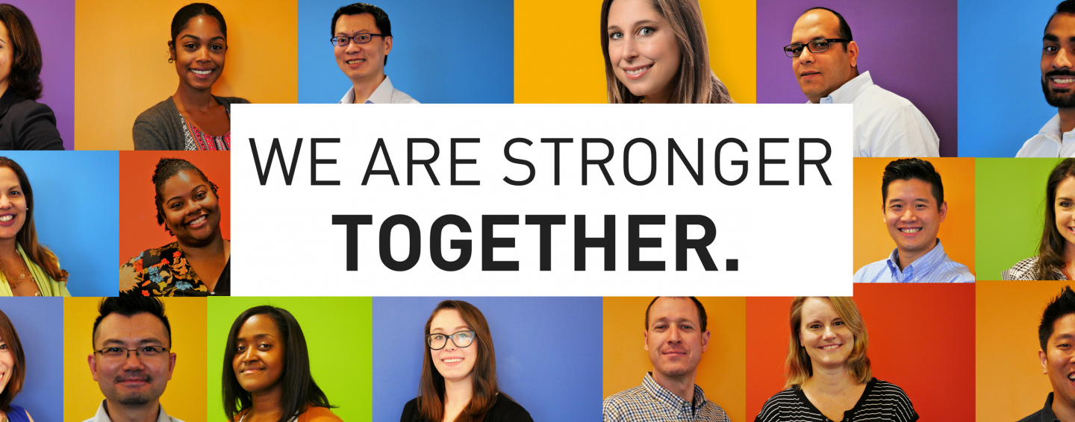
our office

Slide 35
Sample Implementation Guide
HR leads implementation
Official training rollout to all people managers with a requirement for completion of all learning materials within one month
HR holds follow-up discussions with all people managers
Goal being to answer any questions, provide additional insight/tips, etc.
People managers required to roll training material out to their respective teams
People managers to hold follow-up conversations with teams
HR to conduct employee surveys
People managers required to set DEI related performance goals for staff and themselves
Department responsible for implementing DEI toolkit will vary depending on the organization - could be a Leadership Development Org, DEI counsel/Ambassadors, etc.

