Slide 1
Change has Come FAIR CONTRACTS Indemnity / Duty to Defend
David P. Ferrell James A. Smith, Jr. Stephanie Hachem, PE
Nexsen Pruet, PLLC ACEC/NC Kimley-Horn
July 27, 2019

Slide 2
With the passage of HB 871 into law, Broad Form Indemnification and Duty to Defend Provisions in design contracts is not enforceable, so should no longer be a part of contract language that we sign.

Slide 3
But, how?

Slide 4
It started in March 2018…….
In March 2018, I sent an e-mail to Jim
The Board voted to move forward with the initiative
Sully (Mike Sullivan) came to town
We were ready to eliminate onerous indemnification / duty to defend language! -- we just didn’t know exactly how we were going to do it.

Slide 5
ACEC/NC Task Force Formed
Stephanie Hachem – Chair Kimley-Horn
Jim Smith ACEC/NC
Gary Hartong The Wooten Company
Richard Cook Kimley-Horn
Joelle Jefcoat Perkins and Will
David Crawford AIA/NC
Stephen Safran Safran Law
Bill Smith Stanford White
An early key decision: hire a lobbyist
As a result of the Task Force Recommendation and Board Approval David Ferrell joined our Task Force.

Slide 6
Coalition
ACEC led Initiative
Architects
– AIA was an impactful and committed partner
Landscape Architects
Surveyors

Slide 7
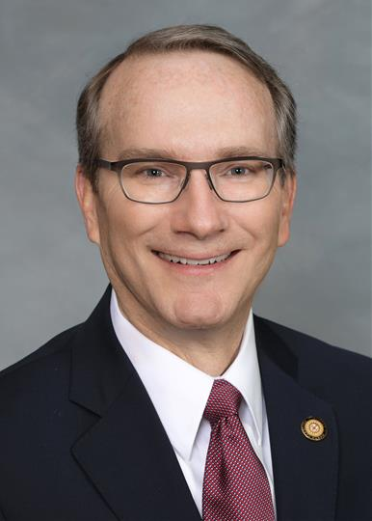
Primary Sponsors: Representative Arp (Union) and Senator Newton (Cabarrus, Union)

Slide 8
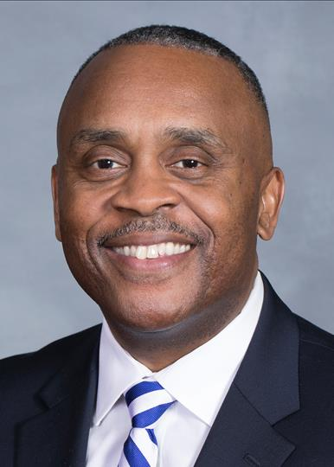
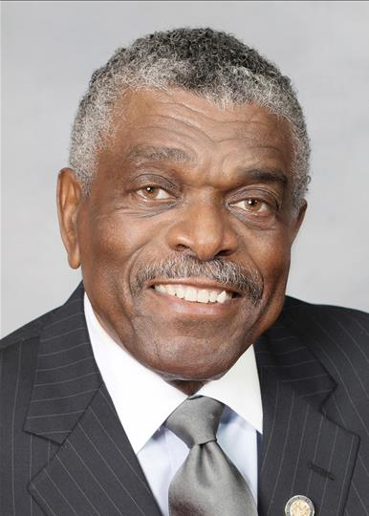
Co-Sponsors: Reps Stevens (Alleghany, Surry, Wilkes), Reives (Chatham, Durham), and Floyd (Cumberland)

Slide 9
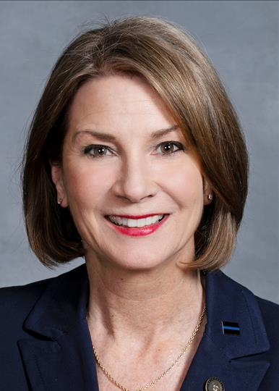
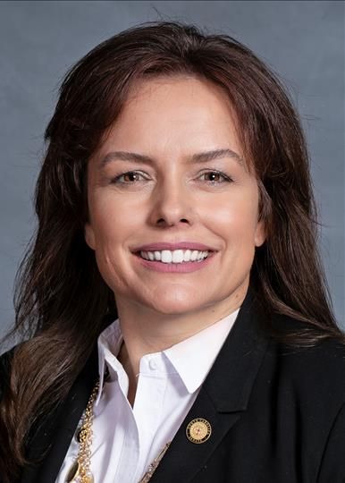
Key Supporters: Sen. Rabon (Bladen, Brunswick, New Hanover, Pender), Harrington (Gaston), Sawyer (Iredell, Yadkin)

Slide 10
Strategies I
Consistent and Controlled Message
Broad Form Indemnification not insurable
over time we somewhat backed away from this one
Foster Broad support by including all involved in construction projects
Apply to Public and Private owners
Remove all exemptions

Slide 11
Strategies II David has joined us.
Consistent and Controlled Message
Amend current statute vs draft new statute?
Avoid Key Opposition
Start with concurrent bills
later decided to go with one
Politically focus on impacts to small / DBE firms

Slide 12
The Process first phase
Language to Bill Drafting
Senate Bill Introduction Deadline (SB 569)
House Bill Introduction Deadline (HB 871)
Senate Judiciary House Commerce
Senate Rules House Rules
Senate Floor (Twice) House Floor
Cross-over Deadline (decision to run HB 871)
Negotiations with Stake Holders

Slide 13
The Process conclusion
Senate Judiciary
Senate Rules
Floor Amendment on Senate Floor
House Concurrence of Senate changes
Ratified
Governor Cooper signed into Law (July 8, 2019)
Effective August 1, 2019

Slide 14
Senate Judiciary (the First Time)
So where were did the Contractors stand on this?
Neutral– or so we thought.
David hears the night prior to our bill going to Senate Judiciary Committee that AGC (Contractors) will oppose us.
We proceed, and bill passes unanimously despite AGC’s opposition
Key presentations by Monty Irvin and Joelle Jefcoat

Slide 15
Senate Floor (twice)
Continued AGC Opposition
Pulled from the Agenda
Back on Agenda
It was recognized that ACEC had negotiated in good faith; the Contractors waited too long to voice opposition.
Strategic Decision made with Senate Leadership & both bill sponsors
It was decided to just run with one bill and because the House bill had already made crossover, we continued with HB 871.

Slide 16
House Rules House Floor
Meanwhile, companion bill in the House passed House Rules late in the evening.
David and Representative Arp got bill added to the House agenda that evening– within an hour of passing House Rules.
Companion bill passes on the House floor ~10:40pm!
We made crossover.

Slide 17
Senate Judiciary (again)
Numerous Stakeholder Meetings
AGC still opposing. We decided we would move ahead with our original language if AGC couldn’t come to agreement with us.
AGC agrees to language that provides some clarification for them but didn’t compromise what we wanted.
HB 871 passes Senate Judiciary and Rules with amendment to follow– AGC does not oppose!

Slide 18
Senate Floor Amendment
Lengthy Floor Amendment was Highly Unusual
Senate Rules Chair Support was critical
Passed quickly and unanimously!
What was so hard about that?!

Slide 19
Current Law – Loopholes and Gaps in Protections
Current GS 22B-1 provides only limited protection to design professionals:
Loopholes in existing language regarding indemnity
Applies only to indemnity claims arising out of personal injury or property damage – not economic loss or damage
Does not address duty to defend at all
Exempts utilities, railroads, and NCDOT from current indemnity language

Slide 20
The Solution HB 871 Fair Contracts
Eliminates Duty to Defend
Limits Indemnity to Own Fault
Eliminates Exemptions
Applies to Public and Private Contracts

Slide 21
The Solution HB 871 Fair Contracts
Eliminates Duty to Defend
Design Professionals cannot be made to "defend" an owner or any other party against claims involving professional negligence

Slide 22
The Solution HB 871 Fair Contracts
“Design Professional” is defined as:
Engineer
Architect
Landscape Architect
Surveyor
Soil Scientist
Geologist

Slide 23
The Solution HB 871 Fair Contracts
Limits Indemnity to Own Fault
Design professionals cannot be made to indemnify an owner or any other party if the design professional was not a "proximate" (direct) cause of the alleged damages or loss.
Includes claims for economic damages/loss as well as personal injury and property damage

Slide 24
The Solution HB 871 Fair Contracts
Limits Indemnity to Own Fault
Does not change a design professional’s ability to indemnify an owner for damages caused by a design professional’s own fault – which could include an owner’s attorney’s fees if found at fault
Existing law
Insurable under professional negligence policies

Slide 25
The Solution HB 871 Fair Contracts
Eliminates Exemptions
The existing exemptions to the current indemnity provisions of GS.22B-1 for NCDOT, railroads, and public utilities are eliminated (and do not apply to these new provisions).

Slide 26
The Solution HB 871 Fair Contracts
Applies to Public and Private Contracts
These protections apply to both public and private contracts
Against public policy, void and unenforceable

Slide 27
Impacts to Your Contracts
Goal: Eliminate these provisions from your contracts
How? Contract negotiation – front end
Applies to Contracts entered into, amended, or renewed on or after the effective date (August 1, 2019)
How to educate public/private entities
How to Use the new Law

Slide 28
Example of a Common Broad-Form Indemnity Provision—Now Illegal
Engineer hereby agrees to indemnify, hold harmless, and defend Entity, its employees, agents, subcontractors and any other third party, God, and your mother, from and against all claims, costs, losses, and damages (including attorney fees) resulting from bodily injury, property damage, and economic loss.

Slide 29
Example of a Duty to Defend Provision—Now Illegal
Engineer shall: (i) at its own cost, expense and risk, defend any and all claims, demands and suits defined in this Contract that may be brought or instituted against any Indemnified Party by any third party, including but not limited to any governmental, state or local agency, or any employee of the Engineer and any party for whose acts they may be responsible; and (ii) reimburse the Indemnified Parties for any and all legal costs (including attorney’s fees) and related expenses incurred by any of them in connection herewith or in enforcing the indemnity granted in this Section

Slide 30
How did we use our new advocacy entities?
With ACEC/NC PAC and ECNC we were well positioned for this endeavor– having both was key to our success.
ECNC
Although we did not need a huge financial effort; ECNC positioned us to do so if needed.
ACEC/PAC

Slide 31
Questions?

