Slide 1



SkillUP, MCCA
SkillUP Case File Checklists
Ambrosia Harrison
STLCC SkillUP Project Support Specialist

Slide 2
Helping Clients . . .
Case Managers are the first line of defense against poor usage of funds
  We assist in enrollment into programs and meeting requirements to enter training
  Providing Labor Market Research and Information data pertinent to their studies
  Providing referrals to additional resources if further assistance is required to meet assessment goals before, during and after training
  Employment connections and assistance with work related expenses that help them succeed in the work place

Slide 3
With SMART Notes
SMART case notes are:
Specific (To the client, class, and their goals)
Measurable (When and where)
Achievable (What is the purpose of writing the note?)
Realistic (Will they work towards this realistically?)
Time-bound (Can it be completed in a timely manner?)
Our hard case notes should include more information than allowable in our MOJobs Case notes per our confidentiality and case note guidance.

Slide 4
Case File Checklists
Ensure we are in compliance with our MCCA contracts, FSD, and DWD
Provide guidelines for approval of SkillUP funds to participants
Assist SkillUP Coordinators, Navigators and Project Support Specialist maintain a complete record of activities completed with Clients
Are a forethought to the Case Notes entered into MOJobs for components and activities.
  Hard files can include documentation that cannot be discussed in MOJobs but can be referenced in case notes for further information

Slide 5
Required Documentation
St. Louis Community College SkillUP Requires copies of the following:
  State ID or License
  Social Security Card
  High School Diploma or GED/Hi-Set
  WorkKeys Scores
  Talify results

Slide 6


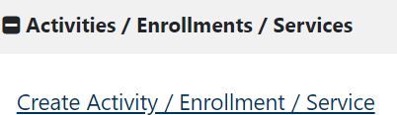
Student File Check List
Student Name Email Phone
Sent FS-5 upon obtaining employment
Post program employment check-in
30 days
60 days
90 days
Before Intake Appointment
Forms/Tasks in chronological order
First Contact Form
DCN Verification Form
Find in MoJOBS-STOP if unable to find & Contact DWD Tech Support
866-506-0251 or dwdsupport@ded.mo.gov
Individual Employment Plan (IEP)
Reverify before 1st day of class.
When class begins add
Activity 361, for 90 days
As soon as possible, minimum by end of month in which student begins class- MoJOBS Completion checklist
HAND WRITTEN CASE NOTES: As needed, add a hand written case note, date, & initial re: student’s progress or re: MoJOBs needs/errors/concerns.
Transfer written progress notes to MoJOBS.
At Intake Appointment-paper forms
SkillUP Registration Form
Assessment/Success/Employment Plan & discuss
Video Release Form
FERPA
Given Labor Statistics -MERIC, O*Net
FS-5, complete and send
WorkKeys Scores
Talify Results
At Intake Appointment in MoJOBS
Add Activities by clicking + sign and clicking “Activities/Enrollment/Services” & click “Create Activity/Enrollment/Service”
Activity 101 & case note
Activity 107 & case note
Activity 205 & case note
Activity 213 & case note
Activity 142 & case note
Activity 141 & case note
SNAP APP completed. Don’t exit the SNAP app, click “next”, and complete
Activity S-20 FNS (or S-10 TANF)
As you monitor student progress add
Progress Case Note (s) Add to file:
ABAWD only, send FS-5 monthly
NCRC-WorkKeys scores, if available
Handwritten Case Notes-date, initial
Final grades
Certificate of Completion
Click “Plan” & complete with student present
Objective Assessment Summary Add
Initial Case Note-met with potential student to discuss MCC SkillUP training enrollment
With student/soon after appointment, add

Slide 7

SkillUP Eligibility and DCN Verification Form
(one client per form)
Send to: to DSS.FSD.Agreements@dss.mo.gov
Date:
Client Name: Click here to enter text.
Client Address (Street, City & Zip Code): Click here to enter text.
Client Date of Birth: Click here to enter text.
Client DCN: Click here to enter text. Comments: Click here to enter text. Submitted by: Ambrosia Harrison
Requesting Agency: St. Louis Community College
Agency Location: 5600 Oakland Ave., St. Louis MO 63110
Agency Contact Phone#: 314-644-9787
E-Mail Addresses for reply: aharrison58@stlcc.edu
(please include everyone that needs the response or is cc’d)
STLCC SkillUP First Contact Form
Name- First | Name-Last
Telephone # | Address
Date of Birth | Email
Referred By | Last 4 digits SS#
Today’s Date | DCN, if known
Please complete the following as part of your initial contact with participant:
What type of educational training are you looking for?
What is your career goal?
3. Do you have your HS diploma or GED? Yes No
************************************************************************************
Response from Howell County
Client DCN: 0051738882
ABAWD/Volunteer: Click here to enter text.
(included should be the 3 non-work months for ABAWDs and the reason they are a volunteer, such as child under the age of 18 in the home, etc.)
4. Do you want to reduce or eliminate your SNAP benefits with this training?
5. Can you and are you willing to work full-time (after your training ends)?
Yes No
Food Stamps (FS):
Pending ☐ Regain
Active
6. Are you receiving any other benefits? Yes No
If yes, by working will this affect your benefits?
Comments:
(or must regain eligibility (give the 3 non-work months) Certification period for food stamp case)
Temporary Assistance (TANF):
Pending ☐ Active
Comments: Click here to enter text.
Are you willing to maintain regular contact via phone, email, and in-person? Yes No
Can you think of anything that would keep you from meeting these expectations at this time?
Revised 9/25/18 tf

Slide 8
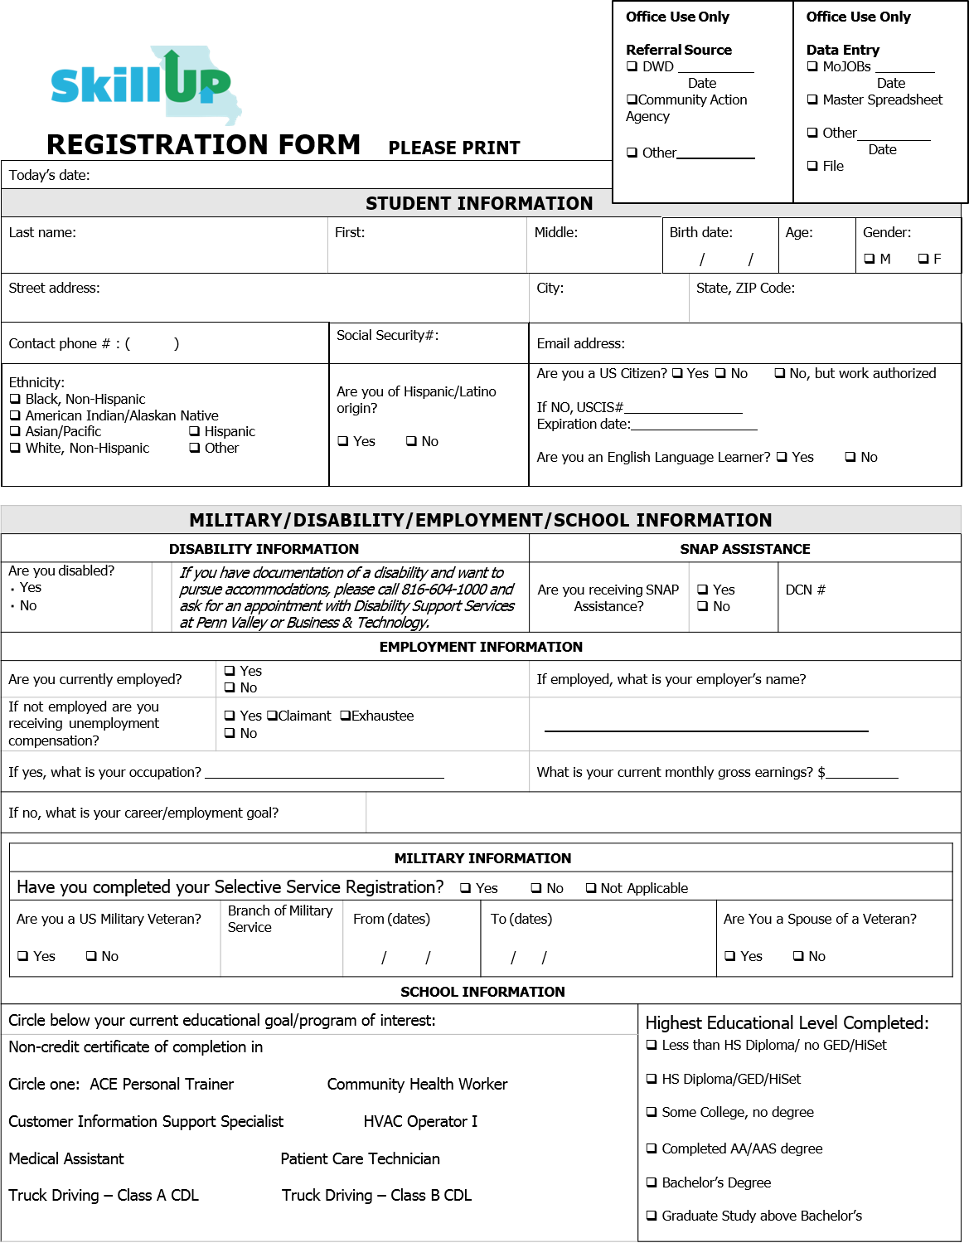

VIDEO RELEASE FORM
I, , hereby grant permission to the Missouri Community College Association, the Missouri Department of .Social Services, and . the rights of icy image, ir. video or still, and of the likeness and sound of my voice as recorded on audit› or video tape, without payment or any other consideration. I •onderstand that my image way be edited, copied, exhibited, published or distributed and waive the right to inSP••t or approve the finished product wherein rriy likeness appears. Additionally, I waive any right to royalties or other compensation arising or related to the use of my image or recording. I also understand that this material may be used for marketing purposes for the SkillUP program in the state of Missouri.
Photographic, avidio or video recordings may be used for ANY USE which may include but is not limited to:
Presentations;
Online/internet Videos;
ivfedia;
Nevrs (Press);
By signing this release, I understand this permission signifies that photographic or video recordings of me may be electronically displayed via the Internet or in the public setting.
I will be consulted about the use of the photographs or video recording for any purpose other than those listed above.
There is no time limit on the validy of this release nor is there any geographic limitation on where these materials may be distributed.
This release applies to photographic, audio or video recordings collected as part of the sessions listed on this document only.
By signing this release, I acknowledge that I have completely read and ftilly understand the above release and agree to be bound thereby. I hereby release any and all claims against any person or organization utilizing this material ION educational purposes.
Full Name Street Address/P.O. Box
City State Zip Code Phone Fax Email Address
Signature Date
If this release is obtained from a presenter under the age or 19, then the signature of that presenter's parent or iegai guardian is also required.
Parents Signature Date

Slide 9

SkillUP Grant: Student Success Plan Assessment/Employment Plan/Student Expectations
Student Name Date Student A#
Successful students think in advance about their goals and the realities of their lives to assess if they are ready to succeed and complete their program.
EDUCATION BACKGROUND:
STUDENT EXPECTATIONS
I, understand and agree to the SkillUp Grant Employment program
rules.
Student’s Name-Print
I will follow my employment plan stated below.
Once I have completed the program I am aware that I must look for and obtain a job in the field I received my training.
I also understand it is my job to check-in with my STLCC SkillUP navigator regularly while I am in class, and that the SkillUP navigator will contact me regarding how class is going, ask if I am in need of any help, and direct me to resources for help.
I understand that the navigator will contact me at 30, 60, and 90 days after I complete the class. The navigator will assist with my job search, obtaining a job, and will ask for my starting wage information.
STUDENT EMPLOYMENT PLAN:
Background: Check highest level of education attained so far:
Need to take HiSet
HS Diploma/GED /HiSet
Some college or Associates Degree in
Technical/career/trade school Field of study
Bachelor’s Degree or beyond in
Learning Challenges: If you have had any challenges learning in the past, please ask about a referral for support services.
*Those with a current degree, certificate or credential in a career field may not be eligible to participate in the SkillUP grant. The decision will be made by the state.
Short Term Training Goal: To obtain enrollment into the program below at STLCC (circle)
ACE Personal Trainer CISS HVAC Operator I Medical Assistant
Patient Care Technician Truck Driving – Class A CDL
Objectives:
Enroll in program.
Attend every class session.
CAREER/JOB BACKGROUND:
Desired Career Pathway
What is your job/career long term goal?
Job Background-fill in all blanks that apply to you:
I am not working at this time.
I am currently working as Hours: (Circle)
weekends am pm to am pm evenings am pm to am pm nights am pm to am pm
Assessing your work schedule, do you have time to attend class? When will you study?
Long Term Employment Goal: To obtain a job in the chosen program field and to become self-sufficient without the
benefit of government assistances within a year.
Objectives:
Successfully complete the program.
Take and pass the state licensing test, if applicable to program
Search for and obtain a job by contacting employers, completing a resume, filling out online applications, and preparing to interview.
Working Goal: I am looking for my starting pay to be approximately
CDL-A $40,000 yearly CISS $12-15 hr. PCT $10-12 hr. MA $13-15 hr.
HVA Operator $10-15 hr.
REALITIES—X if you have a plan for
Attendance. First key to success is showing up-ATTEND EVERY CLASS!
Transportation –Circle: bus car carpool rides
Childcare/childcare if children are ill
Time for studying outside of class, if required in the program
Support: Who is helping you to succeed?
How will you adjust work schedule, if needed?
X IF YOU NEED HELP WITH
□Transportation □Childcare □School related expenses
□Personal or family challenges you’d appreciate help managing. Your answer is confidential. I’ll contact you about this.
□Any other questions/concerns related to completing you educational goals?
ACE Personal Trainer $35,000 yearly
to obtain the ability to provide for my family.
Student’s Signature
Date
Staff Member
Date

Slide 10

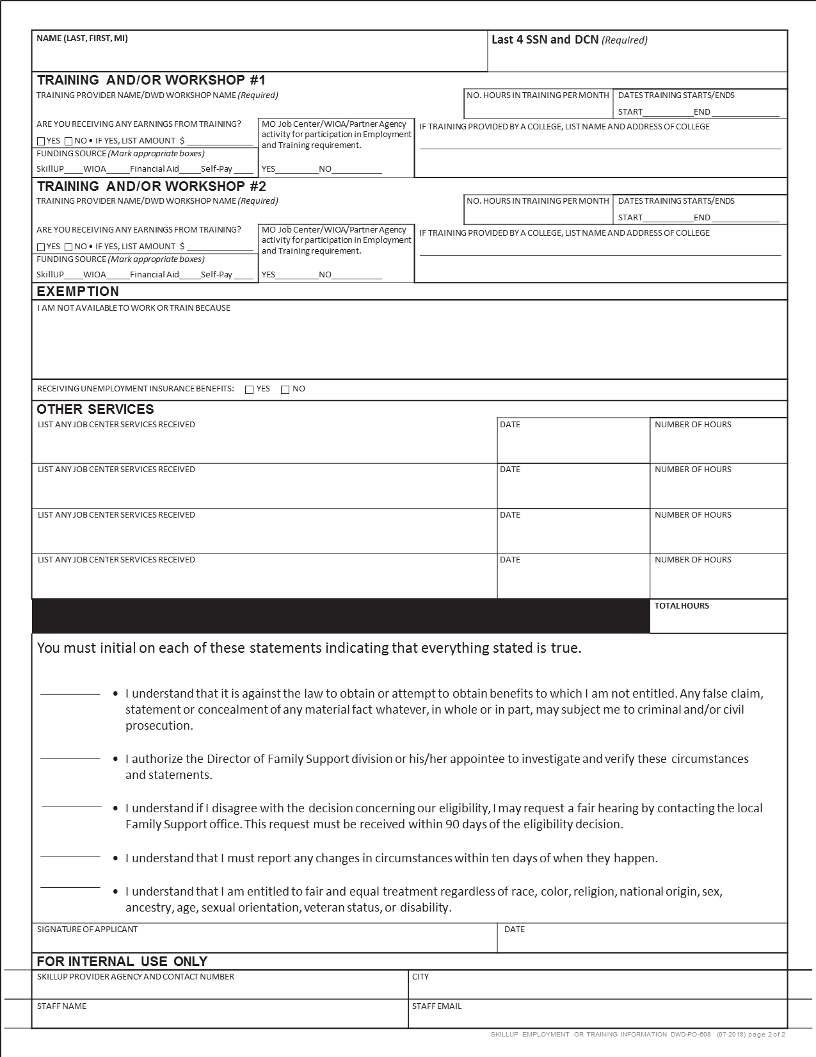

Missouri Department of Economic Development
Missouri Division of Workforce Development
SkillUP Employment or Training Information
ABAWD VOLUNTEER REGAIN ELIGIBILITY
If participant gets Food Stamp benefits, or is attempting to regaining eligibility, and has taken part in work or training in the past 30 days:
Fill out this form to show participant’s work and/or training activities during the past 30 days. Complete as much of this form as you can.
If there is information you are unable to attain, the Family Support Division (FSD) will contact the participant to obtain additional information. If the participant has questions, they must contact FSD at (855) 373-4636, or visit any FSD Resource Center.
Attach copies of any papers that confirm participant’s activities (such as pay-stubs or school schedule).
Job Center staff: Scan to FSD ABAWD Team and DWD Share Drive.
YOUR INFORMATION
NAME
PHONE NUMBER
DCN (Required)
LAST 4 DIGITS OF SSN
ADDRESS (STREET NAME AND NUMBER)
CITY
STATE
ZIP CODE
WORK ACTIVITY #1
NAME
PHONE NUMBER
START DATE
END DATE
ADDRESS (STREET NAME AND NUMBER)
CITY
STATE
ZIP CODE
CURRENT POSITION
AMOUNT EARNED PER PAY PERIOD BEFORE ANY DEDUCTIONS (I.E. TAXES)
PAY PERIOD (CHOOSE ONE)
Monthly Twice a month
TYPE OF WORK IF APPLICABLE (CHOOSE ONE)
Every 2 Weeks
Weekly
Other
On-the-Job Training In Kind
Work Study
Self-Employment
Americorps/Visa Stipend
Commission
Tips or Bonus
COMPLETE THE SECTION BELOW FOR EACH PAYMENT YOU HAVE RECEIVED IN THE LAST 30 DAYS
DATE CHECK RECEIVED
RATE OF PAY
DO NOT INCLUDED TIPS OR SICK/VACATION PAY
TOTAL HOURS WORKED
EARNINGS BEFORE DEDUCTIONS
TIPS
SICK OR VACATION PAY
OVERTIME AMOUNT INCLUDED IN RATE OF PAY
WORK ACTIVITY #2
NAME
PHONE NUMBER
START DATE
END DATE
ADDRESS (STREET NAME AND NUMBER)
CITY
STATE
ZIP CODE
CURRENT POSITION
AMOUNT EARNED PER PAY PERIOD BEFORE ANY DEDUCTIONS (I.E. TAXES)
PAY PERIOD (CHOOSE ONE)
Monthly Twice a month
TYPE OF WORK IF APPLICABLE (CHOOSE ONE)
Every 2 Weeks
Weekly
Other
On-the-Job Training In Kind
Work Study
Self-Employment
Americorps/Visa Stipend
Commission
Tips or Bonus
COMPLETE THE SECTION BELOW FOR EACH PAYMENT YOU HAVE RECEIVED IN THE LAST 30 DAYS
DATE CHECK RECEIVED
RATE OF PAY
DO NOT INCLUDED TIPS OR SICK/VACATION PAY
TOTAL HOURS WORKED
EARNINGS BEFORE DEDUCTIONS
TIPS
SICK OR VACATION PAY
OVERTIME AMOUNT INCLUDED IN RATE OF PAY
For additional information about Missouri Division of Workforce Development services, contact a Missouri Job Center near you.
Locations and additional information are available at jobs.mo.gov or (888) 728-JOBS (5627).
Missouri Division of Workforce Development is an equal opportunity employer/program. Auxiliary aids and services are
available upon request to individuals with disabilities. Missouri Relay Services are available at 711.

Slide 11
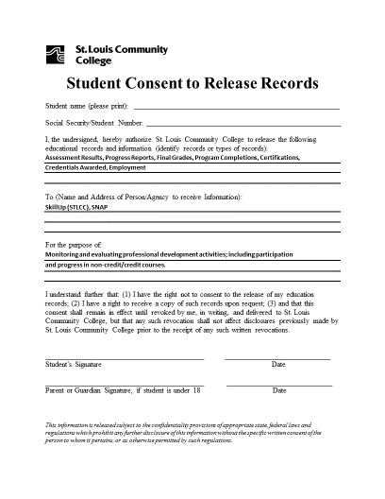
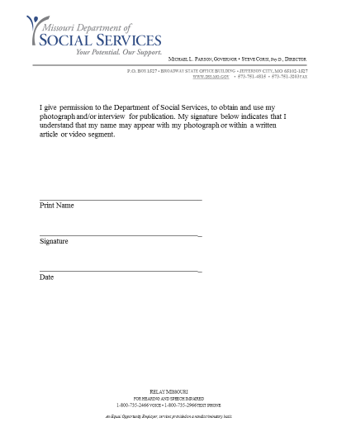

Slide 12
Why So Many Forms?
Demonstrates thoroughness
Shortened Timeline of their lives and barriers they experience
Helps us provide them with more specific resources
Lists out the pros of their future with training as opposed to without
Helps them see us as trusted faculty members they do not want to disappoint
It’s their education with SkillUP funding.
We care and we want them to as well.

Slide 13
Monitoring
Easier follow-ups on current, and past clients (30/60/90)
Documentation should be dated properly to reflect what is in MOJobs and the hard file
Pushes for SkillUP Case Management to be full and complete before funding is approved and before moving to the next client for enrollment

Slide 14
Questions?
Most Informational Resources are Available on the MCCA Website at:
www.mccatoday.org-skillup-program-documents

