Slide 1
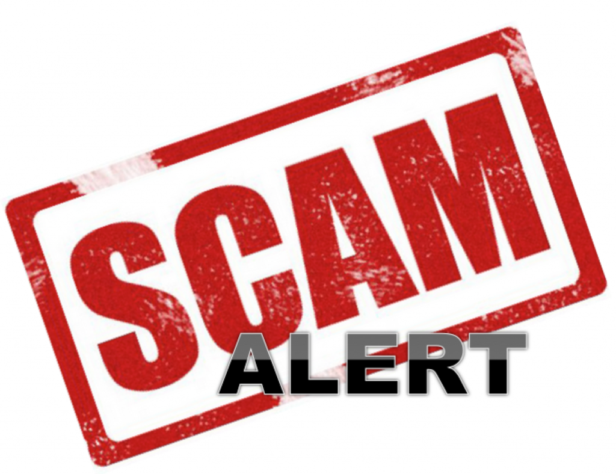
HOW CAN YOU BE AWARE?!

Slide 2
The sale of real estate is one of the top transactions targeted by scammers. The latest scam affecting the public and real estate professionals involves criminals impersonating a seller wanting to list a lot or vacant land.

Slide 3
COMMUNICATION ONLINE OR OVER PHONE ONLY
CHANGES to CONTACT INFO
QUICK SALE or RUSHING THE DEAL
CASH SALE
SOB STORY
ADDENDA CHANGING TITLE or OWNERSHIP

Slide 4
