Slide 1
Demand Side Employment Initiative: EmployABILITY Business Grant

Slide 2
California Department of Rehabilitation Team
Jessica Grove
Kim Rutledge
Sue Pelbath
Megan Davis
Deputy Director of Vocational Rehabilitation Policy & Resources Division
Demand Side Employment Initiative (DSEI) Program Lead
Deputy Director of Legislation and Communications
Deputy Director of Specialized Services Division

Slide 3
Demand Side Employment Initiative (DSEI) Overview
$10 million to increase employment opportunities for individuals with disabilities.
DSEI provides incentives for businesses to hire people with disabilities.
DSEI consists of four key elements:
EmployABILITY Business Grant
Targeted Marketing Campaign
Earn and Learn Opportunities
Training for Human Resources Professionals

Slide 4
EmployABILITY Business Grant
Grants ranging from $20,000 to $200,000
Expand businesses and create job opportunities for individuals with disabilities
Funds available now through June 30, 2024
For small- and medium-sized businesses in California
Access to a valuable and diverse talent pool

Slide 5
EmployABILITY Business Grant Requirements
1
2
Recipients must commit to employing individuals with disabilities
Recipients must provide a full- or part-time ongoing internship for individuals with disabilities to gain meaningful work experience
OR

Slide 6
How Can Grant Funds Be Used?
How Can Grant Funds Be Used?
1
2
3
4
5
6

Slide 7
Consulting Services
1
Training for inclusive practices, such as job analysis, interview strategies and job descriptions
Identifying potential placement for employees with disabilities
Making accessible work environments

Slide 8
Equipment Purchases & Training
w
2
Equipment Purchases & Training
To expand and or support business growth
To acquire accessibility equipment including hardware and software

Slide 9
New Hire Costs for Individuals with Disabilities
3
Advertising
Onboarding
Training
First Month’s Wages

Slide 10
Training and Learning Programs
4
Paid Internships

Slide 11
Physical Location Improvement
5
Doors or Paths of Travel Modifications
Wheelchair Ramp Installation
Push-button Door Openers
Flashing Fire Alarms
Other Physical Modifications

Slide 12
Barrier Removal
6
Get Creative!

Slide 13
Key Dates
2022
2023
2024
EmployABILITY Business Grant applications can be submitted until December 31, 2023, or until funding runs out
Contracts funded through June 30, 2024
Check EmployABILITYCA.com for more information

Slide 14
What The Process Looks Like For Business Owners
1
Visit www.EmployABILITYCA.com to get all the information needed to apply
5
DOR and business owners create final contract
2
Submit application materials via email
3
DSEI panel review
4
Business owners notified of funding award
Grant recipients will need to submit quarterly reports to verify funds and hiring of individuals with disabilities.

Slide 15
Marketing Campaign to Celebrate and Highlight Grant Recipients

Slide 16
We’re Here to Help
Email DSEI@dor.ca.gov for answers regarding the grant application process
We’re here to support hiring individuals with disabilities

Slide 17
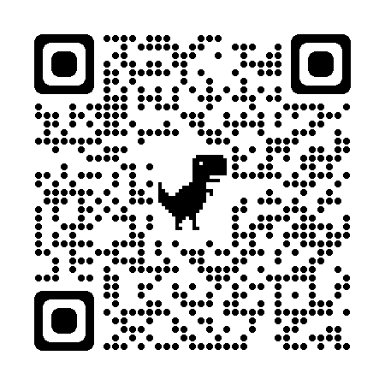
Thank you!
QR CODE GOES HERE
Interested in more information about the EmployABILITY Business Grant?
Scan the QR code to visit our website, EmployABILITYCA.com.

