Slide 1
COLT:
Mentorship Program
Alexandra Chop, MD
Ian Kates, MD
Taylor Kerrins, MD
Kristopher Schock, DO

Slide 2
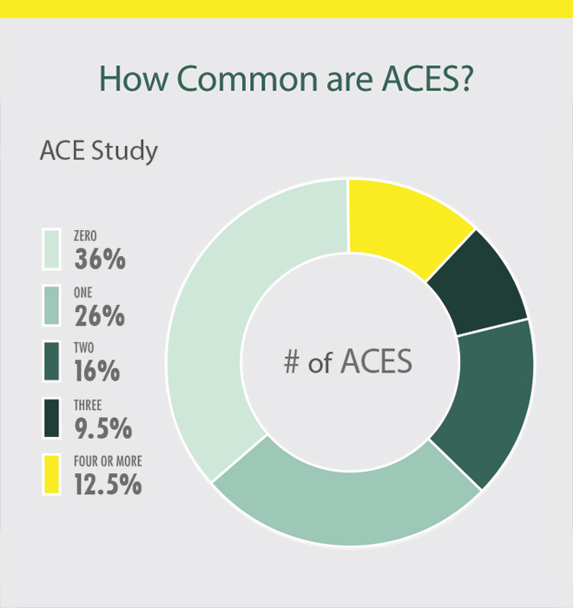
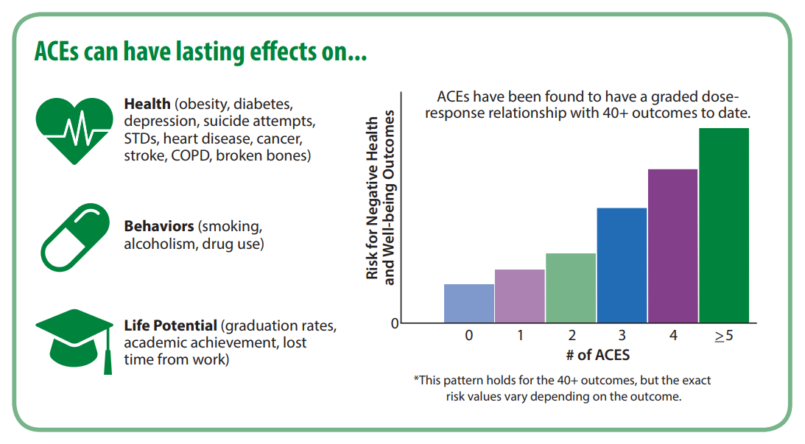
Adverse Childhood Events (ACEs)¹
“Compared to participants with no ACEs, those with higher ACE scores were more likely to report high school non-completion, unemployment, and living in a household below the federal poverty level.”²

Slide 3
Preventing ACEs
Strengthen economic supports to families
Promote social norms that protect against violence and adversity
Ensure a strong start for children
Teach skills
Connect youth to caring adults and activities
Intervene to lessen immediate and long-term harms
Strengthen economic supports to families
Promote social norms that protect against violence and adversity
Ensure a strong start for children
Teach skills
Connect youth to caring adults and activities
Intervene to lessen immediate and long-term harms

Slide 4
The Mentoring Effect
Out of 24 million at risk young people, 9 million never had a mentor.
“Mentoring relationships matter. As children and adolescents navigate their journey to adulthood, those with mentors are more likely to engage, volunteer, and lead. They are more likely to dream of and go to college.”³
Notes:
At-risk youth – There is no universal consensus for what factors make a youth “at-risk.” For purposes of this survey, an at-risk youth is a respondent who is at the time of taking the survey disconnected (out of school and out of work) and/or responds “yes” to any of the risk factors reflected in the survey screening tool that are linked to decreased rates of achieving “productive adulthood”: incarcerated parent or guardian, regular absenteeism, poor academic performance, behavioral problems in school, delinquency, teenage pregnancy, and homelessness.

Slide 5
Vision and Goals:
Exposure of at-risk youth to a variety of potential career paths as well as provision of successful adult role models to aid and guide youth in career choices:
Create a sustainable partnership between Geisinger and Central Pennsylvania Workforce Development Corporation (CPWDC).
Development of Geisinger employees from variety of disciplines to become youth mentors
Notes:
Take careers they otherwise would never have been exposed to… You don’t have to be a doctor or nurse to work at Geisinger...

Slide 6
What is LIFT?
Evidence-based yearlong mentoring program based on Elements of Effective Practice for Mentoring 4th edition.
Mentoring program in its infancy currently rebranding after the COVID pandemic began.
Career Focused
Notes:
LIFT was chosen as a word that invokes the impact of a positive mentoring experience and provides a sense of upward momentum/growth.
Budding program … natural partner as in need of mentors.

Slide 7
Who are the mentees?
In-School Youth (ISY) (Bridges to the Future)
Ages 14-21 years, currently 160 involved
Out-of-School Youth (OSY) (YES to the Future)
Ages 16-24 years, currently 82 participating
Serves the 9 central PA counties
Centre, Clinton, Columbia, Lycoming, Mifflin, Montour, Northumberland, Snyder, and Union
3/3/2021
7
Notes:
LIFT will be recruiting from this pool

Slide 8
Requirements for Mentee Enrollment
Mentees must meet the following requirements to enroll:
Low-income
AND at least one additional barrier:
Basic Skills Deficiency
Prior Offender
Pregnant or Parenting
Homeless, Runaway, and/or Foster Care
English Language Learner
Individual with a Disability
8
Notes:
Likely some history of Trauma, less exposed to career paths and life skills.

Slide 9
Individual and Family Risk Factors For ACEs
Experiencing caregiving challenges related to children with special needs
Children and youth who don’t feel close to their parents/caregivers and feel like they can’t talk to them about their feelings
Youth who start dating early or engaging in sexual activity early
Children and youth with few or no friends or with friends who engage in aggressive or delinquent behavior
Families with caregivers who have a limited understanding of children’s needs or development
Families with caregivers who were abused or neglected as children
Families with young caregivers or single parents
Families with low income
Families with adults with low levels of education
Families experiencing high levels of parenting stress or economic stress
Families with caregivers who use spanking and other forms of corporal punishment for discipline
Families with inconsistent discipline and/or low levels of parental monitoring and supervision
Families that are isolated from and not connected to other people (extended family, friends, neighbors)
Families with high conflict and negative communication styles
Families with attitudes accepting of or justifying violence or aggression

Slide 10
Stakeholders
Geisinger Health System
Geisinger Employees
Central PA at-risk youth community
CPWDC
PA Career Link

Slide 11
What do we need to make this successful?
Money
Managing the program
Connections and Support of the program with supply of willing mentors!
Money
Managing the program
Connections and Support of the program with supply of willing mentors!

Slide 12
Project Update
Streamlining the application process.
Creating a Fast fact sheet to be able to send out on the Daily Dose.
Creating a Flier to hang on the Geisinger Bulletin Boards
Working with Human Resources, Development and Learning, Wellness at Geisinger, and Communications
To speak directly with each department head within Geisinger
Recruiting the first pool of mentors from Geisinger

Slide 13
Moving to the Future
Create large enough pool of mentors to meet demand
Engage in a yearly recruitment process of mentors
Establish a lasting relationship between Geisinger and CPWDC
Expand to more than the Central PA counties
Notes:
Develop handouts and communications for recruitment*

Slide 14
References
1: Centers for Disease Control and Prevention (2019). Preventing Adverse Childhood
Experiences: Leveraging the Best Available Evidence. Atlanta, GA: National Center for Injury
Prevention and Control, Centers for Disease Control and Prevention.
2: Merrick, M.T., Ford, D.C., Ports, K. A., Guinn, A. S. (2018). Prevalence of Adverse Childhood Experiences From the 2011-2014 Behavioral Risk Factor Surveillance System in 23 States. JAMA Pediatrics, 172(11), 1038-1044.
3: Marilyn Metzler, Melissa T. Merrick, Joanne Klevens, Katie A. Ports, Derek C. Ford, Adverse childhood experiences and life opportunities: Shifting the narrative, Children and Youth Services Review, Volume 72, 2017, Pages 141-149, ISSN 0190-7409.
4: Bruce, Mary and Bridgeland, John (2014). The Mentoring Effect: Young People’s Perspectives on the Outcomes and Availability of Mentoring.
Washington, D.C.: Civic Enterprises with Hart Research Associates for MENTOR: The National Mentoring Partnership.

Slide 15
Thank you!
For more information: Please reach out to our group point person: Kris Schock via email:
KMSCHOCK@GEISINGER.EDU

