Slide 1
COLT – Addressing Disparities in Nutrition
Melissa Band, DO Biren Desai, DO Megan Holton, DO Elyse Jensen, MD | Amelia Morgan, DO Amy Sudol, MD Sarah Wilson, DO Mirja Wirtz, MD

Slide 2

Notes:
Elyse

Slide 3
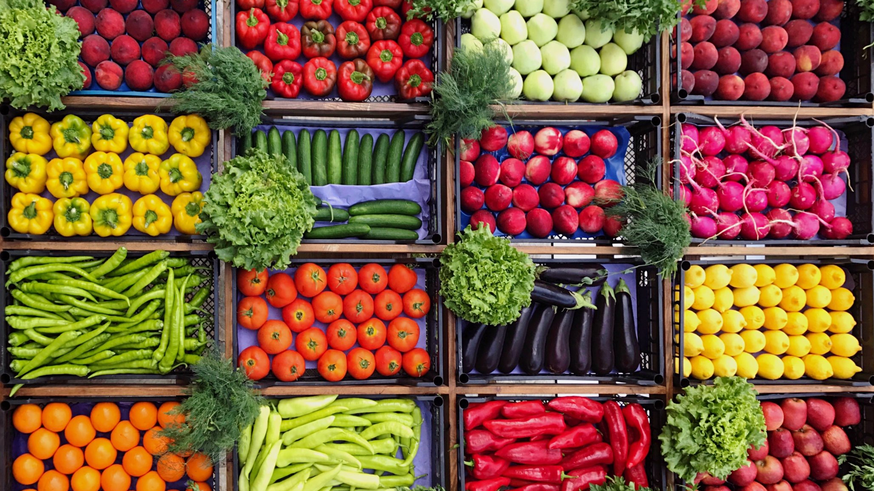
Notes:
Elyse

Slide 4










Identification of a Community Problem
What encompasses poor nutrition today?
Poor nutrition Morbidity and mortality
What we know
~ 34% United States children are obese
Access
Preparation
Knowledge Gaps
COVID-19
Notes:
Biren
Many foods are time intensive and require basic skills that children do not always possess
Problems exacerbated by COVID-19; backpack program and nutrition education in schools
Pediatric obesity has been viewed as a growing epidemic of the past few decades that requires intervention, similar to tobacco use and its accrued medical risks that has prompted multifaceted preventive efforts. Affecting as many as 34% of American children, (1) obesity can be viewed as a top public health threat due to its associated morbidity and mortality. (2) The medical consequences of obesity accounted for 40% of the health-care budget by 2006, with an expected $147 billion in health-care spending alone in 2008. (3) In 2006, obese adults had estimated medical costs $1,429 higher than those for persons of normal weight. (3) For children coming to a pediatric integrated health-care delivery system, expenses were $179 per year higher in obese children versus children who had normal body mass index (BMI). (4) Using the Medical Expenditure Panel Survey data from 2002 to 2005 for children ages 6 to 19 years, the total additional health expenditure in prescription drugs, outpatient appointments, and emergency department visits for children who had elevated BMIs was estimated to be $14.1 billion annually. (5)
Pediatric obesity affects all organ systems, (6) with its medical sequelae paralleling the increasing prevalence in younger children. Type 2 diabetes is being diagnosed in morbidly obese 9-year-olds, and bariatric surgery has been performed in children as young as 12 years. Prevention is paramount, and pediatricians need easy tools that help with early recognition of developing obesity, preventive counseling, and treatment. Bariatric surgery remains an option, albeit a last resort, because the morbidly obese individuals who suffer medical complications remain at risk for a shortened lifespan if they do not achieve significant weight loss. This article discusses trends in epidemiology, recognition, and treatment of obesity in the primary care office as well as community interventions and prevention.

Slide 5
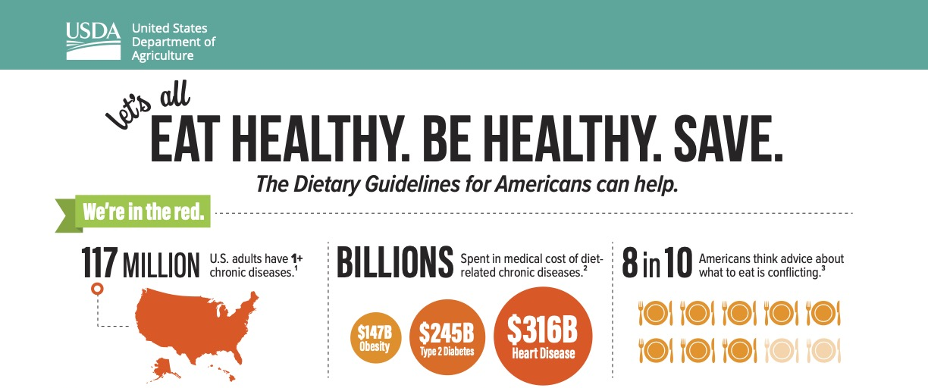
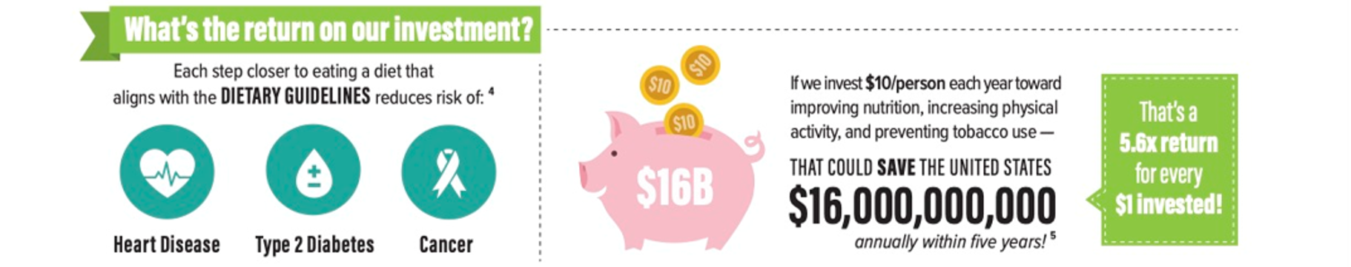
Notes:
Elyse

Slide 6
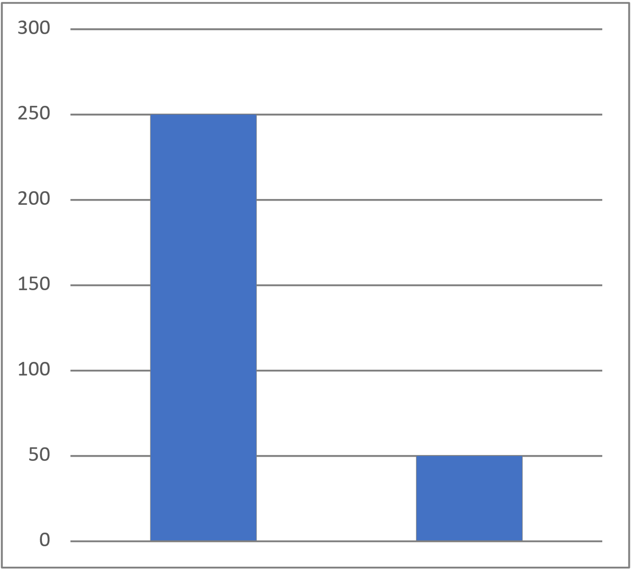

Needs Assessment: Danville
Economic Disadvantage
What is being done?
The Numbers
2,271 Students enrolled in district schools
30.8% Economically disadvantaged
1% Homeless
Backpack Program
Danville Food Bank
Backpacks Delivered per Week
250
250
250
50
50
Pre-Covid
Post-Covid
Notes:
Biren
What is the problem?
What is being done already?
What is the need that is not being met? Kids are not getting the nutrition they need or nutrition supplied is not adequate for proper growth COVID
***Obesity states with economic disadvantage
Children not consistently in school
New familial financial hardships

Slide 7
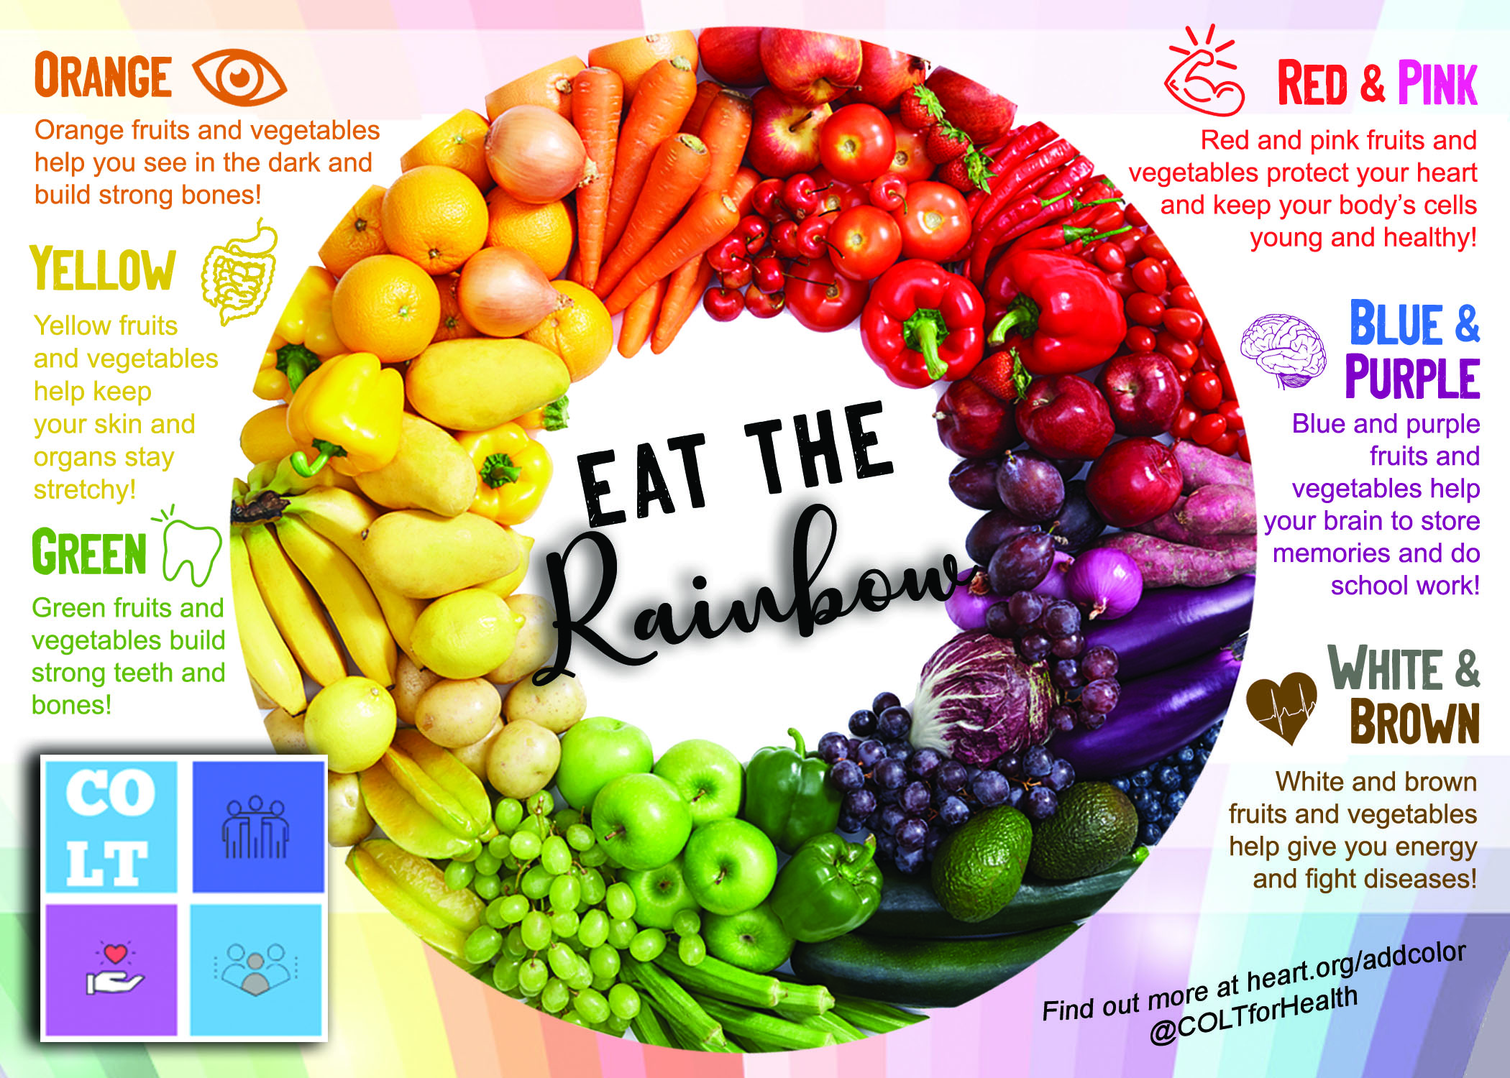
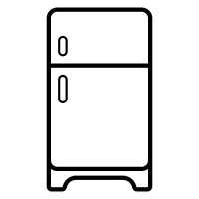

Our Project
Primary Goal:
Improve nutrition in the community through education
Our plan:
Easy-to-understand educational nutritional material for multiple age groups
Repetition, repetition, repetition!
Notes:
Elyse
Location, location, location! Attention-grabbing, appealing graphic
Repetitive visualization of the material in a location where the principles can be directly applied immediately
Oneline platform allows for interaction and community engagement despite need for social distancing during an ongoing pandemic.

Slide 8
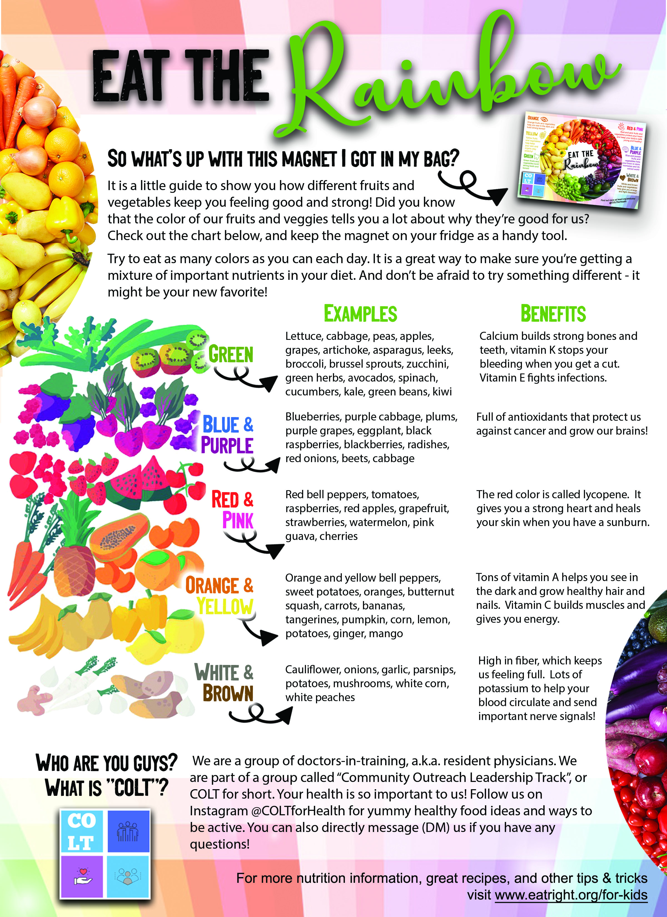



Additional Educational Material
Brochure & Magnet
Create an online platform for local community engagement
Opportunity for students and doctors-in-training to connect
Notes:
Biren

Slide 9





Community Partners
Backpack Program
Danville School District
Culinary Medicine Department & Fresh Food Farmacy
Notes:
Elyse

Slide 10
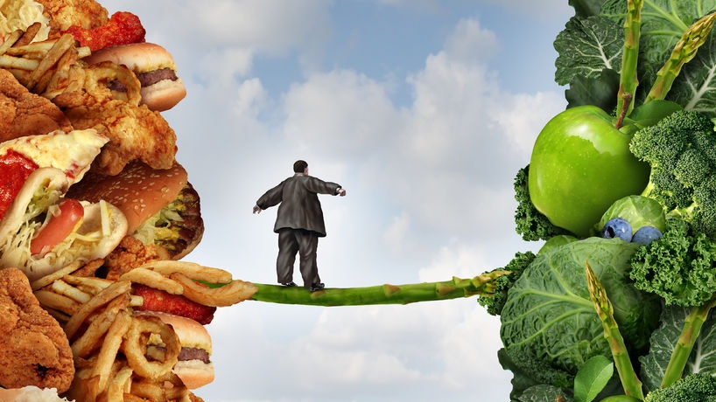
Future Directions
Reflection
Barriers
Future Directions
Why is healthy hard?
Community resources
Learning our audience
Simple changes
COVID-19
Access to resources
Finances
Participant buy-in
In-Person Events & Content Distribution
USDA P-EBT
COLT via School App
Cooking Video Series
Notes:
Biren/Elyse
Solutions don't have to be complicated. Keep it simple. Listen to your audience.
Resources: access to fresh foods, access to cooking materials/fridge/internet

Slide 11
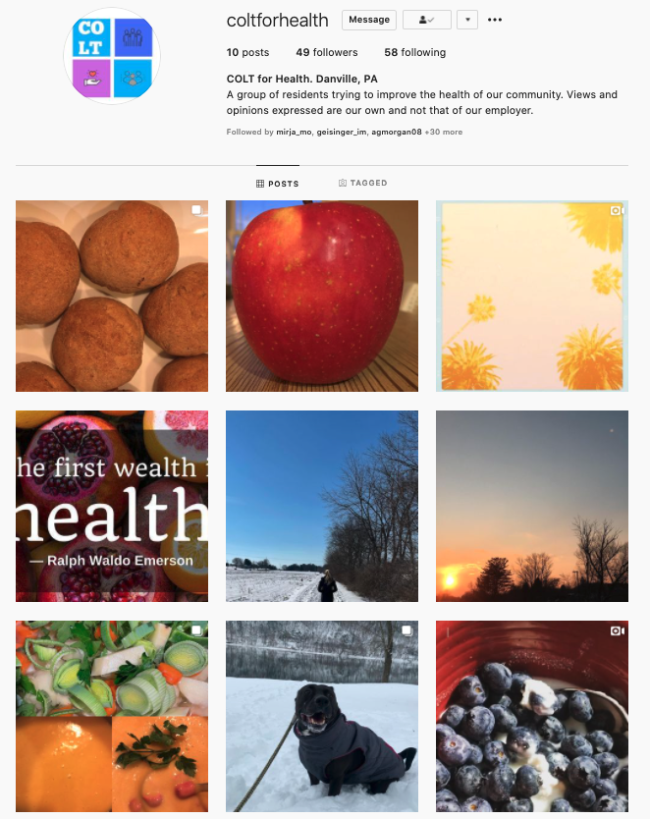
Follow us on Instagram:
@coltforhealth
Thank you

Slide 12
Sources
https://futurereadypa.org/Search/District
Rome, E. S. “Obesity Prevention and Treatment.” Pediatrics in Review, vol. 32, no. 9, 2011, pp. 363–373., doi:10.1542/pir.32-9-363.
https://myplate-prod.azureedge.net/sites/default/files/2020-12/DGA%20Infographic%282018%29.pdf
https://www.uofmhealth.org/health-library/ug2061
https://images.app.goo.gl/5EVyobGn2F48F2w8A
USDA.gov
CDC.gov

