Slide 1
Addressing the Adolescent Mental Health Crisis
Peter Barrale, MD
Ashley Czworniak, DO
Kristin Huynh, DO
Kristin Sanders, MD
Sanjeev Shrestha, MD
Raza Zaidi, MD
Notes:
Thank you ______ and good afternoon to those joining us today.
I would first like to thank everyone that supported the development of COLT, especially our program directors and leader Jeff Emanuel.
My name is Peter Barrale joined here with Dr. Ashley Czworniak, pediatric residents representing a larger group of 6 pediatric and internal medicine residents.
We were grouped together because of our fiery passion for serving the mental heath community.
This is a crisis that spans across all of medicine, especially pediatrics and internal medicine.

Slide 2
Identifying the Crisis
Notes:
The is not breaking news, nor does anyone need to be convinced that this is a significant burden to the community.
So, what can we do as a group of resident physicians to help chip away in our local community?
Before we get to the project details, I would like to share some data about just how horrifying it is.

Slide 3
Nationwide Statistics, 2020
50% of the lifetime mental illness begins by age 14, and 75% by age 24
11-year gap between diagnosis and treatment
70% of adolescents and juvenile detention have diagnosed mental health disorder
Pennsylvania, 2020
12.2% reported one Major Depressive Episode (MDE) in the past year
8.6% report a Severe MDE in 2020
53.9% with MDE did not receive mental health service
32.3% with a Severe MDE received some consistent treatment
Notes:
This is a national crisis.
Half of all mental health illness occurs by 14 years old….and 75% diagnoses are made by 24 years old.
Again, a crippling problem for pediatrics and internal medicine.
This epidemic is also poorly managed, taking on average 8 YEARS to obtain adequate treatment
And to highlight the morbidity of this issue, 70% of adolescents in juvenile detention have a diagnosed mental health disorder.
We are failing our young adults and our future.
Let's look further into Geisinger’s back yard and the state of Pennsylvania.
12% report any mental health illness in the last year
8.6% report a severe mental illness in 2020
Again, these patients are being neglected. 54% did not receive ANY mental health service and only 1/3 of severe MDE had any treatment.
We are failing our community.
Not only is mental health tremendously prevalent, but the numbers are grossly under reported as mental health can manifest as drug abuse, worsened academic performance, incarceration, and suicide.
https://www.mentalhealthfirstaid.org/external/2020/11/10-surprising-mental-health-statistics-from-2020/
https://www.mhanational.org/

Slide 4
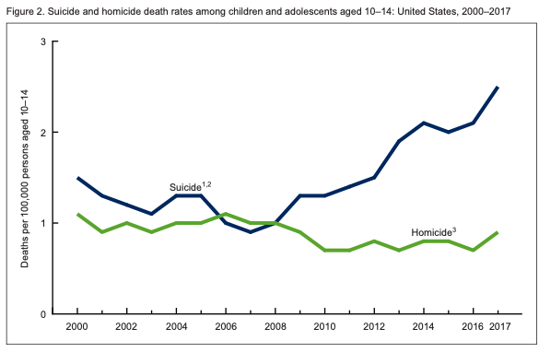
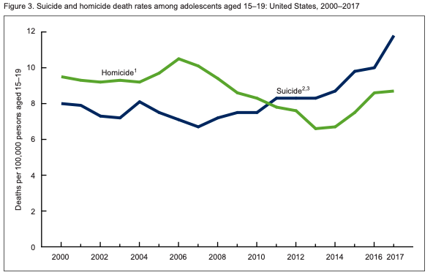
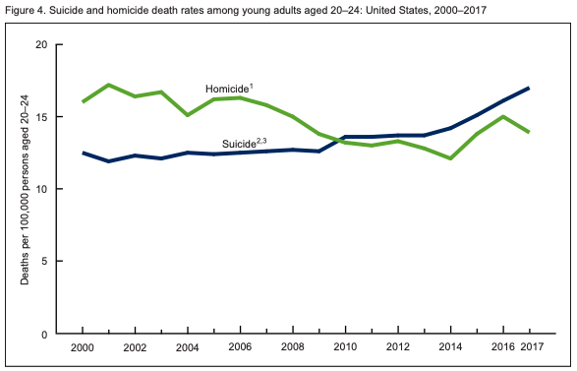
Suicide
 | 10-14 years old | 15-24 years old
1 | Unintentional Injury | Unintentional Injury
2 | Suicide | Suicide
3 | Malignant Neoplasms | Homicide
4 | Congenital Abnormalities | Malignant Neoplasms
5 | Homicide | Heart Disease
11.4% of all pediatric death
Congenital Heart Disease 2.9%
Drowning 4.8%
Cancer 9%
10-14 years old
15-19 years old
20-24 years old
N Engl J Med 2018, NIH 2021, WHO 2020
Notes:
Suicide is responsible for 11.4% of all pediatric death and the second leading cause of death from 10 to 24 years old.
This is absolutely horrifying, and to think mental health is clearly a part of unintentional injury
This kills nearly 3x more than congenital heart disease but doesn’t have a fraction of the infrastructure
NIH suicide trends are in blue. We know its only getting worse and COVID-19 only worsened it.
Our group sought to temporize this community crisis…..
https://www.ncbi.nlm.nih.gov/pmc/articles/PMC6637963/
https://www.nimh.nih.gov/health/statistics/suicide.shtml#part_154968 (2018)
https://www.who.int/news-room/fact-sheets/detail/adolescent-mental-health

Slide 5
How Do We Help?
Identification
Expand screening beyond the doctor’s office
Access
Introduce mental health workers into school districts
Provide mental health care via telemedicine
Bring resident physicians into the community
Increasing the number of mental health professionals
Communal Support
Peer/family mediation
Problem solving courses
Notes:
https://www.ncbi.nlm.nih.gov/pmc/articles/PMC6637963/
https://www.nimh.nih.gov/health/statistics/suicide.shtml#part_154968 (2018)
https://www.who.int/news-room/fact-sheets/detail/adolescent-mental-health
ASHLEY STARTS HERE
There’s not a person in this room who when faced with a challenge regarding the wellbeing of another doesn’t ponder even if only briefly, a solution. Fortunately and unfortunately for us, there are probably a hundred partial solutions to the issue of disordered mental health in teens. The question then becomes how do we do the most good with what we have? Is it wisest to focus our efforts on earlier identification of high risk individuals? Do we instead shift our momentum towards tackling the goliath issue of provider shortage? Or, Do we meet somewhere in the middle and bridge mental health services with community support programs? Ultimately, we decided that a successful program borrows from each of those tenants
(image)

Slide 6
Project Statement
Facilitate earlier detection of mental health disorders in adolescents and offer community based support until connections with a mental health provider can be reliably established
3/3/21
6

Slide 7
International program that trains community leaders to:
Identify teens suffering from mental health crises
Assess for suicidality and self harm
Listen nonjudgmentally
Give reassurance
Encourage support strategies
Enlist professional help
Notes:
Fortunately for us, we did not have to recreate the wheel as a program with similar goals already exists. Youth Mental Health First Aid is an international program designed to teach community leaders such as teachers, school staff, coaches, and parents how to identify an adolescent who is experiencing a mental health or addictions challenge. Importantly as awareness only goes so far, the course equips its participants to provide a tiered system of assistance to at risk teens. Like any respectable first aid course, this program makes use of mnemonics. Specifically, the guiding principles of the course are relayed with the mnemonic ALGEE in which the first step is to assess the severity of the situation looking for signs of acute suicidality or progressing habits of self harm. The following two steps focus on building trust while breaking the stigma surrounding mental disease through actively listening in a nonjudgmental manner and giving validation to the struggles at bay. Once this trust is established it becomes easier for the aid giver to make suggestions for situational de-escalation and when necessary the employment of a licensed mental health professional.
(countries involved include US Canada, UK, Australia, Parkistan, Japan, and Sri Lanka)

Slide 8
Notes:
One aspect of the program that I’m sure we can all appreciate, is has been evaluated in peer-reviewed studies: and not to delve to deeply into any of these but instead rather to convey that these studies show in multiple cases that individuals trained in the program:
Grow their knowledge of signs, symptoms and risk factors of mental illnesses and addictions.
Can identify multiple types of professional and self-help resources for individuals in crisis
Increase their confidence in and likelihood to help an individual in distress
Show increased mental wellness themselves.
This research to only provides us reassurance that were undertaking a trusted program but also it provides us with data that helps us determine which aspects of the MHFA program might be of particular use to our population and which parts might not. It equips us to eventually tailor the program to the Geisinger community. I’d be happy to speak in further detail about any of these studies at the end of the presentation

Slide 9
Roadmap
Partnering with school and local community centers
Advertising
Training
Expand
Feedback
Hold sessions
Notes:
Our plan would be to train 4-5 residents from Peds/IM/Meds Peds to become First Aid Course Instructors. Followed then by partnership building with Danville area schools and community centers which would hold training sessions for first Aid Courses and strategic advertisement to the local community. Feedback would be semi annual reports of number of sessions held by each school or center, number of adolescents who were identified, captured, and connected with mental health professional. Based on this feedback, we would tailor and expand the pilot to other areas in which Geisinger has a known community presence.

Slide 10
“[They are] Teachers, first responders and veterans. They’re neighbors, parents and friends. They’re people in recovery, and those supporting a loved one. They’re First Ladies and Mayors. Mental Health First Aiders are anyone who wants to make their community healthier, happier, and safer for all. “
Notes:
End here
I’d like to close with This is a testimonial pulled from the MHFA website. It resonated with me because this here, this is us. This is Geisinger. It has been since day 1. And if we are truly being honest with ourselves we need to be honest about our responsibility to curtail this mental health crisis. ***
(Needs a picture)

