Slide 1
Employers Using Data to Inform Honest Conversations
Gloria Sachdev, Pharm.D.
President and CEO, Employers’ Forum Of Indiana
gloria@employersforumindiana.org
Hendricks County Chambers
Brownsburg, IN
October 5, 2023

Slide 2
About the Employers’ forum of Indiana
Employer-Led Healthcare Coalition Founded in 2001
Executive Committee Comprised of non-provider employers
Non-Profit 501(c)(3)
Aim: To improve the value employers and patients receive for their healthcare expenditures
https://employersforumindiana.org/

Slide 3
Employers’ Forum of Indiana Members
*Executive Committee Members
Updated August 14, 2023
Individual Members
Allison Transmission*
American Health Network
Anthem BCBS
Aon
ApexBenefits
Apollo Pain Center
Ashley Industrial Molding*
Barnes & Thornburg*
Cameron Memorial Community Hospital
Capital RX (affiliate member)
Carrum Health (affiliate member)
Central Noble Schools*
Certus Management Group
Chris Magiera, MD
Clear Healthcare Advocacy
Conner Insurance
Cummins*
Danzer Veneer Americas, Inc*
Deaconess Hospital
Delta Dental of Indiana (affiliate member)
Eli Lilly and Co.*
Encore Health Network
Eskenazi Health
Everside Health
Express Scripts/Cigna
Fiat Chrysler Automobiles (Stellantis)*
Fort Wayne Medical Oncology & Hematology
Gibson
Goodman Campbell Brain and Spine
Gregory & Appel Insurance
Haynes International*
Healthcare Options*
Hylant
Indiana Health Information Exchange
Indiana Spine Group
Indiana State Teachers Association*
Indiana University*
Ivy Tech*
JA Benefits
LHD Benefit Advisors
Lutheran Health
Managed Health Services
Marathon Health
Merck (affiliate member)
Meridian Medical Services
Metro Plastics*
MJ Insurance
Northwest Cancer Center
Northwest Radiology
OneBridge*
Ortho Indy
PatientMD (affiliate member)
Physicians Health Plan of Northern Indiana
Purdue University*
Qsource
Red Gold*
RE Sutton and Associates
Roche & Genentech*
Roman Catholic Archdiocese of Indianapolis*
Sacred Roots Birth & Wellness Center
Sandoz (affiliate member)
Sanofi Genzyme (affiliate member)
Schweitzer Engineering Laboratories*
Shery Roussarie, MHA/MBA
Suburban Health Organization
The Alliance
The DeHayes Group
TrueRx
UnitedHealthcare
University of Notre Dame*
VeriVitae (affiliate member)
Weaver Popcorn*
Wellbridge Surgical
Group Members
American Physical Therapy Association, Indiana Chapter
Bartholomew Consolidated School Corp*
Fort Wayne Community School Corporation*
Indiana Manufacturers Association
Indiana Pharmacists Association
Patoka Valley Healthcare Cooperative*
South Central Indiana School Trust*

Slide 4
Questions for Thought…
Are your employees getting hospital care services from the best quality at the best price?
Do you own your healthcare claims data, understand the data, and use your data to make evidence-based purchasing decisions?

Slide 5
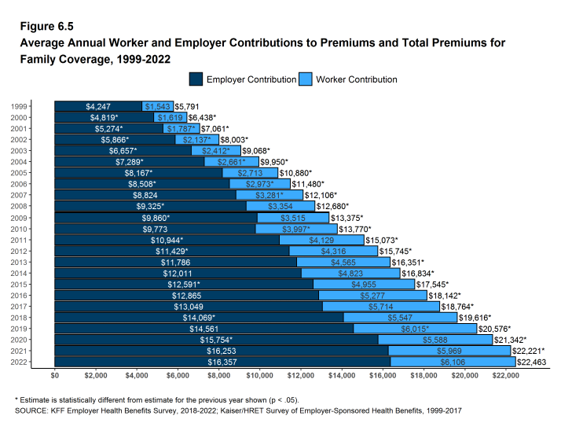
U.S. Employees & Employers are paying more for health insurance Premiums: Family coverage, trend 1999-2022
2022
$6,106 employee + $16,357 employer =
$22,463 total
https://www.kff.org/report-section/ehbs-2022-section-6-worker-and-employer-contributions-for-premiums/
Notes:
The average premium for family level coverage through an employer increased 20% over the last 5 years and 43% over the last 10 years.
This data shows the average, which means that some workers are paying more than the average. KFF data shows that employees at smaller employers pay the largest share of the premium as compared to employees that work at a larger employer.
Many of employer premiums for 2022 were established in 2021 ahead of open enrollment periods, so don’t account for the level of inflation we are seeing. It is possible we may see a larger increase in 2023.

Slide 6
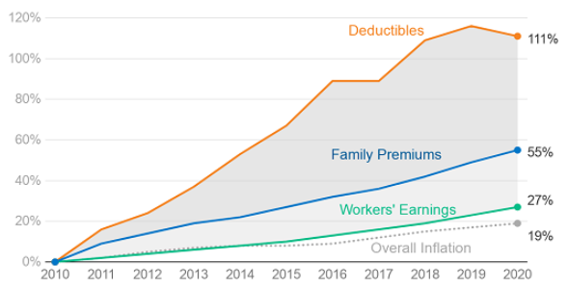
PROBLEM: Employee Deductibles & Premiums have Risen Much Faster than Wages, 2010-2020
Less Pocket Money
NOTE: Average general annual deductibles are for single coverage. Workers in plans without a general annual deductible for in-network services are assigned a value of zero. Source: KFF Employer Health Benefits Survey, 2020; Kaiser/HRET Survey of Employer-Sponsored Health Benefits, 2010 and 2015: https://www.kff.org/health-costs/report/2020-employer-health-benefits-survey/

Slide 7
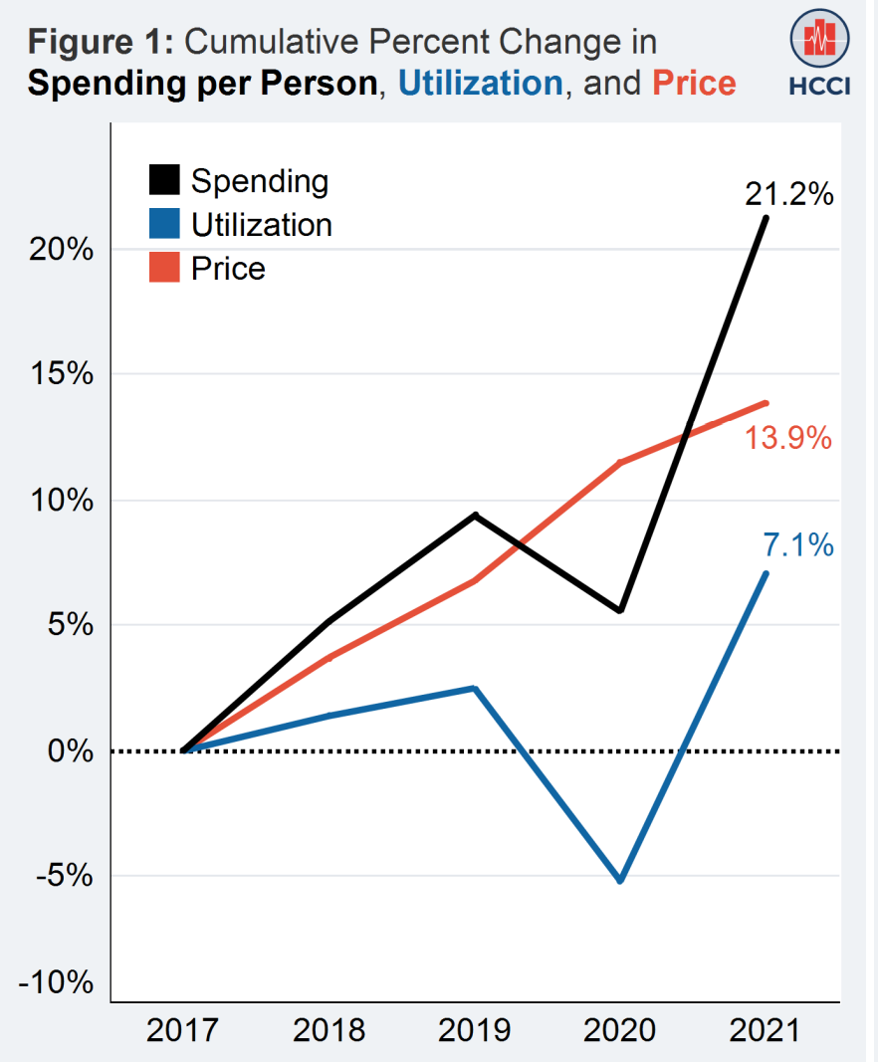
PRICE is the Main Driver of Healthcare Spending
https://healthcostinstitute.org/images/pdfs/HCCI_2021_Health_Care_Cost_and_Utilization_Report.pdf

Slide 8
PROBLEM: MEDICAL Debt in America
Interactive map noting “Share of medical debt in collections” and Median amount in collections per country, state, national levels
Conducted by Urban Institute, non-profit research organization
Last updated June 23, 2022; credit data from February 2022
Includes 10 million lives
Provides demographic information at county level including: white vs communities of color, share without insurance, avg household income
Downloadable Excel Spreadsheets for country, state, and national level data available
https://apps.urban.org/features/debt-interactive-map/?type=medical&variable=medcoll

Slide 9
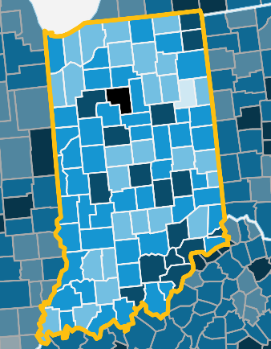
Debt in America: Hoosiers in collections
INDIANA
16% of population (1 in 6 Hoosiers) have medical debt in collections. RANGE = 8% - 28%
Ranked 18th highest in the country with median owed = $773 and mean owed = $2,043
Includes data for all 92 Indiana counties with highest counties as follows:
Cass = 28%, Rush = 25%, Scott = 24%, Jefferson = 24% Crawford = 23%
OTHER STATES percent of population with medical debt in collections:
Michigan = 13%
Illinois = 14%
Ohio = 15%
Kentucky = 17%
NATIONAL AVERAGE percent of population with medical debt = 13%
https://apps.urban.org/features/debt-interactive-map/?type=medical&variable=medcoll

Slide 10
Employer Fiduciary Responsibilities
Employer as fiduciary established by ERISA
Fiduciary reinforced by the Consolidated Appropriations Act (CAA) of 2021
Ensure all gag clauses have been removed from plan contracts
Collect compensations disclosures from all brokers/consultants servicing the plan
Determine if the compensation earned by those vendors is “reasonable”
Submit annual attestations to the DOL
Prepare for detailed reporting on prescription drug usage and coverage equality for mental health vs medical conditions
For more information, see this slide deck from Chris Deacon from a January 2023 EFI meeting

Slide 11
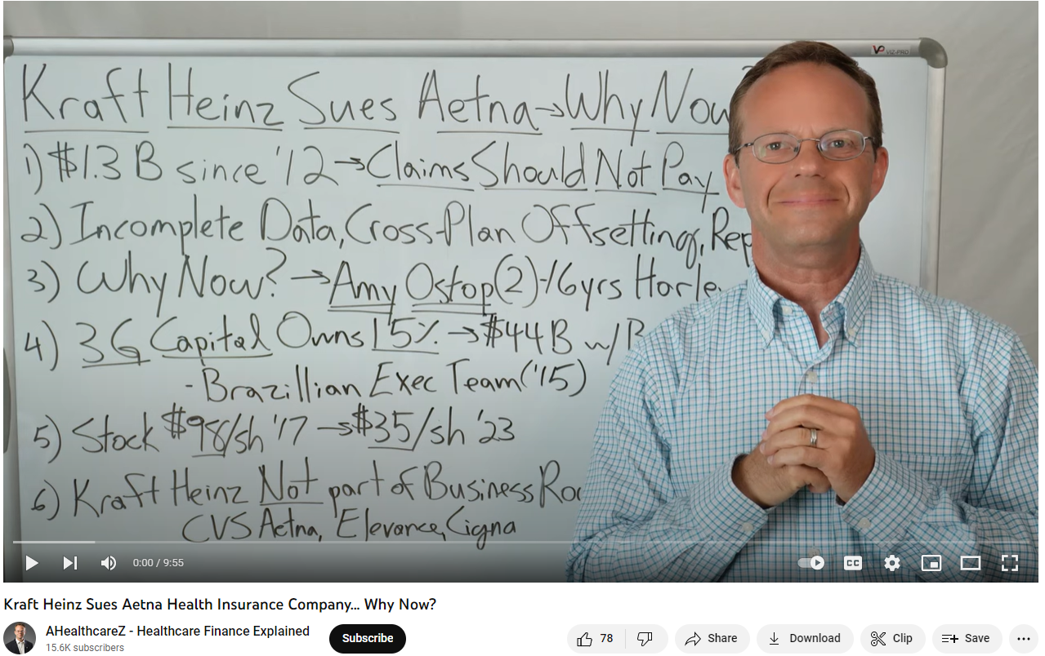
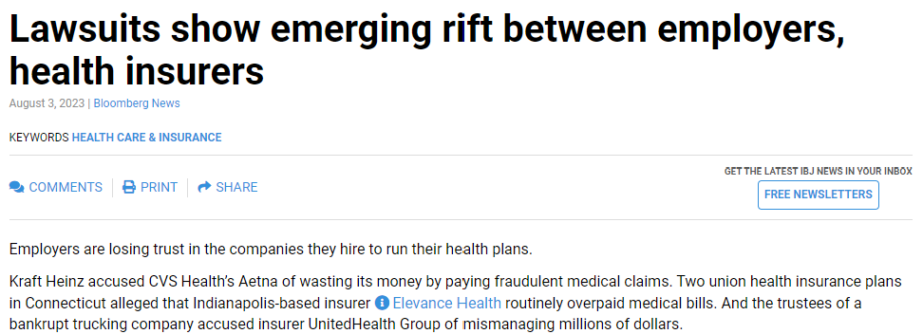
EMPLOYERS ARE SUING ELEVANCE, UNITED HEALTHCARE, AETNA…
Kraft Heinz is suing Aetna
Watch YouTube below
Lawsuits show emerging rift between employers, health insurers – Indianapolis Business Journal (ibj.com)
https://www.beckerspayer.com/payer/employers-are-increasingly-suing-their-health-plan-for-claims-data.html

Slide 12
LAWYERS ARE CIRCLING THE WAGONS Ads for Class Action Lawsuits Looking for Employees to Sue their Employers!

Slide 13
SOLUTION: Begins with More Price & Quality Transparency Ends with Data-Informed Purchasing & Policy Decisions

Slide 14
Rand Hospital Price Transparency Studies
First-of-its-kind study in the country to publish negotiated prices by hospital name, noted as Percent of Medicare & Standardized Prices.
Conceived and commissioned by the Employers’ Forum of Indiana.
Analysis & published report conducted independently by RAND Corp.
Funded by Employers, and grants from the Robert Wood Johnson Foundation, & Arnold Ventures (no funding was accepted from insurers or hospitals).
Does not include Rx drug prices.

Slide 15
OVERVIEW: RAND Hospital Price Transparency studies
 | RAND 1.0 2017 | RAND 2.0 2019 | RAND 3.0 2020 | RAND 4.0 2022
Services | Hospital Inpt & Outpt | Hospital Inpt & Outpt | Hospital Inpt & Outpt Fees Professional Inpt & Outpt Fees | Hospital Inpt & Outpt Fees Professional Inpt & Outpt Fees
States | IN | 25 States | 49 States (excludes Maryland) | 49 states and the District of Columbia (excludes Maryland)
Years | 2013 - 2016 | 2015 –2017 | 2016 – 2018 | 2018 - 2020
Hospitals | 120 | 1,598 | 3,112 | 4,102
Claims | 14,000 inpt facility stays 275,000 outpatient facility services | 330,000 inpt facility stays 14.2 million outpt facility services | 750,000 inpt facility stays (and professional fees) 40.2 million outpt services (and professional fees) | 1.3 million inpt facility stays (and professional fees) 12.2 million outpt services (and professional fees)
Allowed Amounts (Hosp) | $695,000 million faciltiy total: $336 million inpt $359 million outpt | $12.9 billion total: $6.3 billion inpatient $6.6 billion outpatient | $33.8 billion total: $15.7 billion inpatient $14.8 billion outpatient $3.3 billion professional | $78.8 billion total $36.5 billion inpatient facilities, $34.7 billion outpatient facilities $7.6 billion professional
Data Sources | Participating self-funded employers | Self-funded employers, 2 all payer claims databases, and health plans | Self-insured employers, 6 state all-payer claims databases, & health plans across the US | Employers, health plans and 11 APCDs
RAND Hospital Price Transparency Studies (employerptp.org)

Slide 16
Total Hospital Commercial Prices Relative To Medicare
Indiana is 7th highest at 292%
RAND 4.0 study, C. Whaley et al. https://employerptp.org/rand/4-0/

Slide 17
Hospital facility prices relative to Medicare
Indiana is 4th highest 329%
RAND 4.0 study, C. Whaley et al. https://employerptp.org/rand/4-0/

Slide 18
Hospital Inpatient facility prices relative to Medicare
RAND 4.0 study, C. Whaley et al. https://employerptp.org/rand/4-0/

Slide 19
Hospital Outpatient facility prices relative to Medicare
Indiana is 6th highest at 386%
RAND 4.0 study, C. Whaley et al. https://employerptp.org/rand/4-0/

Slide 20
Hospital professional fees Relative to Medicare
Indiana is 4th lowest at 126%
RAND 4.0 study, C. Whaley et al. https://employerptp.org/rand/4-0/

Slide 21
Indiana Ascension Hospitals Total Hospital Commercial Prices Relative To Medicare
CLOSED
RAND 4.0 study, C. Whaley et al. https://employerptp.org/rand/4-0/

Slide 22
Scholars Use “Percent Of Medicare” as a National Benchmarking Standard
U.S. Congressional Budget Office: Report: The Prices That Commercial Health Insurers and Medicare Pay for Hospitals’ and Physicians’ Services. 2022; Report: An Analysis of Private-Sector Prices for Hospital Admissions. 2017
The Commonwealth Fund: Report: Reducing Health Care Spending: What Tools Can States Leverage? 2021
RAND Corporation: Report: Prices Paid to Hospitals by Private Health Plans: Findings from Round 4 of an Employer-Led Transparency Initiative, 2022; Report: Nationwide Evaluation of Health Care Prices Paid by Private Health Plans: Findings from Round 3 of an Employer-Led Transparency Initiative, 2020
Harvard University: Article: Wide State-Level Variation in Commercial Health Care Prices Suggests Uneven Impact of Price Regulation, 2020. Bio Michael Chernew, PhD is also the current Chairman of Medicare Payment Advisory Commission (MedPAC),
Johns Hopkins University: Article: Market Power: Price Variation Among Commercial Insurers for Hospital Services, 2018.
Healthcare Cost Institute: Article: Comparing Commercial and Medicare Professional Service Prices, 2020. Niall Brennan, PhD, CEO of the HCCI and former Chief Data Officer at the Centers for Medicare and Medicaid Services.
America’s Health Insurance Plans (AHIP): Article: National Comparisons of Commercial and Medicare Fee-For-Service Payments to Hospitals, 2016

Slide 23
2023 Indiana Legislation: Two Bills that Passed into Law
HEA 1004
Sets a price benchmark of 285% of Medicare against which Indiana's five largest hospital systems will be compared.
Eliminates hospital facility fees at off-campus labs, imaging centers, physician offices, etc. (there are numerous exceptions).
IGA | House Bill 1004 - Health care matters (in.gov)
SEA 7
Bans new primary care physician non-compete agreements and notes non-competes are unenforceable in certain circumstances.
Prevents non-compete agreements from applying to any physicians after the terms of their employment contract have been fulfilled.
IGA | Senate Bill 7 - Physician noncompete agreements (in.gov)

Slide 24
Indiana HEA 1004 Details - Rep. Donna Schaibley (R)
HEA 1004 passed with bipartisan support, 45-5 in the Senate and 90-7 in the House of Representatives. This bill establishes the following:
Effective 1-1-25, prohibits 5 nonprofit health systems from charging facility fees for off-campus services provided in an “office setting” including hospital, medical, surgical, and pharmaceutical services or products. Requires bills for healthcare services to be submitted on an individual provider form and prohibits payers’ acceptance of institutional provider forms. Several exceptions are noted.
Requires 5 nonprofit health systems to submit their hospital price data annually to the Department of Insurance (DOI). Requires DOI to contract with a third party to calculate Indiana nonprofit hospital systems’ prices for self-funded, fully-funded, individual market health plans, and total. "Prices" means allowables that are paid for patient care services.”
By 3-1-24, and by March 1 annually thereafter, requires these hospital systems to submit price data for 2021-2023 to DOI or DOI’s third party contractor, to analyze data required, as well as provide hospital price transparency data required to be made public by CMS.
By 12-1-24, and annually thereafter, require the DOI contractor to compare hospital system commercial inpatient, outpatient, and “practitioner” prices per hospital and per health system to 285% of Medicare, and provide a report to DOI, the Health Care Cost Oversight Task Force, and the Budget Committee.
Effective 7-1-23, and annually thereafter, requires hospitals to report net patient revenue and total number of paid claims by payer to Indiana State Department of Health as part of their annual financial reports.
The first report is due by 12-1-23.
Establishes a $1,000/day late submission fine which goes into the payer affordability penalty fund.
By 11-1-23, requires FSSA to do a one-time analysis on Medicaid hospital and professional reimbursement rates for Indiana, all other states and determine a national reimbursement rate average. By 12-1-23, this report is to be submitted to Health Care Oversight Task Force and General Assembly.

Slide 25
Continued HEA 1004
Effective 7-1-23, Requires that “Not more than twice annually”, Third Party Administrators (TPA), insurers, and HMO’s contracted with self-funded or fully-insured group plan provide any requested information to health plans within 15 business days. Minimum reporting shall include timing of paid claims, information on individual claims more than $50,000, and more.
DOI may assess a $1,000 per day fine to TPAs, insurers, and HMOs if claims data is provided after 15 business days. Fines to be deposited into the payer affordability penalty fund.
Effective 1-1-24, provides a tax credit for employers with < 50 employees if they adopt a health reimbursement arrangement (HRA) in lieu of traditional employer provided health insurance plan. The tax credit is up to $400 for the first year and $200 for second year. The amount of tax credit granted may not exceed $10 million per year.
Effective 1-1-24, allows for primary care providers to be eligible to receive a tax credit of $20,000 x 3 years, if they meet certain criteria. Qualifying providers include those in family medicine, general pediatrics, internal medicine, and general practitioners (GPs).
Effective 7-1-23, allows physicians who were credentialed by Medicaid in prior 12 months to be provisional credentialed to establish or join an independent primary care practice. This allows for expediated credentialing while insurers continue their own credentialing process.
Effective 7-1-23, Establishes that providers who enter into a value based health care reimbursement agreement and an electronic medical records access agreement with a health plan may qualify to participate in a program established by the health plan to reduce or eliminate Prior Authorization requirements.

Slide 26
Continued HEA 1004
Effective immediately, establishes the Health Care Cost Oversight Task Force
Consist of six legislators whose duties are defined
Indiana State Department of Health, the Family and Social Services Administration, and DOI are required to provide data, documents an information deemed necessary to the task force.
Charges this task force to assess and monitor Indiana’s healthcare costs across industries.
Repeals Public Forum requirement for Hospitals and Insurance Companies.

Slide 27
SageTransparency.com Hospital Price, Quality, Cost Data Sources
RAND 4.0
NASHP Hospital Cost Tool
CMS Hospital Star Rating
Prices paid by employers & insurers
Claims data from employers, insurers, and APCDs
PUBLIC
Commercial breakeven price
Federal government data submitted by hospital
Quality ratings
Posted by the federal government
Turquoise Health
Prices posted by payer
Hospitals’ own websites aggregated by Turquoise Health into clinical categories
Quantros/Healthcare Bluebook
PROPRIETARY
Quality ratings
Determined by Quantros

Slide 28
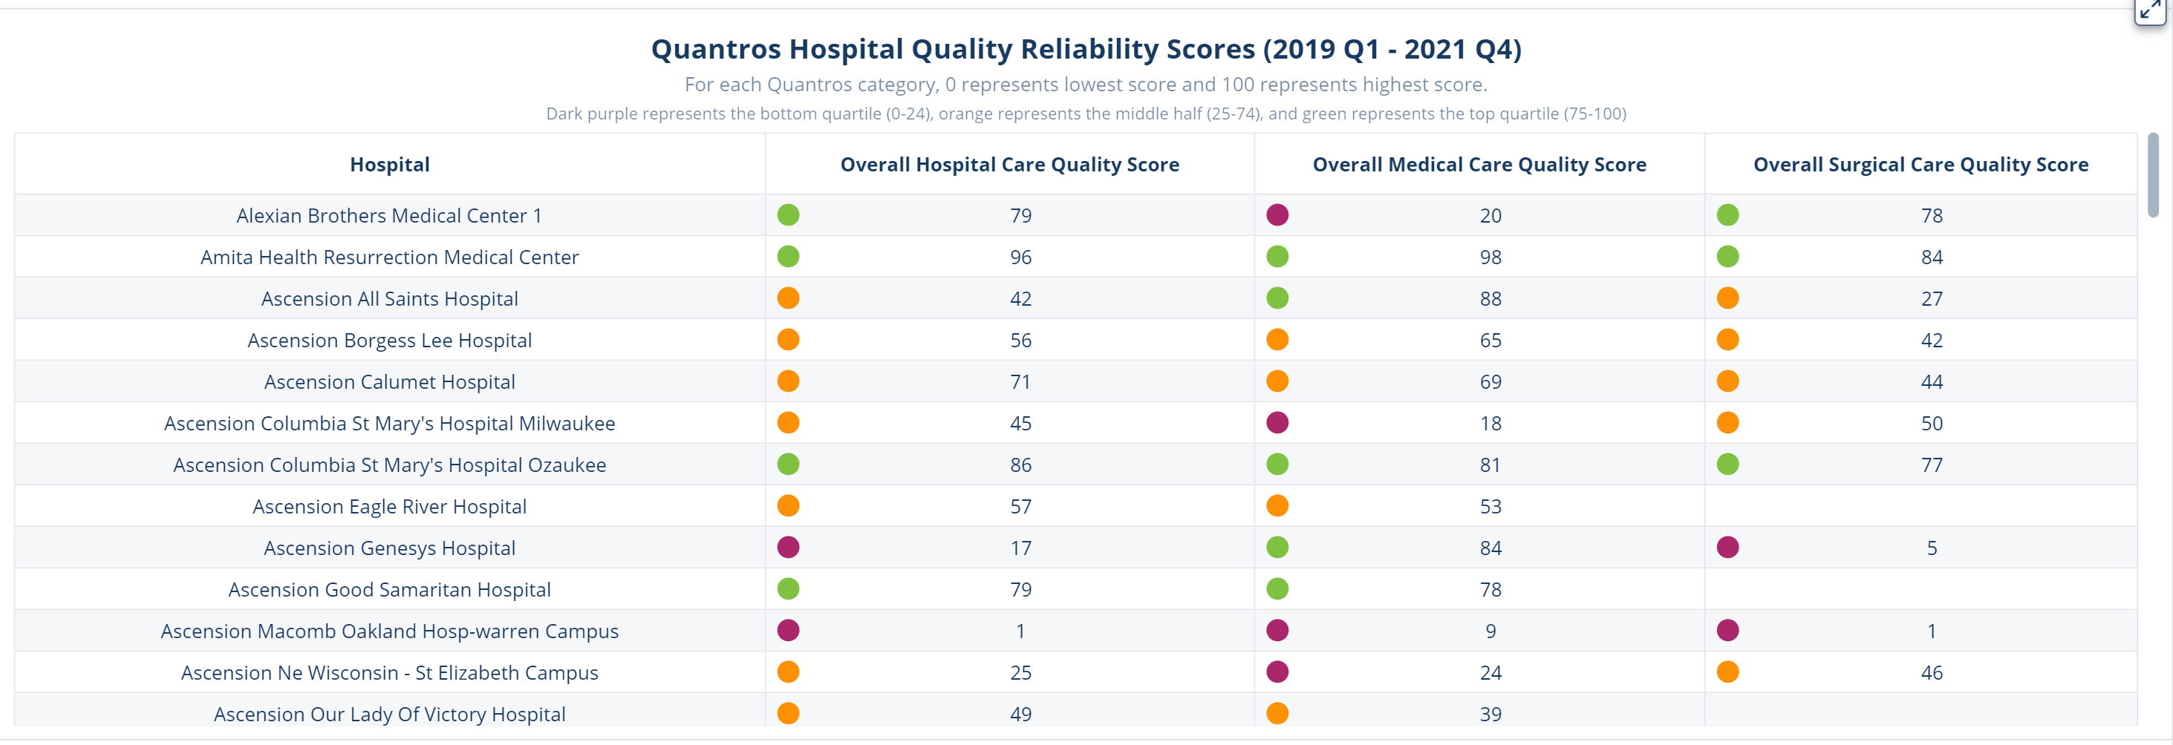
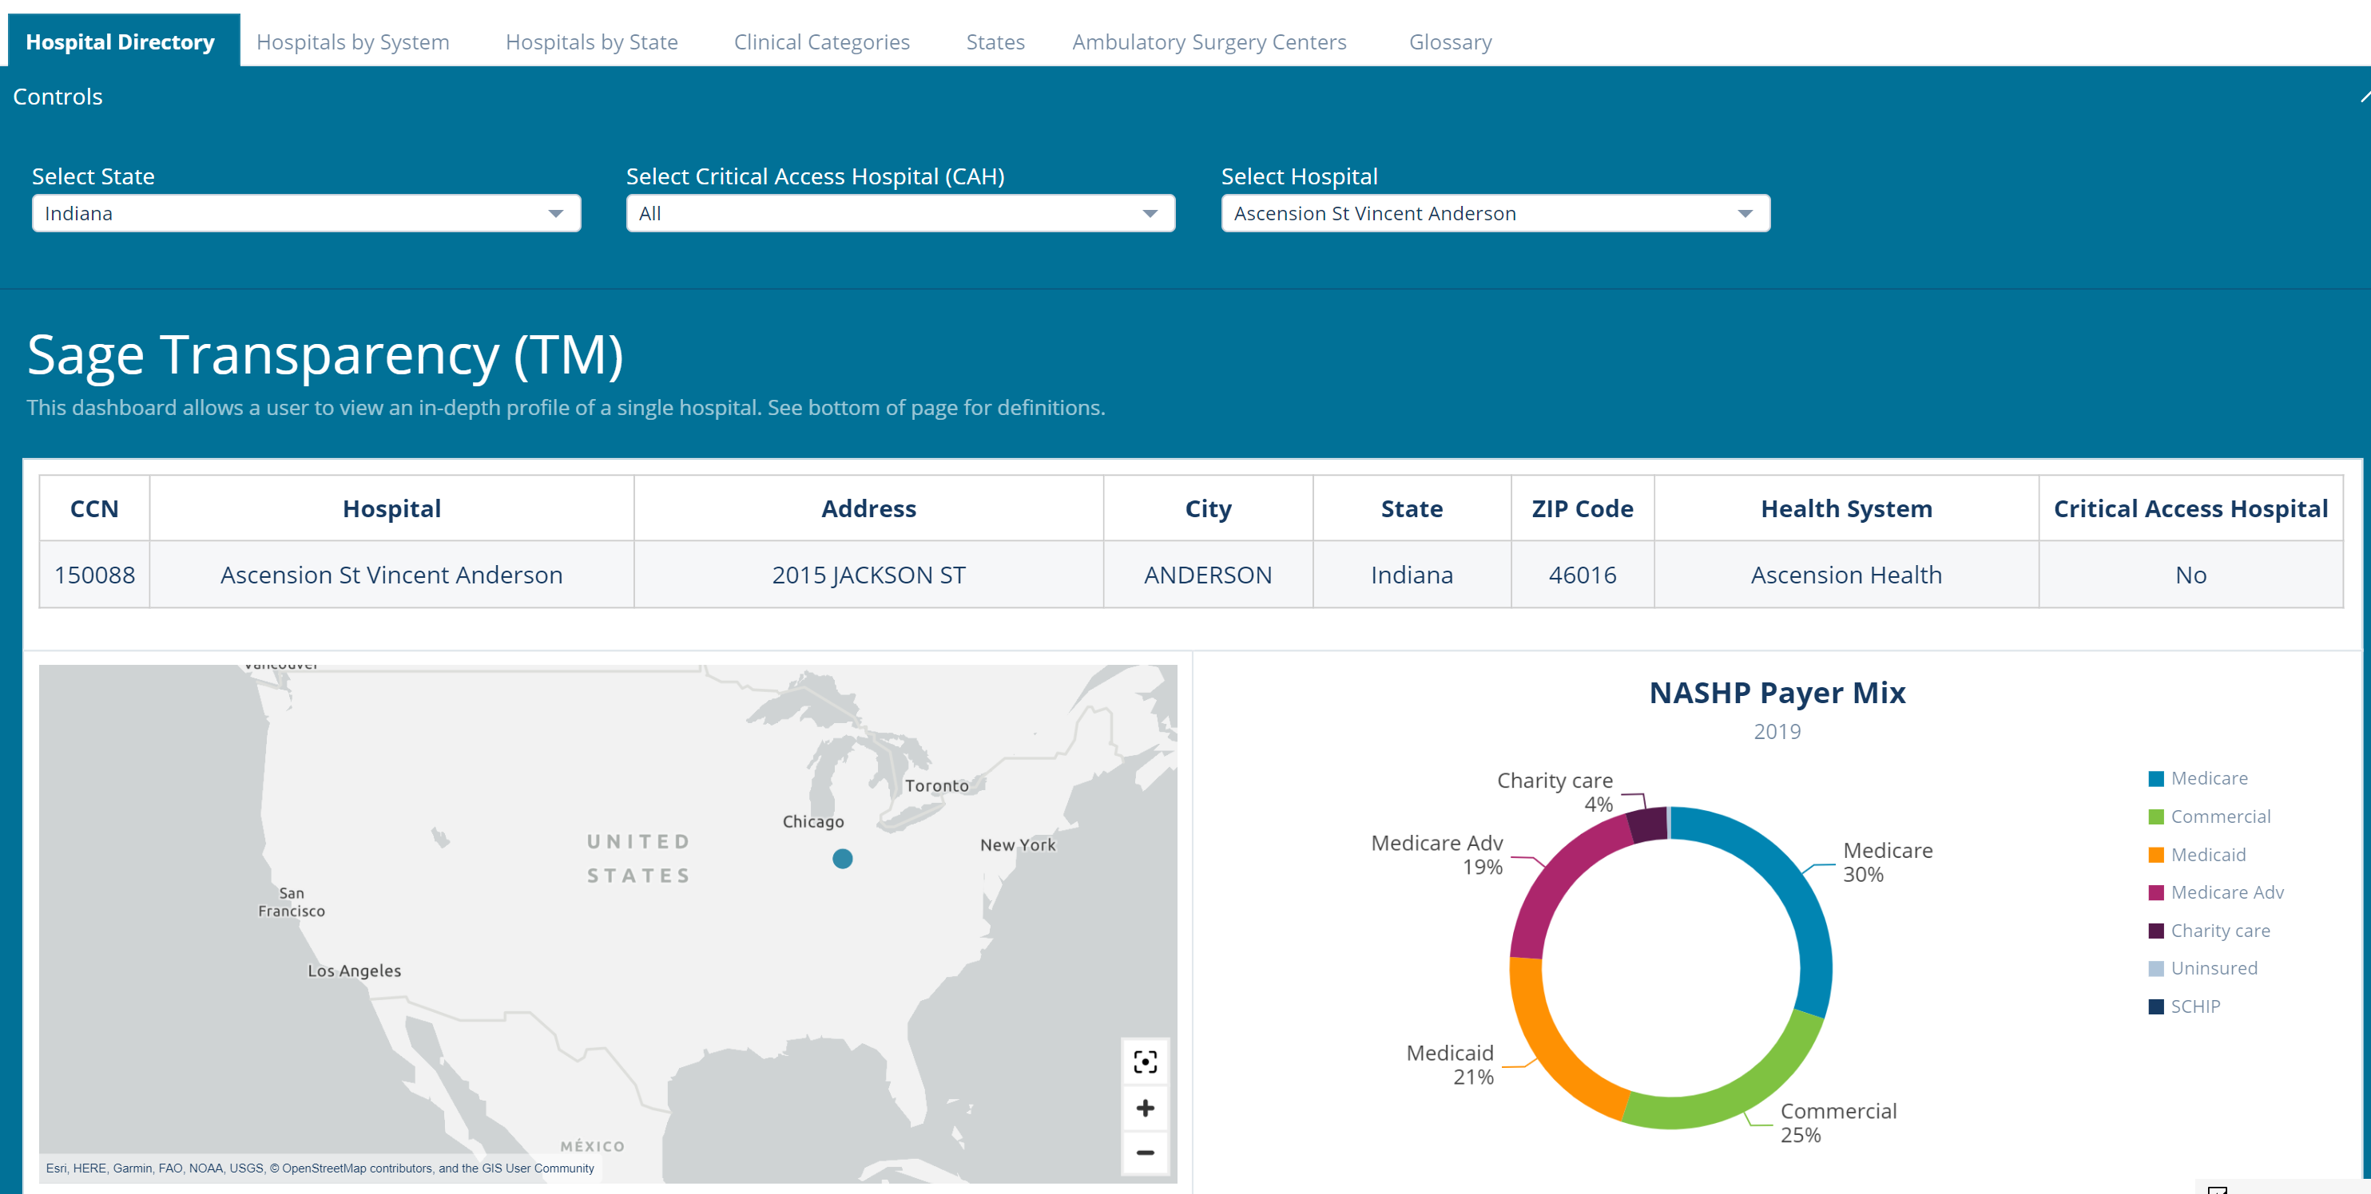

Slide 29
You are Invited: Upcoming Forum All-Stakeholder Meeting November 2nd
Location: Indiana Landmarks Center
Time: 1 – 5pm ET
Please come as my guest. ☺

Slide 30
Thank you!
Gloria Sachdev
gloria@employersforumindiana.org

Slide 31
 | CMS Hospital Quality Star Rating¹ | Total Facility Plus Professional² | Total Facility² | Total Professional²
Indiana University Health West | 4 | 332% | 376% | 149%
Hendricks County Regional Hospital | 5 | 299% | 358% | 102%
Indiana | - | 292% | 329% | 126%
National | - | 248% | 260% | 162%
1. CMS Hospital Quality Ratings (as of July 26, 2023): https://data.cms.gov/provider-data/dataset/xubh-q36u
2. Sage Transparency: https://dashboard.sagetransparency.com/

