Slide 1
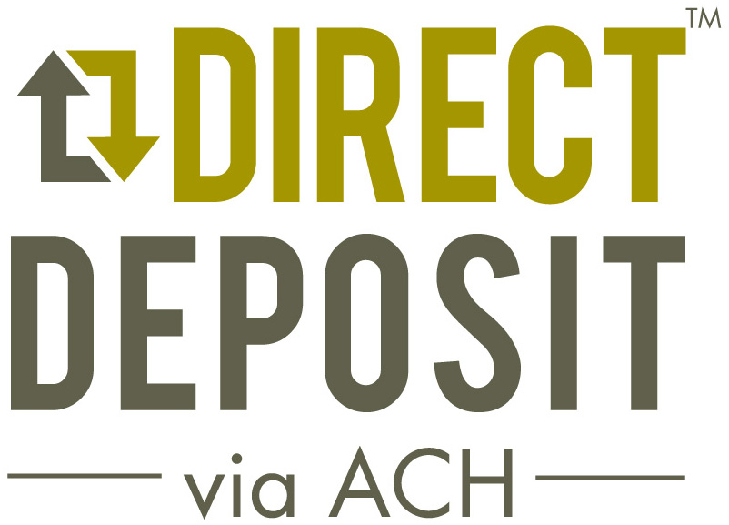
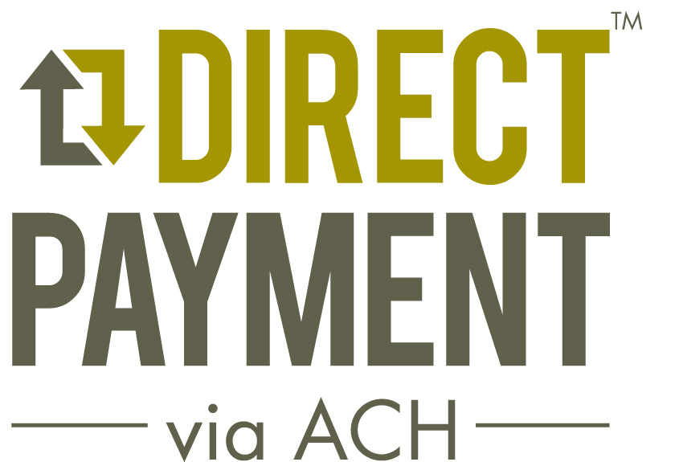
Financial Literacy includes
Electronic Payments
Notes:
Financial Literacy is the ability to understand finance. More specifically, it refers to the set of skills and knowledge that allows you to make informed and effective decisions that impact your personal financial situation. There are various options available for sending and receiving money, some of which are beneficial to you. Certain methods are expensive, while others are slow. This presentation aims to explain the electronic delivery option for sending and receiving money using “ACH.”

Slide 2
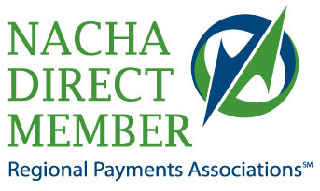
Disclaimer
Copyright 2013 REGIONAL PAYMENTS ASSOCIATIONS. All rights reserved.
This material is derived from collaborative work product developed by NACHA ─ The Electronic Payments Association and its member Regional Payments Associations. This material is not intended to provide any warranties or legal advice, and is intended for educational purposes only. NACHA owns the copyright for the NACHA Operating Rules & Guidelines.
Notes:
Our disclaimer is that we are not providing legal advice and the presentation is meant for educational purposes only.

Slide 3
You are a consumer…
Receive money into your bank or credit union account (via deposit or credit)
Send money from your account to a person or company (via payment or debit to your account)
Notes:
The methods in which we move money in and out of our accounts are changing. We used to rely heavily on checks; however, electronic channels have become increasingly popular, replacing check writing as the method to send and receive funds. We often refer to this process as Electronic Funds Transfer.

Slide 4
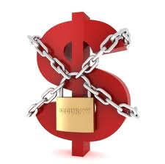
Why Move Money Using a Bank or Credit Union?
Your money is safe with Federal Deposit Insurance and federal laws.
Banks and credit unions must provide consumer protections by law.
Notes:
No other money transport service provider is as regulated or watched as a chartered, insured bank or credit union. Banks and credit unions are required to have multiple examinations performed each year regarding all areas of their business. They are even required by NACHA – the electronic payments association which governs the ACH Network - to have an Annual ACH audit to ensure they are processing within the Network’s Rules. Non-Bank entities do not have the same regulatory oversight. Regulatory bodies such as the FDIC, OCC, NCUA and OTS are able to regulate so heavily because they provide insurance on deposits. The agency that regulates your bank or credit union is often displayed on the window or at the counter of the facility. Of particular importance to you is the fact that you can’t lose money (up to $250,000 currently) if your financial institution goes out of business. Regulators uphold many laws to protect consumers. Regulation E defines how your bank discloses information and how it handles disputes. GLBA- the Graham Leach Bliley Act- defines what data is sensitive and how it should be protected. BSA/AML mandates that banks look at certain risk criteria to make sure fraud or criminal activities aren’t taking place. OFAC mandates that banks look for terrorist activity.
Federal Deposit Insurance Corporation
National Credit Union Administration
Office of the Comptroller of the Currency
Federal Financial Institutions Examination Council
Federal Reserve Board
NACHA- The Electronic Payments Association
REG E- is under the Electronic Funds Transfer Act
GLBA- Gramm-Leach-Bliley Act
BSA- Bank Secrecy Act
AML- Anti-Money Laundering
OFAC- Office of Foreign Assets Control

Slide 5
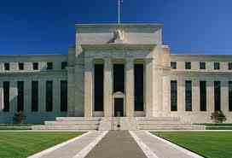
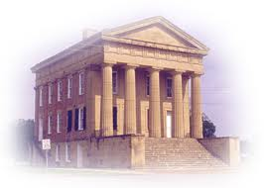
DEFINITIONS
An ACH payment is a payment directly from one bank account to another. Direct Deposit is the most recognized kind of ACH payment.
The ACH Network consists of a group of banks and credit unions that exchange money on your behalf in a secure, electronic manner.
$$
$$
Notes:
ACH is an acronym meaning Automated Clearing House. Banks and Credit Unions that use the ACH Network agree to be bound by the same Rules in order to move money electronically. There is a central clearing facility known as the ACH Operator (currently the Federal Reserve Bank) which appropriately collects and sends the money to each bank and credit union.

Slide 6
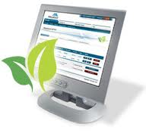
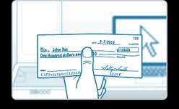
Are You Using ACH Already?
Notes:
There are many phrases people tend to use when they are moving money that actually mean they are using the ACH Network. You may hear the word eCheck or electronic check, or EFT for electronic funds transfer or automatic debit or credit. All of these terms ultimately mean ACH.
To help avoid confusion, NACHA, the organization that governs the ACH Network, is encouraging all businesses and consumers to use the same language by calling a payment either Direct Deposit via ACH or Direct Payment via ACH.
Some stores and gas stations have a card that you enroll in that automatically withdraws from your bank or credit union account. This is also an ACH.

Slide 7
Direct deposit via ach
Receive Money

Slide 8
Receive Money
SPEND MORE TIME
PLAYING
97%
of people who use Direct Deposit via ACH are satisfied
Notes:
There are more efficient ways to spend your time than dealing with checks or trips to your bank or credit union. Having your money deposited into and making payments from your accounts safely and electronically with Direct Deposit via ACH and Direct Payment via ACH leaves more time for the things you love to do. Shift workers who leave work at 11:00 PM at night find it difficult to find a bank open to cash their check. Check cashing facilities charge fees, ultimately taking money out of your check to provide their services. With Direct Deposit via ACH you will automatically receive your full paycheck into your bank account without any additional work on your part.

Slide 9
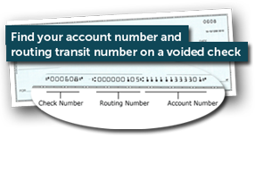
Examples of Direct deposit:
Payroll
Employee expense reimbursement
Government benefits (i.e. Social Security, VA)
Taxes & other refunds
Investments
Money from friends or family
Notes:
Direct Deposit via ACH is the deposit of funds into a consumer’s account for payroll, employee expense reimbursement, government benefits, taxes and other refunds, and annuities and interest payments. These types of payments include any ACH credit sent from a business or government to a consumer.

Slide 10
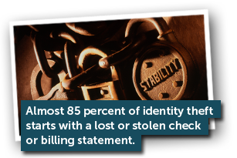
Benefits of Direct Deposit
Get paid on time every time.
Money is available at business opening on payday.
No waiting for checks to arrive.
No waiting in line to deposit or cash checks.
No lost or stolen checks.
Notes:
Under the NACHA Operating Rules, credits must be posted to your account according to the agreement you have with the individual or company sending you money. Funds cannot be posted to your account late. If the individual or company wishing to send you money indicates that you should be paid on the 15^{th,} and as long as the company and its bank transmit the instructions on time to the ACH Operator, you should receive your credit on the 15th. Some banks or credit unions may receive the payment instructions early from the ACH Operator and in that case may choose to give you credit early, for example on the 14th. This is not required by the Rules, but is a frequent practice.

Slide 11
Direct Deposit via ACH Benefits
Works even when you're away from home.
On time, every time!
Eliminates the risk of lost or stolen checks
Fast access to your money
Notes:
There are many benefits to Direct Deposit via ACH including convenience, dependability and the eliminated risk of lost or stolen checks. The United States Treasury Department reports that over 540,000 Social Security and SSI checks were reported lost or stolen in 2010 alone!

Slide 12
3 out of 4 working Americans who have access to Direct Deposit via ACH use it.
Notes:
Don’t pay someone else to receive your money! Keep all of your money every time with Direct Deposit.

Slide 13
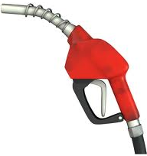
Good for the Environment
Paper Checks use more than
674
million gallons
of fuel a year
674
Gallons of fuel a year
Notes:
Switching to electronic payments makes a significant environmental impact. Every year, paper checks use more than 674 million gallons of fuel and add more than 3.6 million tons of greenhouse gases to the environment. This amount includes the cost to cut, transport and mill paper; fuels used to cut, transport and mill paper; printing and delivering boxes of checks to consumers; and taking, clearing and settling check payments, as well as returning checks to consumers in monthly account statements.
In one year alone, the average American household would save 6 pounds of paper by switching from paper to electronic billing, statements and payments.

Slide 14
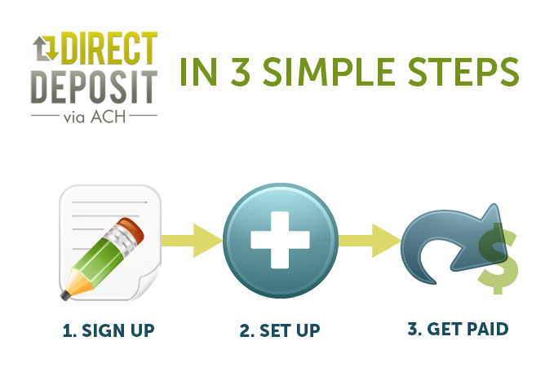

Slide 15
Ask about it!
All you need to do is complete an authorization form for Direct Deposit through your employer or the company that issues your deposit.
Notes:
You will have to tell the person you want to get money from, your account information. Don’t send it via plain email. Make sure you securely and privately give them your account information.
Could be on a form while sitting in their office, over the phone (making sure you called them and are talking to the intended company), or during a secure internet session. Look for the S in https) Make sure you recognize the web page you are visiting and nothing is out of the ordinary.

Slide 16
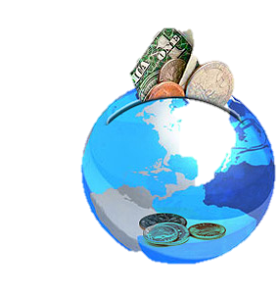
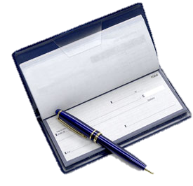
Looking for ways to save?
Split your deposit into a savings or investment account each pay period.
Notes:
A NACHA survey concluded that consumers who use split deposit by way of Direct Deposit via ACH save up to $90 more per month than those who use another method to save.
Save “invisibly” by depositing a fixed amount or percentage of your pay into a savings or investment account each pay period. Since the money goes straight into your savings account, your savings grows steadily over time.
Budget better with Direct Deposit:
With Direct Deposit via ACH, you could split a portion of your pay into a separate account and use that account to pay all of your bills. Just be sure that the amount of money you have going into your bill account matches the amount of your monthly bills. You can then set up for all of your monthly bills to be paid from that account. The remainder of your paycheck would simply go into your typical bank account.

Slide 17
Direct Payment via ach
Give Money

Slide 18
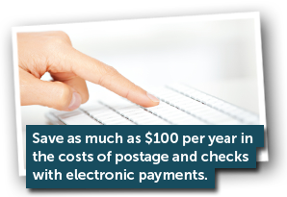
Uses of Direct Payment:
Pay your bills or tuition
Donate to your favorite charity
Make a purchase
Send money to a friend or family member
Benefits of Direct Payment:
Convenient
Versatile
Save time and hassle of writing paper checks
Notes:
Note we have now switched to talking about Direct Payment.
Pay your bills or tuition,
donate to your favorite charity, make a purchase,
or send money to a friend or family member electronically from your checking or savings account.
Benefits of Direct Payment:
Convenient
Versatile
Save time and hassle of writing paper checks

Slide 19
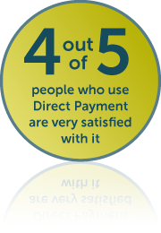
Benefits of Direct Payment
Easy to set up and use
You are in control of paying your bills
Helps you avoid late or missed payments
Works even if you’re away from home
Eliminates the risk of lost or stolen checks
Transfers funds safely, securely and directly from your accounts
Protects the environment

Slide 20
Easy to Set Up
To Sign up for Direct Payment via ACH:
Check your regular bills or statements for instructions
Look at the websites of the companies you pay for an online form
Use your bank or credit union’s online bill payment service
Have a voided check for your checking account or a document from your bank or credit union that verifies your account number and the institution’s routing transit number
Notes:
Fill out authorization
The organization you’re paying may provide you an online form, make one available for download from its website or mail you an authorization form.
You may be asked to provide voided check or a copy of a document from your bank or credit union that verifies your checking or savings account number and the institution’s routing transit number. This ensures your Direct Payment via ACH is set up accurately.
Providing the voided check is not required during the sign up process, but is often requested. If you do not carry checks, you can ask your bank or credit union to provide you with a letter asserting your account information.

Slide 21
Automatic Bill Payment
Bills will be paid automatically on the specified date
it can be a single or recurring payment (monthly)
Or you can authorize a one time payment as needed
Monitor your checking account
Notes:
Once you have authorized a company or government agency to initiate a Direct Payment via ACH to withdraw funds from your account to pay a bill, the bill will be paid automatically on the specified date – it can be a single or recurring payment, such as monthly.
Or you can log on and authorize a one time payment
There is nothing more you need to do

Slide 22
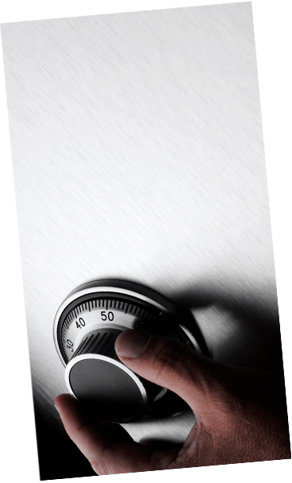
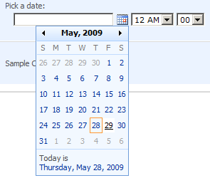
Electronic Payments are Safe
Federal laws protect you.
You are in control of the payment.
Notes:
You can request a Stop Payment on an ACH just as you can with a check. When you dispute a transaction with your bank or credit union you most likely will have to sign some paperwork either in-person or online.
Debits to saving accounts are limited to 6 per month
If you know a debit is going to post to your account, and you wish to keep it from posting, you can request a Stop Payment from your bank or credit union
You can dispute transactions that have posted to your account if you:
Do not recognize the debit
The Amount is incorrect
The debit posted earlier than the agreed upon date
It is a fraudulent transaction

Slide 23
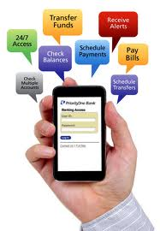
Use Good Practices for Electronic Payments
Don’t use unsecure Internet connections or public terminals to make payments
Protect your computer and mobile phone with a login password
Do not save password information
Monitor your account daily and discuss questions with bank or credit union

Slide 24
Conclusion
www.electronicpayments.org
Contact your bank or credit union for further information
ACH is:
Convenient
Safe
Secure
Reliable
Available

