Slide 1
From Virtual to Reality: Combatting Loneliness & Isolation Through
Camarillo Health Care District “Adventures in VR”
ACHD 71st Annual Meeting, September 13-15, 2023
Notes:
.

Slide 2
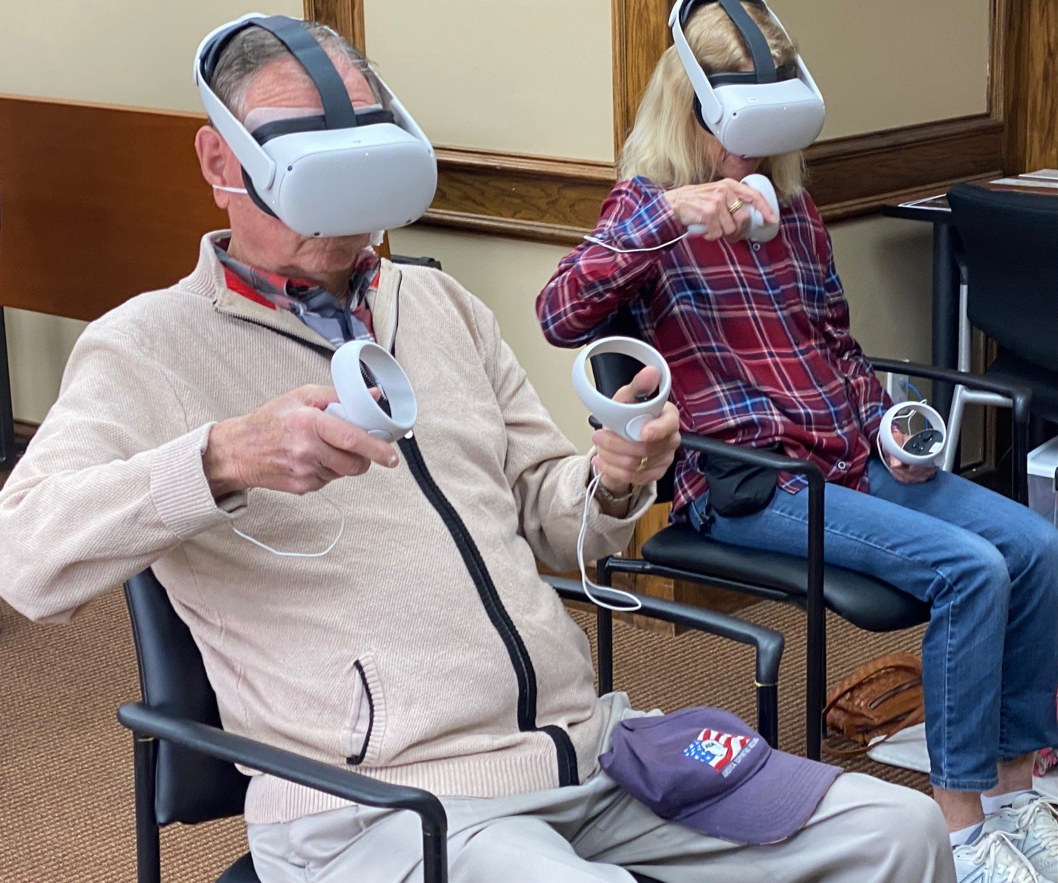
Today’s Discussion:
Program Origin
Program Funding
Program Development
Program Growth

Slide 3
Program Origin
The Pandemic
Depression
Isolation
Loneliness

Slide 4
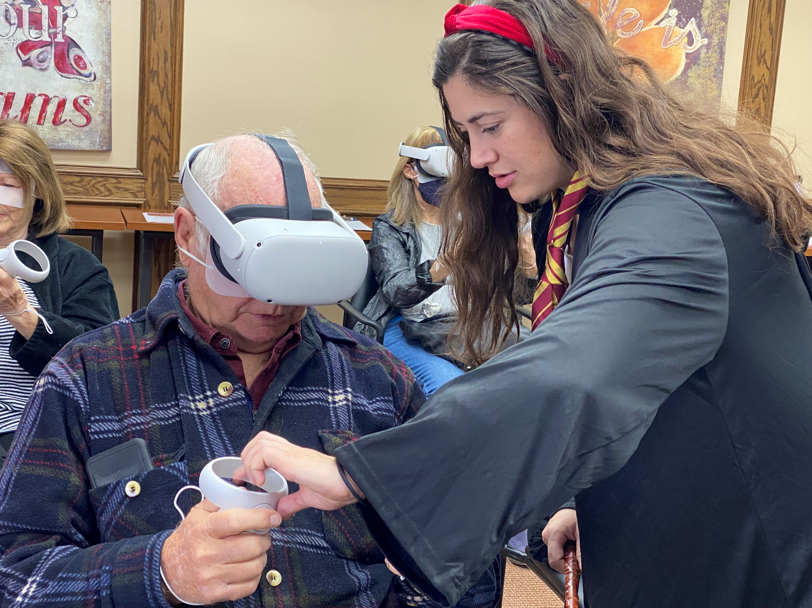
Forced Creativity
Origin
COVID closures
Translated what we could
HUGE digital literacy issues (esp older adults)
HUGE remote access issues (esp older adults)
Reopening harder than closing; creativity required

Slide 5
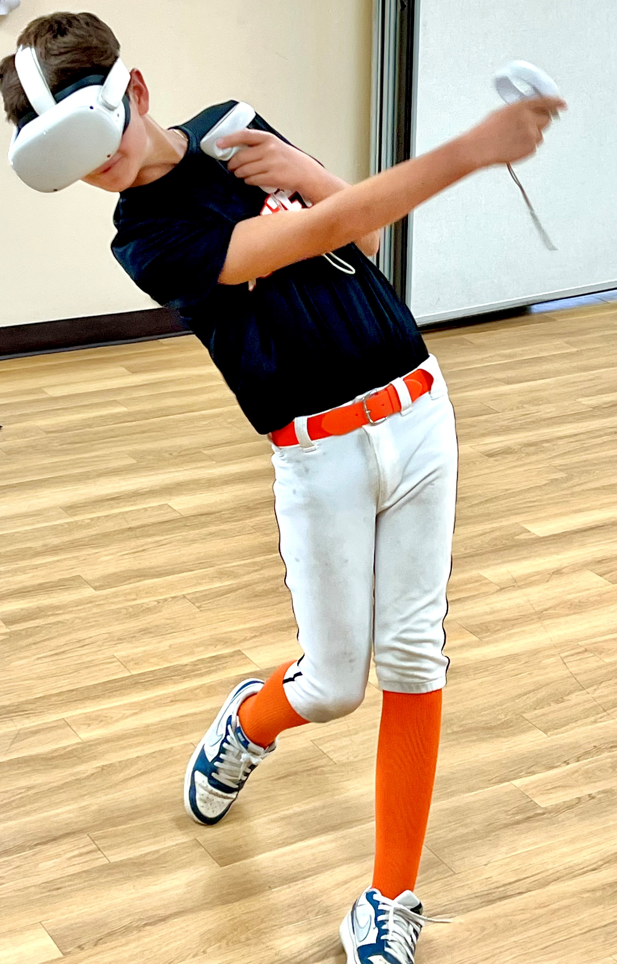
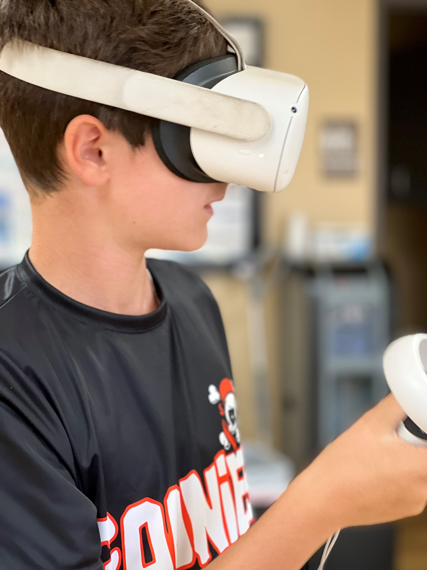
Forced Creativity
Origin
Dream BIG
“Re-emerge” think tank
The weekend, a young son, and baseball
Too technological, too silly, too wild sounding
Nathan, 13

Slide 6
Program Funding
The Three Bs
Board
Budget
Bandwidth

Slide 7
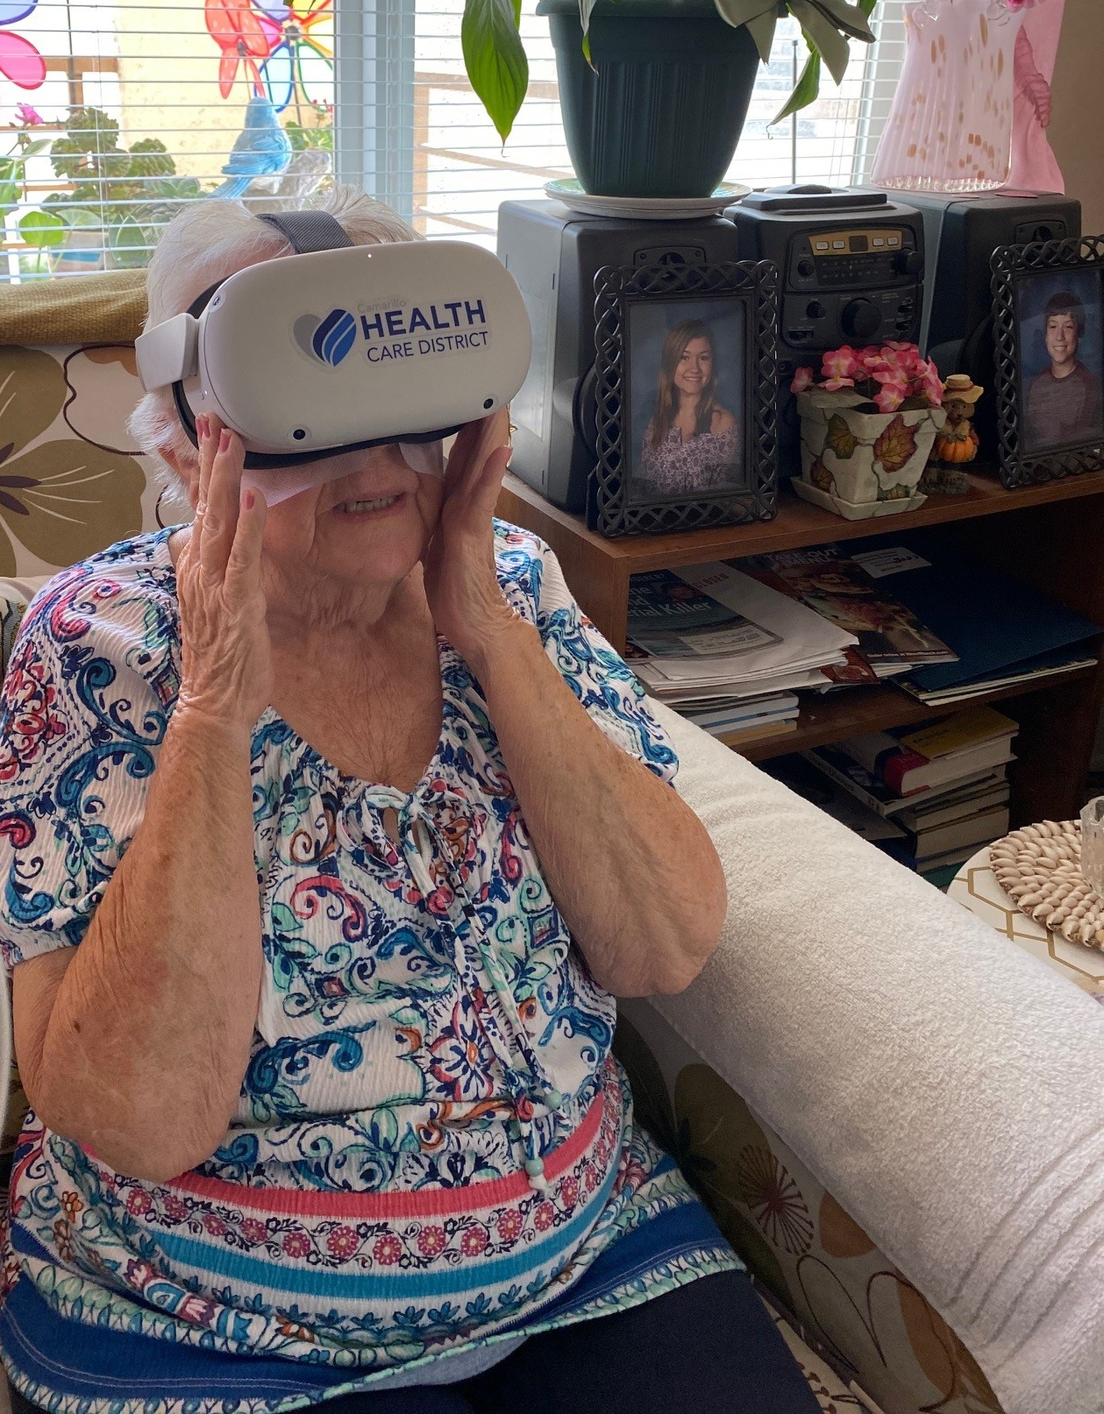
The Three Bs
Funding
Board
Visionary, Courageous, Innovative
Formula: vision + courage= innovation
Budget
Assembly appropriation for COVID response
Created carve out following year
Prioritized hiring
Bandwidth
Know staffing capacity; Develop needed skill sets

Slide 8
Program Development
Operationalizing
Practice
Procedure
Protocol

Slide 9
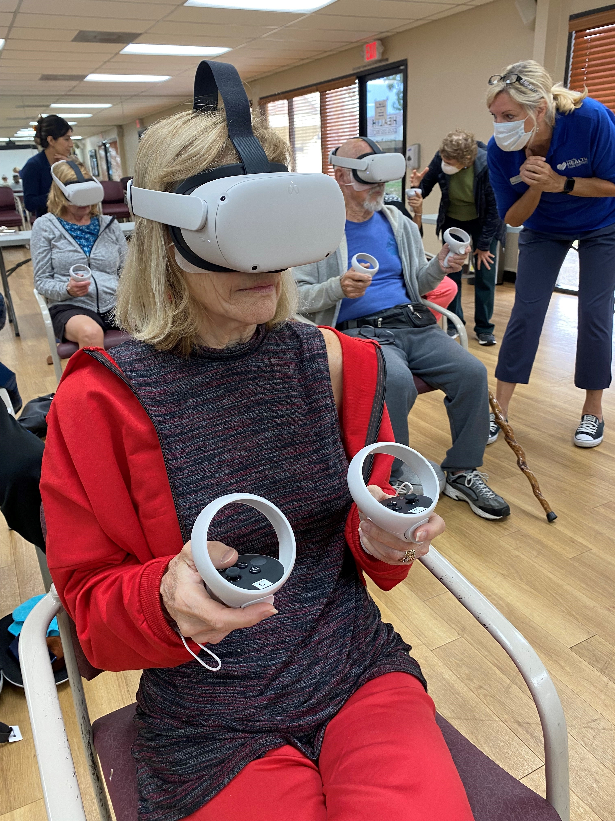
Procedure & Protocol
Development
Procedure
People
Waivers (liability waiver = participation forms)
Instructional ppt/videos
Post-class survey
Program
Inventory system
Repair and Maintenance
Storage system
Staff training

Slide 10
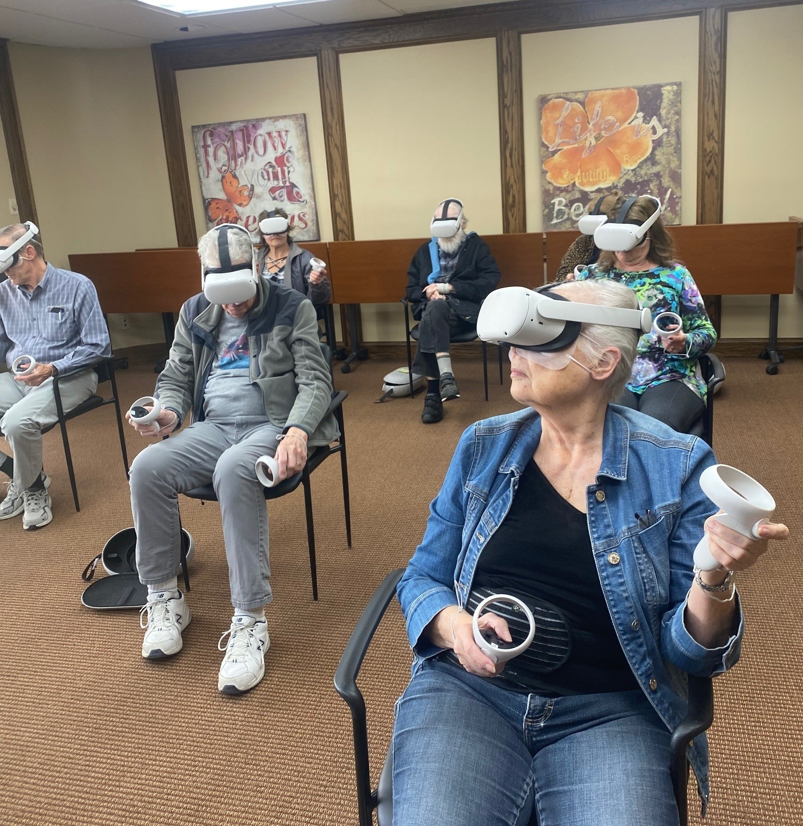
Procedure & Protocol
Development
Protocol
Care and cleaning
Masks for each use
Spacers for glasses wearers
6-8 class size…highly monitored. 1:1
Time between classes for reset and sanitize
Forms ready…back-to-back classes
Staff training

Slide 11
Program Growth
What else can this program do?
Dream…
…some more
Go Big!

Slide 12
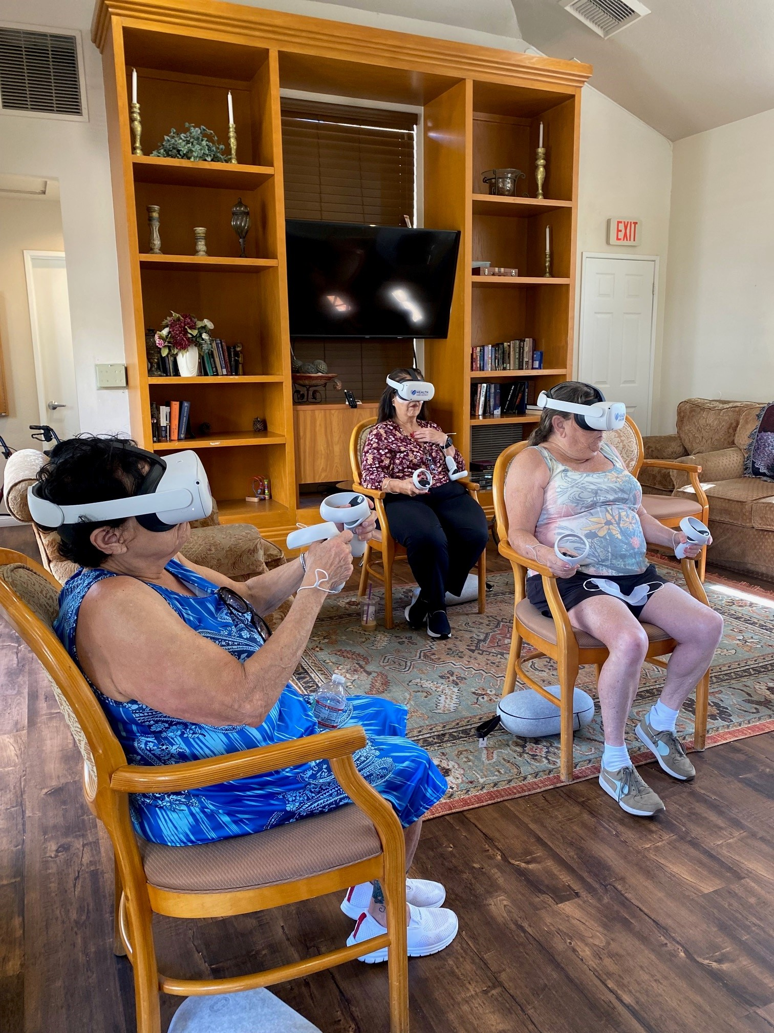
Program Expansion
Expansion
Success
Publicity
Full Classes
Community Champions (CCoA, City, Board, Staff)
What next?
Keep dreaming
Mobilization (city grant)
No walls
Is it a trend?
Budget carve-outs
Notes:
)

Slide 13
What We Learned:
Stay true to brainstorm etiquette: nothing is too silly; Be willing to dream outside the box
COVID made us very practiced at thinking and evaluating quickly; rapid cycle testing (Plan-Do-Study-Act)
Write good procedures before you launch program
Setting up headsets takes time (initially & during class)
Clients need to pay in advance
Buy the carrying case! Number all the pieces of each set!
Modify program as you go
ENJOY IT! (have staff experience it)
Assemblywoman Jacqui Irwin

Slide 14
Trippy vid:

Slide 15
Thank you!
Mariana Gutierrez, Health Promotion Coordinator
Michelle Rogers, Community Education & Outreach Mgr
Kara Ralston, CEO
www.camhealth.com

