Slide 1


AB 1234
Ethics Training
Richard D. Pio Roda, Principal
Meyers Nave
September 13, 2023

Slide 2
Why Are We Here?
California state law (AB 1234)
Cal. Govt. Code Sec. 53235.1
Mandates ethics training within first year of appointment
All local elected officials or members of legislative bodies who receive any compensation or expense reimbursements
And employees designated by the legislative body
Must receive
2 hours
of training
every 2 years

Slide 3
AB 1234 Training Overview
Personal Financial Gain by Public Officials
Conflicts of Interest Under the Political Reform Act
Contractual Conflicts of Interest (Gov’t Code § 1090)
Conflicts of Interest and Campaign Contributions
Conflicts of Interest When Leaving Office
Bribery

Slide 4
AB 1234 Training Overview
II. Laws Regarding Claiming Perquisites of Office
Limitations on Receipt of Gifts
Honoraria Ban
Misuse of Public Funds
Prohibitions Against Gifts of Public Funds
Mass Mailing Restrictions
Prohibitions Against Free or Discounted Transportation by Transportation Companies

Slide 5
AB 1234 Training Overview
III. Government Transparency Laws
Economic Interest Disclosure under the Political Reform Act
Brown Act
Public Records Act

Slide 6
AB 1234 Training Overview
IV. Laws Relating to Fair Processes
Common Law Bias Prohibitions
Due Process Requirements
Doctrine of Incompatible Offices
Incompatible Activities
Competitive Bidding Requirements for Public Contracts
Disqualification from Participating in Decisions Affecting Family Members (Anti-Nepotism Laws)

Slide 7

I. Personal Financial Gain by Public Officials
Conflicts of Interest under the
Political Reform Act (PRA)
Contractual Conflicts of Interest
(Gov’t Code § 1090)
Conflicts of Interest and
Campaign Contributions
Conflicts of Interest when
Leaving Office
Bribery

Slide 8

I. Personal Financial Gain by Public Officials
Conflicts of Interest under PRA
Basic Rule
Public officials* have a disqualifying conflict of interest under the Political Reform Act of 1974 when a decision has a:
  Reasonably foreseeable material financial effect on an official’s economic interest
  Different from the effect on the public generally
* For purposes of this rule, a “Public Official” is every member, officer, or employee and certain consultant of a state or local government agency

Slide 9

I. Personal Financial Gain by Public Officials
What is an “Economic Interest” under the PRA?
Business investments of $2,000 or more
Business management positions or
employment in for-profit entities
Real property Interests of $2,000 or more
Sources of income of $500 or more
(within previous 12 months)
Sources of gifts of $590 or more (within previous 12 months)
Personal financial effects or finances

Slide 10

I. Personal Financial Gain by Public Officials
How do you determine if the “Economic Interest” qualifies as a Conflict of Interest under the PRA?
Four-Part Test:
4: Is the official “making, participating in the making, or using their position to influence” the governmental decision from which the financial effects result?
3: Is the effect on the official the same as on the “public generally”?
2: Is it material?
1: Is the financial effect “reasonably foreseeable”?

Slide 11
I. Personal Financial Gain by Public Officials
STEP 1:
Is the financial effect
“reasonably foreseeable?”
STANDARD:
“Realistic possibility and more than hypothetical or theoretical”
A. Conflict of Interest under the PRA

Slide 12

I. Personal Financial Gain by Public Officials
A. Conflict of Interest under the PRA
Q: Is it material?
A: Determine correct “materiality standard”
Materiality is a measure of “how important” it is.
Rules vary by type of interest.
In general, materiality is presumed when the public official's financial interest is a party to, or the subject of, the governmental decision.

Slide 13

I. Personal Financial Gain by Public Officials
A. Conflict of Interest under the PRA
Is the effect on the official the same as on the “public generally”?
  Effect on official is indistinguishable from its effect on the public generally if:
  Significant segment of public is affected (i.e., 25% of all businesses, real property or individuals); and
  Effect on their interest is not unique compared to the effect on a significant segment (e.g., Decision would have a disproportionate effect on development potential of official’s real property or on an official’s business due to its proximity to project that is subject of the decision).

Slide 14
I. Personal Financial Gain by Public Officials
Examples of Materiality
Business Investments/Positions
  Increases assets of business
  or liability
Gifts, Income, Personal Finances
  Indirect impact on sources
  of income
  Financial benefit on
  family member
Real Property Interests
  Owned Property close to proposed development
  500 Foot Rule: An official whose property is located within 500 feet of other property that is the subject of a governmental decision is presumed to have a disqualifying “material” financial interest

Slide 15

I. Personal Financial Gain by Public Officials
Conflict of Interest under the PRA
Is the official “making, participating in the making, or using their position to influence” the governmental decision from which the financial effects result?
Determine if the official is:
  Making a decision
  Participating in a decision
  Using official position to attempt
  to influence a decision
Official may still participate if an
exemption applies

Slide 16
I. Personal Financial Gain by Public Officials
Conflicts of Interest under PRA: Recusal
Public official with a disqualifying interest must:
Publicly identify interest in sufficient detail
Recuse self from discussions or acting
on matter
Leave room, unless matter on consent agenda
    May speak during public comment on certain personal interests.
Exception

Slide 17
I. Personal Financial Gain by Public Officials
B. Conflicts of Interest in Contracts
Basic Rule (Gov. Code Section 1090)
Applies Broadly
Prohibits public officials and employees from having financial interests…
in contracts…
Made by them in their official capacities
Applies to renewals, extensions, and oral contracts
Financial interests in contracts are broadly construed

Slide 18

I. Personal Financial Gain by Public Officials
B. Conflicts of Interest in Contracts
Legislative body deemed to make all agency contracts
Legislative body members are deemed to have participated in making all contracts of the agency, except where an exception applies
Prevents the agency from entering into a contract in which a member of the agency’s board or commission has a financial interest
Employees can avoid prohibition by not
participating in the making of the contract
Notes:
If legislative body member has financial interest in contract and no exception applies, entire agency may not enter into the contract.
Includes bodies with authority to make the contract
Contracts include grants

Slide 19

I. Personal Financial Gain by Public Officials
B. Conflicts of Interest in Contracts
Remote Interest Exceptions
Public official does not have an interest in a contract if:
the interest is “remote”
the interest is disclosed to the legislative body and
noted in official records
and the official does not vote
(applies only to multi-member bodies)
Notes:
This means the contract may be entered into.

Slide 20
I. Personal Financial Gain by Public Officials
B. Conflicts of Interest in Contracts
Remote Interest Exceptions - Examples
Employee or officer of non-profit
Landlord or tenant of contracting party
Salary or per diem from a directly involved government department
Engineer, geologist, architect, or planner employed by a consulting engineering or architectural firm
  Owner/partner of a firm who serves as appointed member of unelected board
  or commission
  Supplier of same goods and services for 5 years prior to election/appointment
  Employee of private party if:
    10 or more employees, and
    Employed more than 3 years

Slide 21

I. Personal Financial Gain by Public Officials
B. Conflicts of Interest in Contracts
Non-Interest Exceptions
Public official is deemed not interested and may
participate in making of the contract.
Examples:
Ownership of less than 3% of stock, constituting less than 5% of income
Spouse of officer/employee of public agency, if the office holding or employment has existed at least one year prior to the spouse’s election/appointment
Salary or per diem from a non-directly involved government department
Non-salaried member of non-profit, with disclosure and noting records

Slide 22

I. Personal Financial Gain by Public Officials
B. Conflicts of Interest in Contracts
Consequences of Violations
Contract is void and unenforceable
Payments made to the contracting party must be
returned to the public agency
Public agency may keep benefit of the contract
Willful violations are criminal
Permanently disqualified from holding office
FPPC now has jurisdiction and can issue administrative fines
Offering section 1090 advice

Slide 23

I. Personal Financial Gain by Public Officials
C. Conflicts of Interest in Campaign Contributions
Basic Rule
Public officials are disqualified from making a
decision involving a license, permit, contract,
entitlement for use if official has accepted a
campaign contribution exceeding $250 in the
preceding 12 months.
Competitively bid, labor, or personal
employment contracts are exempt

Slide 24
I. Personal Financial Gain by Public Officials
C. Conflicts of Interest in Campaign Contributions
Major changes enacted by SB 1429
“Directly elected” exception removed
Official may not accept a campaign contribution exceeding $250 while
an application is pending, and for 12 (not 3) months after the decision
is made
May return contribution within 30 days of when officer knows, or should have known, about the contribution and the proceeding to avoid conflict
Application to donations before 2023 uncertain

Slide 25
I. Personal Financial Gain by Public Officials
D. Conflicts of Interest When Leaving Office
Lobbying
Former
Agency
One year ban on lobbying former agency
Applies to elected officials, executives, and general managers
Applies only if compensated and representing another person
Decisions Involving Prospective Employers
Public officials and employees are prohibited from being involved in governmental decisions directly relating to a prospective employer

Slide 26

I. Personal Financial Gain by Public Officials
E. Bribery
Basic Rule
Elements of the crime
A governmental official
(elected, appointed, employed);
Requests, takes, or agrees to take a bribe; and
Represents that the bribe would unlawfully influence vote decision, or opinion. Representation can be express or implied.
“anything of value
or advantage, present or prospective”
Must have corrupt intent that official duty would be unlawfully influenced

Slide 27
Quiz

Slide 28
Question 1:
The City Council will be attending a conference and they want to contract with a vendor to make Dublin pins that they can all wear to the conference.
Councilmember owns a business manufacturing decorative pins and offers to provide the pins at a discount.
Can the
City enter into an agreement with the business?

Slide 29
Answer to Question 1:
No.
The City cannot enter into an agreement with the Councilmember’s business even though the pins will be provided at a discount.

Slide 30
Question 2:
The City and Tesla are negotiating the purchase of solar panels to install at
City Hall.
A councilmember holds Tesla stock.
Can the City contract with
Tesla to purchase the panels?

Slide 31
Answer to Question 2:
It depends on the amount and value of the stock.
The City most likely can enter the agreement with Tesla. The stock interest is most likely a “non-interest” for purposes of Section 1090. To be a “non-interest,” the Councilmembers must own less than 3% of Tesla’s shares and earn no more than 5% of their annual income from the corporation.
However, depending on the value of the stock, Councilmembers may have personal conflicts of interest under the PRA and would be required to recuse themselves even if the City was able to enter into the agreement.
Notes:
(14) That of a person owning less than 3 percent of the shares of a contracting party that is a for-profit corporation, provided that the ownership of the shares derived from the person's employment with that corporation.

Slide 32

Question 3:
Can the Councilmember participate in consideration of the amendment?
  An applicant seeks
  a general plan amendment.
A Councilmember received
a $300 campaign contribution
from the applicant 3 months ago.
© Meyers Nave 2023

Slide 33
Answer to Question 3:
No.
SB 1439 removed the exception for officers of local government agencies, thus the prohibition against receiving campaign contributions applies.
* Uncertainty regarding whether restrictions apply retroactively.
Notes:
Even if they weren’t directly elected, the contribution was received more than 12 months before the consideration of the item.

Slide 34

II. Laws Relating to Claiming Prerequisites of Office
Limitations on the Receipt of Gifts
Agency Distribution of Tickets
Honoraria Ban
Misuse of Public Funds
Prohibitions Against Gifts of Public Funds
Mass Mailing Restrictions
Prohibitions Against Acceptance of Free or Discounted Transportation From Transportation Companies

Slide 35
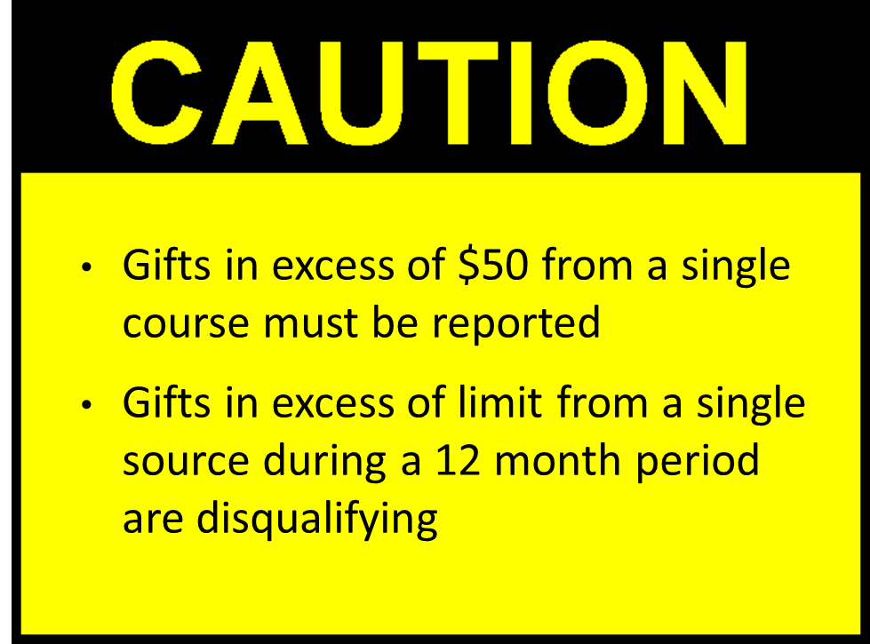
II. Laws Relating to Claiming Prerequisites of Office
Gifts
Basic Rule
Gift Limit Prohibition:
Public officials and employees may not accept gifts from a single source during a calendar year in excess
of $590
Up from $520
Effective 1/1/23 - 12/31/24
Gifts received in excess of $50 from
a single source in a calendar year must be reported.
Public Officials may not accept a gift in excess of $590 from a single source in a calendar year.

Slide 36

II. Laws Relating to Claiming Prerequisites of Office
Gifts
What is a Gift?
Anything of value that provides a personal benefit for which the donor does not receive equivalent consideration
  Includes rebates or discounts unless given in the regular course of business to members of the public

Slide 37

II. Laws Relating to Claiming Prerequisites of Office
Gifts
When is a Gift received?
The public official has actual possession of the gift; or
When the official takes any action exercising direction or control over the gift, including discarding the gift or turning it over to another person.
Give it back
or donate it
to charity
Notes:
Note, this includes gifts that are accepted by someone else on the official’s behalf and gifts made to other at the direction of the official. Ex. If your staffer receives Warriors tickets and directly passes them on to someone else, you were in receipt of and accepted the gift because you directed the distribution.
Also note, Gifts TO Family Members (Regulation 18943), under certain circumstances, a gift to an official’s family member is considered a gift to the official. (Regulation 18943.) Anything given to a family member is presumed to be a gift to the official if: (1) there is no established relationship between the donor and the family member where it would generally be considered appropriate for the family member to receive the gift or; (2) the donor is someone who lobbies the official’s agency, is involved in an action before the official’s agency in which the official may foreseeably participate, or engages in business with the agency in which the official will foreseeably participate.

Slide 38
II. Laws Relating to Claiming Prerequisites of Office
Gifts
Numerous Exceptions
Gifts returned
Gifts donated to charity
(without claiming a deduction)
Gifts from family members
Informational material
Inheritance
Leave credits
Disaster relief provisions
Travel and subsistence as part of campaign activities
Prizes received in a bona fide competition
Entrance to an event while performing a ceremonial role (includes one guest)
Agency distribution of tickets to entertainment

Slide 39

II. Laws Relating to Claiming Prerequisites of Office
Gifts
Numerous Exceptions to Gift Rule
Benefits received as a guest
attending a wedding
Bereavement offerings
Acts of neighborliness
Reciprocal exchanges in a
social relationship
Personalized plaques or trophies valued at less than $250
Bona fide date or dating relationship
Acts of human compassion
Gifts from long-term,
close personal friends

Slide 40
II. Laws Relating to Claiming Prerequisites of Office
Gifts
Limitations on Receipt of Gifts
Special Exceptions for Travel Payments
Some payments are not subject to limits and not reportable
Payments by government agency or non-profit
Others are not subject to limits but are reportable
Travel rules are very specific; check with legal counsel if your travel will be paid for by a third party

Slide 41

II. Laws Relating to Claiming Prerequisites of Office
B. Agency Distribution of Tickets
Basic Rule
A ticket or pass provided to an official is not a gift under the PRA and does not require reporting if:
Distribution is made pursuant to a policy adopted by the agency
Policy identifies the public purpose served in distributing the admissions

Slide 42

II. Laws Relating to Claiming Prerequisites of Office
C. Honoraria Ban
Basic Rule
Elected officials, city managers, and city attorneys, may not accept any payment for:
Giving a speech,
Publishing an article, or
Attending a public or private conference, convention, meeting, social event, meal, or similar gathering.
Notes:
§2.141 a. Honoraria
No local elected officeholder, candidate for local elected office, or other individual specified in Govt C §87200 may accept any honorarium. Govt C §89502. "Honorarium" means a payment in consideration for a speech given (or other form of oral presentation), article published, or attendance at any public or private conference, meeting, or like gathering. Govt C §89501(a). An honorarium does not include earned income for personal services that are customarily provided in connection with the practice of a bona fide business or profession, unless the sole or predominate activity of the business or profession is making speeches. Govt C §89501(b)(1). See also 2 Cal Code Regs §§18930-18933. The limitations on honoraria do not apply if, within 30 days of the receipt of the honorarium, it is returned unused, donated to the general fund of the agency in question, or donated to charity under certain circumstances. Govt C §89501(b)(2); 2 Cal Code Regs §§18932.5, 18933. Designated employees may not accept an honorarium from any source if the employee would be required to report the receipt of income or gifts from that source on his or her statement of economic interests form. Govt C §89502(c).

Slide 43

II. Laws Relating to Claiming Prerequisites of Office
C. Honoraria Ban
Exceptions
Donated to Agency General Fund
Made Directly to a
Bona Fide Non-profit
Returned
Honorarium
Campaign Contributions (but must be reported)
Bona Fide Business
(teaching, practicing law,
banking, medicine)
Notes:
§2.141 a. Honoraria
No local elected officeholder, candidate for local elected office, or other individual specified in Govt C §87200 may accept any honorarium. Govt C §89502. "Honorarium" means a payment in consideration for a speech given (or other form of oral presentation), article published, or attendance at any public or private conference, meeting, or like gathering. Govt C §89501(a). An honorarium does not include earned income for personal services that are customarily provided in connection with the practice of a bona fide business or profession, unless the sole or predominate activity of the business or profession is making speeches. Govt C §89501(b)(1). See also 2 Cal Code Regs §§18930-18933. The limitations on honoraria do not apply if, within 30 days of the receipt of the honorarium, it is returned unused, donated to the general fund of the agency in question, or donated to charity under certain circumstances. Govt C §89501(b)(2); 2 Cal Code Regs §§18932.5, 18933. Designated employees may not accept an honorarium from any source if the employee would be required to report the receipt of income or gifts from that source on his or her statement of economic interests form. Govt C §89502(c).

Slide 44
II. Laws Relating to Claiming Prerequisites of Office
D. Misuse of Public Funds
Basic Rule
Public officials and employees may not use public resources for any private gain
Whether financial or political
Government cannot expend resources to promote a partisan position in an
election campaign
But it can educate about ballot measures

Slide 45
II. Laws Relating to Claiming Prerequisites of Office
E. Gifts of Public Funds
Constitutional Prohibition
Public agencies may not
make gifts of public funds
An expenditure is not a gift if it serves a public purpose, even if it benefits a private party
Legislative body’s determination
of a public purpose is given
great deference

Slide 46

II. Laws Relating to Claiming Prerequisites of Office
F. Mass Mailing Prohibition
Basic Rule
A “mass mailing” is:
A tangible item sent or delivered
To 200 or more people within a calendar month
That “features” an elected officer by:
Including the photograph or signature, or
Singling out the officer by the manner of display of name or office in the layout, such as headlines, captions, type size, or type color
For which the costs of design, production, and printing exceed $50 and are paid with public monies
Mass mailings may not be sent at public expense

Slide 47

II. Laws Relating to Claiming Prerequisites of Office
G. Acceptance of Free or Discounted Travel
From Travel Companies
California Constitution prohibits public officers
(not all employees) from accepting free passes or discounts from a transportation company
One who accepts forfeits his/her office
Prohibition does not apply to discounts offered
to the general public
FREE TRAVEL
Notes:
Under Cal Const art XII, §7, "[a] transportation company may not grant free passes or discounts to anyone holding an office in this state; and the acceptance of a pass or discount by a public officer, other than a Public Utilities Commissioner, shall work a forfeiture of that office." This proscription applies to all forms of transportation. The Attorney General has provided limiting interpretations of this section. See 85 Ops Cal Atty Gen 40 (2002) (member of board of directors of public transit agency may accept passes for free transportation on agency's buses to perform member's duties of monitoring agency's transportation services); 80 Ops Cal Atty Gen 146 (1997) (constitutional provision does not prohibit accepting ticket earned with "frequent flier" miles); 76 Ops Cal Atty Gen 1 (1993) (Attorney General granted leave to sue mayor to test his right to hold office in view of his acceptance of airline ticket upgrade); 74 Ops Cal Atty Gen 26 (1991) (constitutional provision did not prohibit upgrade to honeymooning official when airline's policy was to upgrade all honeymooners); 67 Ops Cal Atty Gen 81 (1984) (constitutional provision did not prohibit free or discounted pass when it was offered to all members of greater class, i.e., spouses of flight attendants).

Slide 48
Quiz

Slide 49

Question 4:
Your neighbor is going on vacation and gives you two tickets to the Warriors game. Face value on each ticket is $200.
Can you accept the tickets?
© Meyers Nave 2023

Slide 50
Answer to Question 4:
Yes, the combined value of the tickets is less than $590.
Assuming your neighbor has not given you any other gifts such that you have received more than $590 from them in the calendar year, you can accept the tickets.
However, as the gift is in excess of $50, you will need to disclose
the gift.

Slide 51

Question 5:
Councilmember has campaign t-shirts made by a screen printing business that is located 5 minutes from the City Hall.
City staff offers to pick up the t-shirts and return them to the Councilmember during regular business hours.
May staff retrieve
the t-shirts?
© Meyers Nave 2023

Slide 52
Answer to Question 5:
No.
Utilizing City staff time to obtain campaign t-shirts would constitute a misuse of public resources.
Public officials are prohibited from using public resources for private political gain.

Slide 53
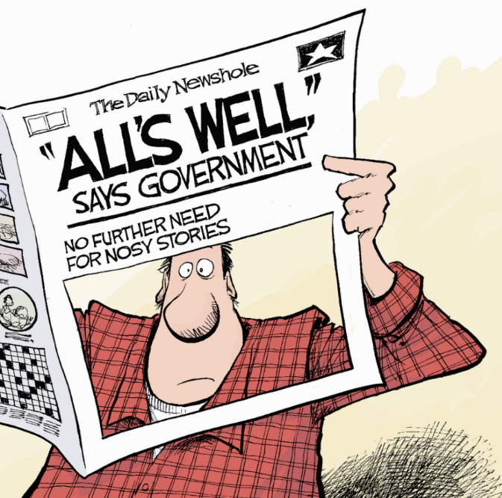
III. Government Transparency Laws
Economic Interest Disclosure
Under The Political Reform Act
Brown Act
Public Records Act

Slide 54
III. Government Transparency Laws
Public Policy Considerations
Economic Interest Disclosure. Public has right to know public officials’ economic interests that may affect their official decisions
Right to Access/Information. People have a right to access information that enables them to monitor the functioning of government.
Brown Act. The people have a right to be informed about the conduct of their business, and for deliberations to be conducted and actions to be taken openly (absent an exception).

Slide 55

III. Government Transparency Laws
Economic Interest Disclosure
Under the Political Reform Act
A Form 700 must be filed by enumerated public officials including those listed in an agency’s Conflict of Interest Code
Filed upon taking office, leaving office, and on an annual basis
Requires disclosure of personal financial interests
It’s a public document!

Slide 56
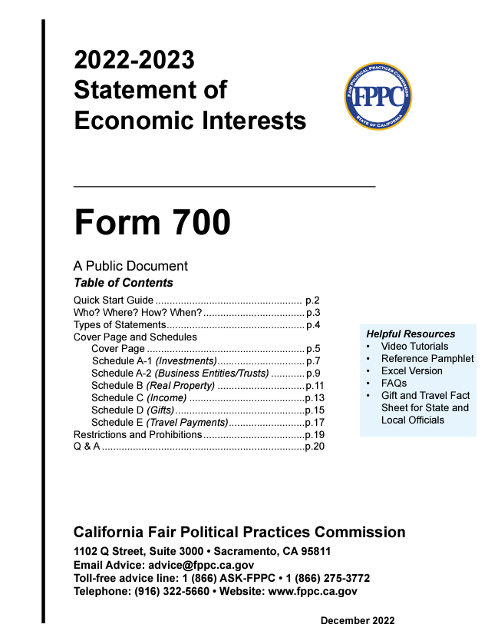
III. Government Transparency Laws
Form 700
Key Points
Not required to list primary home
Remember to list spousal income
Assuming and Leaving Office

Slide 57
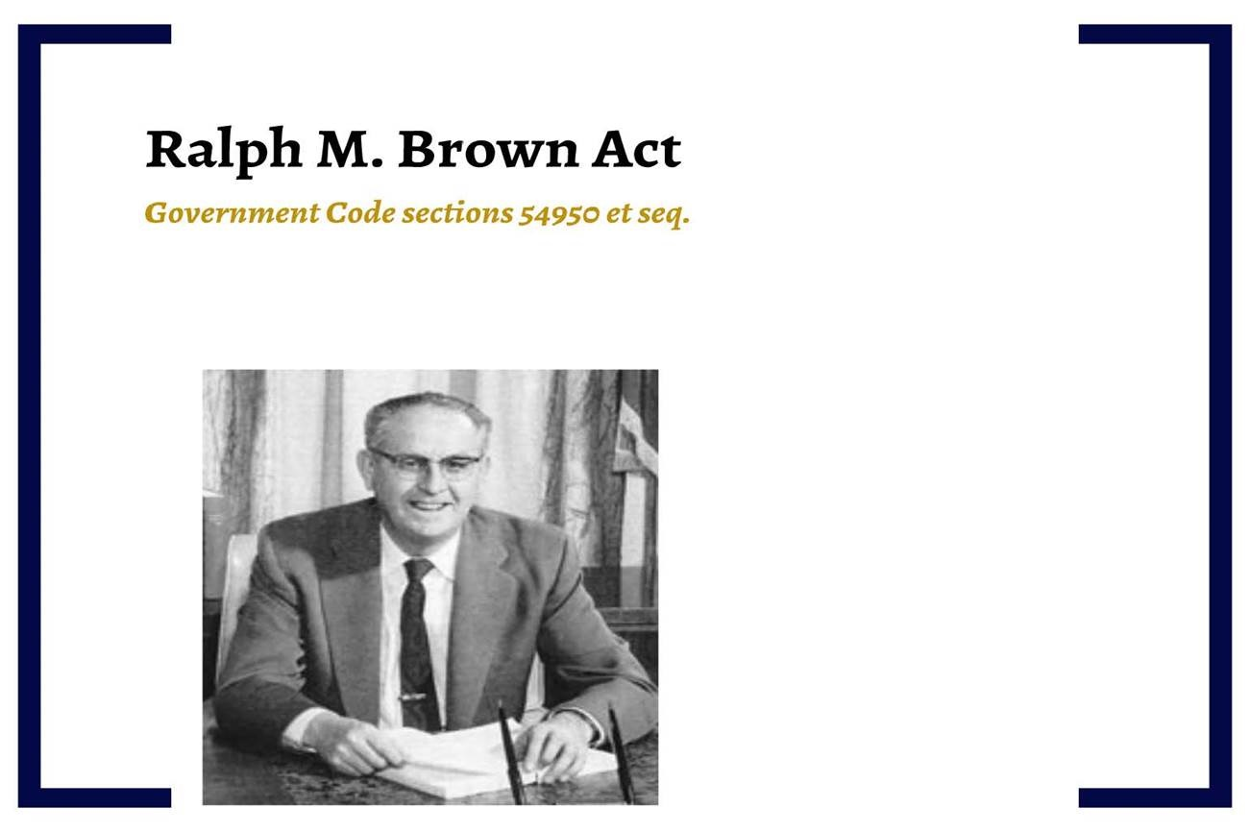
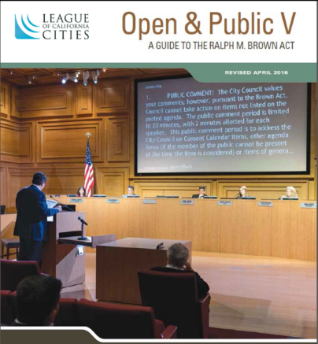
III. Government Transparency Laws

Slide 58
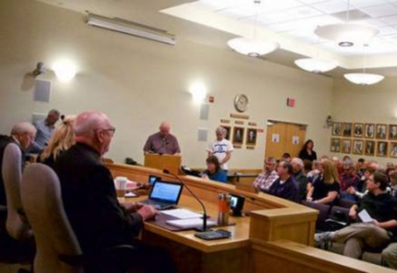
III. Government Transparency Laws
B. Brown Act
Open Meeting Requirements
Meetings of Legislative Bodies shall be open and public

Slide 59
III. Government Transparency Laws
Legislative Bodies
What is a
legislative body?
Governing body
Appointed body
Standing committee
What is not a legislative body?
Ad Hoc Committee
if comprised
of less than
a quorum

Slide 60
III. Government Transparency Laws
B. Brown Act Definition of Meetings
A congregation of a majority of the members at the same time and place to hear, discuss, or deliberate on an item of business within the agency’s subject matter jurisdiction
Exceptions:
Conferences Community meetings Social or ceremonial occasions | Individual contacts Standing committees Meetings of other legislative bodies

Slide 61

III. Government Transparency Laws
B. Brown Act—Avoiding “Serial Meetings”
A majority may not, outside a meeting, use a series of communications to discuss, deliberate, or take action on any item of business
Does not prevent employees and officials from engaging in separate conversations outside of a meeting provided that the comments or positions of other members
are not communicated

Slide 62

III. Government Transparency Laws
B. Brown Act—Avoiding “Serial Meetings”
Examples
Hub and Spoke
A staff member (the hub) communicates with members
of a legislative body (the spokes) one-by-one for input on a proposed action and in the process reveals members’ positions to other members in advance of the meeting.

Slide 63

III. Government Transparency Laws
B. Brown Act—Avoiding “Serial Meetings”
Examples
Daisy Chain
Member A contacts Member B, Member B contacts Member C, Member C contacts Member D and so on, until a quorum has discussed, deliberated or taken action on an item within the legislative body’s subject matter jurisdiction.

Slide 64
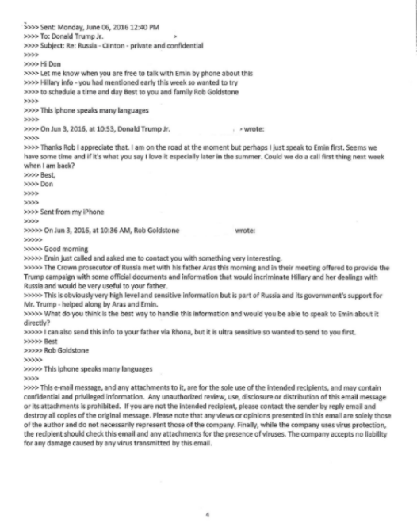
III. Government Transparency Laws
B. Brown Act—Avoiding “Serial Meetings”
Examples
Emails
Informal nature of email communication is ripe for inadvertent Brown Act violations.

Slide 65


III. Government Transparency Laws
B. Brown Act—Avoiding “Serial Meetings”
AB 992 (Social Media)
Amends Government Code section 54952.2 to clarify that most communications on social media are permissible.
Bright-line rule: Members of a legislative body may not respond directly
to any communications posted on the internet by other members of the same legislative body regarding a matter within the jurisdiction of the legislative body.
Careful with digital icons, i.e. emoji's
in discussions on social media.

Slide 66

III. Government Transparency Laws
B. Brown Act
Closed Sessions
Closed session discussions are confidential
Required to publicly report certain actions taken
in closed session
Permissible Closed Session Topics:
Real estate negotiations Pending or threatened litigation Initiation of litigation | Personnel Labor negotiations Public security

Slide 67

III. Government Transparency Laws
B. Brown Act
May take action only on items on posted agenda
Posting requirements: | Exceptions:
Regular meetings must be posted 72 hours before meeting Special meetings must be posted 24 hours before meeting | Emergency Urgent → need for immediate action came to agency’s attention after posting the agenda

Slide 68
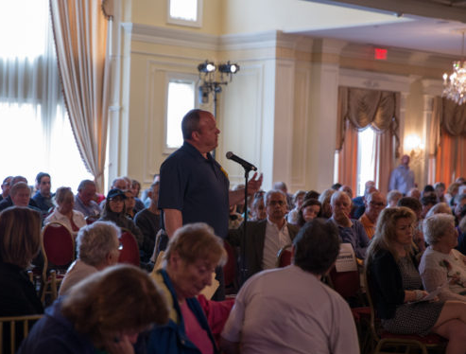
III. Government Transparency Laws
B. Brown Act
Public Participation Rights
Regular meetings must provide an opportunity for
the public to speak regarding any matter within the
body’s jurisdiction
  Legislative body may briefly discuss these items
  and refer matters to staff, but cannot take action
Public can address the legislative body on matters on the agenda before or during consideration of the item

Slide 69

III. Government Transparency Laws
B. Brown Act
Public Participation Rights
Public has the right to make audio/video recordings

Slide 70

III. Government Transparency Laws
B. Brown Act
SB 1436
Requires an oral report in open session summarizing the recommendation to adjust the compensation of any “local agency executive” before action is taken.
© Meyers Nave 2023

Slide 71

III. Government Transparency Laws
B. COVID-19 Changes to the Brown Act
Agenda posted at all locations, with teleconference locations specifically identified
All locations open to the public with public participation possible at each location
At least quorum of legislative body member must participate from locations within
city boundaries
Roll call votes only

Slide 72

III. Government Transparency Laws
B. Teleconference — Traditional Rules
AB 361
Public must be able to offer comment in
real time
What happens if technology fails?
No further action allowed until public access to the meeting is restored

Slide 73
III. Government Transparency Laws
AB 2449
Provides alternative teleconference procedures
At least a quorum of the legislative body must participate in person from a singular physical location identified on the agenda, which location will be open to the public and within the boundaries of the local agency;
A member may only teleconference for publicly disclosed "just cause" or in "emergency circumstances" approved by the legislative body; and
A member may only teleconference for a limited number of meetings.
Notes:
Note: don’t think Council needs to facilitate 2449 participation, will likely ask the council how to handle

Slide 74

III. Government Transparency Laws
AB 2449
Qualifying Circumstances:
"Just cause" means: (1) childcare or caregiving need;
(2) contagious illness; (3) physical or mental disability
needs; or public official business travel.
"Emergency circumstances" means a physical or family
medical emergency.
3 consecutive months or 20% of regular meetings per calendar year if body meets less than 10 times per year.
Of this limit, “just cause” can only be used twice per year.

Slide 75
III. Government Transparency Laws
AB 2449
Public must be able to offer comment in real time
What happens if technology fails?
No further action allowed until public access to the meeting is restored

Slide 76
III. Government Transparency Laws
C. Consequences for Violating the Brown Act
Nullification of a decision made in violation of the Brown Act’s requirements;
Criminal penalties;
A possible award of attorneys’ fees to the party successfully bringing a Brown Act lawsuit;
Loss of public confidence.

Slide 77
Quiz

Slide 78

Question 6:
The City Council establishes a standing committee of two of its five members,
which meets monthly.
A third Councilmember wants to attend
these meetings and participate.
    1. May they
    attend?
    2. Is this a Brown
    Act violation?
© Meyers Nave 2023

Slide 79
Answer to Question 6:
Yes, they may attend an open and noticed meeting of a standing committee of the City provided that they attends only as an observer and do not participate in the deliberations.
Attending the standing committee is not a violation of the Brown Act. However, if they participate in the discussions then it would be a violation.

Slide 80
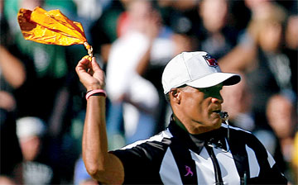
Question 7:
A Councilmember e-mails a newspaper article pertaining to an upcoming agenda item to the other four Council members.
The Councilmember indicates support for the agenda item based on the article and three members respond back to the email and indicate that they also support the item and that the information was very helpful.
Was this a Brown
Act violation?
© Meyers Nave 2023

Slide 81
Answer to Question 7:
Yes, the Councilmembers participated in a discussion of an item within the jurisdiction of the body that was not noticed, open or public.

Slide 82

Question 8:
During public comment for items not listed on the agenda, a speaker requests that the City Council write a letter of support on behalf of his cause.
The City Council proceeds to vote on writing the letter and it passes unanimously.
Was this a Brown
Act violation?
© Meyers Nave 2023

Slide 83
Answer to Question 8:
Yes, the City Council has taken action on an item that was not noticed on the agenda. Before taking action, the City Council should have directed staff to put the item on the agenda for a future City Council meeting for consideration/action.
Notes:
DA or any person may begin action 54960.5
Action brought pursuant to 54960 or 54960.1 where it is found that local agency has violated this chapter
Reasonable attorneys fees
Defendant can receive award of reasonable attorneys fees if defendant has prevailed in final action and court finds that the action was “clearly frivolous and totally lacking in merit”

Slide 84

III. Government Transparency Laws
C. Public Records Act
Transparency
Privacy

Slide 85
III. Government Transparency Laws
C. Public Records Act
Basic Rule
All non-exempt, state and local government agency records in any form or medium are subject to public inspection during office hours or copying upon payment of duplication costs.
Record
Defined
Broadly
Any tangible thing containing information relating to the conduct of the public’s business prepared, owned, used, or retained by any state or local agency regardless of physical form or characteristics.

Slide 86
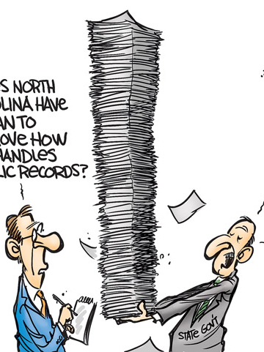
III. Government Transparency Laws
C. Public Records Act
Duty to Assist Requestors
Agencies are required to:
Assist requestors with identifying records and information that are responsive to requests or to the purpose of the requests.
Describe the information technology and physical location in which the records exist.
Provide suggestions for overcoming any practical basis for denying access to the records or information sought.

Slide 87

III. Government Transparency Laws
C. Public Records Act
Exemptions
Drafts
Pending litigation
Personnel records
Medical, dental, and other insurance records
Closed session minutes and legal memoranda and other materials distributed in a closed session
Records protected by the attorney-client privilege

Slide 88

III. Government Transparency Laws
C. Public Records Act
Emails and text messages about public business on personal phones, devices, or accounts.
CA Supreme Court held that these records are subject to disclosure in response to a Public Records Act request.
(City of San Jose et al. v. Superior Court)

Slide 89
III. Government Transparency Laws
C. Public Records Act
SB 1421 and SB 16
Certain police records subject to disclosure:
1) Officer involved shootings; 2) Incidents resulting in great bodily injury/death; 3) Sexual assault; 4) Dishonesty; 5) Excessive Force; 6) Discrimination; 7) Unlawful Arrest/Search
AB 748
Video and audio footage of officer involved shootings and incidents resulting in great bodily injury/death

Slide 90
Quiz

Slide 91

Question 9:
Over the course of several years, two Councilmembers exchanged emails about a property in the City with numerous delinquent payment issues. They exchanged no other emails.
All the emails were sent to and from their private email accounts, which the Councilmembers use for City business.
A member of the public asks the City for all emails between the two Councilmembers.
How should the
City respond?
© Meyers Nave 2023

Slide 92
Answer to Question 9:
The Supreme Court held that emails about public business exchanged between private email addresses on private devices are public records.
City of San Jose v. Superior Court.
Notes:
The mechanism for obtaining those records is not yet totally clear

Slide 93

IV. Laws Relating to Fair Processes
Common Law Bias Prohibitions
Due Process Requirements
Doctrine of Incompatible Offices and Incompatible Activities
Disqualification From Participating
in Decisions Affecting Family Members
(Anti-nepotism Laws)
Competitive Bidding Requirements for
Public Contracts

Slide 94
IV. Laws Relating to Fair Processes
Common Law Bias Prohibitions
Elements:
  A public officer…
  Must exercise the powers conferred on him or her with disinterested skill, zeal, and diligence, and primarily for the benefit of the public
One cannot be tempted by personal or pecuniary interests
Applies to non-financial interests
Disqualifies one from participating

Slide 95

IV. Laws Relating to Fair Processes
Due Process Requirements
Applies only to “quasi-judicial” matters (i.e., those involving the application of existing rules to a specific set of facts)
“Procedural due process” gives those with a property interest a right to:
  Notice and opportunity to be heard by a fair and impartial decision maker

Slide 96

IV. Laws Relating to Fair Processes
Doctrine of Incompatible Offices
Government Code § 1099
Elements
A person may not hold two public offices simultaneously
If the potential for conflict or overlap in the functions or responsibilities in the office exist
Forfeiture of first office
Often requires individual analysis of specific offices
Common law rule often overridden by statue

Slide 97

IV. Laws Relating to Fair Processes
Incompatible Activities
Elements (Gov’t Code § 1126):
Agency officers and employees shall not engage in any employment, activity, or enterprise for compensation which is inconsistent, incompatible, in conflict with, or inimical to his or her duties

Slide 98

IV. Laws Relating to Fair Processes
Anti-Nepotism Laws and Policies
Disqualification from participating in decisions affecting family members (anti-nepotism laws)
Political Reform Act requires recusal when decisions have a material impact on one’s spouse or dependent children.
Common law bias will require recusal in many cases.

Slide 99
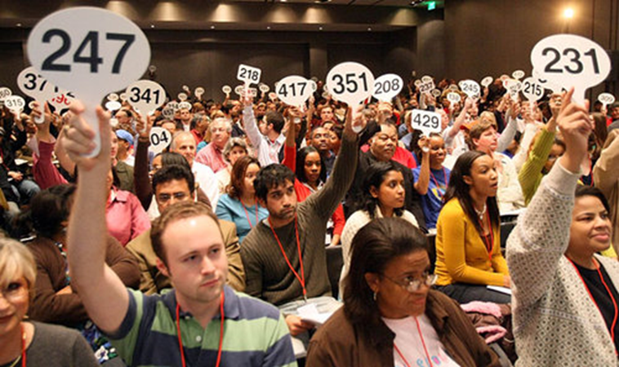
IV. Laws Relating to Fair Processes
Competitive Bidding Requirements
Public works projects above a certain amount must be awarded to lowest responsible bidder
Generally, applies only to construction projects

Slide 100
IV. Laws Relating to Fair Processes
Not to protect bidders
Guards against favoritism,
fraud, and corruption
Prevents waste of
public funds
Seeks to obtain best economic result for the public
Competitive Bidding
Requirements
PURPOSES

Slide 101
Quiz

Slide 102

Question 10:
A Councilmember’s best friend is applying for a City grant program.
There are limited funds and the City received dozens of applications.
The Councilmember knows that their best friend will be very upset if they does not vote for the application and it could affect their relationship.
    Can the Councilmember participate in the decision to award the grant?
© Meyers Nave 2023

Slide 103
Answer to Question 10:
It depends.
If, despite the personal relationship, the Councilmember can exercise their powers with disinterested skill, zeal, and diligence, and primarily for the benefit of the public, then the Councilmember may participate in the decision. If the Councilmember believes that the personal relationship would affect their ability to exercise their duties impartially, then the Councilmember may have a common law conflict of interest and recusal is appropriate.

Slide 104

Question 11:
A council member of the East Apple City Council is elected to the Apple County Board of Supervisors.
May the individual serve in both roles?
© Meyers Nave 2023

Slide 105
Answer to Question 11:
No.
These are incompatible offices.
There is a possibility of a significant clash of duties between the
two offices.
Upon being sworn into the Board of Supervisors, the council member will be deemed to have vacated the position on the
City Council.

Slide 106
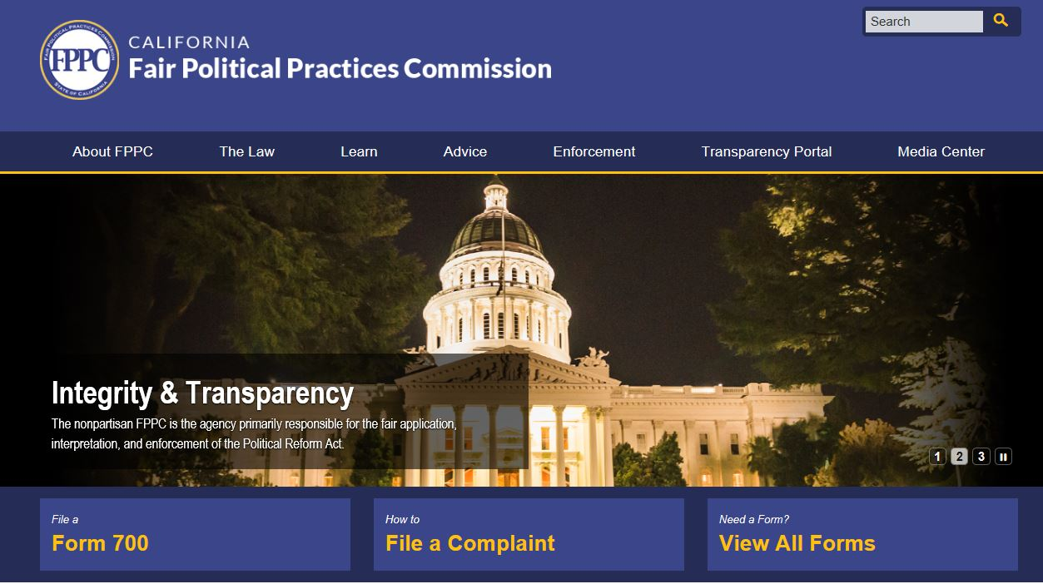
Questions
Contact the FPPC
Toll-free advice line:
1 (866) ASK-FPPC
Email advice: advice@fppc.ca.gov

Slide 107
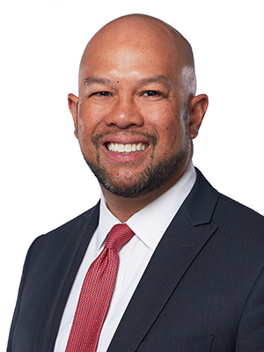
Presenter
Richard D. Pio Roda
Principal
rpioroda@meyersnave.com
1999 Harrison Street, 9th Floor
Oakland, CA 94612
Phone: 510.808.2000
www.meyersnave.com

