Slide 1
ACHD ANNUAL MEETING ADVOCACY STATE OF THE ASSOCIATION

Slide 2
Important Deadlines

Slide 3
California Budget
Deficit: $33.5 B, up from $22.5B in the fall.

Slide 4
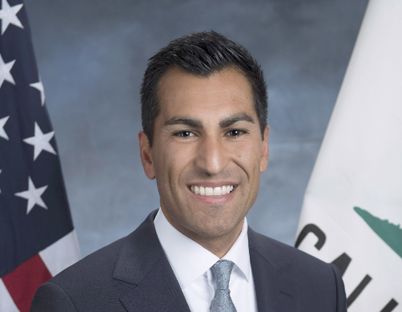
Changes in Leadership
Assemblymember Robert Rivas
Senator Mike McGuire

Slide 5
Physician Employment Bills-
AB 242- Eliminates the sunset on the Critical Access Hospital (CAH) physician employment pilot program. - Enrolled
SB 784- Would allow district hospitals to directly employ physicians. – 2-year bill. Eligible to move in January.

Slide 6
AB 557 (Hart) ENROLLED
Would allow local agencies to continuing to use the teleconferencing protocol in place from the pandemic.

Slide 7
AB 1484 (Zbur) - ENROLLED
Would prevent public providers covered under a collective bargaining agreement from utilizing temporary employees.
Senate Floor
ACHD brokered amendments with SEIU to clarify staffing agency employees are not included unless PERB process (as exists in current law) has deemed them single or joint employers.

Slide 8
AB 869 (Wood) 2-YEAR
Would offer relief to qualifying small, rural, and public district hospitals with regard to meeting the Hospital Seismic Safety Act 2030 deadline.
The bill would extend the deadline to 2035 and every two years until funding becomes available.

Slide 9
SB 799 (Portantino) ENROLLED
Gut & Amended on 8/22/2023
Would provide employees who remain on strike for more than two weeks with Unemployment Insurance (UI) benefits, thus requiring employers (via UI) to fund ongoing labor disputes.
Conference Committee
ACHD Oppose

Slide 10
SB 525 (Durazo)- ENROLLED
Was amended 9/11/2023
Will be eligible to be heard at 4:53 pm on 9/14/2023
Recent amendments reflect industry wide deals between: CHA, CPCA, Dialysis and SEIU.
The bill now established 3 minimum wage schedules based on covered employer type

Slide 11
SB 525 Continued
Contracts/Contractors/Subcontractors:
- Has been narrowed
- Covered employer must directly or indirectly have control over wages, hours or working conditions.
Exempt Employees:
- Salary shall be no less than 150% of health care worker minimum wage or 200% of applicable minimum wage, whichever is greater.

Slide 12
Wage Tier 1:
Covered employers with 10,000 or more full time employees, Dialysis Clinics, and any County with a population over 5 million
June 1, 2024: $23 per hour
June 1, 2025- $24 per hour
June 1, 2026- $25 per hour

Slide 13
Wage Tier 2:
Primarily rural health and community clinics as specified:
June 1, 2024- May 31, 2026- $21 per hour
June 1, 2027- $22 per hour
June 1, 2027- adjusts by 3.5% until $25

Slide 14
Wage Tier 3:
Rural hospitals and providers as defined, high government payer mix, county population less than 250,000.
June 1, 2024 – May 31, 2023- $18 per hour, with 3.5% adjuster annually.

Slide 15
For all other providers
June 1, 2024-May 31, 2026 - $21 per hour
June 1, 2026- May 31, 2028- $23 per hour
June 1, 2028- adjusted by 3.5% until $25

Slide 16
Other Bills of Note: Oppose
SB 399 (Wahab): Would prohibit employer speech regarding religious and political matters, including unionization. – 2-YEAR
SB 504 (Reyes): Would allow for sympathy strikes for public employees- ENROLLED
SB 1156 (Bonta): Would create a workers’ compensation presumption for hospital employees including infectious disease, cancer, musculoskeletal injury and PTSD. – 2-YEAR.

