Slide 1
The Journey to Drive Trust, Engagement, and Quality Performance
Alex MacLennan, PHR
Chief Human Resources Officer
Tahoe forest Hospital District

Slide 2
Previous Culture Challenges
2014 – 59th percentile of employee engagement
2017
Engagement score put us in the 63th percentile nationally.
Response rate of 51%
Feedback stated a perception of no anonymity
Lack of trust between employees and management
Disciplinary meetings
Something needed to change.
Continuing just culture path…. but additional support was needed.

Slide 3
Just Culture and High Reliability
What is it?
A method in which organizations are accountable for the systems they have designed, and responding to the behaviors of their employees in a fair and just manner.
Expectations
Judge the system before the employee
Remove biases
Improve systems
Believe the best of employees. We are in healthcare!

Slide 4
Understanding Just Culture
Just Culture emphasizes the fair and just approach to managing human errors and system failures.
It distinguishes between unintentional human errors, at-risk behavior, and reckless behavior to determine appropriate responses.
Discipline when the situation calls for it.
System changes when they are not working.

Slide 5
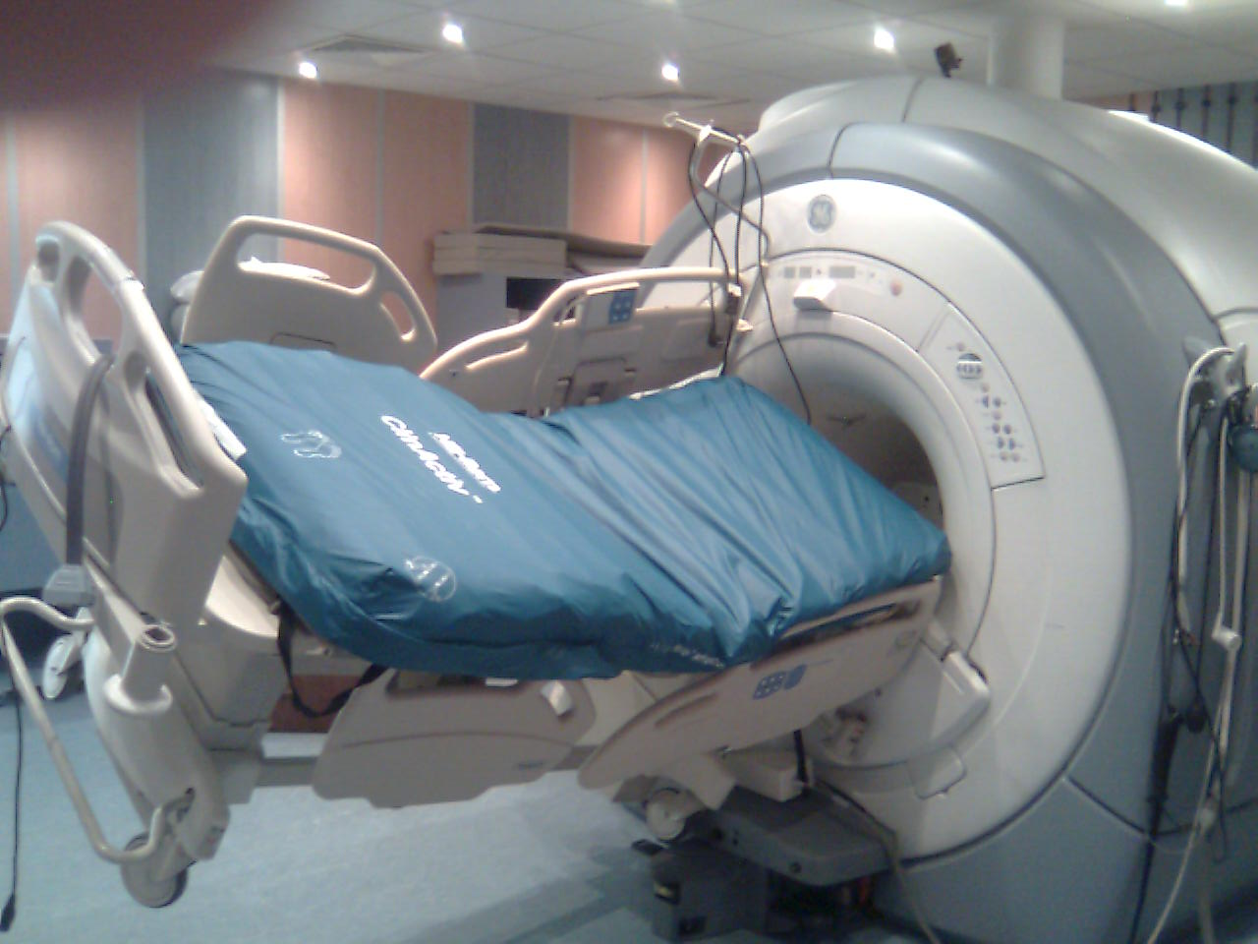
Benefits of Just Culture in Healthcare
Open Communication
Learning from Mistakes
Retaining Trust
Reduced Fear of Reporting
Identifying Systemic Issues
Notes:
Open Communication: Just Culture encourages open reporting of errors and near-misses, leading to a more transparent culture where issues can be addressed promptly.
Learning from Mistakes: By focusing on learning rather than blame, healthcare professionals are more likely to report errors and contribute to a culture of continuous improvement.
Retaining Trust: When healthcare professionals feel supported rather than punished for errors, trust within the organization improves.
Reduced Fear of Reporting: Fear of retribution can prevent error reporting, but Just Culture mitigates this fear, leading to increased reporting and insights into potential risks.
Identifying Systemic Issues: Understanding the real causes of errors helping to identify and rectify underlying system issues, making the healthcare system safer overall.

Slide 6
Understanding High Reliability
High Reliability refers to a commitment to safety and error prevention in complex and hazardous environments like healthcare.
Key characteristics include a preoccupation with failure, reluctance to simplify, sensitivity to operations, commitment to resilience, and deference to expertise.
The focus is on reducing errors, preventing harm, and creating a robust system that can withstand potential failures.
Notes:
It is a way to look at risk differently
preoccupation with failure – Meaning - For example, when nurses conduct a high-risk iv medication double check, the second nurse should assume the first nurse made a mistake, hunt for it, and correct it, rather than assume the intravenous pump is working or programmed properly and the medication is right.
Reluctance to simplify - common and convenient response to a problem – Putting up a sign that says do not harm yourself on the equipment.
sensitivity to operations – Keeping the larger picture in mind so that you can see potential future errors.
commitment to resilience – commitment to Building and maintain resilient systems, This commitment also means responding the right way when errors occur
deference to expertise – Using expertise from all areas, when things go wrong. So basically, asking the right people about challenging situations and trusting their answers

Slide 7
Benefits of High Reliability in Healthcare
Improved Patient Safety
Reduced Medical Errors
Enhanced Quality of Care
Efficient Resource Utilization
Increased Staff Engagement and reporting errors
Improved Reputation
Notes:
Improved Patient Safety: High Reliability principles minimize errors and prevent adverse events, leading to a safer environment for patients.
Reduced Medical Errors: By promoting a culture of vigilance and continuous improvement, medical errors are reduced, thus decreasing potential harm.
Enhanced Quality of Care: A culture that emphasizes reliability results in consistently high-quality care and better patient outcomes.
Efficient Resource Utilization: Fewer errors mean less waste of resources on rectifying mistakes, enabling the efficient use of healthcare resources.
Increased Staff Engagement: Empowered and engaged staff, who actively participate in safety initiatives, contribute to a positive work environment.
Improved Reputation: Organizations with a strong focus on reliability earn a reputation for safe and quality care, attracting more patients and talented healthcare professionals.

Slide 8
The Synergy of High Reliability and Just Culture
High Reliability and Just Culture complement each other to create a comprehensive culture of safety and quality in healthcare.
High Reliability focuses on building robust systems and processes, while Just Culture ensures a fair and supportive approach to handling errors and learning from them.
Notes:
Both are important to building trust, while also improving outcomes or preventing bad outcomes

Slide 9
Identifying the Issue
Human Error: An inadvertent action; inadvertently doing something other than what should have been done; slip, lapse, mistake
At-Risk Behavior: A behavioral choice that increases risk where risk is not recognized. Or is mistakenly believed to be justified.
Reckless Behavior: A behavioral choice to consciously disregard a substantial and justifiable risk.
Based on choice, not outcome

Slide 10
Drift

Slide 11
Drift

Slide 12
Risk is Everywhere
Recognize the risks that systems are trying to mitigate
Build resilient systems
Teach about the risks, not just the system.
Failures are going to happen! Zero is not attainable!
Notes:
Resilient systems
Are they resilient to mechanical failure
Are they resistant to human performance
Human behavior
Do they require a high level of knowledge?
Do they have redundancies or capture opportunities?
Teach to the risks!
Failures will happen. You may as well have a good culture in place to address when things go wrong.
What have we seen over the journey to high reliability and Just culture

Slide 13
Steps for Successful Implementation
Leadership Commitment
Training and Education
Creating Reporting Mechanisms
Analyzing Data
Continuous Improvement
Notes:
Leadership Commitment: Strong leadership support is crucial for successfully implementing High Reliability and Just Culture principles.
Training and Education: Provide training to staff on High Reliability and Just Culture concepts, emphasizing the importance of reporting errors and near-misses.
Creating Reporting Mechanisms: Develop easy-to-use reporting systems to encourage staff to report errors without fear of retribution.
Analyzing Data: Regularly analyze reported data to identify trends, systemic issues, and areas for improvement.
Continuous Improvement: Act on the insights gained from data analysis to continuously improve safety and quality.
Implementing High Reliability and Just Culture in healthcare is a powerful approach to improve patient safety, enhance quality of care, and foster a culture of learning and accountability.
By working together, healthcare organizations can create an environment where errors are seen as opportunities for improvement, leading to better outcomes for patients and healthcare professionals alike.

Slide 14
Value Advocates
It all began with low response rate…
What is it now and how has it helped?
Notes:
What is it? –
How has it helped
Myth Busters
Rumor control
Idea generation
Idea generation when trying to solve something
Advocating for the health system
Trust building
Do what employees want/think is valuable
Help with events
New projects
Tahoe forest Treat trail,
Shout out page
Employee spotlight

Slide 15
Important to Implementation
Chose the right employees
Build and stick with a group charter
Stay Active and Appropriate Funds
Allow employees to create the agenda and lead the conversation
Notes:
Chose the right employees
Employee Cheerleaders
Diverse work backgrounds
Do’ers
Build and stick with a group charter
Term
Expectations and Roles
Attendance
Executive Leadership Sponsor
Stay Active and Appropriate Funds
Allow employees to create the agenda and lead the conversation

Slide 16
Peer Support
Healthcare workers see and hear about some crappy things
What is it?
Peer Support is not…
Notes:
Healthcare workers see and hear about some crappy things
They don’t want to go home and unload onto their families
Many think they have to “Suck it up” – and sometimes that is the case
It is not just nurses and doctors.
What is it?
Group of trained employees, at all levels, on how to talk with people that are going through difficult situations.
Know the resources available. Good listeners
What peer supporters is not
Social workers
Psychiatrists
Also Peer support does the sunshine cart.

Slide 17
Important to Implementation
Choose the Right Employees
Educate the Peer Supporters
Build and Stick with a Charter
Stay Active and Allot funds
Notes:
Chose the right employees!
Application Process
Compassionate
Good listeners
Educate before you put people out there
Really important to make sure they know what their role is.
Build and stick with a charter
Term
Expectations
Leadership Sponsor
Ongoing practice and Trainings
log when you are deployed
Stay Active and dedicate some funds

Slide 18
In Conclusion
2022 – 92% of Engagement
response rate of 83%
Fewer disciplinary meetings.
Trust indicators with employees has increased.
Relations with Unions is great!
Social events now create meaningful and better connections.
Employees feel valued.
More recognition of benefits.

Slide 19
Questions

