Slide 1
Civility in Local Government:
The People’s Business and the Limits of Public Comment

Slide 2
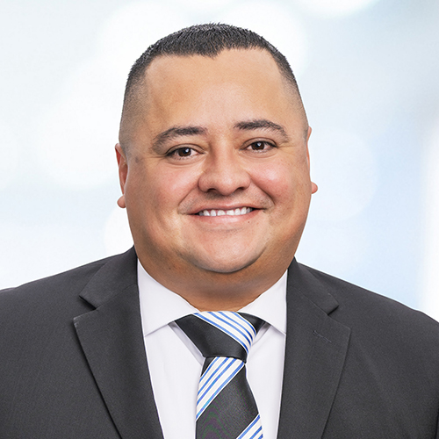
Presenter
Henry Castillo
Associate
Henry.Castillo@bbklaw.com
(909) 238-7117
Henry G. Castillo gained first-hand knowledge of the legislative process on a variety of public policy issues from his years serving elected officials at the state level. As a Municipal Law attorney at Best Best & Krieger LLP, he brings that valuable experience and insight to his local public agency clients. Henry advises clients on a multitude of legal areas, including conflict of interest, the Brown Act, local elections laws, constitutional law issues, public contracting and some labor and employment issues. Henry advises both municipal and special district clients.

Slide 4
Overview
History of the Brown Act
Purpose of the Brown Act
Right to Access/Public Comment
Limits of Public Comment
Mitigating Disruptive Conduct
Disruptive Meetings
Best Practices
Dealing with Specific Types of Disruptions by Members of the Public

Slide 5
The Ralph M. Brown Act
In late 1951, San Francisco Chronicle reporter Mike Harris spent six weeks looking into the way local agencies conducted meetings. State law had long required that business be done in public, but Harris discovered secret meetings or caucuses were common. He wrote a 10-part series on “Your Secret Government” that ran in May and June 1952.

Slide 6
The Ralph M. Brown Act
Out of the series came a decision to push for a new state open meeting law.
Assembly Member Ralph M. Brown carried legislation.
The “Brown Act”, has evolved under a series of amendments and court decisions, and has been the model for other open meeting laws—such as the Bagley-Keene Act, enacted in 1967 to cover state agencies.

Slide 7
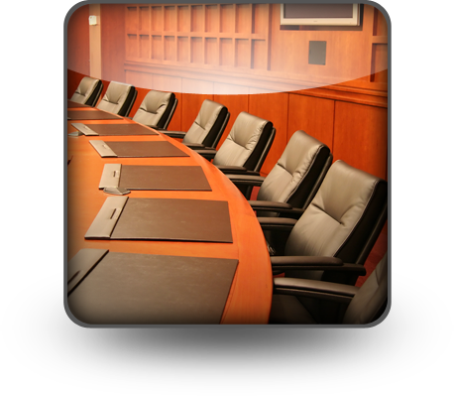
Purpose of Brown Act
To ensure that almost all aspects of the decision-making process of legislative bodies of local agencies are conducted in public and open to public scrutiny.
“The people, in delegating authority, do not give their public servants the right to decide what is good for the people to know and what is not good for them to know. The people insist on remaining informed so that they may retain control over the instruments they have created.” (Gov. Code 54950.)

Slide 8
The Right to Access
Two key parts of the Brown Act have not changed since its adoption in 1953:
“In enacting this chapter, the Legislature finds and declares that the public commissions, boards and councils and the other public agencies in this State exist to aid in the conduct of the people’s business. It is the intent of the law that their actions be taken openly and that their deliberations be conducted openly.”
“The people of this State do not yield their sovereignty to the agencies which serve them. The people, in delegating authority, do not give their public servants the right to decide what is good for the people to know and what is not good for them to know. The people insist on remaining informed so that they may retain control over the instruments they have created.”

Slide 9
California Health Care District Law
Health and Safety Code section 3200 et. seq.
Section 32106 provides that except as provided in the Ralph M. Brown Act (Gov. Code section 54950 et. seq.) all of the sessions of the board of directors, whether regular or special, shall be open to the public…

Slide 10

The Right to Public Comment
  At every regular meeting, members of the public have the right to directly address the body on any item of public interest if that item is under the jurisdiction of the body.
  For agenda items, the public must be given an opportunity to comment before or during the body’s consideration of the item.
  At special and emergency meetings, members of the public have the right to address the body about any item that is listed on the agenda.

Slide 11
The Right to Public Comment
Citizens have an enormous first amendment interest in directing speech about public issues to those who govern
Reasonable regulations (i.e. amount of time) permissible
Cannot prohibit “public criticism of the policies, procedures, programs, or services” of the District, or the acts or omissions of the legislative body”

Slide 12
The Right to Public Comment
Public comments on general policies or services provided by the District, or on the nature of any Board member’s acts or omissions, must always be allowed unless the commenter is, through their conduct, creating an actual disturbance of the meeting
Disruptions must be managed consistent with First Amendment Principles
Court have concluded that Board meetings are limited public forum for purposes of First Amendment analysis

Slide 13
Limits on Public Comment
Limited Public Forum
  The Ninth Circuit has explained that [local governments] may “regulate not only the time, place, and manner of speech in a limited public forum, but also the content of speech – as long as content-based regulations are viewpoint neutral and enforced that way.”
  The [local government] may “close an open meeting by declaring that the public has no First Amendment right whatsoever once the public comment period has closed.”

Slide 14
Limits on Public Comment
A [local government] may NOT extinguish all First Amendment rights at a public meeting
A member of the public may not be ordered removed from a meeting merely for making an inflammatory gesture, such as a “Nazi salute” unless this conduct is actually disruptive

Slide 15
Disruptions at Public Meetings
Courts have emphasized that [local governments] are not free to define “disruption”
Courts have explained that “disruptions mean an actual disruption”.
It does not mean constructive disruption, technical disruption, virtual disruption, nunc pro tunc disruption, or imaginary disruption

Slide 16
What is actual disruption?
Behavior Considered Disruptive | Behavior Not Considered Disruptive;
Exceeding the allotted time to speak | A silent Nazi salute to the board, i.e., a silent act of protest that went largely unnoticed by the meeting participants, until singled out by an offended board member
“Excessive” profanity and slander (must rise to the level of disrupting the Board’s ability to conduct its business) | Personal attacks against individual board members, even if it appears off-topic, as this is considered political speech protected by the Constitution
Speaking without first being recognized by the Mayor/presiding officer (for instance, yelling things out from the audience) | Profanity alone, without the additional element of a “disruption” to the meeting
Specific, credible threats to the Board, members of the public, or themselves | Criticism of Board policies, or District employees or officials, whether valid or entirely unfounded
Inciting violence or using “fighting words”
Encouraging members of the audience to disrupt the meeting (i.e., by applauding), when the meeting is actually disrupted
Yelling and speaking out of order to an extent that it hinders another member of the public from addressing the legislative body

Slide 17
Regulating Disruptions at Public Meetings
In applying rules prohibiting disruptions at meetings, the requirements of viewpoint neutrality is critically important
Courts have invalidated orders that individuals be removed from meetings where the courts concluded that the actions were based on viewpoints of the speakers, or speech offended the sensibilities of the public officials
First Amendment principles limit the circumstances in which a body may order a member of the public removed from a meeting for behavior the body deems disruptive

Slide 18
Taking Control of Disruptive Meetings
Orderly conduct of public meetings protects the right to free speech
Freedom of everyone to talk at once can destroy the right of anyone to effectively talk at all
If any public participation is permitted the rules regulating who may speak cannot be used to silence a participant merely because their views happen to be unpopular with the audience or with the government sponsors of the meeting

Slide 19
Taking Control of Disruptive Meetings
Must apply all rules of decorum equally.
To withstand scrutiny under the First Amendment, the City must apply its rules of decorum equally to all content addressed to the Council. For instance, if the Council applied a rule to one content (or subject matter), and not the other, then an adversely impacted community member could reasonably contend that even though a rule on its face was viewpoint neutral, the Council is violating the First Amendment as applied because the Council is choosing to favor one view over the other by stifling speech on that subject (which is viewpoint discrimination).

Slide 20
Mitigating Disruptive Meetings
SB 1100
  A bill designed to address disruptions at public local government meetings
  SB 1100 prescribes the following process for removal:
    Warn the individual that their behavior is disrupting the meeting and their failure to cease their behavior may result in removal
    Remove the individual if they do not “promptly” cease their disruptive behavior
  Under existing law, and as interpreted by the courts, a city council may adopt rules governing the conduct of their public meetings and allow for the removal of a person who makes slanderous, profane, or threatening remarks or engages in any other disorderly conduct that disrupts the meeting
  If there is no disruption, there cannot be a removal

Slide 21
Mitigating Disruptive Meetings
SB 1100
  A bill designed to address disruptions at public local government meetings
  SB 1100 prescribes the following process for removal:
    Warn the individual that their behavior is disrupting the meeting and their failure to cease their behavior may result in removal
    Remove the individual if they do not “promptly” cease their disruptive behavior
  Under existing law, and as interpreted by the courts, a city council may adopt rules governing the conduct of their public meetings and allow for the removal of a person who makes slanderous, profane, or threatening remarks or engages in any other disorderly conduct that disrupts the meeting
  If there is no disruption, there cannot be a removal

Slide 22
Consequences for Disrupting a Meeting
**Take a recess and speak to the individual
Penal Code section 403
  Makes it a misdemeanor to willfully disturb or break up a lawful assembly or meeting unless the person has legal authority to do so
  Actually impair the ability of the body to effectively conduct its meeting
Removal from meeting
  For the agenda item or for the whole meeting?
Clearing the room

Slide 23
Disruptive Meetings
https://www.youtube.com/watch?v=gIzQH0_-TmQ
https://www.latimes.com/california/story/2023-07-25/board-of-supervisors-meeting-temporarily-shut-down-amid-protest
https://www.youtube.com/watch?v=tN9Dj5tkXAE

Slide 24
Best Practices
Adoption of board rules that clarify the types of behavior deemed disruptive
If a highly charged issues is on the agenda, encourage the presiding officer to explain these rules and how they will be applied
Meet with key staff, and if appropriate a police department representative, before the meeting to ensure that everyone is on the same page about how disruptions will be handled
Encourage the presiding officer to provide at least one warning before ordering a disruptive individual from the meeting room

Slide 25
Best Practices
Encourage the agenda to be organized in a manner most likely to ensure that the critical business of the council can be completed even if disruptions are anticipated with respect to a particular agenda item

Slide 26
Best Practices
Treat everyone equally
Know your rules of decorum- create a cheat sheet
A recess is better than removal
Meet with Chair, Board Clerk in advance to discuss protocol – always better when on the same page
Sometimes just ignoring it is the best practice
Can remind public that vulgar speakers do not reflect the values of the board
Make a record of disturbances
Rethink when public comment is made and room set up
Make sure safety and conducting District business, not speech, is the top priority

Slide 27
Dealing with Specific Types of Disruptions by Members of the Public
A speaker refuses to leave the microphone after his or her speaking time has expired
Speaker insist on addressing matters clearly not relevant to the agenda item
Verbal disruptions from the audience
A large crowd shows up to the meeting with large signs to protest a certain policy/action

Slide 28
QUESTIONS

