Slide 1


FENTANYL HARM REDUCTION AWARENESS EDUCATION PROJECT
Jana Trew, MS
Senior Program Officer - Behavioral Health
Alejandro Espinoza, MPH
Chief of Community Engagement
Desert Healthcare District & Foundation
Palm Springs, California

Slide 2


PRESENTATION OBJECTIVES
  Attendees will be introduced to the Fentanyl Harm Reduction Awareness Project as carried out by the Desert Healthcare District and Foundation in partnership with Riverside University Health System-Public Health.
  Attendees will gain a better understanding of the strategies applied utilizing a harm reduction framework to increase vulnerable community member awareness of the dangers of Fentanyl and how to employ harm reduction supplies to assist those experiencing an overdose event.
  Attendees will understand the outcomes gained from the implementation of this project and the identified elements that can inform future expanded project implementation of this type into other communities.

Slide 3
Mission
To achieve optimal health at all stages of life for all District residents.
Vision
Equitably connecting Coachella Valley residents to health and wellness services and programs through resources and philanthropy, health facilities, information and community education, and public policy.
The Desert Healthcare District and Foundation work with community partners and stakeholders to develop, fund and implement important health and wellness initiatives, programs and services. As a well established healthcare district (75 years) serving and representing the Coachella Valley, the District was approached by Riverside University Health System-Public Health to partner with them on this Fentanyl Harm Reduction Awareness Project as part of a Federal grant they received. This project also aligns with the District’s Mission, Vision and Strategic Plan.

Slide 4
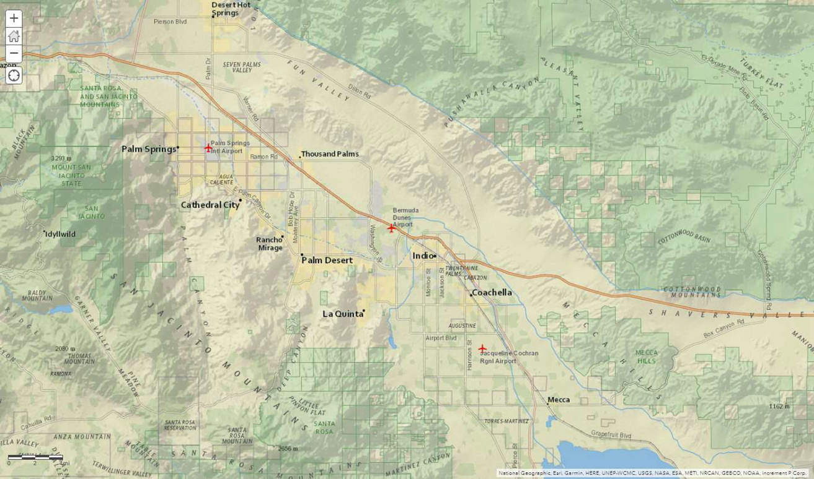

Geographic Boundary
N

Slide 5




Project Description:
The Desert Healthcare District (DHCD), in partnership with Riverside University Health System -Public Health, has created an action plan to address the high overdose deaths plaguing the Indio community from a harm reduction education framework that leveraged existing community partners already providing an array of support services to those at most risk for potential overdose and death. The City of Indio is within DHCD boundaries.
Review of existing Riverside County Overdose Data to Action (RODA) reported data related to the number of overdose deaths specific to the community of Indio, California identified high occurrence trends by age, race, drug of choice, location and informed the development of a collaborative action plan to respond to the needs of these indicated groups to include:
  Leverage: Working with community stakeholders/organizations that serve the community members who are at risk for overdose incidents
  Supply Distribution: Utilization of existing harm reduction supplies/educational materials for dissemination through established outreach networks
  Tracking: Creation of tracking methodology to identify contacts made, project participation levels and overdose deaths during project term

Slide 6
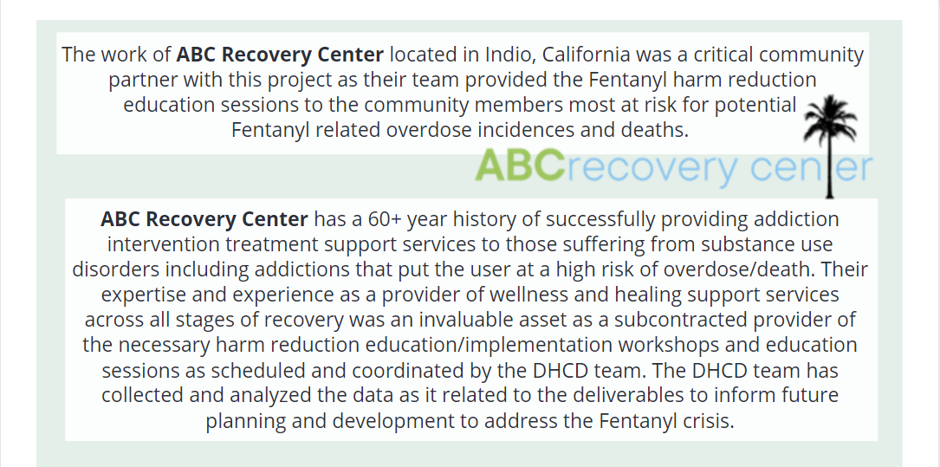
Project Partnerships:
ABC Recovery Center was selected as a subcontractor for this project to increase linkage to care for community members

Slide 7
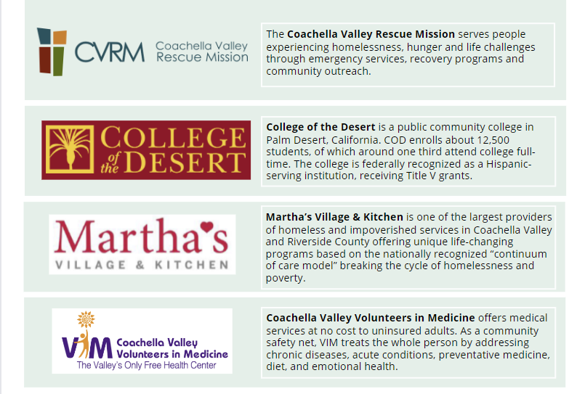
Organization Participants:
These organizations provided the necessary access linkage to community members for harm reduction education trainings or outreach activities

Slide 8
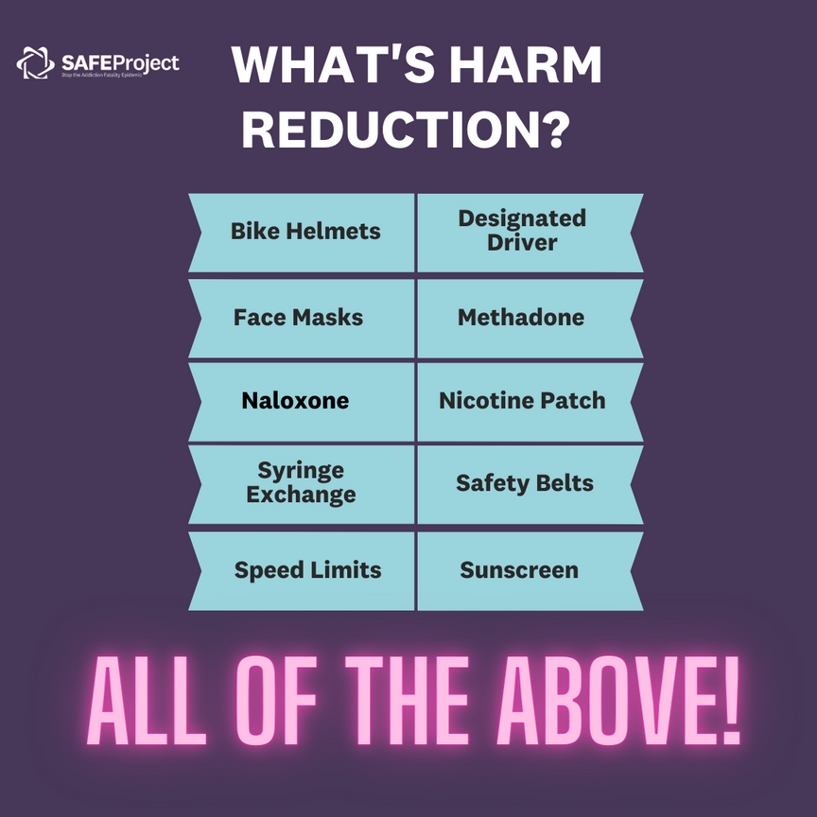
Project Elements:
Harm Reduction as a Strategy For Saving Lives
What is Harm Reduction?
Harm reduction is a practical and transformative approach that incorporates community-driven public health strategies — including prevention, risk reduction, and health promotion. Harm reduction centers the lived and living experience of people who use drugs, especially those in underserved communities, in these strategies and the practices that flow from them.
Harm Reduction principles can be applied to so many
areas of our lives. From domestic violence, Eating
disorders, maladaptive coping strategies, to toxic
relationships with loved ones. We use risk
management everyday.
Harm Reduction stops people from being injured and
dying from things that are preventable.
Safe Project 2023

Slide 9
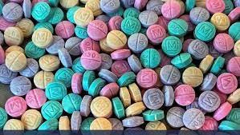

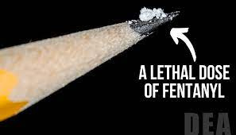
FENTANYL
Fentanyl was first developed in 1959 and introduced in the 1960s as an intravenous anesthetic. It is legally manufactured and distributed in the United States. Licit fentanyl pharmaceutical products are diverted via theft, fraudulent prescriptions, and illicit distribution.
Fentanyl is a synthetic opioid that is up to 50 times stronger than heroin and 100 times stronger than morphine. It is a major contributor to fatal and nonfatal overdoses in the U.S. (1)
In 2022, Centers For Disease Control (CDC) provisional data indicated that more than two thirds (68%) of the reported 107,081 drug overdose deaths in the United States involved synthetic opioids other than methadone, principally illicitly manufactured fentanyls (IMFs).
1. Wilson N, Kariisa M, Seth P, Smith H 4th, Davis NL. Drug and opioid-involved overdose deaths—United States, 2017–2018. MMWR Morb Mortal Wkly Rep 2020;69:290–7. 10.15585/mmwr.mm6911a4 California Department of Public Health 2023

Slide 10

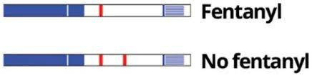
HARM REDUCTION SUPPLIES / MATERIALS - FENTANYL TESTING STRIPS (FTS)
Step 1: Put a small amount (at least 10mg) of your drugs aside in a clean, dry container.
Step 2: Add water to the container and mix together.
Please note: For most drugs, you need ½ teaspoon of water. If you are testing methamphetamines, use1 full teaspoon.
Step 3: Place the wavy end of the test strip down in the water and let it absorb for about 15 seconds.
Step 4: Take the strip out of the water and place it on a flat surface for 2 to 5 minutes.
Step 5: Read results.
Positive results: A single pink line on the left-hand side indicates that fentanyl or a fentanyl analog has been detected in your drugs. If you receive a positive result, it is much safer to discard the batch. Using it could kill you. Illicitly manufactured fentanyl is extremely potent and can be deadly.
Negative results: Two pink lines indicate that fentanyl or a fentanyl analog has not been detected in your drugs. Remember that no test is 100% accurate and your drugs may still contain fentanyl or fentanyl analogs even if you receive a negative result. You should still take caution as FTS might not detect more potent fentanyl-like drugs, like carfentanil, and fentanyl might not be everywhere in your drugs and your test might miss it.
Source: National Center for Injury Prevention and Control, Division of Drug Overdose Prevention

Slide 11

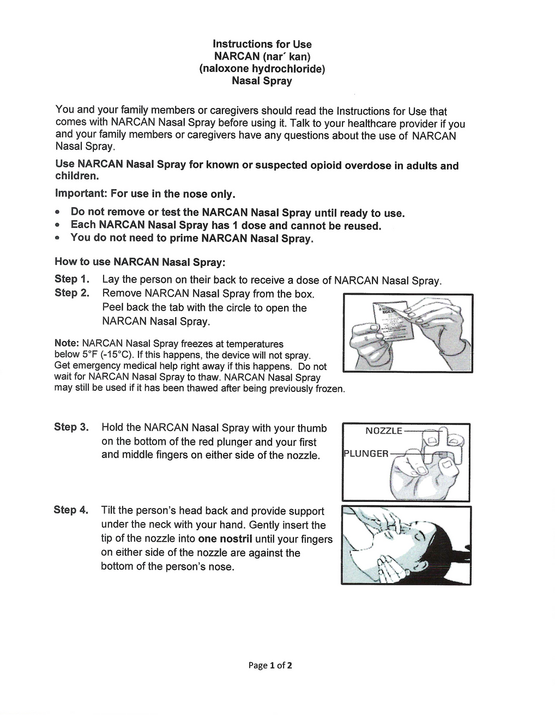
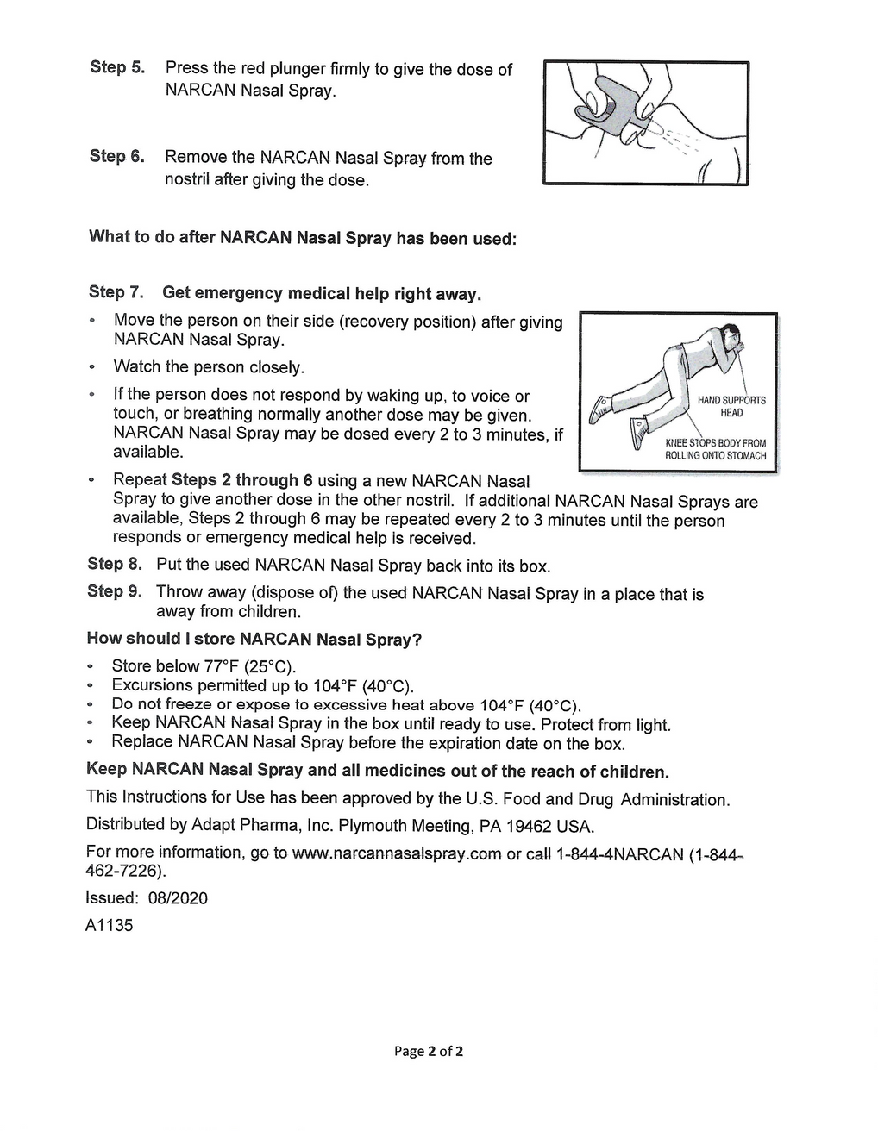
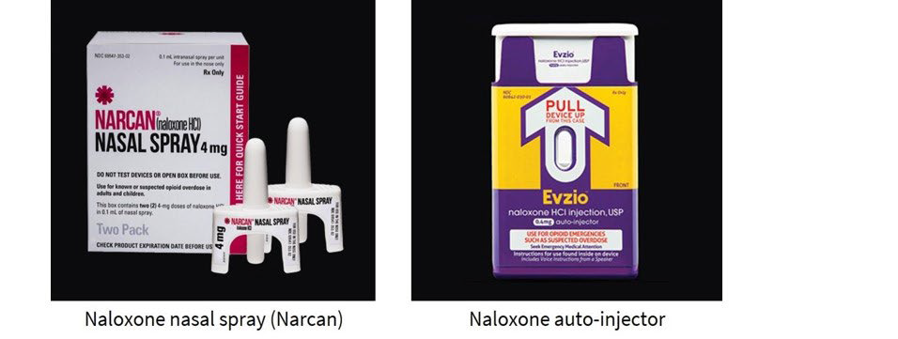
HARM REDUCTION SUPPLIES / MATERIALS
NALOXONE/NARCAN ADMINISTRATION

Slide 12

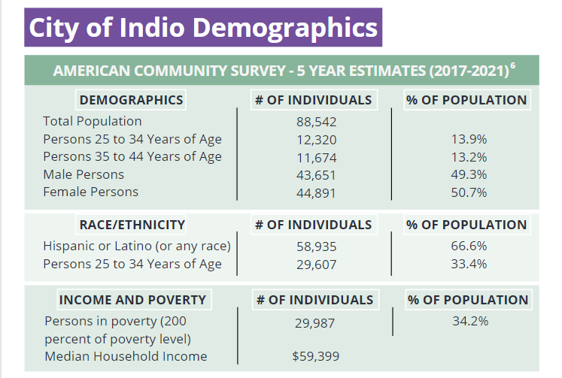


PROJECT TARGET - INDIO, CALIFORNIA
U.S. Census Bureau. (2023). 2017-2021 American Community Survey 5-year Estimates Public Use.

Slide 13

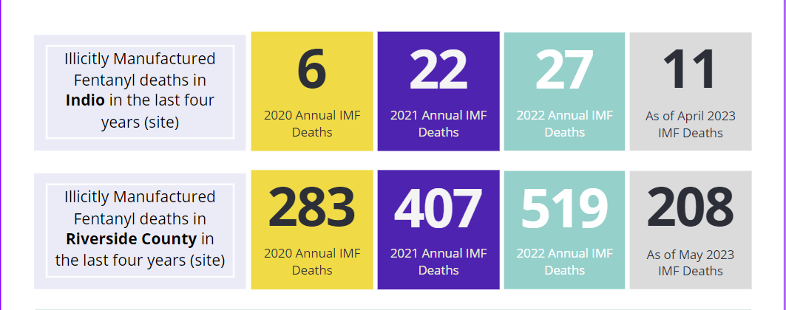
PROJECT TARGET - INDIO, CALIFORNIA
Overdose Deaths
Riverside County Overdose Data to Action data dashboard shows the number of overdose deaths within the community of Indio, California. The data revealed high incidence trends by age, race, drug of choice, location, and informed the targeted population and the development of a collaborative action plan.

Slide 14

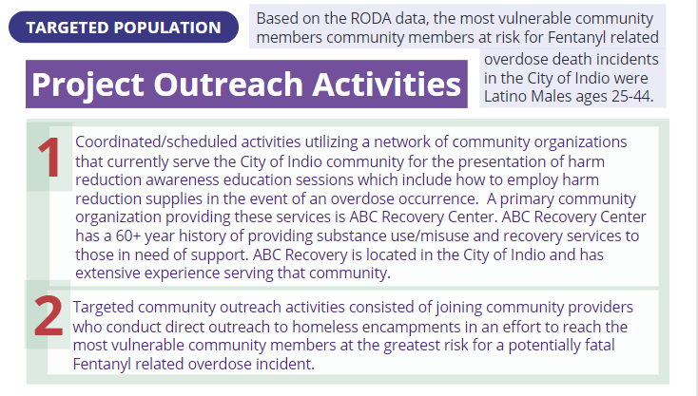

PROJECT TARGET - INDIO, CALIFORNIA
What Did We Do?
Project Term: April 2023 - August 2023

Slide 15
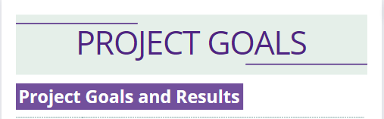

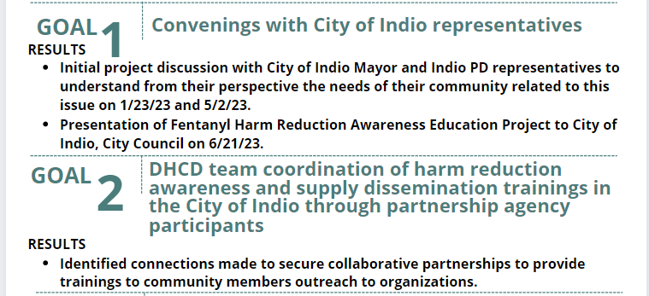
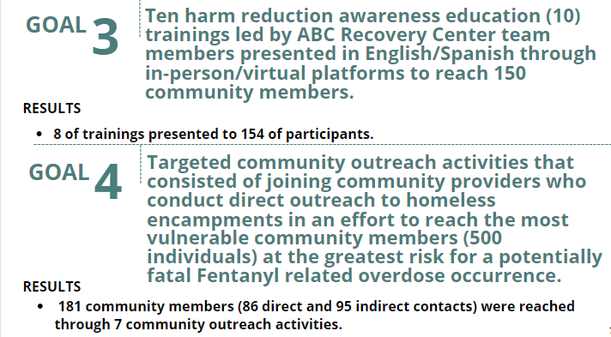
What Did We Do?
How Well Did We Do It?

Slide 16

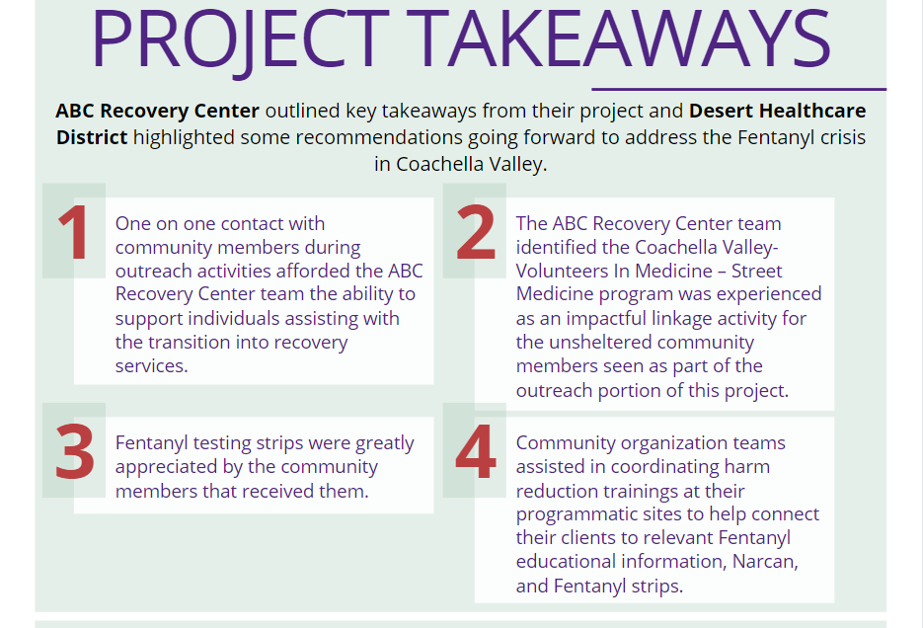

Slide 17

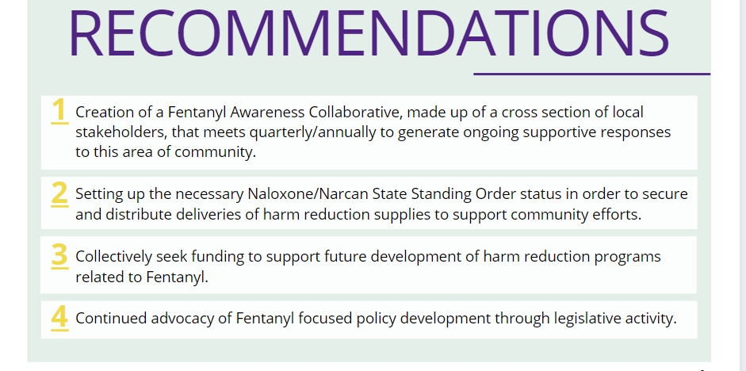

Slide 18


POST PROJECT
NEXT STEPS/OPPORTUNITIES

Slide 19

POTENTIAL OPPORTUNITIES
Expansion of the support platform to include other cities in the Coachella Valley
The city of Indio is not the only city in the Coachella Valley impacted by fentanyl; however, RODA data determines it is the city with the highest number of overdose fatalities and overdose near fatalities. The lessons learned, best practices, and strategies derived from the city of Indio project can guide the development of a future framework that can be enhanced and replicated in other areas of the Coachella Valley.
  Deliver quarterly training and capacity building to navigators, including, certified peer recovery specialists, community health workers, case managers, social workers, etc.
  Making the referral process to available treatment facilities, programs, harm reduction resources, and other supportive services.
  Train hospital case managers and/or discharge personnel on treatment program referrals, availability of harm reduction resources, and other supportive services for nonfatal opioid overdose hospital patients.
  Collaborate with all three Coachella Valley school districts to offer a series of overdose prevention and response training and/or presentations geared towards school nurses, faculty, parents, and students (Grades 7-12).

Slide 20

POTENTIAL OPPORTUNITIES
  Develop a community-wide awareness and distribution campaign targeting family members and friends of opioid users and offer free access to naloxone, fentanyl testing strips, and other harm-reduction resources.
  Develop data-sharing agreements with local hospitals to monitor opioid overdose trends by utilizing data from emergency departments (ED) and/or emergency medical services (EMS) to detect increases or decreases in fatal and/or nonfatal opioid overdoses in the Coachella Valley to inform an early response, resource allocation, and deployment.
  Support community-based response efforts by disseminating quarterly relevant opioid overdose data via infographics and reports to first responders, substance abuse treatment and recovery providers, law enforcement, community-based organizations, healthcare providers, and key stakeholders.

Slide 21
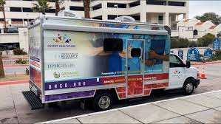
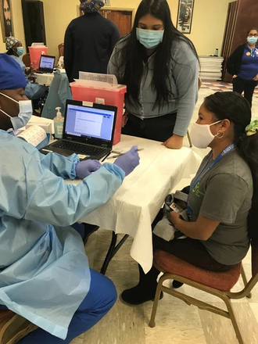
Deployment of a Medical Mobile Unit
The Coachella Valley is a vast rural area with a long distance between medical providers, in some cases, District residents must travel more than 45 minutes to access crucial medical services and resources. In addition, like many communities across California, unhoused individuals are very prominent in the Coachella Valley, and have their unique barriers to accessing medical care and services.
In December 2022, the DCHD purchased and deployed a medical mobile unit in partnership with Desert Physicians Medical Group (DPMG), which runs the day-to-day operations and coordinates the medical staff that offer medical services. This medical mobile unit will be a crucial component in reaching and providing fentanyl harm reduction resources and medical care to community members who encounter barriers to accessing medical providers.
Multi-City/Municipality Coordination
Coordination and planning between the nine cities and Riverside County will be a great opportunity to maximize resources, share information, and ensure that a collaborative approach to fentanyl harm reduction is the primary focus.
As a next step, the DHCD would like to host an annual forum to convene service providers, public safety, community-based organizations, elected officials, and key stakeholders to identify partnership opportunities, discuss and share best practices, identify emerging trends, review data, and referrals amongst organizations.

Slide 22



THANK YOU
Jana Trew, MS
Senior Program Officer - Behavioral Health
jtrew@dhcd.org
Alejandro Espinoza, MPH
Chief of Community Engagement
aespinoza@dhcd.org

