Slide 1


Community Health Workers: Building Community Capacity
September 14, 2023
Ramona Faith CEO
Ben Spierings Community Health Program Manager

Slide 2
Healthy Petaluma
At Healthy Petaluma, we are advocates for the health and well-being of everyone in southern Sonoma County through equitable access to services and programs.
We're dedicated to improving the health of our community through program funding, targeted initiatives, direct services, and our extensive relationships with other organizations.
We work with Petaluma Valley Hospital’s operator to ensure continued local access to acute and emergency health care services.

Slide 3
Healthy Petaluma
What have we been up to?
  Sold Community Hospital January 1, 2021
  Previously known as Petaluma Health Care District
  5 member elected Board
  Jurisdiction includes 85K residents
  Receive no community tax dollars
  Rejected request to close Hospital Family Birthing Center
  Blue Zones Transformational Project Petaluma
  Initiating new grant giving process
  By-Zone Elections
  Board Study Sessions on community needs
  Established Community Health Worker Program

Slide 4
What is a Community Health Worker?
"A Community Health Worker (CHW) is a frontline public health worker who is a trusted member of and/or has an unusually close understanding of the community served.
This trusting relationship enables the CHW to serve as a liaison/link/intermediary between health/social services and the community to facilitate access to services and improve the quality and cultural competence of service delivery.
A CHW also builds individual and community capacity by increasing health knowledge and self-sufficiency through a range of activities such as outreach, community education, informal counseling, social support and advocacy."
- American Public Health Association

Slide 5
Sonoma County CHW Cohort
To Advance the Sonoma County CHW Workforce:
• Enhance existing efforts
• Expand multilingual trainings
• Create new professional development opportunities
• Ensure best practices in recruiting, hiring, training and supervision
Cohort established August 2021 via CDC Covid Relief Community Grant funding through the County of Sonoma and is set to end August 2024.

Slide 6
CHW Program Framework
  CHW definition (start with APHA definition)
  CHW core competencies and roles
  Recruitment practices
  Optional and required training (formal and on-the-job)
  Standards for pay and benefits
  Supervision structures
  Billing practices
  Program evaluation
  Employee support practices (selfcare, retention, etc.)

Slide 7
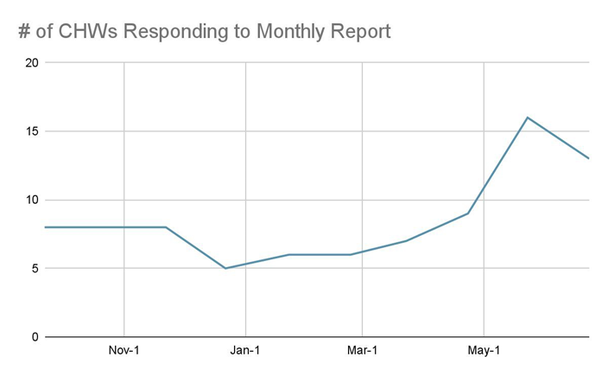
Sonoma County CHW Cohort
Members of the Sonoma County CDC CHW Cohort
  Increase of 4 to 9 Organizations
  Increase from 8 to 16 CHWs

Slide 8
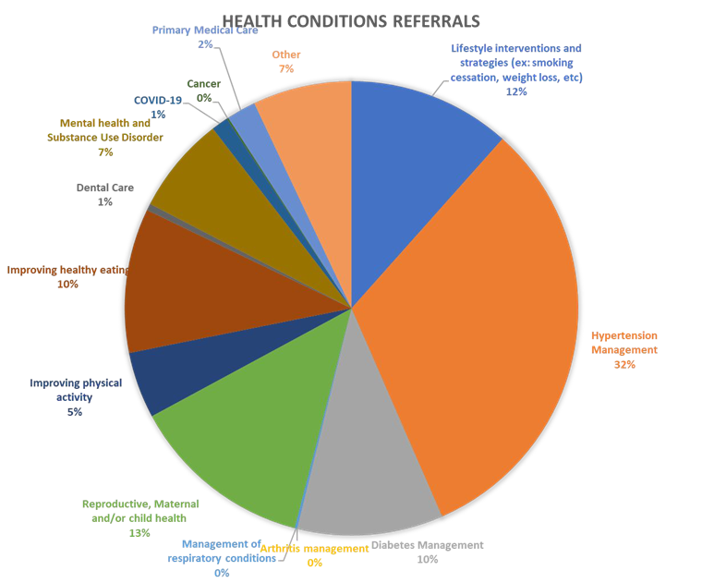
Sonoma County CHW Cohort
Top 5 Referrals Reported from Cohort (September 2022- June 2023)
  Hypertension Management: 32%
  Reproductive, Maternal and/or Child Health: 13%
  Lifestyle Interventions: 12%
  Diabetes Managment: 10%
  Improving Healthy Eating: 10%

Slide 9
Healthy Petaluma CHW Program
  Part of the Sonoma County CHW Cohort
  Grant Funded
  Began August 2021
  Grant Funding ends August 2024
  Hired 2 full-time CHWs
  Community-Based Program Focused on Equitable Access
  Paid Education (Courses and Attendance)
  Building Community Partnerships

Slide 10





Data Sources and Stakeholder Input

Slide 11
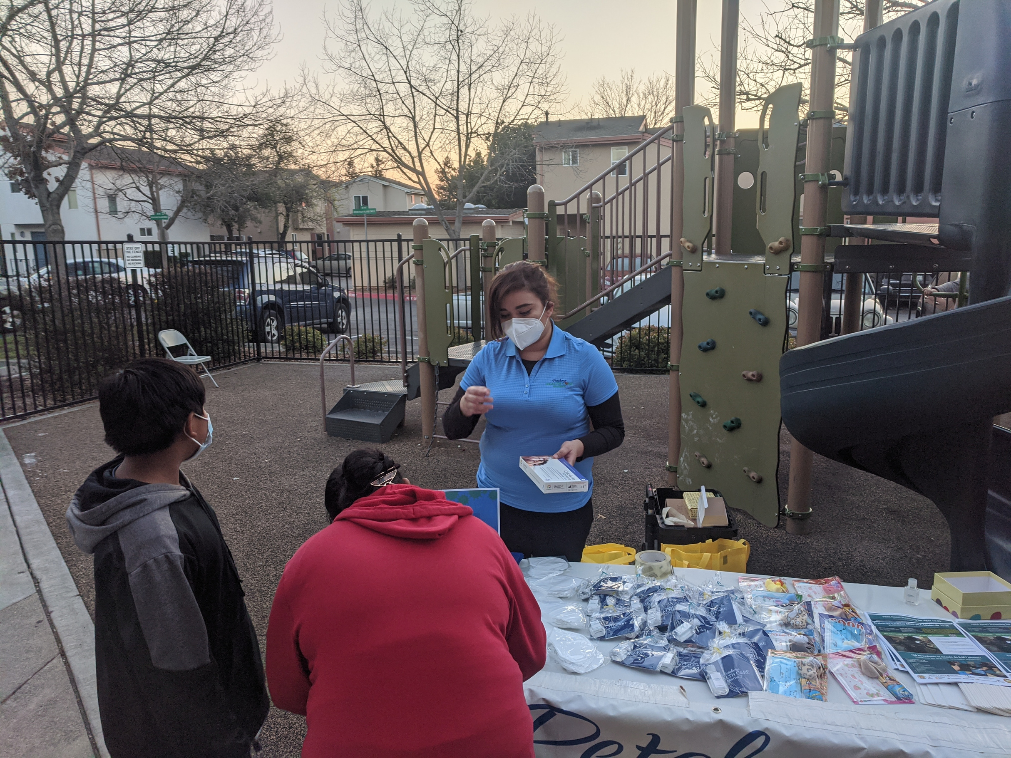
COVID-19 Community Support
In Community Vaccination Clinics
Worked with local partners like Petaluma Health Center and Burbank Housing to coordinate COVID-19 vaccination clinics at Burbank Housing locations
COVID-19 Resource Distribution
At clinics and community events, free COVID-19 resources distributed, including more than 1,400 rapid testing kits, KN-95 masks, and prevention information.

Slide 12
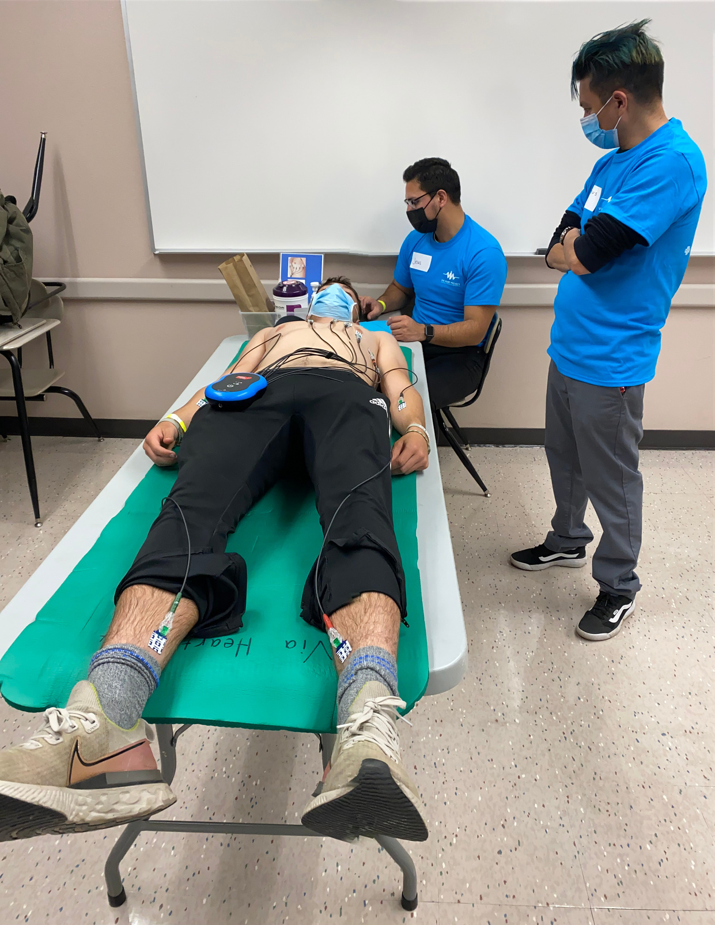
2022 Heart Screening
Free Youth and Young Adult Heart Screening
Healthy Petaluma partnered with the Via Heart Project and SRJC Petaluma Campus for anyone ages 12-25.
Of the 181 screened, 32 were referred for a physician follow-up, and 3 serious cardiac anomalies were identified.
3 lives saved

Slide 13
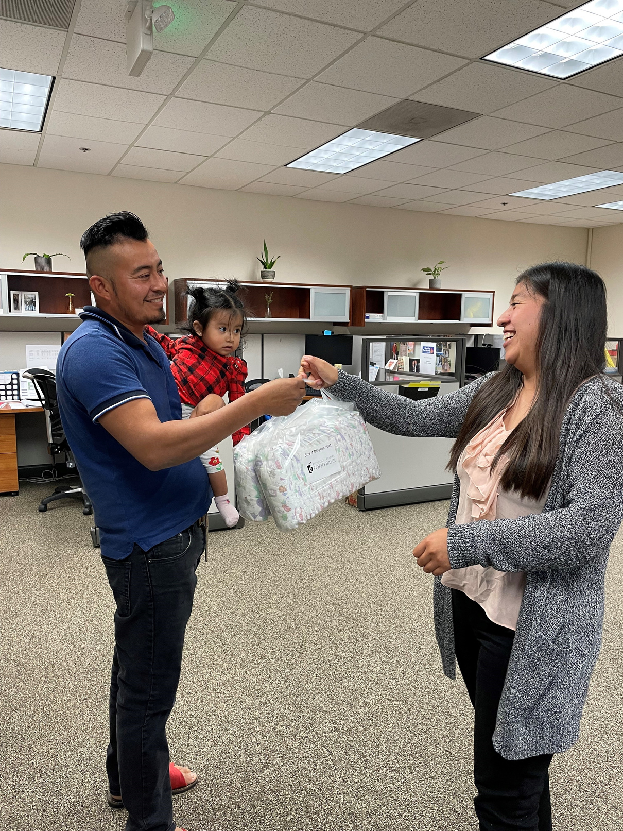
Diaper Distribution
Free Diapers
Thanks to Redwood Empire Food Bank, we are able to provide free diapers to our community members!
Since the beginning of the program in November 2022, we have distributed over 18,000 diapers!

Slide 14
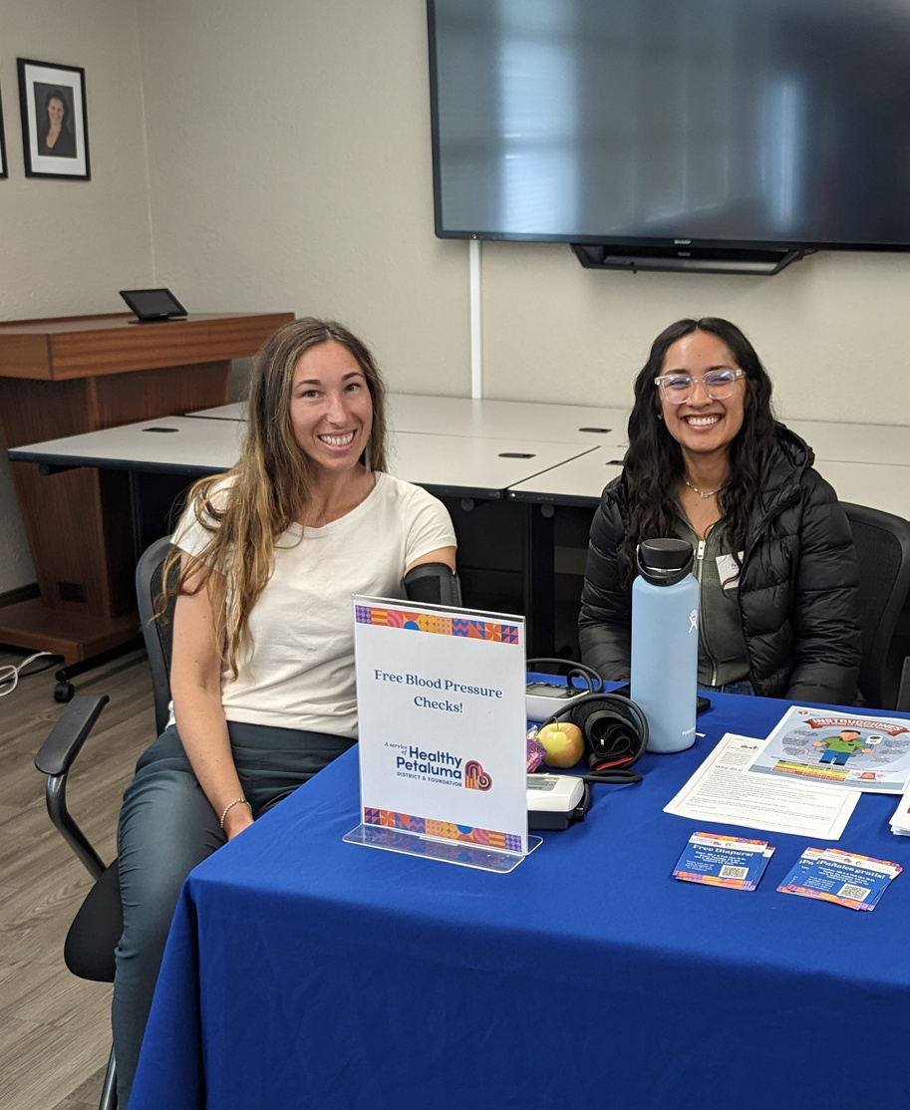
Blood Pressure Checks
Free Blood Pressure Checks
Trained through the American Heart Association, our CHW's provide free blood pressure checks at health fairs, community events, or when out in community and neighorhoods.
Every interaction provides an opportunity to link individuals with needed services through motivational interviewing.

Slide 15
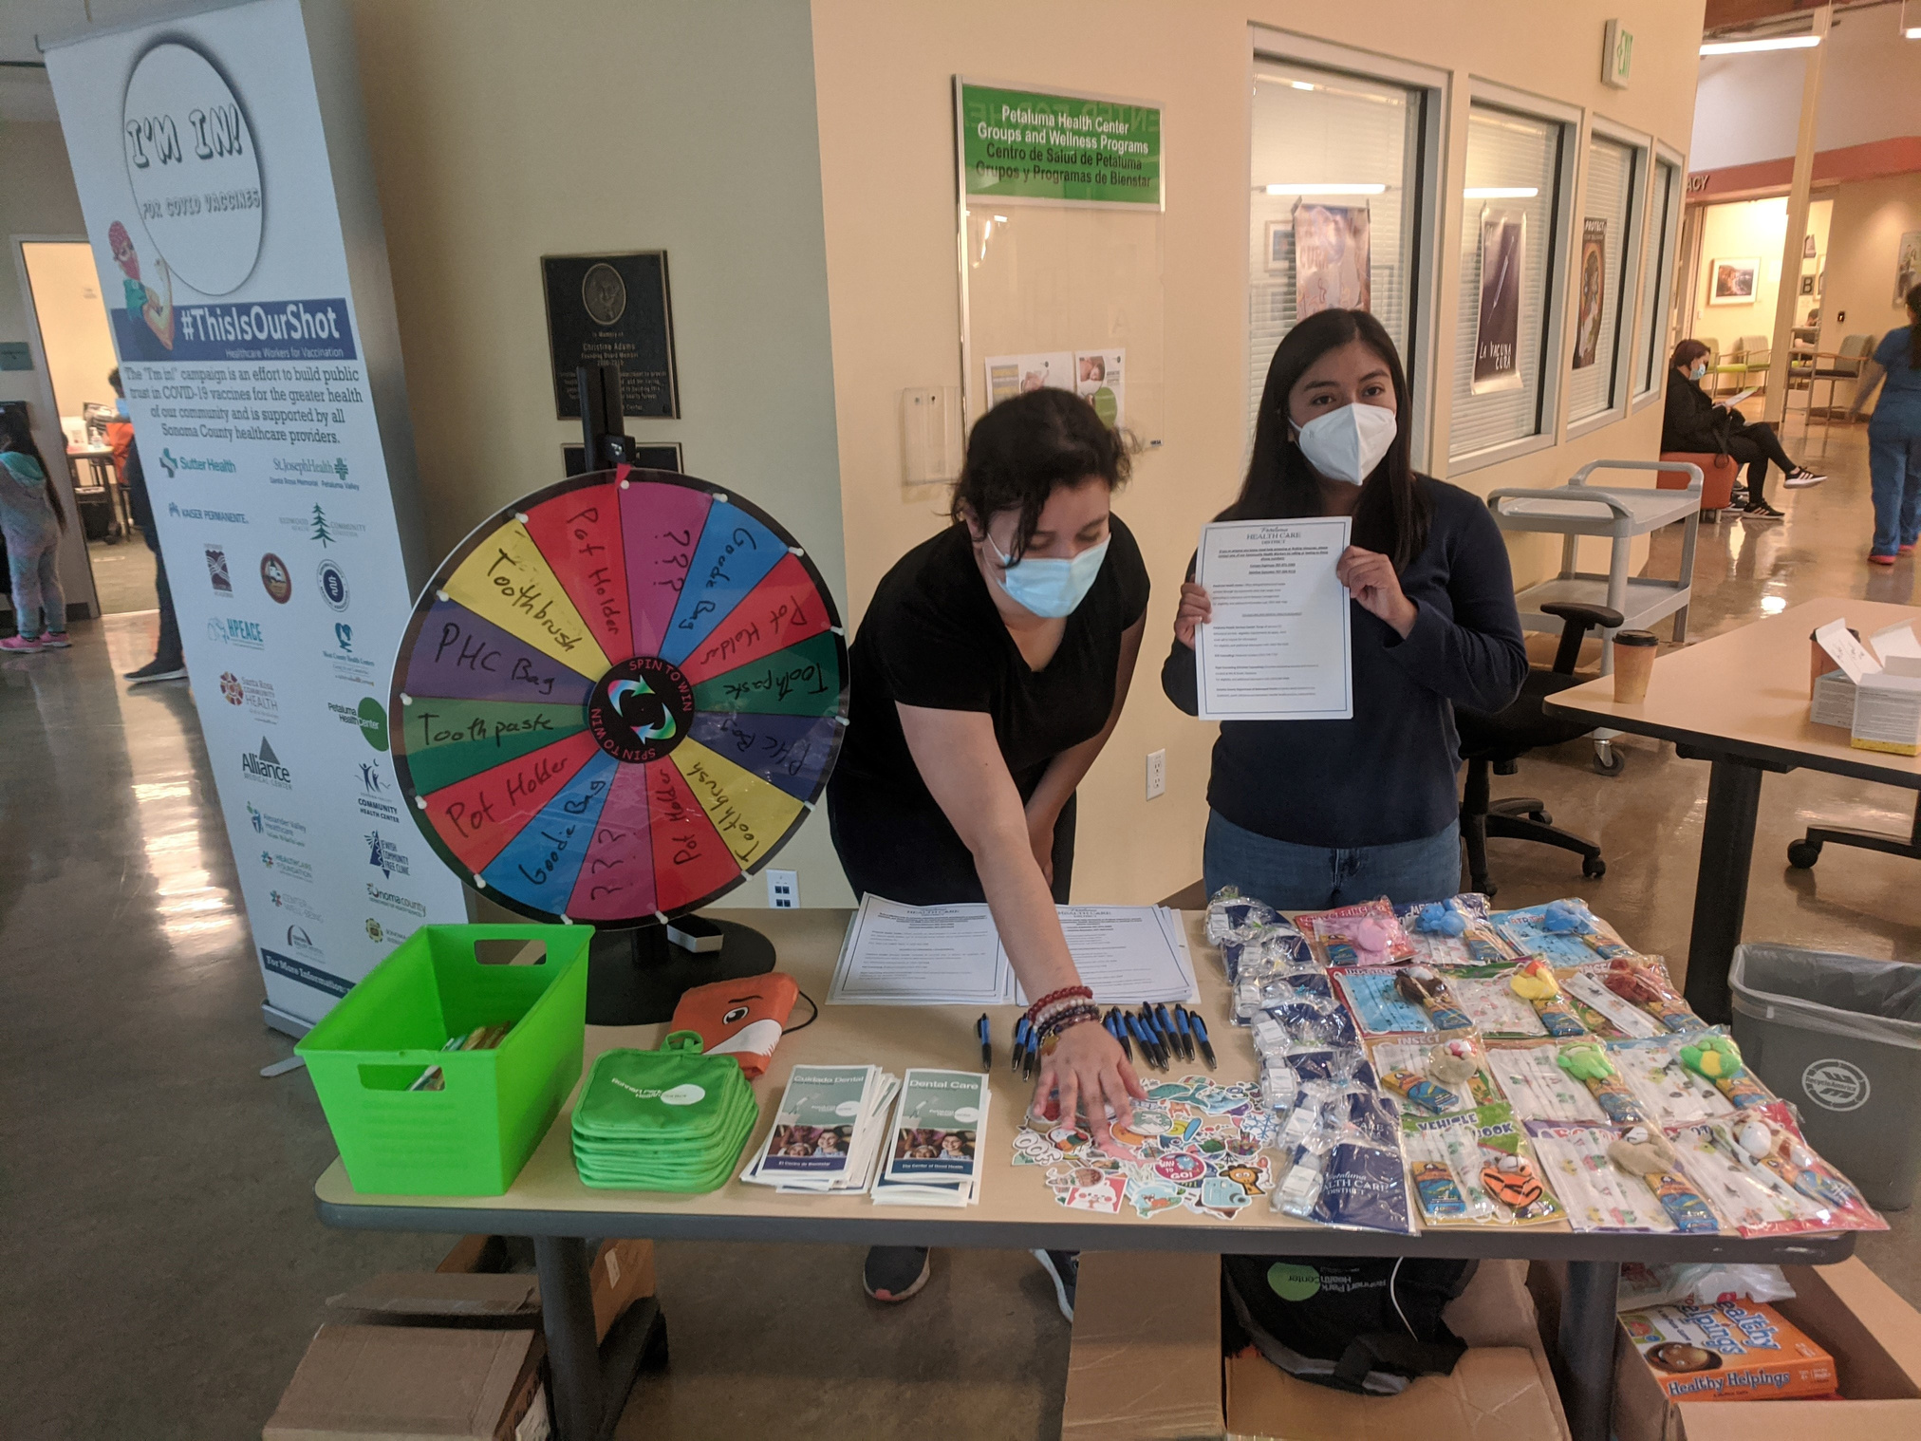
Working With PHC
McDowell Elementary School Mobile Unit
Partnering with the Petaluma Health Center's Mobile Unit, our CHW's work with parents to learn what health information they want to know more about.
Childhood Immunization Clinic
In October 2022 and January 2023 Petaluma Health Center and Petaluma City Schools provided free non-covid childhood immunizations for students in Petaluma.
Building parents capacity to be self sufficient.

Slide 16
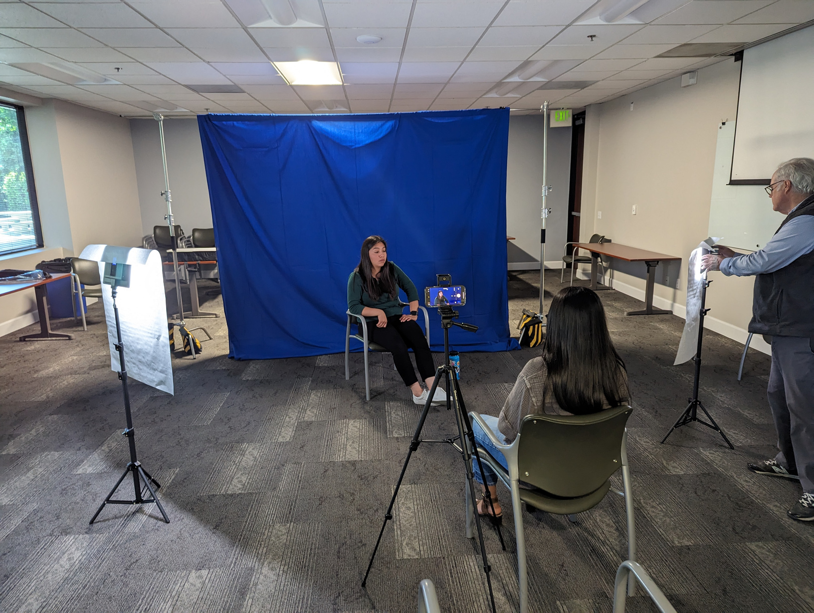
Senior Memoir Pilot
Activating Our Senior Community
Our CHWs have started a pilot program with members of the Petaluma Senior Advisory Council to interview seniors and give them the opportunity to share their wisdom with the community and reflect upon their own experiences.
This provides our seniors with a renewed sense of Value, Purpose, and Belonging.

Slide 17
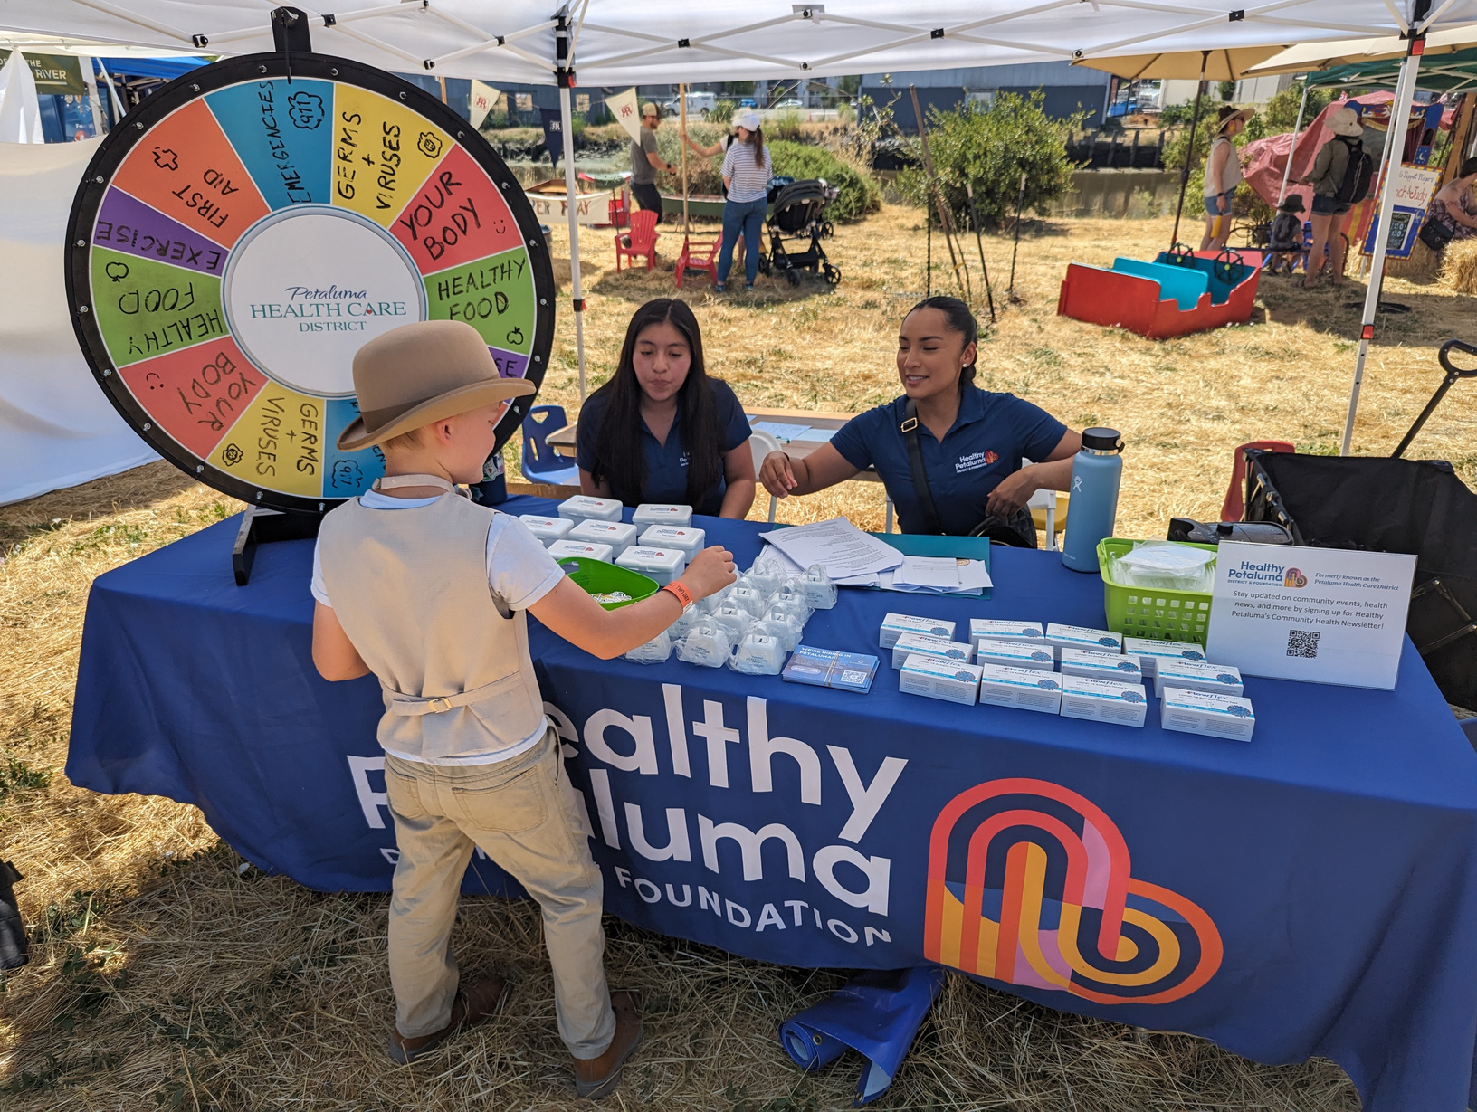
In Community
Farmers Markets, the Local Library, and More
Our CHWs regularly table at prioritized locations in community to provide health information, Blood Pressure Checks/Know Your Numbers, and information on new wellness initiatives. This also provides the CHWs with the opportunity to solicit the communities input on health topics and serve as a liaison between health/social services and our community.
Our CHW Program has resulted in over 6,800 interactions with our residents.

Slide 18
CHW Program Moving Forward
Bridging Community Based and Clinical Based CHW Efforts
Narcan Community Distribution and Education
Raise Awareness and Further Educate our Community Partners on the Impact of CHWs on Community Health and Wellbeing
CHW Professional Development

Slide 19
Lessons Learned
  Allowing Opportunities for Ongoing Education
  Takes Time to Build Relationships and Capacity
  Competitive Pay and Benefits
  Integrate into Work Teams
  Bilingual or Bicultural
  Supervisors Who Understand the Role
  Good/Open Communication with team and supervisors
  Frequent Check-Ins
  Find the Right People

Slide 20

Thank you!

