Slide 1
Governance Toolkit
Board Session 1:
The Board's Role in Community Engagement
Jim Rice: 1-612-703-4687 jim_rice@ajg.com

Slide 2
ACHD Governance Series
Effective Board Work for Enhanced Service and Performance
Six Short (15 minute) Programs for use by ACHD Members
Community Engagement
Balancing Governance & Management
Board Orientations
Strategic Planning
Board Self-Assessments
Board Education Programming

Slide 3
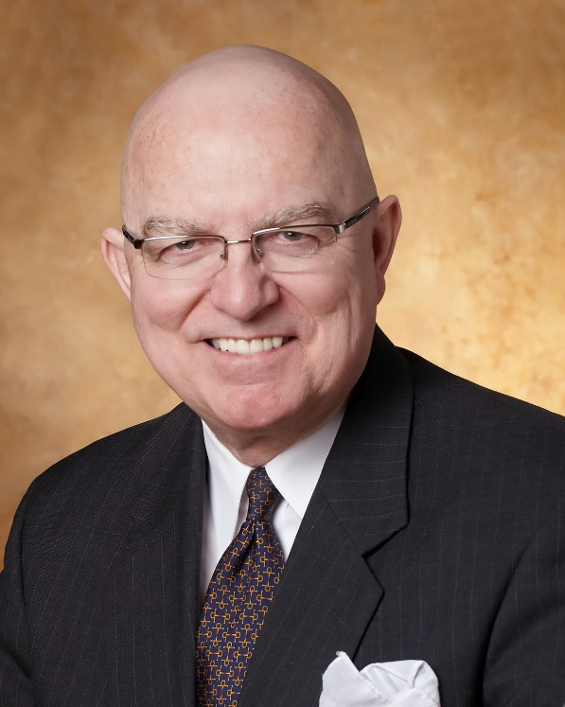
Jim Rice: Governance Adviser
Experienced. Practical. Responsive.
Jim Rice, PhD, FACHE is Senior Adviser with the Governance & Leadership service line of Gallagher’s Human Resources & Compensation Consulting practice, and Chairman of the Akadimi Foundation. Having served on many boards, Jim focuses his consulting work on strategic governance structures and systems for high performing medical groups, hospitals, credit unions and integrated care systems. He is often engaged for enhanced strategic alliances and mergers for large and small not-for-profit organizations; as well as leadership development programming for Physicians, Boards and C-Suite Senior Leaders.
Dr. Rice holds a masters and doctoral degree in management and health policy from the University of Minnesota. He has received the University of Minnesota, School of Public Health Distinguished Alumni Leadership Award; a National Institute of Health Doctoral Fellowship; a US Public Health Service Traineeship in Hospital Management; a Bush Leadership Fellowship at Stanford and the National University of Singapore; and the American Hospital Association’s Corning Award for Excellence in Hospital Planning. He is a Fellow in the American College of Healthcare Executives (ACHE) and has worked in over 35 countries in North America, Asia, Africa and Latin America.
Connect: 1-612-703-4687 jim_rice@ajg.com

Slide 4
Community Engagement
Focus of Session:
What is “Community Engagement”?
Why is it important?
Common issues or challenges?
What can Boards do to be more successful?
Resources for further insights?

Slide 5
What is “Community Engagement”?
Structured process to build and nurture partnership(s) with diverse players:
Social Determinants of Health (SDOH) partners
Provider partners
Payer partners
Government, Civic and Business leaders
Supply Chain partners
Donor partners
Partnerships that deliver meaningful value/results for health gain and health care in resource constrained environment!

Slide 6
2. Why is it important?
No real choice as a community organization formed for and from the community!
Landscape is more Complex, Riskier, and Expensive
Not wise to go it alone: need wisdom, leverage and resources
Collaboration expected model from key stakeholders: payers | media | community leaders | providers | employees | donors | policy makers
Mission mapping demands engagement for vitality

Slide 7
3. Common Issues or Challenges?
Few paying us to protect and promote community health compared to restoring health via acute care
New partnerships require new People, Personalities, Processes, Priorities, and Professions
Many distractions and competing priorities as US and California policy constraints pull us from populations compared to patients
Lack of experience and tools in community based planning and “Collaborative Governance”
Lack of resources to walk-the-talk

Slide 8
4. What can Boards do to be more successful?
Invite education from community leaders on needs, barriers, and new strategies within new models and new money
Study successful models of “Collective Impact” and “Collaborative Governance” across California, across the US, and in other countries
Experiment with “Community Plunges”

Slide 9
5. Resources for further insights:
Foster McGaw Award winners: https://www.aha.org/award/2017-12-11-foster-g-mcgaw-prize-winners-and-finalists
Public Health Institute: https://www.phi.org/
National Association of Counties: https://www.naco.org/topics/health
Social Determinants of Health: https://www.cdc.gov/socialdeterminants/index.htm
Association for Community Improvement https://www.aha.org/topics/association-community-health-improvement-achi
Collective Impact: https://www.collectiveimpactforum.org/what-collective-impact
Many Others

Slide 10
Thank you for all you do for the people in your healthcare district!
We hope this short program stimulates your continuous pursuit of enhanced board work to strengthen your healthcare district’s support for health care and health gain in challenging times.
Please contact ACHD to access their many other board support resources.
Jim Rice: 1-612-703-4687 jim_rice@ajg.com

