Slide 1
ACHD Governance Toolkit
Board Session 2
Balancing Governance & Management
Jim Rice: 1-612-703-4687 jim_rice@ajg.com

Slide 2
ACHD Governance Series
Effective Board Work for Enhanced Service and Performance
Six Short Programs for use by ACHD Members
Community Engagement
Balancing Governance & Management
Board Orientations
Strategic Planning
Board Self-Assessments
Board Education Programming

Slide 3
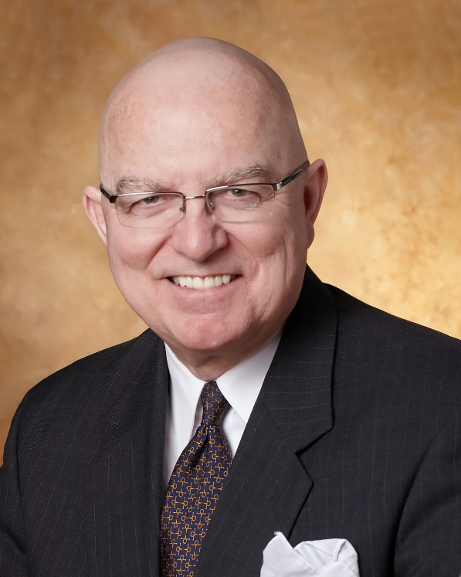
Jim Rice: Governance Adviser
Experienced. Practical. Responsive.
Jim Rice, PhD, FACHE is Senior Adviser with the Governance & Leadership service line of Gallagher’s Human Resources & Compensation Consulting practice, and Chairman of the Akadimi Foundation. Having served on many boards, Jim focuses his consulting work on strategic governance structures and systems for high performing medical groups, hospitals, credit unions and integrated care systems. He is often engaged for enhanced strategic alliances and mergers for large and small not-for-profit organizations; as well as leadership development programming for Physicians, Boards and C-Suite Senior Leaders.
Dr. Rice holds a masters and doctoral degree in management and health policy from the University of Minnesota. He has received the University of Minnesota, School of Public Health Distinguished Alumni Leadership Award; a National Institute of Health Doctoral Fellowship; a US Public Health Service Traineeship in Hospital Management; a Bush Leadership Fellowship at Stanford and the National University of Singapore; and the American Hospital Association’s Corning Award for Excellence in Hospital Planning. He is a Fellow in the American College of Healthcare Executives (ACHE) and has worked in over 35 countries in North America, Asia, Africa and Latin America.
Connect: 1-612-703-4687 jim_rice@ajg.com

Slide 4
Balancing Governance & Management
Focus of Session:
What is “Governance” & what is “Management”?
Why is it important to get the difference right?
Common issues or challenges?
What can Boards do to be more successful?
Resources for further insights?

Slide 5
1. What is “Governance” & what is “Management”?
Governance: a structured group decision making process by people entrusted to play a “Fiduciary Role” to establish direction, policy framework, secure resources, and monitor progress to plans on behalf of the organization’s mission and to benefit key stakeholders.
Management: a team of leaders assembled by CEO (the only employee of the Board) to partner with Board to develop strategies and execute the tactics of policies and plans designed to serve the organization’s mission and beneficiaries.

Slide 6
DUTY OF OVERSIGHT
The governing body is responsible for the overall direction of the organization. It must supervise and direct its own officers while insuring the group’s efforts in carrying out its mission. The duties of care, loyalty, and obedience describe the manner in which members are expected to carry out their fundamental duty of oversight in service to the organization’s mission.
DUTY OF CARE
Members must consider all reasonably available and pertinent information before taking action. Each member must act in good faith, with the care of a prudent community leader or businessperson in similar circumstances, and in a manner they believe to be in the best interest of the organization.
DUTY OF LOYALTY
Members must candidly and transparently discharge their duties in a manner designed to benefit only the organization, not individual interests. This duty incorporates the obligation to disclose situations that may potentially conflict with the mission, as well as a requirement to avoid competition with the organization.
DUTY OF OBEDIENCE
Members are required to ensure that the organization’s decisions and activities adhere to its fundamental purpose.

Slide 7
Assessment
ASSESS
ALIGN
Reporting
Workforce Planning
Goals Management
Talent
Analytics
Board - CEO
Internal Mobility
ENHANCED
BOARD – CEO
PARTNERSHIP
Talent
Sourcing
Leadership & Succession Planning
Communications
Contingent
Balancing
Career Planning
Selection
ACQUIRE
Performance Management
Onboarding
DEVELOP

Slide 8
2. Why is it important to get the difference right?
A well aligned partnership between the Board and CEO is associated with these benefits:
Fewer Errors in Stakeholder Communications & Enthusiasm
More Effective Board Meetings
Sharper focus on Strategic Service and Financial Plans
Enhanced Morale and Collaboration with Providers
Better Media Relations
More Effective Donor Relations
Less Turnover of Board and Staff

Slide 9
3. Common issues or challenges?
Slide into Micro-Management Distractions:
Unplanned walking tour of hospital departments
Pressure to hire staff or contractors
Second guessing terms of payer or supply chain agreements
Management Withholds Difficult News Until Crisis Stage
Mixed Signals along “Fault Lines” to Providers, Unions, Public, Staff, Payers and Donors

Slide 10
4. What can Boards do to be more successful?
Role clarity in board recruitment, onboarding, annual performance reviews of Board & CEO, in “Authority Matrix”
Competency mapping to optimize use of Board Talent
Effective Board Chairperson Role & Interventions
CEO more frequent, effective and transparent communications
Orientation to “Appreciative Listening” among all parties
Planned tours and visits with key stakeholders
Culture of Celebration Trust and Collaboration

Slide 11
5. Resources for further insights:
Nonprofits: CEO-Board Partnership is Key
BoardSource: CEO Nightmare: Micromanagement
BoardEffect Insights: Balanced Roles Key
ACHD Authority Matrix draft

Slide 12
Thank you for all you do for the people in your healthcare district!
We hope this short program stimulates your continuous pursuit of enhanced board work to strengthen your healthcare district’s support for health care and health gain in challenging times.
Please contact ACHD to access their many other board support resources.
Jim Rice: 1-612-703-4687 jim_rice@ajg.com

