Slide 1
ACHD Governance Toolkit
Board Session 3
SMART Board Orientations
Jim Rice: 1-612-703-4687 jim_rice@ajg.com

Slide 2
ACHD Governance Series
Effective Board Work for Enhanced Service and Performance
Six Short Programs for use by ACHD Members
Community Engagement
Balancing Governance & Management
Board Orientations
Strategic Planning
Board Self-Assessments
Board Education Programming

Slide 3
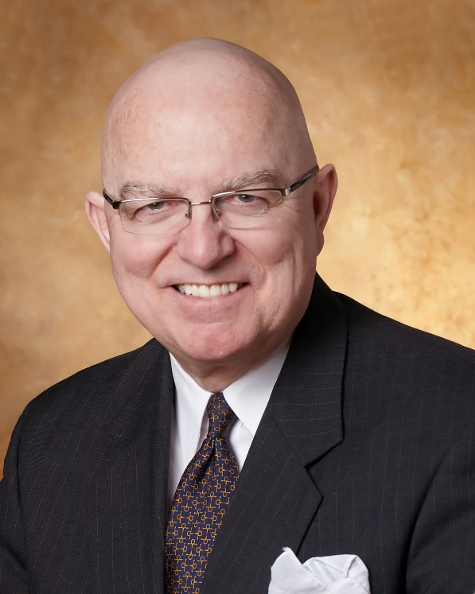
Jim Rice: Governance Adviser
Experienced. Practical. Responsive.
Jim Rice, PhD, FACHE is Senior Adviser with the Governance & Leadership service line of Gallagher’s Human Resources & Compensation Consulting practice, and Chairman of the Akadimi Foundation. Having served on many boards, Jim focuses his consulting work on strategic governance structures and systems for high performing medical groups, hospitals, credit unions and integrated care systems. He is often engaged for enhanced strategic alliances and mergers for large and small not-for-profit organizations; as well as leadership development programming for Physicians, Boards and C-Suite Senior Leaders.
Dr. Rice holds a masters and doctoral degree in management and health policy from the University of Minnesota. He has received the University of Minnesota, School of Public Health Distinguished Alumni Leadership Award; a National Institute of Health Doctoral Fellowship; a US Public Health Service Traineeship in Hospital Management; a Bush Leadership Fellowship at Stanford and the National University of Singapore; and the American Hospital Association’s Corning Award for Excellence in Hospital Planning. He is a Fellow in the American College of Healthcare Executives (ACHE) and has worked in over 35 countries in North America, Asia, Africa and Latin America.
Connect: 1-612-703-4687 jim_rice@ajg.com

Slide 4
Board Orientations
Focus of Session:
What is a good “Board Orientation”?
Why is it important?
Common issues or challenges?
What can Boards do to be more successful?
Resources for further insights?

Slide 5
What is a good “Board Orientation”?
Prompt: within 30 days
Professional: Tied to Position Description, Plans, & Matrix
Promotional: Champion the Mission/Vision
Packaged: Multi-media. Modules. Multiple Speakers
Passionate: Weave in Stories to Make Data Sing

Slide 6
2. Why is it important?
More Effective & Efficient Decision Making
Less Wasted Time in Meetings
Enhanced Messaging & Brand in District
Expanded Engagement & Pride with providers, staff, public and donors
Increased ROI Probability

Slide 7
3. Common issues or challenges?
Chair and CEO do not prioritize the Orientation
New Members think they already have all the answers
CEO tries to do it all alone, rather than a team effort
Process is boring and time consuming
Content is narrow and does not map to District health needs, the mission, and the strategic and financial plans

Slide 8
4. What can Boards do to be more successful?
Make it a priority via the “Five Ps” of slide 5
Make it engaging visually, animated, tailored to Member
Make it a team sport: Staff, Board-Buddy, Mentor
Make it digital and 24/7
Make it comprehensive & interesting:
Real Patient Case Stories (But HIPPA Compliant)
Real Physician and Nurse Stories
Map to ”Balanced Score Card” type metrics: Make Data Sing
Include touring with planned presentations by staff
Encourage “Q Factor” by Board Members

Slide 9
5. Resources for further insights:
Consider ACHD Certification Criteria Checklist
BoardEffect checklists save time
See Association Checklists for Topics
Dashboard Graphics: Stimulate Thinking is Key
Map to Board Member Handbook links

Slide 10
Thank you for all you do for the people in your healthcare district!
We hope this short program stimulates your continuous pursuit of enhanced board work to strengthen your healthcare district’s support for health care and health gain in challenging times.
Please contact ACHD to access their many other board support resources.
Jim Rice: 1-612-703-4687 jim_rice@ajg.com

