Slide 1
Governance Toolkit
Board Session 4
Effective Strategic Planning
Jim Rice: 1-612-703-4687 jim_rice@ajg.com

Slide 2
ACHD Governance Series
Effective Board Work for Enhanced Service and Performance
Six Short Programs for use by ACHD Members
Community Engagement
Balancing Governance & Management
Board Orientations
Strategic Planning
Board Self-Assessments
Board Education Programming

Slide 3
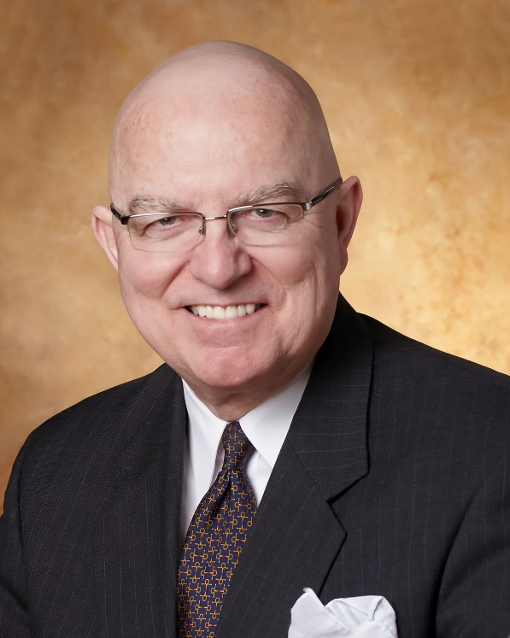
Jim Rice: Governance Adviser
Experienced. Practical. Responsive.
Jim Rice, PhD, FACHE is Senior Adviser with the Governance & Leadership service line of Gallagher’s Human Resources & Compensation Consulting practice, and Chairman of the Akadimi Foundation. Having served on many boards, Jim focuses his consulting work on strategic governance structures and systems for high performing medical groups, hospitals, credit unions and integrated care systems. He is often engaged for enhanced strategic alliances and mergers for large and small not-for-profit organizations; as well as leadership development programming for Physicians, Boards and C-Suite Senior Leaders.
Dr. Rice holds a masters and doctoral degree in management and health policy from the University of Minnesota. He has received the University of Minnesota, School of Public Health Distinguished Alumni Leadership Award; a National Institute of Health Doctoral Fellowship; a US Public Health Service Traineeship in Hospital Management; a Bush Leadership Fellowship at Stanford and the National University of Singapore; and the American Hospital Association’s Corning Award for Excellence in Hospital Planning. He is a Fellow in the American College of Healthcare Executives (ACHE) and has worked in over 35 countries in North America, Asia, Africa and Latin America.
Connect: 1-612-703-4687 jim_rice@ajg.com

Slide 4
Strategic Planning
Focus of Session:
What is “Strategic Planning”?
Why is it important?
Common issues or challenges?
What can Boards do to be more successful?
Resources for further insights?

Slide 5
What is “Strategic Planning”?
One does not discover new lands without consenting to
lose sight of the shore for a very long time. Andre Gide
A structured group process to answer 4 Key Questions:
Where are we today? (Situation Analysis) SWOT Analysis
Where should we go tomorrow? (Goal Formulation) Scenarios
How Shall we get there? (Resource Allocation, MBO, Budgeting)
Are we getting there? (Performance Management)

Slide 6
2. Why is it important?
Essential Board Role: Mission Driven
CEO Partnership, but Stakeholder Engaged
Population Health Needs Based (CHNA)
Prudent Targeting of Scarce Resources to Pursue Mission
Roadmap to Enable Organizational Vitality

Slide 7
3. Common Issues or Challenges?
Inexperienced Participants
Lack of Credible Data and Information
Lack of Diversity of Thought and Perspectives
Lack of Broad Stakeholder Engagement/Ownership
Lack of Accountable Road-mapping & Accountabilities
Balance Inside-Out and Outside-In Planning
Transparently Celebrate Progress to Plans

Slide 8
4. What can Boards do to be more successful?
Prioritize the Work of Strategic Thinking & Planning
Invite education, insights and ideas from other hospitals, hotels, service industries, and public utilities
Map the Process to Calendar & Budget Cycle
Balance Inside-Out and Outside-In Planning
Consider “Charrette” style of strategy retreats.
Transparently Celebrate Progress to Plans

Slide 9
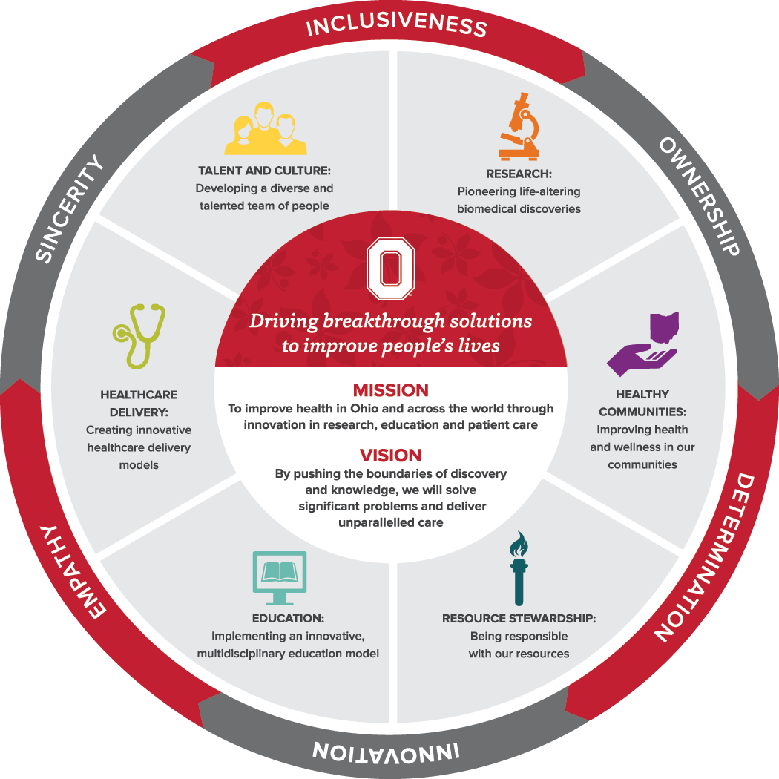
4. What can Boards do to be more successful?
Provide Vision of Output
But the Process is More Important than The Plan
Wexner Medical Center Ohio University

Slide 10
Vision 2010
Performance Pillar Model
Quality
Service
Growth
Finance
People
What
What
What
What
What
Top 100 US Rural Hospital Systems
97% Patient Satisfaction
5% More Market Share
“A” Credit Rating
Top Employer
How
How
How
How
How
Put the Patient First
Recognize & Reward Service Excellence
Expand Role in ED & Chronic Diseases
Operate Performance Driven Processes
Nurture a Culture of Respect & Value
Each unit leader asks and answers 2 questions:
How can our unit/team best contribute to the achievement of the CCMH “Results Hierarchy”?
How can I best earn the work & enthusiasm of my followers to best accomplish my monthly & annual work plans and budgets?
Action Plans & Budgets for Each Division, Department or Unit

Slide 11
5. Resources for further insights:
Health Center Plan as a Provocative Guide
Critical Access Hospitals’ Issues
Rural Health Blueprint for Performance Plans
Balanced Scorecard Institute Guide

Slide 12
Thank you for all you do for the people in your healthcare district!
We hope this short program stimulates your continuous pursuit of enhanced board work to strengthen your healthcare district’s support for health care and health gain in challenging times.
Please contact ACHD to access their many other board support resources.
Jim Rice: 1-612-703-4687 jim_rice@ajg.com

