Slide 1
Governance Toolkit
Board Session 5
Board Self-Assessments
Jim Rice: 1-612-703-4687 jim_rice@ajg.com

Slide 2
ACHD Governance Series
Effective Board Work for Enhanced Service and Performance
Six Short Programs for use by ACHD Members
Community Engagement
Balancing Governance & Management
Board Orientations
Strategic Planning
Board Self-Assessments
Board Education Programming

Slide 3
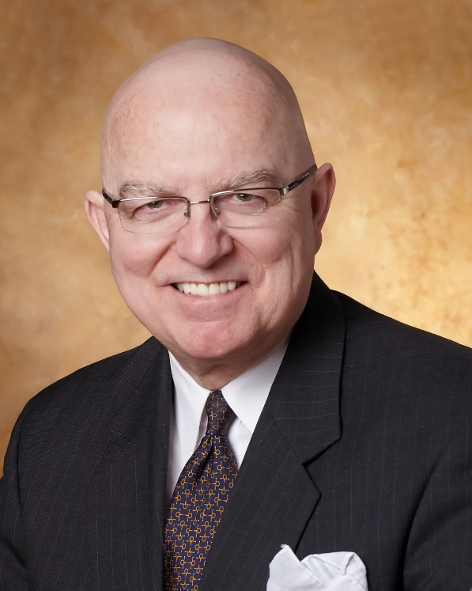
Jim Rice: Governance Adviser
Experienced. Practical. Responsive.
Jim Rice, PhD, FACHE is Senior Adviser with the Governance & Leadership service line of Gallagher’s Human Resources & Compensation Consulting practice, and Chairman of the Akadimi Foundation. Having served on many boards, Jim focuses his consulting work on strategic governance structures and systems for high performing medical groups, hospitals, credit unions and integrated care systems. He is often engaged for enhanced strategic alliances and mergers for large and small not-for-profit organizations; as well as leadership development programming for Physicians, Boards and C-Suite Senior Leaders.
Dr. Rice holds a masters and doctoral degree in management and health policy from the University of Minnesota. He has received the University of Minnesota, School of Public Health Distinguished Alumni Leadership Award; a National Institute of Health Doctoral Fellowship; a US Public Health Service Traineeship in Hospital Management; a Bush Leadership Fellowship at Stanford and the National University of Singapore; and the American Hospital Association’s Corning Award for Excellence in Hospital Planning. He is a Fellow in the American College of Healthcare Executives (ACHE) and has worked in over 35 countries in North America, Asia, Africa and Latin America.
Connect: 1-612-703-4687 jim_rice@ajg.com

Slide 4
What is a good “Board Self-Assessment”?
An effective and valuable BSA (Board Self-Assessment) is a survey, usually conduct every year or every two years, to evaluate the degree to which the board (and often management) believes the board’s work is functioning at a high level of performance.
The survey incorporates questions about key dimensions for good governance of healthcare districts, and invites each board member (and periodically the senior management team) to assess the degree to which they believe the board and its committees are accomplishing their fiduciary duties.
ACHD offers a very good survey tool for free to all Members that generates a useful and easy to read summary of the performance review. The results can then be used to shape an annual board education and development plan for the coming 12-24 months.

Slide 5
2. Why is it important?
Conducting, and then using the results of a Board Self Assessment (BSA) to continuously improve your board work is important because:
Continuous review and improvement is a best practice;
Medicare requires good governance as a means to ensure a culture of good performance via better quality, use of resources, and good access to needed to care;
Boards help ensure compliance with public payer rules;
Performance review helps build confidence among providers, staff, media and donors; and
Board member time, talent and pride are more likely optimized when good self-reflection yields better governance.

Slide 6
3. Common Issues or Challenges?
Lack of board and CEO recognition of the value of Board Self-Assessment to be used as a means to continuously enhanced board work.
Lack of commitment to use the assessment results to guide future board work performance enhancement via board education and development.
Unprepared to invest in ongoing board development to improve the board’s effectiveness and performance growth.
Lack of experience with use of web based, confidential survey tools.
Discomfort of board members to identify less than perfect performance.

Slide 7
4. What can Boards do to be more successful?
Establish a Board Commitment to continuously improve the performance of the Board on behalf of the people served by the healthcare district;
Design assessment process to balance board only survey with one that invites senior managers’ input;
Consider periodically using interviews via outside consultants;
Commit to use results to design annual board education program (See next slide);
Consider comparative discussions with other organizations on their approach and tools.

Slide 8
Revisit Governance Educational Framework
CEO Briefings
Periodic memos prepared by C-Suite Team and routed through CEO to Board on challenges, trends, opportunities, and policy developments in California and US health sector.
Custom Individual Programming
Speakers on Hot Topics
Annually plan for at least two board meetings with Speakers for 15-20 minutes from Medical or Nursing Staff, Executive Team or other health systems on priority topics
Healthcare District
Board Education Plan
Provide custom set of materials for each member based on their identification of topics of interest from next slide. Also leveraged use of ACHD materials.
Small groups of Hospital Board members attend state educational programs and report back to full Board on insights and materials.
State Programs
Summer Community Education Symposium
Hospital to host afternoon events with 2-3 speakers on priority topics related to CHNA and Strategic Plan with invited community leaders and media from the region, ending in light reception with refreshments. Venue outside hospital campus.
Staff Support

Slide 9
5. Resources for further insights:
Board and Executive Teams may explore these resources :
ACHD Supportive Resources on Board Assessments
Sample BSA Guide
BoardEffect Strategy for Board Self-Assessments
BoardSource insights for good assessments

Slide 10
Thank you for all you do for the people in your healthcare district!
We hope this short program stimulates your continuous pursuit of enhanced board work to strengthen your healthcare district’s support for health care and health gain in challenging times.
Please contact ACHD to access their many other board support resources.
Jim Rice: 1-612-703-4687 jim_rice@ajg.com

