Slide 1
Governance Toolkit
Board Session 6
Developing a Board Education Program
Jim Rice: 1-612-703-4687 jim_rice@ajg.com

Slide 2
ACHD Governance Series
Effective Board Work for Enhanced Service and Performance
Six Short Programs for use by ACHD Members
Community Engagement
Balancing Governance & Management
Board Orientations
Strategic Planning
Board Self-Assessments
Board Education Programming

Slide 3
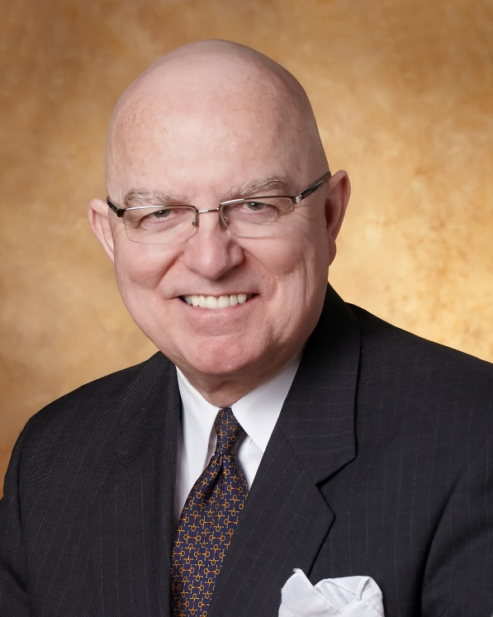
Jim Rice: Governance Adviser
Experienced. Practical. Responsive.
Jim Rice, PhD, FACHE is Senior Adviser with the Governance & Leadership service line of Gallagher’s Human Resources & Compensation Consulting practice, and Chairman of the Akadimi Foundation. Having served on many boards, Jim focuses his consulting work on strategic governance structures and systems for high performing medical groups, hospitals, credit unions and integrated care systems. He is often engaged for enhanced strategic alliances and mergers for large and small not-for-profit organizations; as well as leadership development programming for Physicians, Boards and C-Suite Senior Leaders.
Dr. Rice holds a masters and doctoral degree in management and health policy from the University of Minnesota. He has received the University of Minnesota, School of Public Health Distinguished Alumni Leadership Award; a National Institute of Health Doctoral Fellowship; a US Public Health Service Traineeship in Hospital Management; a Bush Leadership Fellowship at Stanford and the National University of Singapore; and the American Hospital Association’s Corning Award for Excellence in Hospital Planning. He is a Fellow in the American College of Healthcare Executives (ACHE) and has worked in over 35 countries in North America, Asia, Africa and Latin America.
Connect: 1-612-703-4687 jim_rice@ajg.com

Slide 4
Board Education Programming
Focus of Session:
What is a good “Board Education Program”?
Why is it important?
Common issues or challenges?
What can Boards do to be more successful?
Resources for further insights?

Slide 5
What is a good “Board Education Program”?
Board education is a diverse and multi-media set of learning experiences for board members to continuously strengthen their work in three levels:
Collective decision-making for healthcare district vitality
Committee effectiveness
Personal growth, effectiveness, and pride
content driven by self-assessments, Brown Act, and ACHD Certification topics.

Slide 6
2. Why is it important?
Health sector is complex and rapidly changing
Community leaders may have limited insights into hospital fiduciary duties and board governance best practices
Each board member is unique, as are their development needs
ACHD Members often have a small number of board members so access to diverse expertise can be constrained
The Board can set a tone for continuous growth and development from the top for executives, medical staff and other community leaders.

Slide 7
3. Common issues or challenges?
Lack of time and budget
Lack of enthusiasm from CEO and Board Chairperson
Lack of governance model to which educational programming is directed for continuous performance enhancements
Unwillingness to borrow concepts and ideas from the boards of other service/membership industry governing bodies (Hotels, Banks, Chambers of Commerce, Colleges, Churches)
Lack of commitment from board members to improve their work

Slide 8
4. What can Boards do to be more successful?
Establish a culture and policy frame that continuous board development is valuable and essential to the district’s vitality
Make education a part of the board member’s job description
Drive education topics by the district’s strategic plan and Community Health Needs Assessment (CHNA)
Be creative on “Faculty” from within and outside the healthcare district
Build educational experiences around practical case studies and multi-media learning opportunities (See next slide)

Slide 9
Revisit Governance Educational Framework
CEO Briefings
Periodic memos prepared by C-Suite Team and routed through CEO to Board on challenges, trends, opportunities, and policy developments in California and US health sector.
Custom Individual Programming
Speakers on Hot Topics
Annually plan for at least two board meetings with Speakers for 15-20 minutes from Medical or Nursing Staff, Executive Team or other health systems on topics such as shown on next slide.
Healthcare District
Board Education Plan
Provide custom set of materials for each member based on their identification of topics of interest from next slide. Also leveraged use of ACHD materials.
Small groups of Hospital Board members attend state educational programs and report back to full Board on insights and materials.
State Programs
Summer
Community Education Symposium
Hospital to host afternoon events with 2-3 speakers on priority topics related to CHNA and Strategic Plan with invited community leaders and media from the region, ending in light reception with refreshments. Venue outside hospital campus.
Staff Support

Slide 10
Revisit Governance Educational Framework
Please circle the 2-3 topics you would most be interested in from this list:
Topics for Board Education through end of 2020:
Payment system reforms and methods, especially “Pay for Performance” or “Value for Money Contracting” for physicians and for hospitals
Trends in hospital cost reductions
Patient centered care and excellent patient experiences
Trends in philanthropic fund raising
Provider burnout in hospitals
Balancing mental health and physical health programming
Maximizing relationships with primary care physicians
Building and governing community health partnerships
Trends in governance best practices
Health Information Technologies and Electronic Medical Records
Hospital Physician Integration and Alignment
Physician leadership development academies and programs
Regulatory oversight and compliance challenges for board members
Succession planning for boards and CEOs
Enhancing medical staff relationships
Safety and Quality
Health Challenges in rural health
Clinical integration and successful clinical service lines
Others you can define here?

Slide 11
5. Resources for further insights:
IHI Boards and Quality Programming
State Hospital Programs: Washington
State Hospital Programs: ACHD
Public Health Institute Programs

Slide 12
Thank you for all you do for the people in your healthcare district!
We hope this short program stimulates your continuous pursuit of enhanced board work to strengthen your healthcare district’s support for health care and health gain in challenging times.
Please contact ACHD to access their many other board support resources.
Jim Rice: 1-612-703-4687 jim_rice@ajg.com

