Slide 1
What Census Data Tell Us About the City of Westerville, Ohio
August 2, 2022
Tim Sarko
Data Dissemination Specialist
U.S. Census Bureau, Data Dissemination and Training Branch
1

Slide 2
Outline
2020 Census Redistricting File – What it tells us about the City of Westerville, OH
American Community Survey (ACS) basics
Data Equity
Resources for learning more
Questions
2

Slide 3
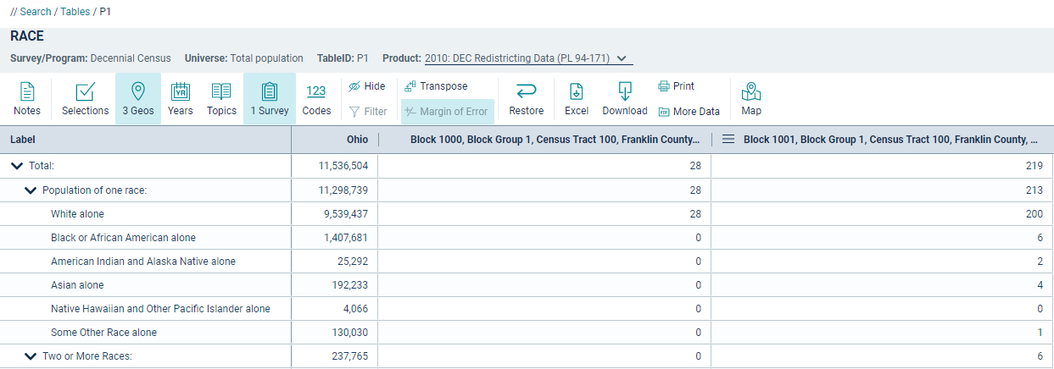
Redistricting File
sector
Public Law 94-171 directs the Census Bureau to provide data to the governors and legislative leadership in each of the 50 states for redistricting purposes. This product is the first file released that will include demographic and housing characteristics about detailed geographic areas.
Subjects will include:
Voting age
Race
Hispanic or Latino origin
Occupancy status
Group quarters population by major GQ types
Geography: Census Block

Slide 4
What Topics are Available in the P.L. 94-171 Data?
Tables: P = Population H = Housing
P1: Race
P2: Hispanic or Latino, and Not Hispanic or Latino by Race
P3: Race for the Population 18 Years and Over
P4: Hispanic or Latino, and Not Hispanic or Latino by Race
for the Population 18 Years and Over
P5: Group Quarters Population by Major Group Quarters Type
H1: Occupancy Status
https://data.census.gov/cedsci/all?q=&g=0500000US39035&d=DEC%20Redistricting%20Data%20%28PL%2094-171%29

Slide 5
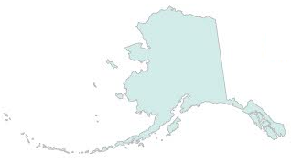
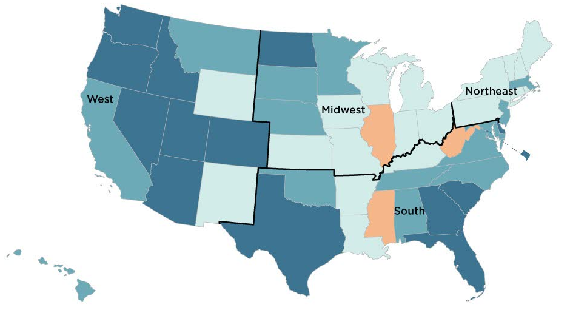
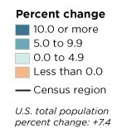
Percent Change in State Population (2010 to 2020)
Utah was the fastest growing state, increasing by 18.4% between 2010 to 2020.
Texas, Florida, California, Georgia and Washington accounted for nearly half of the total population numeric increase in the U.S. between 2010 and 2020.
Ohio increased by 262,944 in population (2.3%) from 2010 to 2020.

Slide 6
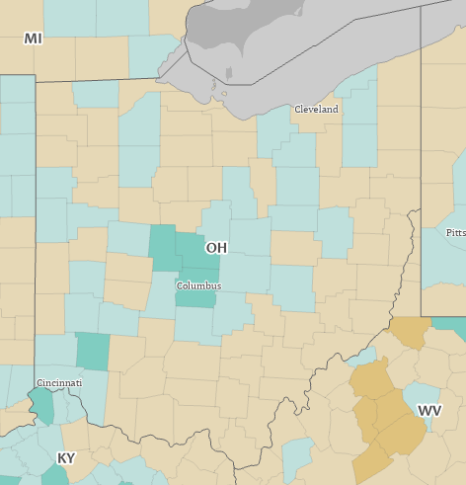
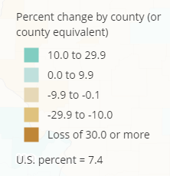
Percent Change in Population for Ohio Counties (2010 – 2020)
Ohio’s population increased by 262,944 (or 2.3%) from 2010 to 2020
Franklin County’s population increased by 160,393 (or 13.8%) from 2010 to 2020
Delaware County’s population increased by 39,910 (or 22.9%) from 2010 to 2020
5 fastest growing counties in Ohio: Delaware (22.9%), Union (20.0%), Warren (13.9%), Franklin (13.8%), Fairfield (8.7%)

Slide 7
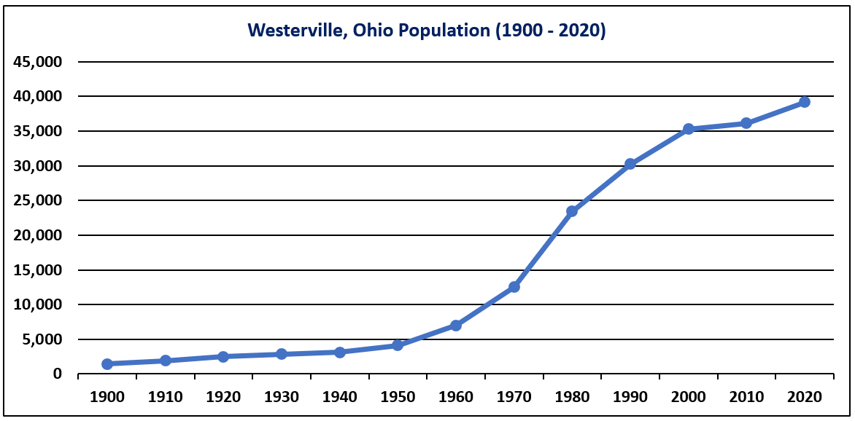
Westerville, Ohio Population (1900 - 2020)
39,190
1,462
Westerville’s population increased by 3,070 (or 8.5%) from 2010 to 2020.

Slide 8
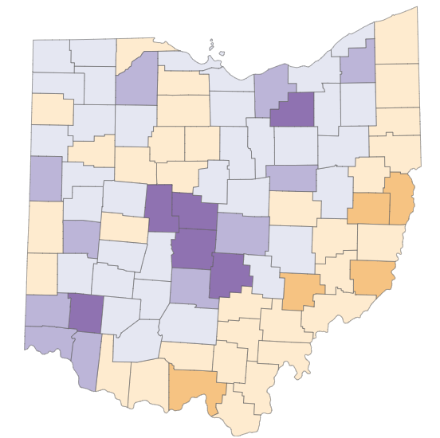
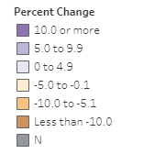
Percent Change in Population 18 Years and Over for Ohio Counties

Slide 9
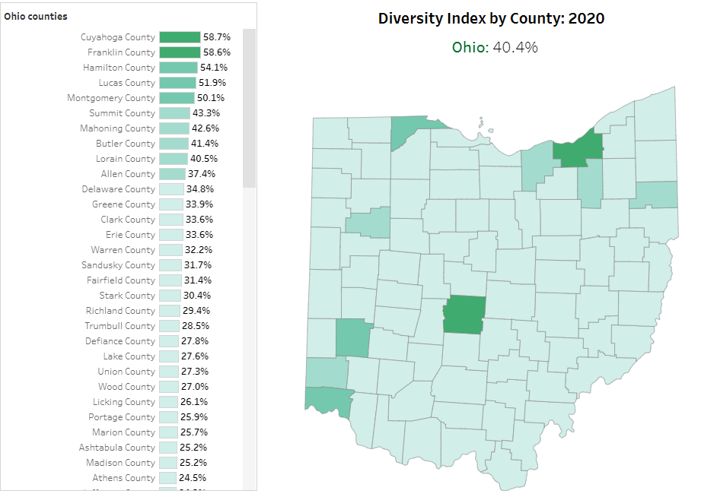
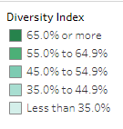
Diversity Index – Ohio Counties
Diversity Index measures the probability that 2 people chosen at random will be from different race and ethnicity groups.
Delaware County had a 21.5% Diversity Index in 2010 which increased to 34.8% in 2020.
Franklin County had a 49.8% Diversity Index in 2010 which increased to 58.6% in 2020.

Slide 10
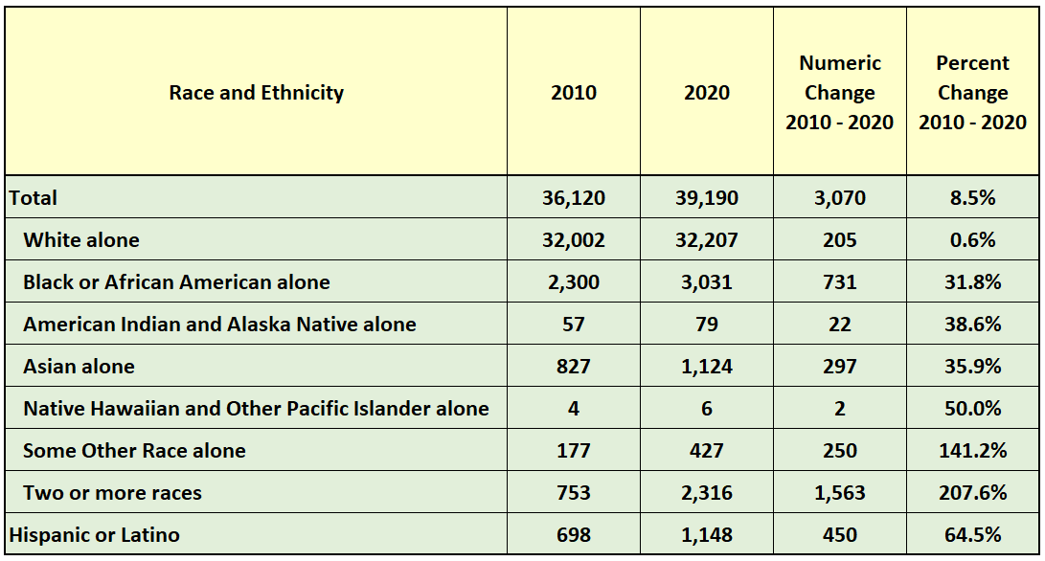
Change in Race and Ethnicity for Westerville, Ohio (2010 – 2020)

Slide 11
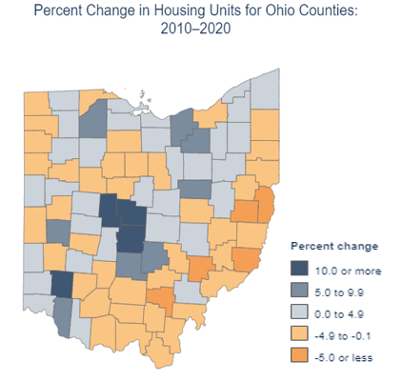
Percent Change in Housing Units (2010 – 2020)
Source: 2010 & 2020 Census Redistricting Data

Slide 12
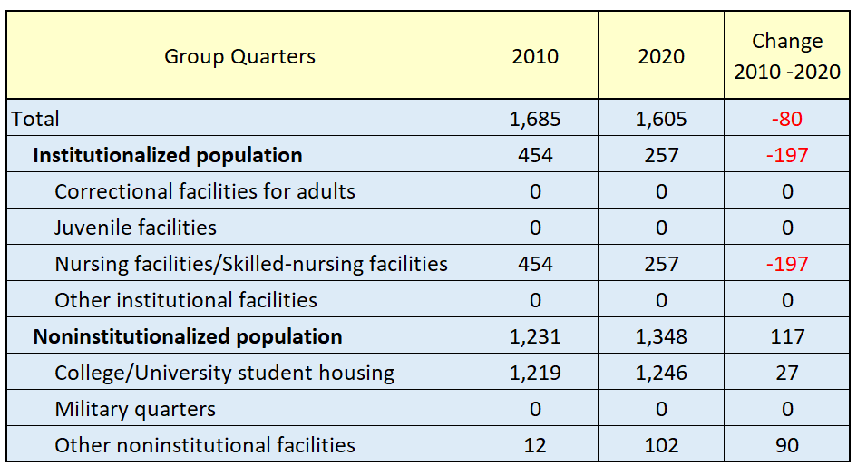
Change in Group Quarters Population by Major Group Quarters Type (2010 – 2020)
Westerville, Ohio
Source: 2010 & 2020 Census Redistricting Data

Slide 13
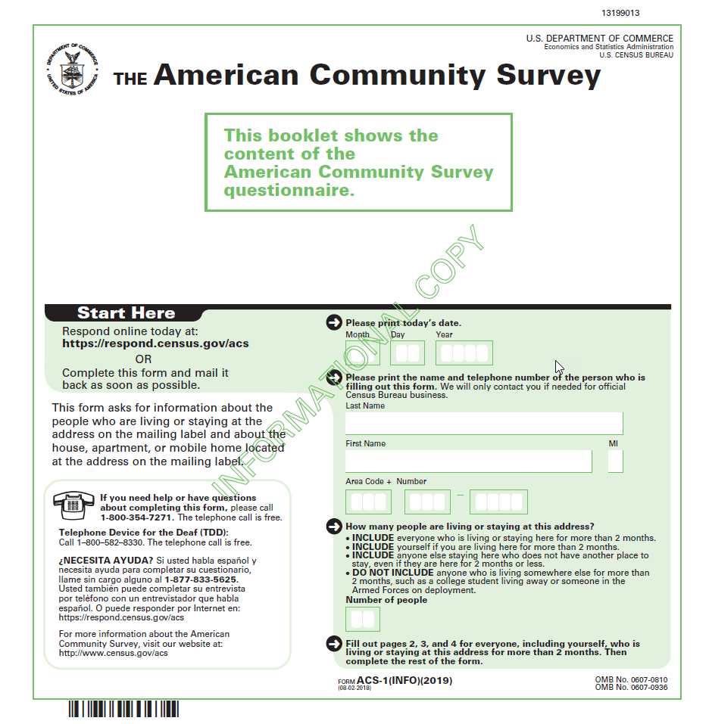
American Community Survey (ACS) Basics
The American Community Survey is on the leading edge of survey design, continuous improvement, and data quality
The nation’s most current, reliable, and accessible data source for local statistics on critical planning topics such as age, children, veterans, commuting, education, income, and employment
Surveys 3.5 million addresses and informs over $675 billion of Federal government spending each year
Covers 40+ topics, supports over 300 evidence-based Federal government uses, and produces 11 billion estimates each year
Key annual data releases:
1-year Estimates (for large populations)
5-year Estimates (for very small populations)

Slide 14
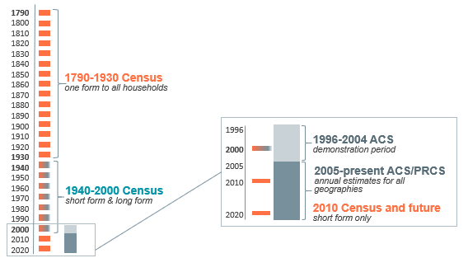
American Community Survey (ACS) & the Census

Slide 15
American Community Survey (ACS) Differences
 | ACS | Census
Purpose | Sample estimates | Official counts
Collects | Detailed social, economic, housing and demographic characteristics | Basic demographics
Produces | Population and housing characteristics | Population and housing totals
New Data Every | Year | 10 years
Data Reflect | Period of time | Point in time

Slide 16
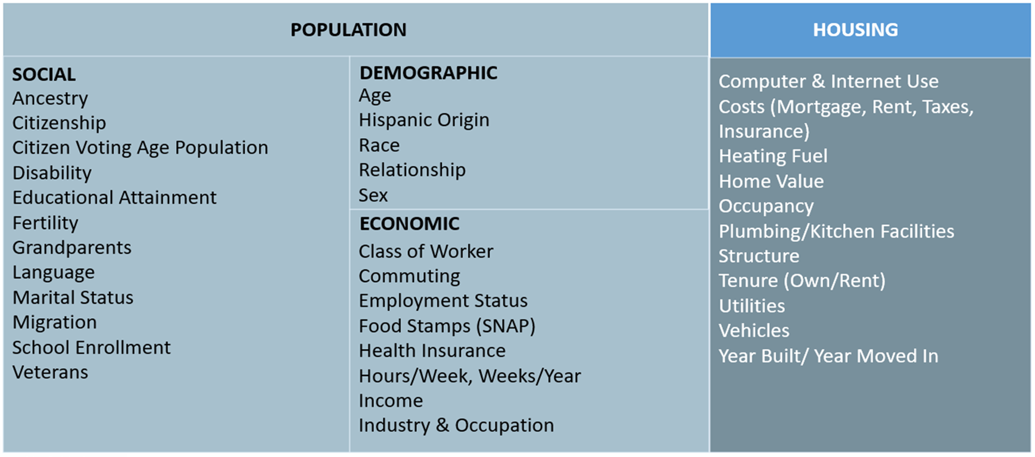
American Community Survey (ACS) Data

Slide 17
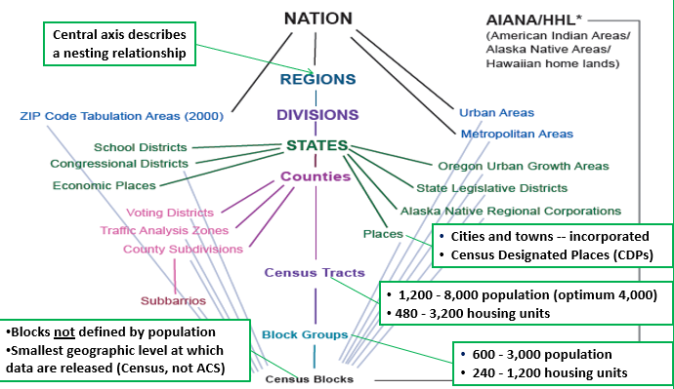
American Community Survey (ACS) Select Geographies

Slide 18
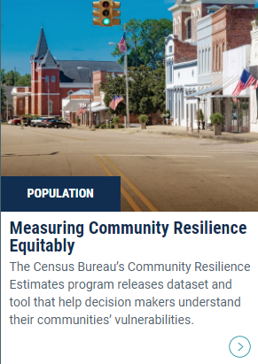
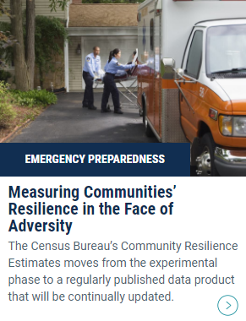
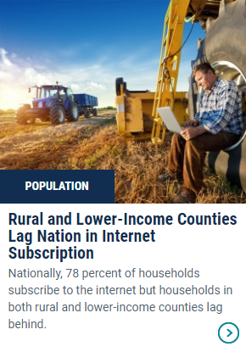
Data Equity

Slide 19
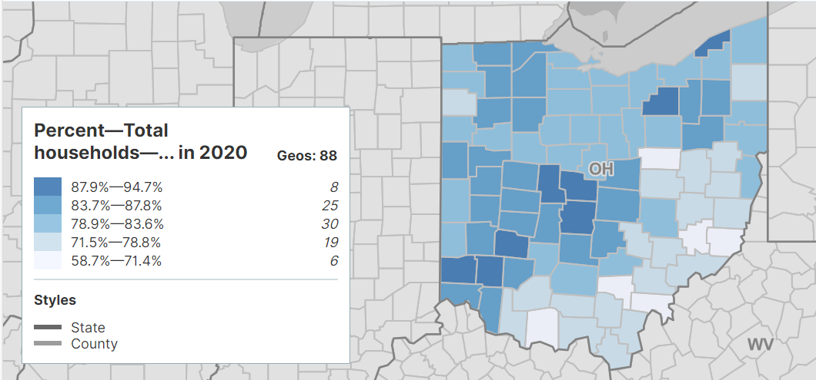
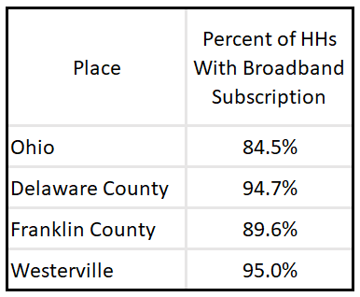
Percent of Households With a Broadband Subscription (2020)
Source: 2020 ACS 5-Year Estimates

Slide 20
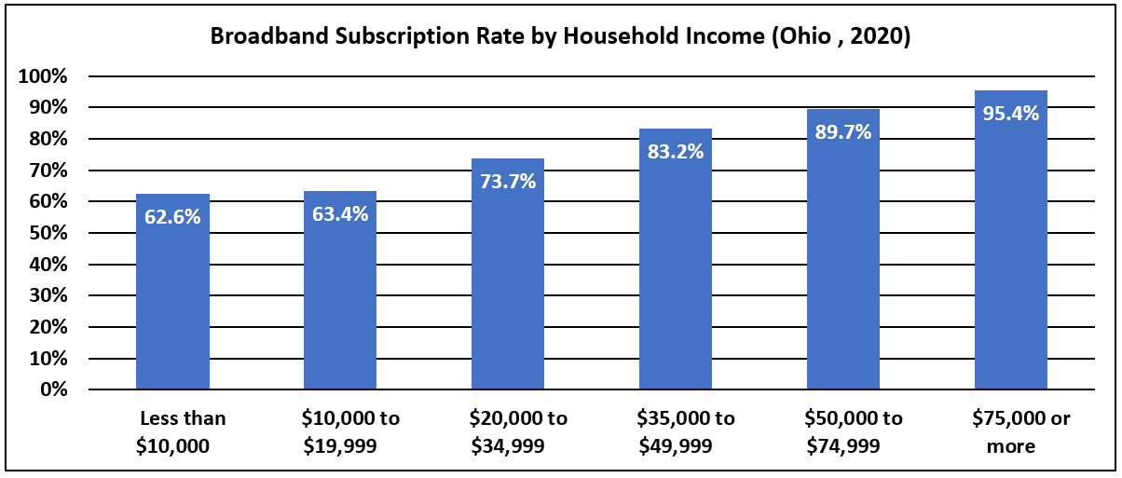
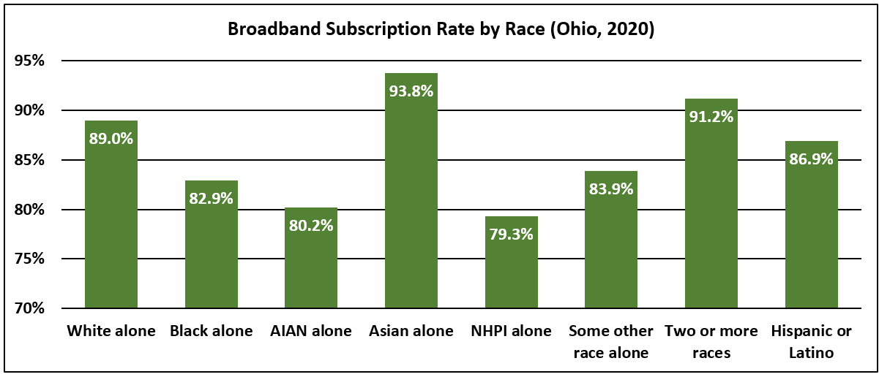
Broadband Subscription Rates by Household Income, Race & Ethnicity (Ohio)
Source: ACS 5-Year Estimates

Slide 21
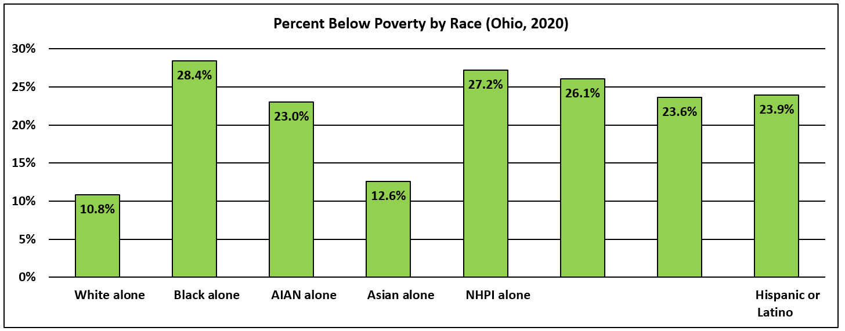
Poverty Rate by Race & Ethnicity (Ohio, 2020)
Percent Below Poverty by Race & Ethnicity (Ohio, 2020)
2010 2020 2010 2020
Some other race alone
Two or more races
Westerville had a 5.3% poverty rate (2020)
Source: 2020 ACS 5-Year Estimates

Slide 22
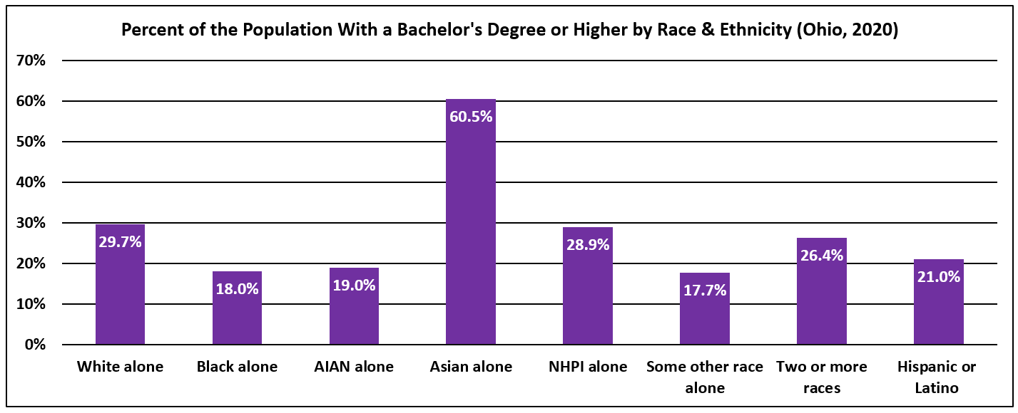
Percent of Population With a Bachelor’s Degree or Higher by Race (Ohio, 2020)
55.5% of the population of Westerville had a Bachelor’s degree or higher
Source: 2020 ACS 5-Year Estimates

Slide 23
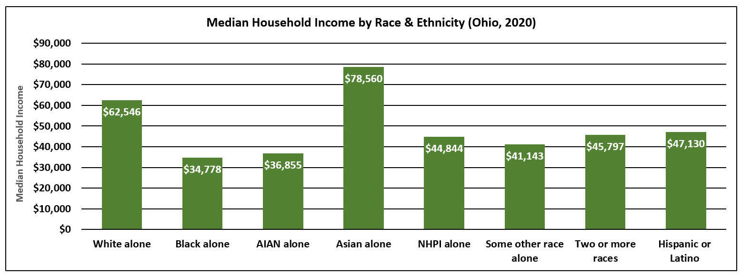
Median Household Income by Race & Ethnicity (Ohio, 2020)
Median household income for Westerville was $92,287 (2020)
Source: 2020 ACS 5-Year Estimates

Slide 24
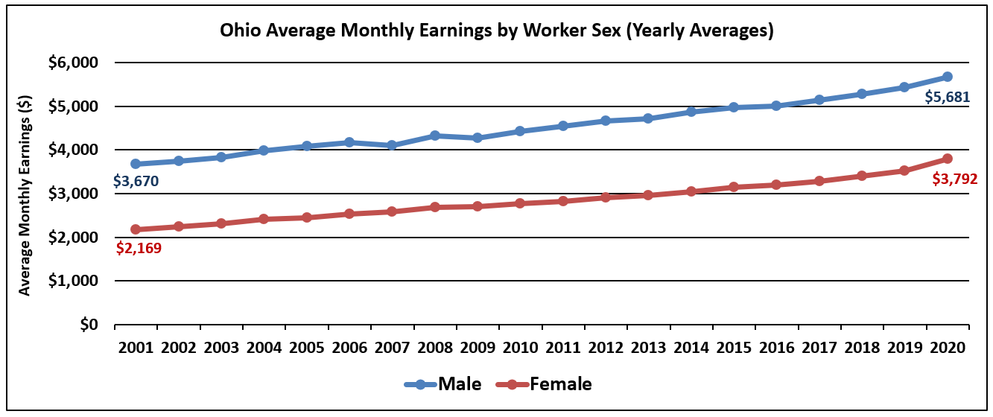
Average Monthly Earnings by Worker Sex (Ohio, 2001 – 2020)
Average monthly earnings for males was $6,070 and females was $4,224 for Columbus Metro Area (2020)
Source: Longitudinal-Employer Household Dynamics Program

Slide 25
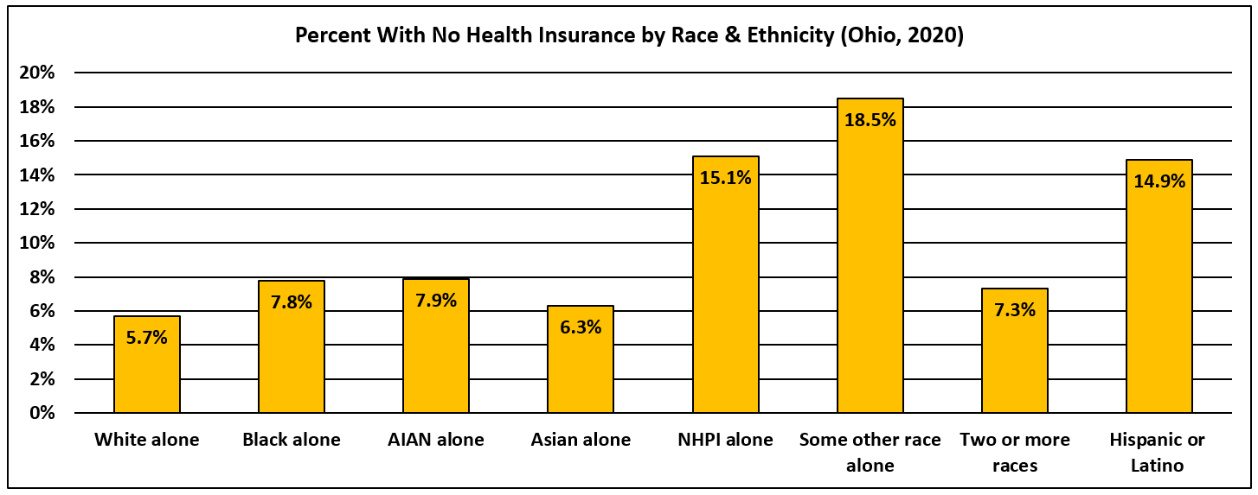
Percent of the Population With No Health Insurance by Race & Ethnicity (Ohio)
2.5% uninsured in Westerville (2020)
Source: 2020 ACS 5-Year Estimates

Slide 26
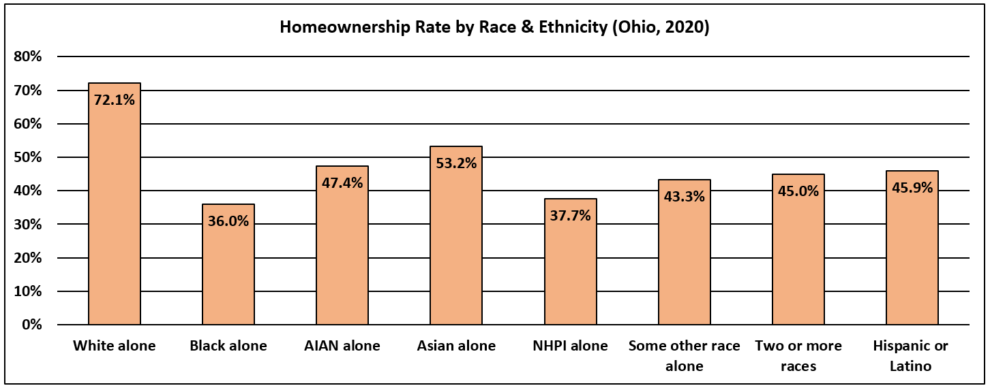
Homeownership Rate by Race & Ethnicity (Ohio, 2020)
The homeownership rate for Westerville was 77.7% (2020)
Source: 2020 ACS 5-Year Estimates

Slide 27
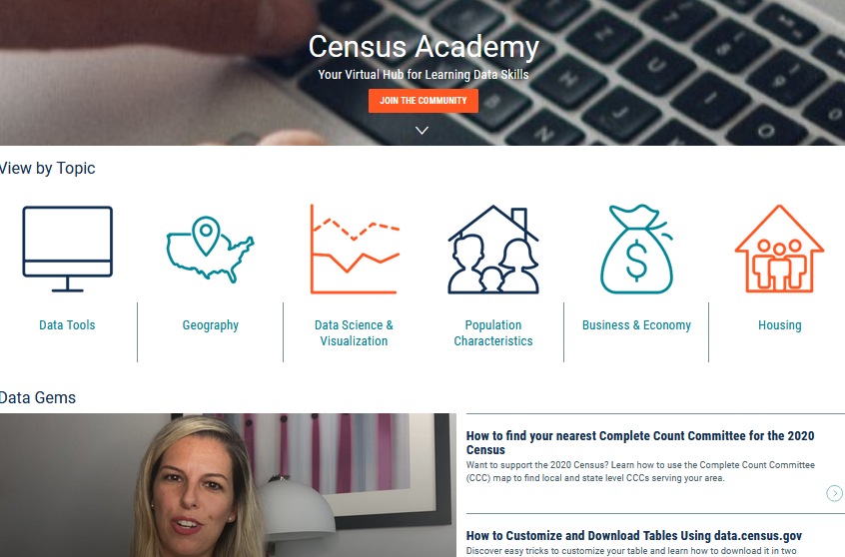
Data Dissemination and Training
Census.gov/Academy
Bring our data experts to you.
Request a free data training for your organization.
Receive our Data Gems.
These short “how-to” videos are an easy and quick way to increase your knowledge of Census data. Get them in your inbox!
Get access to our Courses.
You will learn-at-your-own-pace with these video-tutorials designed for different skill levels.
Interact with our instructors via Webinars.
Learn about our data releases and tools while attending these live virtual classes.
Contact us:
Census.askdata@census.gov
1-844-ASK-DATA
Share your ideas and feedback at census.academy@census.gov

Slide 28
THANK YOU

