Slide 1
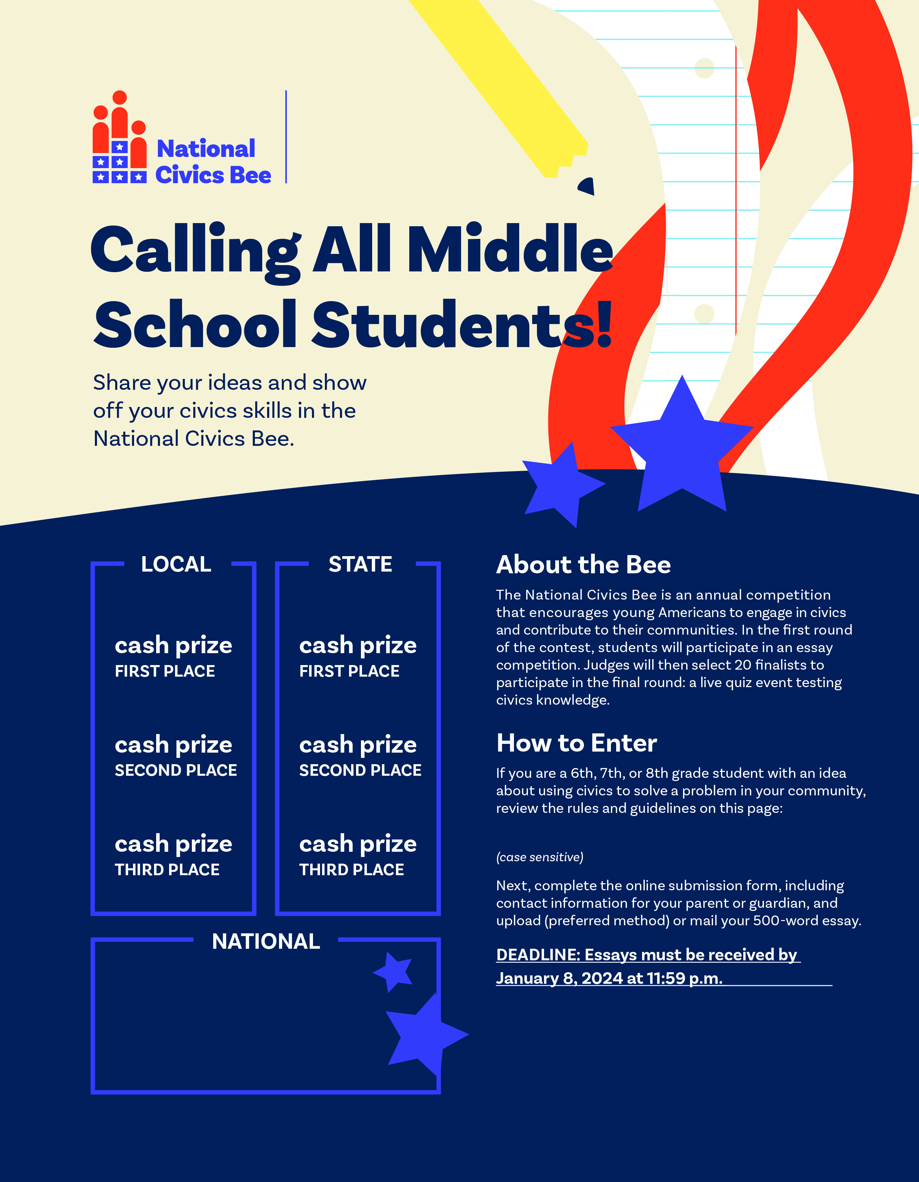
[CHAMBER LOGO]
$500
$1,000
$250
$500
$125
$250
[CHAMBER WEBSITE URL]
State Finalists who advance to the national competition will compete for prizes worth more than $50,000.
[U.S. TIMEZONE]
[CHAMBER NAME]
[Address Line 1]
[Address Line 2]
[email address]
The National Civics Bee is presented by the [CHAMBER NAME], with support from the U.S. Chamber of Commerce Foundation.

Slide 2
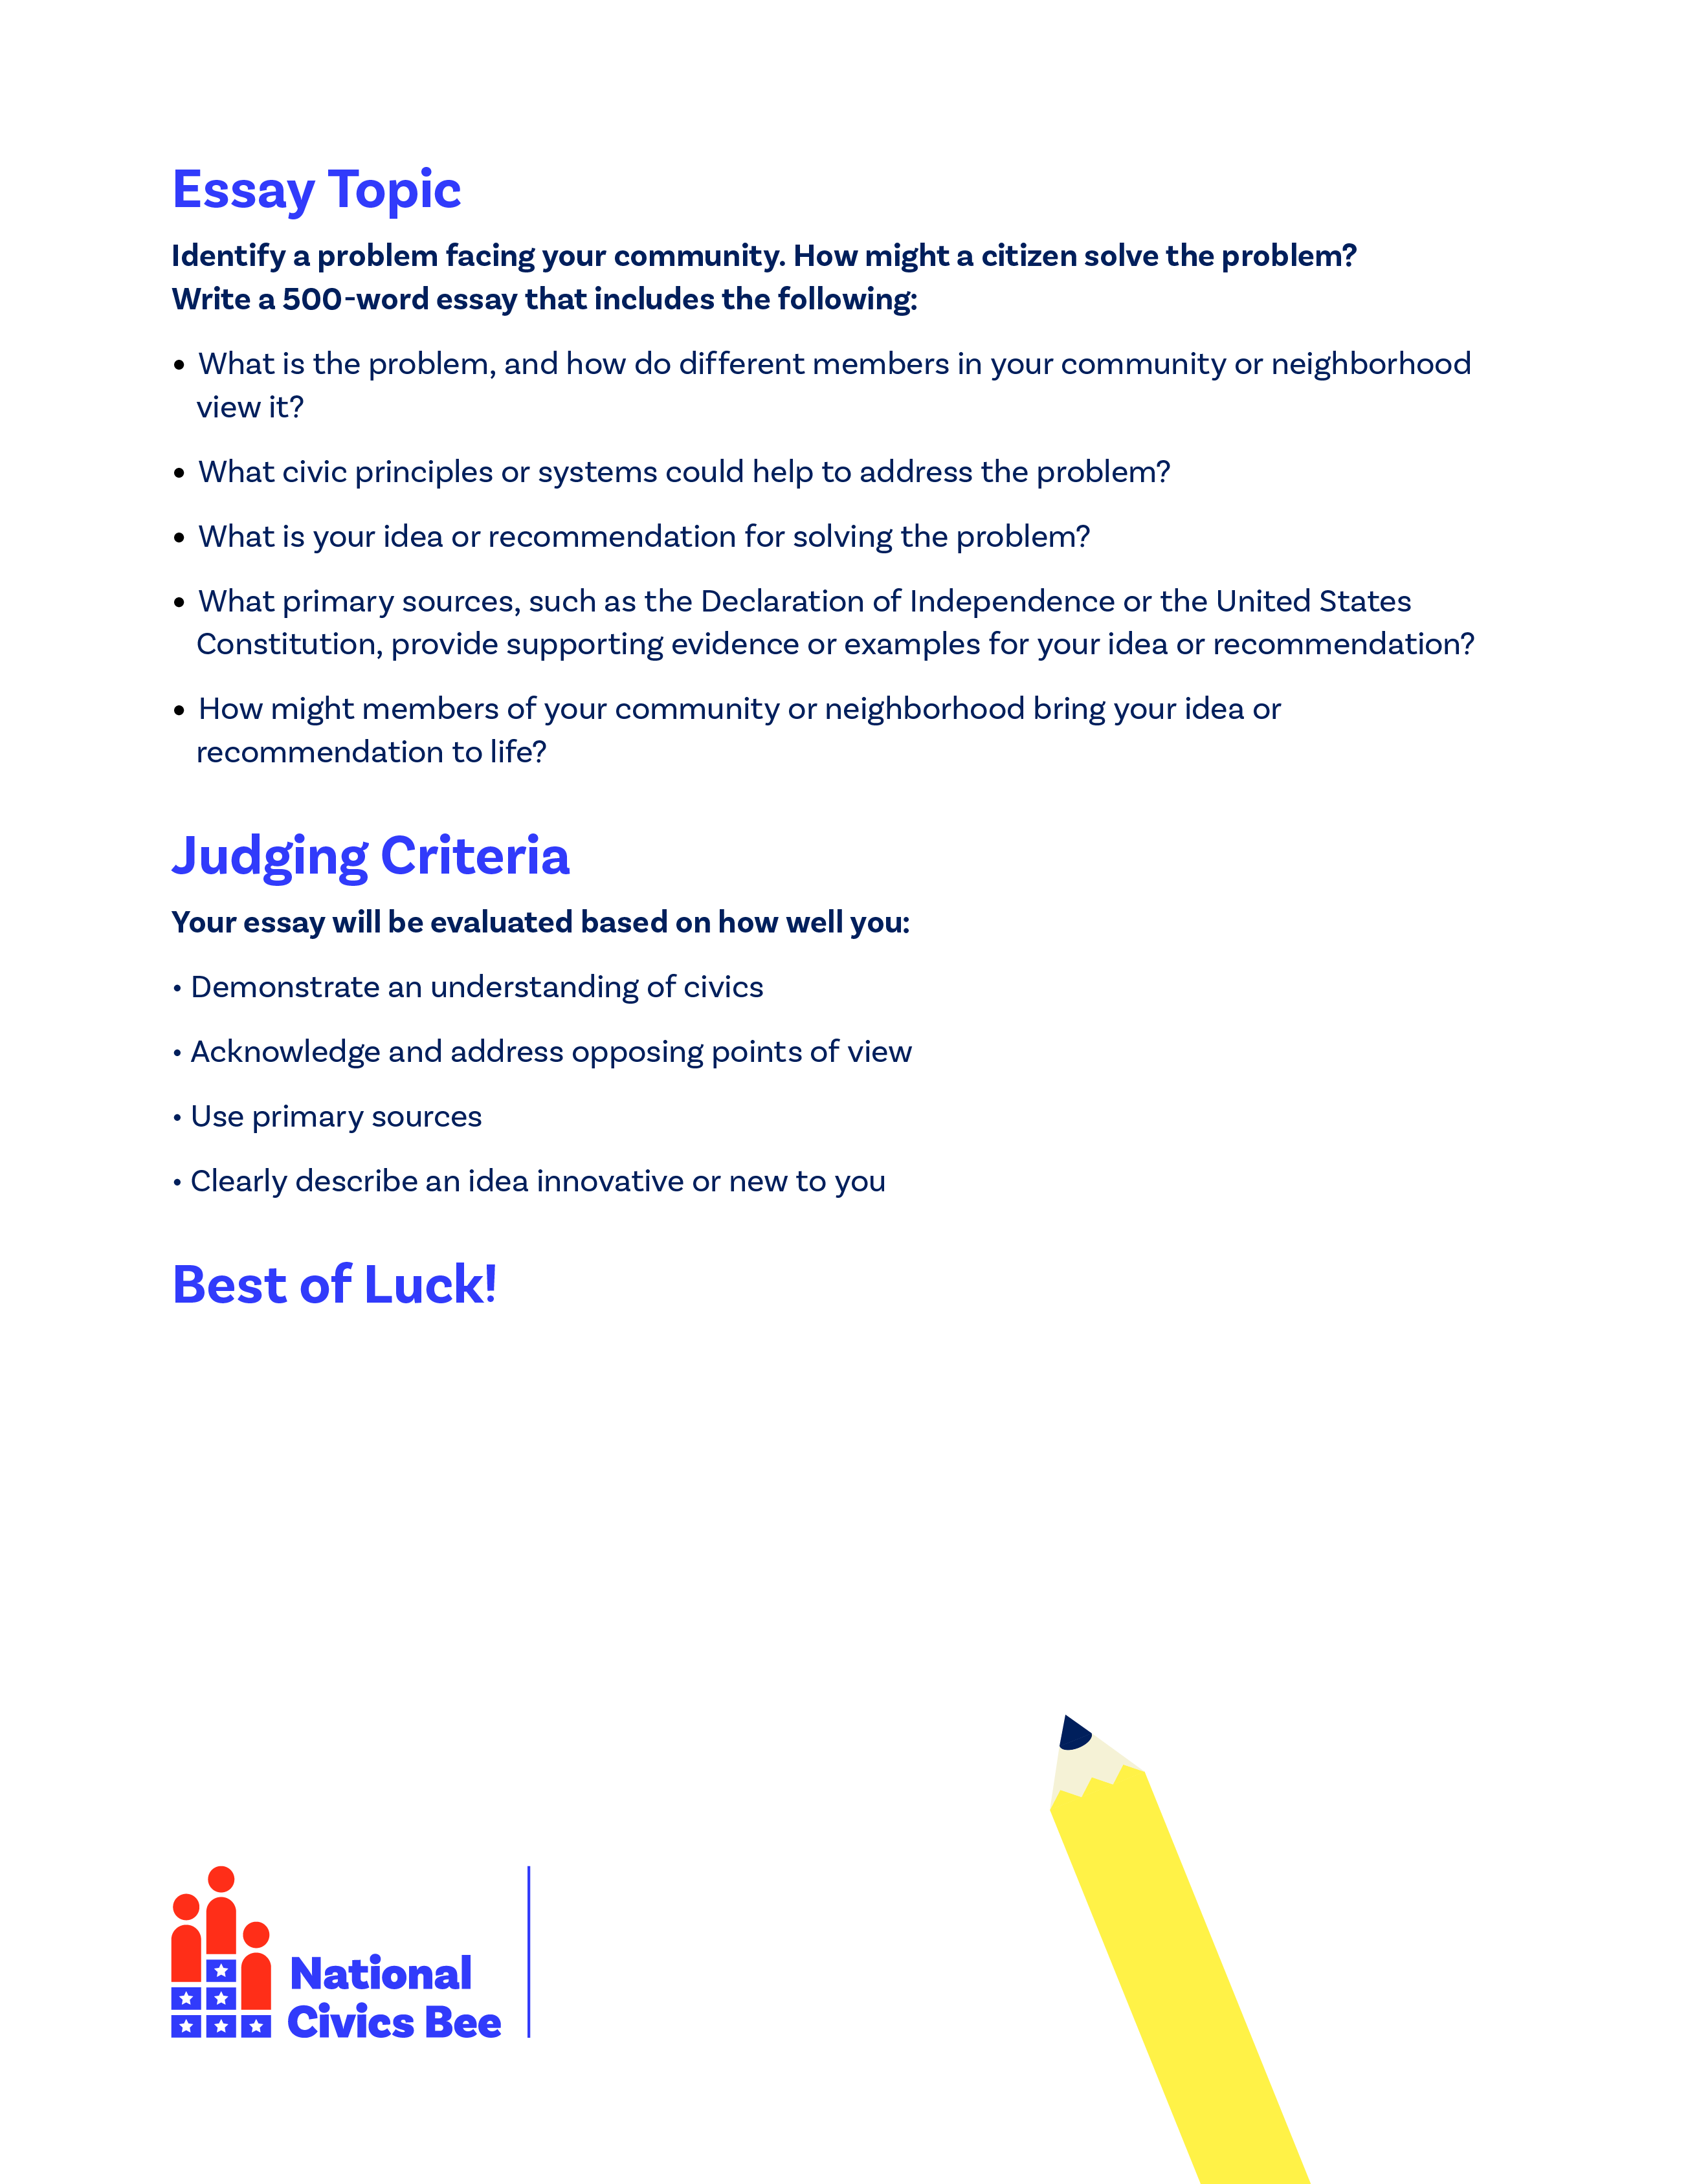
[CHAMBER LOGO]

