Slide 1
Wine
Labeling
Demaris Brown
TTB Specialist

Slide 2
How To Get It Right The First Time!!
Mandatory Items
Top Reasons for Corrections for Oregon Wineries
Allowable Revisions

Slide 3
Mandatory Label Information
Brand Label must have:
Brand Name
Class/Type
Appellation
(under certain circumstances)

Slide 4
Mandatory Label Information
Any Label
Bottler’s Name and Address
Net Contents
Sulfite Declaration
Alcohol Content
Health Warning Statement
Country of Origin Statement- Imports only

Slide 5
Brand Name
Name under which the product is sold, usually the most prominent piece of information on the label.
If there is no brand name, name of the bottler/importer as shown on the brand label
May not create a misleading impression
Must appear on the Brand Label
27 CFR 4.33

Slide 6
Brand Name
Front Label
Back Label

Slide 7
Class and Type Designation
Definition- The specific identity of the wine
    The required class and type designation is based on the defined classes and types
    The required designation identifies the labeled wine as to its specific class and/or type
  CLASS
  The broad category “wine” is divided, under standards of identity, into 9 defined classes, e.g., “grape wine,” “Aperitif Wine,” “Fruit Wine” etc…
  TYPE
  Except for Other than Standard Wine, the types are defined as: “Table Wine,” “Dessert Wine,” “Vermouth,” etc…
27 CFR 4.34

Slide 8
Standards of Identity
Nine classes:
Grape Wine
Sparkling Grape Wine
Carbonated Grape Wine
Citrus Wine
Fruit Wine
Wine from Other Agricultural Products
Aperitif Wine
Imitation or Other than Standard Wine
Retsina Wine
27 CFR 4.21

Slide 9
Class and Type
Examples
“Red Wine”, “White Wine”, “Sparkling Wine,” “Peach Wine,” “Honey Wine”
“Table wine” and “Dessert wine" may appear in lieu of the class designation for grape wine.
  Table Wine: 7 – 14% alc/vol
  Dessert Wine: 14.1% - 24% alc/vol
A varietal designation(grape type)
  Chardonnay
  Pinot Noir
A truthful and adequate statement of composition may be used in lieu of a class designation that is not defined in the Standards of Identity.
Sangria-Grape wine with Natural flavors added
Margarita Wine Cocktail-Grape wine with Natural flavors added
27 CFR 4.34

Slide 10
Class/Type Designation
Front Label
Back Label

Slide 11
Alcohol Content
Table Wine may be used for wine with
7-14% alcohol by volume
Alcohol __% by volume
Alcohol __% to __% by volume, for ranges
“Alc.” and “Vol.” or “Alc” and “Vol”
27 CFR 4.36

Slide 12
Alcohol Content
Front Label
Back Label

Slide 13
Appellation of Origin
Mandatory if any of the following appear on the label:
Grape Varietal
Vintage Date
Semi-Generic Designation
      (if Grandfathered)
Estate Bottled/Grown
Must appear on the Brand Label
27 CFR 4.25, 4.23, 4.24, 4.26, 4.27

Slide 14
Appellation Of Origin
Front Label
Back Label

Slide 15
Name & Address Statement
Name or Trade name of the Bottler as listed on the permit
Address (City and State) of the bottler as listed on the permit
May appear on any label
27 CFR 4.35(a)

Slide 16
Name and Address
Front Label
Back Label

Slide 17
Net Contents
Metric standards of fill; authorized sizes per 27 CFR 4.72
May be on label or etched/blown into the container
“ml” on containers of less than 1 liter and “L” on container of one liter or more
May appear on any label
27 CFR 4.37, 4.72

Slide 18
Net Contents
Front
Label
Back Label
2017

Slide 19
Sulfite Declaration
Must declare if 10 ppm or more
“Contains Sulfites”
Statement may appear on any label
If less than 10 ppm, may be omitted:
      Obtain Lab Analysis
      Attach analysis to COLA
27 CFR 4.32(e)

Slide 20
Sulfite Declaration
Front Label
Back Label

Slide 21
Health Warning Statement
GOVERNMENT WARNING: (1) ACCORDING TO THE SURGEON GENERAL, WOMEN SHOULD NOT DRINK ALCOHOLIC BEVERAGES DURING PREGNANCY BECAUSE OF THE RISK OF BIRTH DEFECTS. (2) CONSUMPTION OF ALCOHOLIC BEVERAGES IMPAIRS YOUR ABILITY TO DRIVE A CAR OR OPERATE MACHINERY, AND MAY CAUSE HEALTH PROBLEMS.
May appear on any label
27 CFR 16

Slide 22
Health Warning Statement
The words “GOVERNMENT WARNING” must be in Capital Letters and Bold Type
The “S” in Surgeon and “G” in General must be capitalized
Appear as one statement
Legible on contrasting background
Separate and Apart
27 CFR 16

Slide 23
Health Warning Statement
Front Label
Back Label

Slide 24
Allowable Revisions
When do I NOT need to get new approval?
Allowable Revisions- https://ttb.gov/allowable-revisions/label-generator.shtml

Slide 25
Includes but not limited to:
Deleting non-mandatory
Repositioning
Change color/font
Percentage of blend
Vintage date
Change name or Trade Name to reflect a name that is listed on your permit.
Change “Produced” to “Vinted” or “Cellared”
Net Contents
Alcohol Content
Age Statement

Slide 26
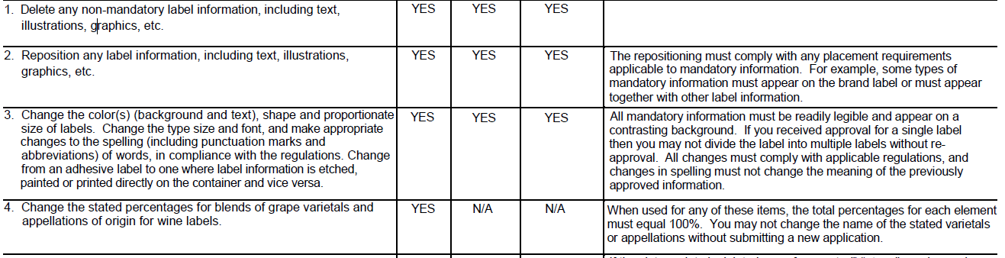

Approved COLA
Allowable revision
Wine for a
Rainy Day
Wine for a
Rainy Day
Albariño
Virginia
2014
Albariño
Virginia
2014
12.5% Alc. by Vol. Reserve 750 ml
12.5% Alc. by Vol. 750 ml
Alcohol & Tobacco Tax & Trade Bureau

Slide 27
Approved COLA
Allowable revision
SUNNYSIDE ACRES
SUNNYSIDE ACRES
White Wine
Finger Lakes
New York
New York
Finger Lakes
White Wine
Alcohol & Tobacco Tax & Trade Bureau

Slide 28
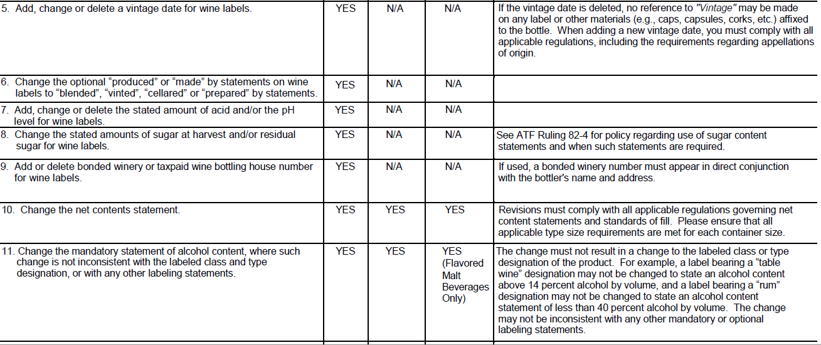

Approved COLA
Allowable revision
Dog House
Red Table Wine
Dog House
Red Table Wine
750 ml
1 Liter
Alcohol & Tobacco Tax & Trade Bureau

Slide 29
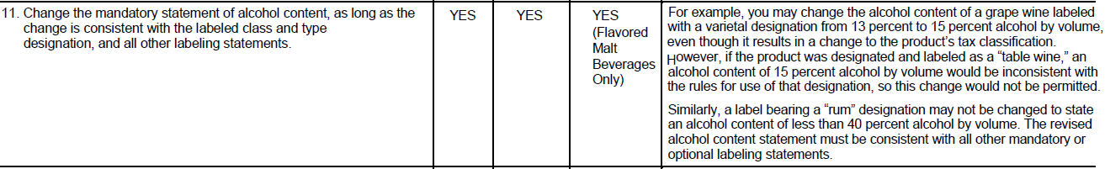

Approved COLA
Allowable revision
Whistlin’ Jack’s
Whistlin’ Jack’s
Texas
Chardonnay
Texas
Chardonnay
12% Alc./Vol. 750ml
15% Alc./Vol. 750ml

Slide 30
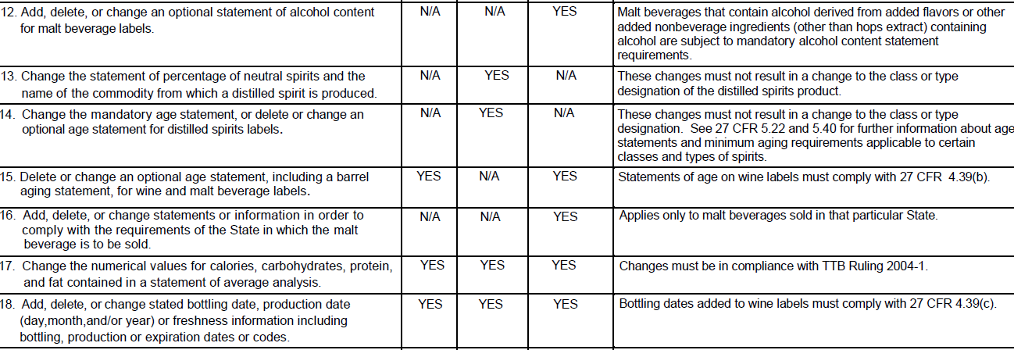
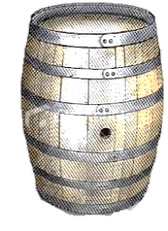
Approved COLA
Allowable revision
Bailey Best
Bailey Best
Zinfandel
Zinfandel
California
California
Ale aged in Bourbon Barrels
Aged 18 months
in New Oak Barrels
Aged 28 months
in New Oak Barrels
750 ML
750 ML
Alcohol & Tobacco Tax & Trade Bureau

Slide 31
Top Reasons for Correction
C/T Designation is missing
Name or Trade Name are incorrect
Clarification Needed
Application Omissions
Application not submitted by the bottler
Wrong Label uploaded as the Brand label
General Misleading
Appellation Conflict
C/T info in Brand, Fan-ciful Name or Appellation field
Appellation is missing
*Highlighted in Red are application errors

Slide 32
Questions

