Slide 1
SFFMA Volunteer Fire Chiefs Academy

Slide 2
SFFMA Volunteer Fire Chiefs Academy
Session 2
Administration Management
Budget Concepts
Chief Chris Barron Chief Bruce Woods
Manchaca VFD Texas A&M Forest Service

Slide 3
BUDGET DEFINITION
A PLAN OF FINANCIAL OPERATION CONTAINING AN ESTIMATE OF PROPOSED EXPENDITURES FOR A GIVEN PERIOD AND THE PROPOSED MEANS OF FINANCING THEM, USUALLY FOR A SINGLE FISCAL
YEAR.
Notes:
More important definition is that Budgeting is a Planning Process. It is critical that Fire Chiefs be active in all aspects of the budget process. Over the time of the course will go into details of the different types of budgets, things that the Chief need to be aware of, the budget progress.

Slide 4
Objective Of Budgetary Controls
To ensure compliance with legal provisions contained in the annual appropriated budget approved by a governmental agency or legal entity
Regardless of the Size or Type of Fire Department; all Fire Department’s need to have a budgetary control system in place
Notes:
Objectives of why we have budget controls

Slide 5
Required by State Law
Political Subdivision Type
Who Approves
Municipalities
County Government
Emergency Services Districts
County Commissioner Court
City Council
Emergency Services Board
Hospital District Board
MUD District Board
Wait Our FD isn’t a Political Subdivision
Provide Services to and receive Funding From
Fire Department Boards
Notes:
There are a large number of VFD in Texas that ARE NOT political subdivisions. This slide shows the different types of political subdivisions and who approves their budgets. For those fire departments that are not political subdivisions BUT receive funding from political subdivisions are impacted by state laws related to budgeting. However for FD that are not political subdivisions and do not receive any funds from any political subdivisions are not required by law to complete a budget BUT their BYLAWS may require it. Regardless of the law budgeting is a planning process and is critical to any department

Slide 6
Types of Budgets
Balanced Budget: Has no deficit or surplus. The revenues coming are equal to the expenditures.
Need to Ponder Completing a Needs Assessment
Line Item Budget: Simple to the point budget. Minimal information regarding purpose of the expense line item.
Majority of Volunteer Fire Departments use a Line Item Budget
Notes:
All local government budgets in Texas are balanced budgets (unlike the federal government ). Line Item budget is most common type of budget. One key item to consider that line-item budgets do not require completing a needs assessment

Slide 7
Line- Item Budget
Four basic parts of Line-Item Budget
Revenue
Operation Ending Fund Balance
Operating Expenses Budget
Capital
Notes:
Example of a line-item budget showing each expense object with a annual expense budget.

Slide 8
Line- Item Budget
Revenue
Source | 2015 Actual | 2016 Actual | 2017 Actual | 2018 Budget
ESD #2 | $210,000 | $210,000 | $215,000 | $215,000
Donations | $ 8,800 | $ 7,009 | $ 2,910 | $ 2,000
AMR | $ 2,000 | $ 2,755 | $ 3,120 | $ 3,200
Investment | $ 1,001 | $ 1,001 | $ 1,001 | $ 1,001
Total Operating Revenues | $221,001 | $220,765 | $222,031 | $221,201
Notes:
Example of a line-item budget showing each expense object with a annual expense budget.

Slide 9
Line- Item Budget
Operating Ending Fund Balance
Available Ending Fund Balance
Fund Balance | 2015 Actual | 2016 Actual | 2017 Actual | 2018 Budget Projected
Total | $222,301 | $220,812 | $222,541 | $215,000
Notes:
Example of a line-item budget showing each expense object with a annual expense budget.

Slide 10
Line- Item Budget
Operating Expenses
Title | 2015 Actual | 2016 Actual | 2017 Actual | 2018 Budget
Fuel | $48,000 | $51,234 | $46,719 | $55,000
Supplies | $ 3,221 | $ 3,880 | $ 3,910 | $ 4,000
Utilities | $ 4,334 | $ 5,755 | $ 5,920 | $ 6,200
Insurance | $ 7,200 | $ 7,200 | $ 9,825 | $ 11,000
Repairs | $ 21,001 | $ 20,765 | $ 22,031 | $ 21,201
Notes:
Example of a line-item budget showing each expense object with a annual expense budget.

Slide 11
Line- Item Budget
Capital
Title | 2015 Actual | 2016 Actual | 2017 Actual | 2018 Budget
Capital | $0 | $12,000 | $0 | $7,000
Notes:
Example of a line-item budget showing each expense object with a annual expense budget.

Slide 12
Types of Budgets
Performance Based Budget: This process of budgeting, takes into account the end result or the performance delivered thus insuring cost effective and efficient planning.
It relies on three aspects of understanding of the final outcome, the strategies formulated to reach those final outcomes and the specific activities that were carried out to achieve those outcomes. With a very detailed and objective analysis, this budgeting process is very result oriented in its approach.
Performance based budgeting has emerged as a transparent and accountable method for the majority of political sub-divisions in Texas
Notes:
Performance based budgets are common in cities over 10,000 and are transparent and accountable method of developing budgets. Take time to do it. Can help the fire department break stereotypes with City Council, City Managers, Boards, etc.

Slide 13
Parts of Performance Base Budget
Overview of the Fire Department and Goals and Objectives
Inputs: Major Expenditures Grouped such as Personnel, Supplies, Maintenance and Services
Outputs: such as # of Emergency Responses, # of Fire Inspections, # Public Education
Outcomes: such as response time, % citizens reached by fire prevention education, ISO rating, loss ratio
Line Item Budget
Performance based budgeting takes time BUT does provide justification to maintain or expand budget. Requires Fire Department to complete a needs assessment.
Notes:
Goals and Objectives need to be SMART, Inputs (expenditures) are grouped by typed. Outputs are what your fire department does, and outcomes is the results of your inputs & outputs.

Slide 14
Types of Budgets
Zero based budget: Unlike traditional budgets needs and costs of every function are taken into consideration for the next year’s budget. So the budget is futuristic and may or may not be equal or more from the last year’s budget as traditionally calculated.
Private sector driven & Lean Six Sigma
In public sector good budget method if profound fiscal impact affects the political subdivision or fire department
Notes:
Zero based budgeting is gaining steam due to Lean Six Sigma. According to Zero Based budgeting one-size-fits-all (line item and even performance based) will give way to Zero based which is based on placing a emphasis on changing the rules due to producing outcomes effectively rather than spending all of the allocated budget

Slide 15
BUDGET PREPARATION
Fire Chief Leadership Role
Fire Chief Reporting Role
Engage your Officers!
Be pro-active track & understand your FD outputs and outcomes
Be knowledgeable of your City or County or ESD or Community revenue streams (tax rates/sales tax, fees ) AND what are the expenses/liabilities
Never be late or unprepared for the budget process!
City Manager/ Finance Director
County Judge & County Court of Commissioners
ESD Board of Directors
Fire Department Board of Directors
Remember the Budget process includes compromises, competition and POLITICS
Notes:
Fire Chief needs to take a Leadership role. Engaged your officers! Be pro-active in your outputs and outcomes. This is critical no matter how large or small your department is.

Slide 16
How is the Amount of Budget Expense Determined
Fire Chief must monitor revenues & expenditures year around
FIRE CHIEF NEEDS TO BE KNOWLEDGIBLE OF THEIR RESPECTED COMMUNITY’S:
PROPERTY VALUATION APPRAISALS. INCREASING OR TENDING THE SAME?
CURRENT TAX RATE OF THE CITY OR COUNTY OR ESD
SALES TAXES & COMMERICAL DEVELOPMENT (VIBRANT OR STALE)
WATER AND SEWER FEES
CITATION VIOLATIONS
PERMIT FEES
PAY FOR COUNTY RUNS
FORMULA USED BY COUNTIES TO FUND FIRE DEPARTMENTS
DONATIONS
EXPENDITURES CANNOT LEGALLY EXCEED APPROPRIATIONS. (TAXES OR FUNDS)

Slide 17
Performance Measures
If you aren’t collecting performance measures then you can’t defend or increase your budget properly:
Key performance Indicators (KPI)
Balance Scorecard System= KPI are measured with use of data bases
Six Sigma =Provides a set of tools for identifying & removing waste

Slide 18
FD Performance Measures
Total Cost for Fire Services Per 1000 Population
Total Cost for Fire Personnel Per 1000 Population
Total Cost per Certified Volunteer Firefighter (For combination FD include Career Firefighters)
Total Cost per Capita
Total Responses Per 1000 Population (Including Fire, Medical and False Alarm Responses)
Total Fire Responses per 1000 Population
Residential Structural Fire Responses per 1000 Population

Slide 19
FD Performance Measures
Commercial Structural Fire Responses per 1000 Population
Total Number False Alarms per 1000 Population
Total Medical Related Responses per 1000 Population
Response time in minutes and seconds from time the call is received at dispatch until a unit arrives on scene
Overall Citizen Satisfaction with the Quality of Fire Services

Slide 20
FD Performance Measures
How to calculate rate per 1,000:
Divide the population size by one thousand. In the example, 250,000 divided by 1,000 equals 250, which is called the quotient, the result of division. Divide the number of occurrences by the previous quotient. In the example, 10,000 divided by 250 equals 40.
How to calculate per capita:
Measurement / Population = Measurement per Capita.

Slide 21
Budget Preparation Process: It’s a Year Around Process
Internal Review: Fire Chief presents proposed budget to Finance Director and or City Manager or Mayor or ESD President or FD Board President
Once Internal Review is completed Budget is formally submitted for External review
Budget Approved By the Fire Department’s Governing Body in a Public Setting
Budget Implementation, Evaluation and Budget Preparation
Notes:
Year around process. Internal review takes on different methods depending on the community. Many internal review process is formal and results in a polished product. The internal review process is where “give and take” is formulated between the Chief and his or her Boss (City Manager, ESD Board President, etc.). The External review is completed in a public setting and takes many steps. Some councils, ESD boards, etc. go line item by line item while others just stay elevated in their review.

Slide 22
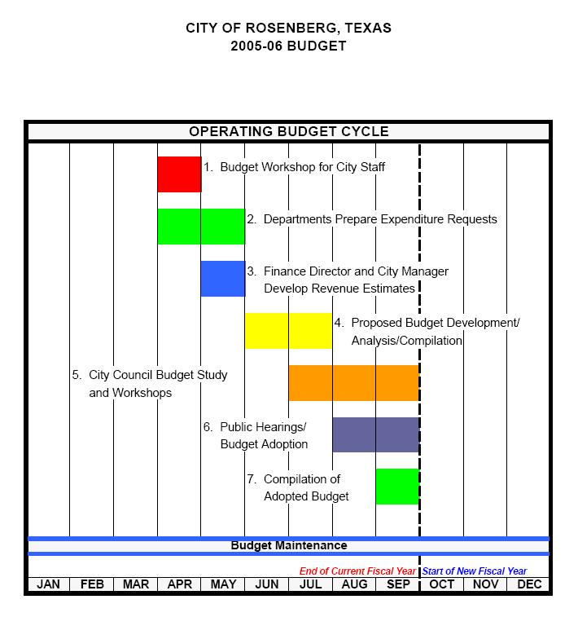
Example of Municipal Based Budget Schedule
Notes:
Example of a city budget process showing all the meetings and public hearings

Slide 23
It is More than a Budget
The budget has four goals:
1. Policy Document: Policy reflected in spending amounts and spending priorities
2. Financial Plan: The budget outlines estimated revenues and anticipated expenditures for each fund. Per the Texas State Constitution, the city must pass a balanced budget where expenditures cannot exceed revenue for the year and any fund balance ("rainy day fund") it may have
3. Operations Guide: The budget document contains departmental missions and goals it wishes to accomplish, staffing tables, narratives and highlights that describe the scope of operations. This function of the budget starts to go into detail how the Council or ESD or VFD goals and objectives will be carried out
4. Communication Device: The budget is a document that is presented to the public where they can learn about the city's or ESD or VFD operations.

Slide 24
Balance Sheet
Balance Sheet: Total assets= Total liabilities+ Equity
Current Assets: Cash and cash equivalents
Non-Current Assets: Property & equipment
Current Liabilities: Accrued expenses
Non-Current Liabilities: Loans & deferred tax liabilities
Equity: Retained earnings

Slide 25
Key Points
For Fire Departments that are part of a political subdivision taxes are primary source of revenue
For Fire Departments that are not a political subdivision BUT receive funding from a political subdivision remember that revenue is from taxes
Internal review is the stage of the budget process in which you as the Fire Chief will be critically examined to determine if the data is available to justify the request
Public Hearings are in the External Review part of the budget process

Slide 26
Key Points
Budget Process is Critical to Your Department Regardless of the Size and Type of the Department
Common Types of Budgets are all Balance Based that include: Line –Item, Performance Based, and Zero Based.
The Budget Process is a Year Around Task Essential that Fire Chief is Actively Engaged
Line-Item Budgets are the Most Common Budget for Small Volunteer Fire Departments
Budget Failure is a Result of Poor Planning, the Inability to Convince Others of Your Needs and Not Understanding the Fiscal /Political Environment

Slide 27
For More Information
Bruce Woods
Chief/ Department Head
Mitigation and Prevention Department
Texas A&M Forest Service
200 Technology Way, Suite 1120
College Station Texas 77845-3424
BWOODS@TFS.TAMU.EDU
979-458-7362 (Office)
936-546-1485 (Cell)

