Slide 2
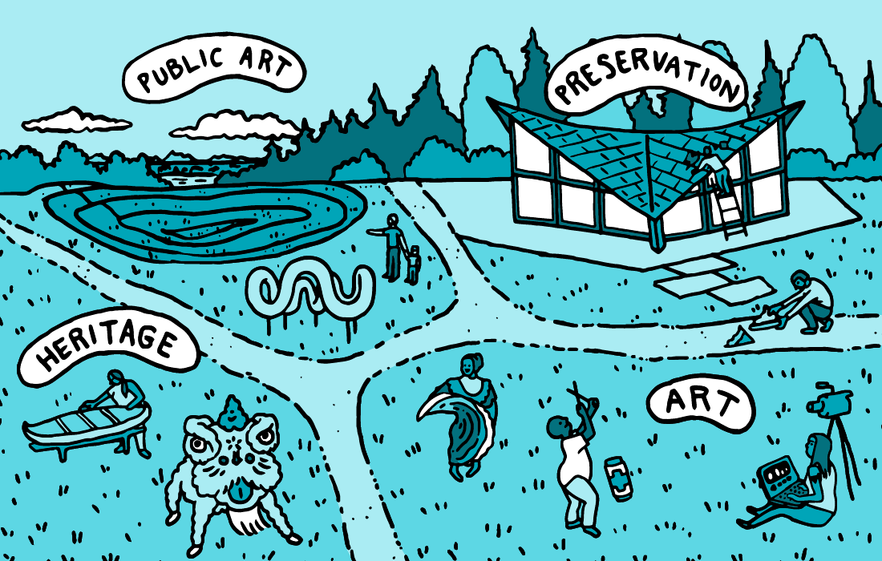
4Culture supports four cultural areas including —
arts, heritage, historic preservation, and public art.

Slide 3
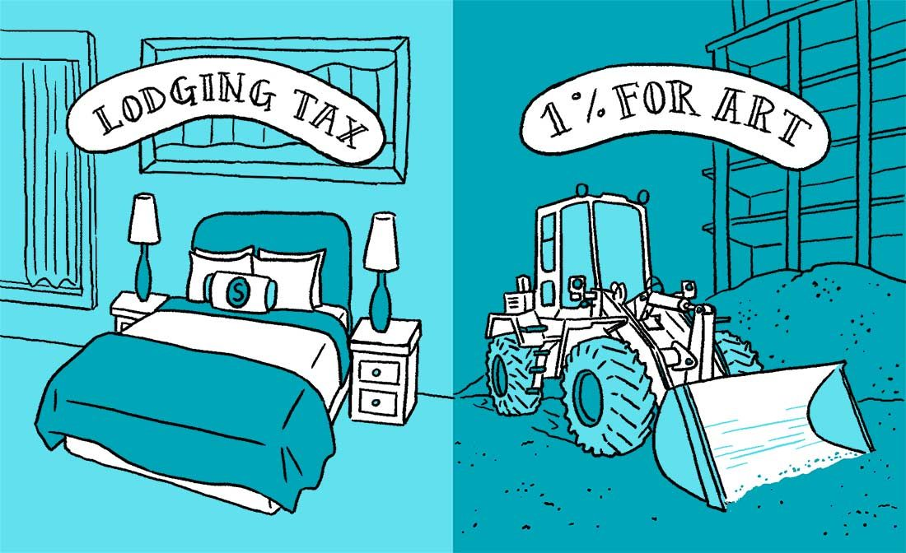
Using Lodging Tax and 1% for Art funds, 4Culture offers grants and commissions.
Most often these are selected through a peer review process. Funding recommendations are then reviewed by our volunteer Board for approval.

Slide 4
Mission
With a focus on racial equity, we fund, support, and advocate for culture to enhance the quality of life in King County.
Vision
We envision a vibrant county where culture is essential and accessible to all.

Slide 5
As closures, cancellations, and loss of work due to COVID-19 impact our cultural communities, the 4Culture Cultural Relief Fund is distributing more than $1M to cultural workers and cultural organizations in King County.

Slide 6
Cultural Relief: Emergency
For: Cultural Workers
Grants up to $2,000 for cultural workers who have suffered significant financial hardship.
Cultural Relief Fund: Organizations
For: Cultural Organizations
Grants up to $5,000 are available for cultural organizations that have suffered significant financial hardship.
Response + Resources
Our ongoing list of local and national grants, loan programs, community resources, and online activities for the cultural sector is available and updated frequently.
Join us weekly on Zoom for Hello4Culture: Digital Edition.
Cultural Relief: Creative Response
For: Cultural Workers
A grant up to $2,000 to pursue an innovative idea that shows significant promise in supporting other King County residents significantly impacted by the outbreak of the COVID-19 virus.

Slide 7
The first round of funding was made available on April 1st and will run through May 15th. Applicants may apply at any time within that time frame.
The applications are simple and they take about 30 minutes to complete. They are reviewed weekly by a peer-panel. We notify applicants within 10 business days about the status of their application.

Slide 8
CULTURAL WORKERS ELIGIBLITY
ELIGIBILITY:
Be an individual who can demonstrate current and ongoing work in the fields of arts, heritage, preservation, or public art.
Reside full-time in King County, Washington.
Be at least 18 years old.
Not be enrolled in any degree-seeking program.
Not be a 4Culture staff, Advisory Committee, or Board member, or a 4Culture Cultural Relief Fund panelist during the period of review.

Slide 9
CULTURAL WORKERS EVALUATION CRITERIA
CRITERIA:
Applicant demonstrates a direct financial impact from the outbreak of the COVID-19 virus including but not limited to: loss of income (e.g. wages, gigs, ticket/art/book sales, clients, etc.) or loss of opportunity (e.g. cancellation of a fellowship, residency, performance, screening, reading, exhibition, etc.) OR
Applicant articulates a creative idea that shows significant potential or demonstrated impact in supporting King County residents affected by the outbreak of the COVID-19 virus AND
Applicant demonstrates a compelling need and use for grant funds AND
Applicant identifies one or more recent (last six months) or future (next six months) cultural contributions for the citizens of King County.

Slide 10
CULTURAL ORGANIZATIONS ELIGIBLITY
ELIGIBILITY:
Any organization whose primary mission relates to arts, heritage, or preservation may apply for Cultural Relief funds.
You must have a minimum 2-year track record of programming or activity.
You must be located in and serving King County, Washington.
You must demonstrate a direct financial impact from the outbreak of the COVID 19 virus, including but not limited to: loss of income (e.g. ticket sales, admissions, earned revenue, or rental fees) or loss of opportunity (e.g. cancelation of events, including fundraising events; cancellation or postponement of programs).
You must not be a 4Culture staff, Advisory Committee, or Board member, or a 4Culture Cultural Relief Fund panelist during the period of review.

Slide 11
CULTURAL ORGANIZATIONS EVALUATION CRITERIA
CRITERIA:
Financial Hardship: every organization will experience financial impacts at this time, but some will suffer acute financial hardship. Applicants are asked to clearly state the financial challenges they face.
Emergency: applicant demonstrates an emergency need and a timely use of grant funds. Applicants that demonstrate an emergency circumstances will be given priority.
Public Benefit: applicant offers substantial public benefit in a typical year. For 4Culture’s purposes, public benefit describes your organization’s efforts to make your events, activities, or programs more accessible to King County residents, particularly underserved communities.

Slide 12
Questions?

Slide 13
4Culture.org
hello@4culture.org
206.296.7580 or TTY 711

