Slide 1
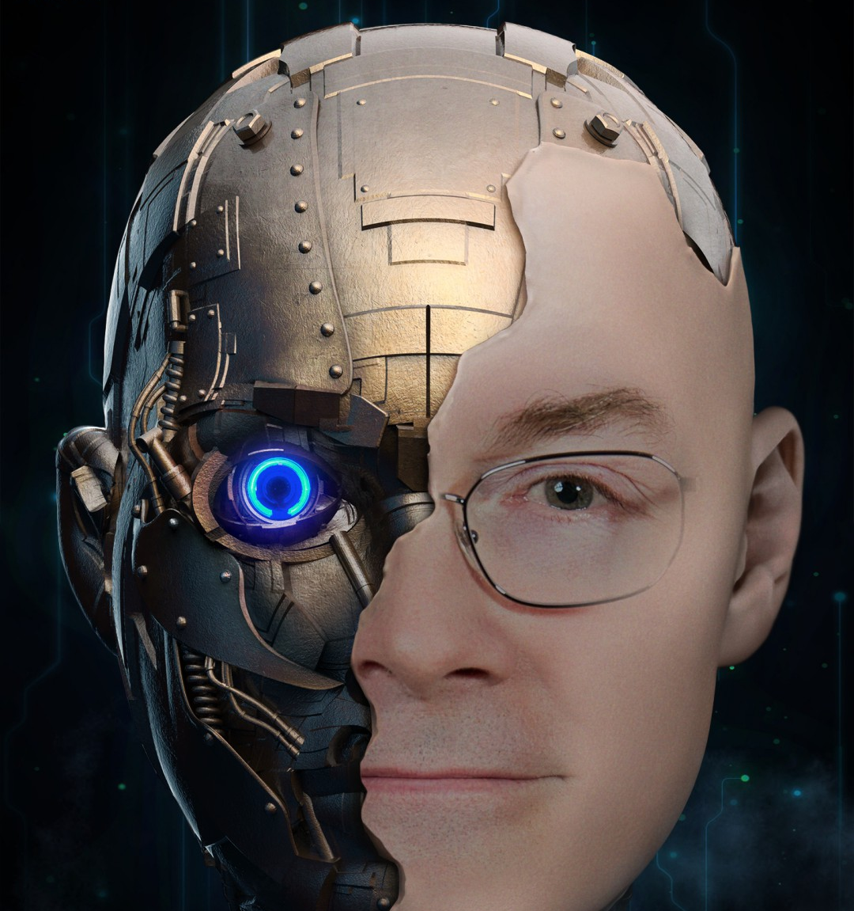
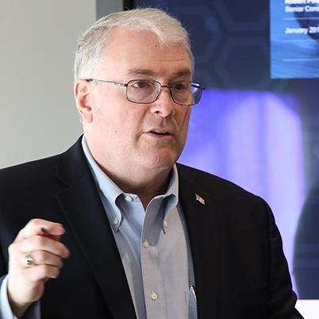
Presenter
Kris has over 44 years of progressive experience in the IT sector, in various industries spanning technology, including EFT, telecom, health care, staffing, loyalty, manufacturing, professional services, retail, banking, public sector and higher education.
As the former Chief Technology Officer for NTT DATA Inc., Kris led NTT DATA’s R&D and innovation programs, leveraging NTT Group R&D and related investment to deliver client impact. Kris was also a partner in the IT Strategy Practice.
Kris led IT strategy and transformation efforts both as a consulting leader and as a senior executive practitioner including:
Large healthcare payer / Private University/ Oldest Bank in the Americas / Global Manufacturer / Global Professional Services Firm / Global Staffing Company / Large Bottler
Additionally, Kris has held numerous executive delivery roles throughout his career allowing him to provide unique perspective to dynamic client environments.
Chief Development Officer for Manpower
Head of eBusiness for Alliance Data
Chief Development Officer for Office Max
CIO – Octel
SVP of Product Management for large Point of Sale company
Kris takes great pride and enjoyment in helping senior IT and business executives realize the promise of todays and tomorrow’s IT to achieve their business and personal goals.
Kris Fitzgerald Former Chief Technology Officer NTT DATA Services
“The art of the probable is closing no doors to your future, by what you do today.”
2022 All Rights Reserved.
1
Notes:
Share my background – what I’m focused on, my role with UTD and mentoring and faculty advisor.
Additionally, mentoring start up companies
I’ve worked with global teams my last 20 years, from leading a global apps team of over 600 people in 20+ countries (Manpower), to leading Dell’s public sector consulting globally. In all of this, it was ALL about the teams, building them, leading them, giving them room to grow.
Also – lived in UK for a bit as an expat / time in various countries /
Over 9MM miles of travel, 26+ countries in my 40+ years.

