Slide 1
DRAFT – PRE-DECISIONAL & DELIBERATIVE
LTCF supplies reporting
From NHSN
13

Slide 2
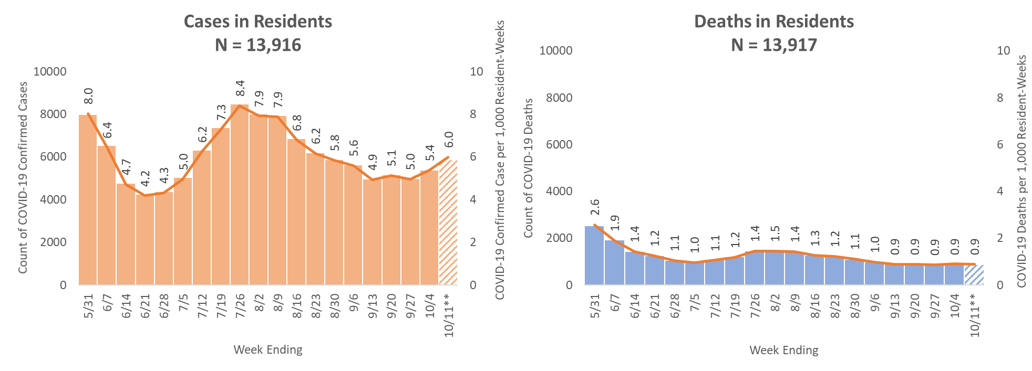
Skilled Nursing Facilities, COVID-19 Cases and Cases per 1,000 Resident- Weeks among Residents, National, by CCN, Inferred Data*
4-week change in incidence: increase
*Number of facilities reporting may vary from week to week
** Patterned fill represents data is likely still accruing, all data can be modified week-to-week by facilities
4-Week Change Definition (apply to last 4 weeks)
Increase: meet both: (1) rate for week 4 was greater than week 1; (2) at least two out of three paired consecutive rate comparisons showed a significant increase.
Decrease: meet both: (1) rate for week 4 was lower than week 1; (2) at
least two out of three paired consecutive rates comparisons showed a significant decrease.
Note: Mid-p (1-tailed) method was used to test a statistical significance
Inferred Data: For the purpose of best epidemiological understanding, data that fail quality checks or appear inconsistent with surveillance protocols are assigned a value based on their patterns of data-entry or excluded from analysis
Data are provisional until officially released from CDC – For Internal Use Only (FIUO) – For Official Use Only (FOUO) –Sensitive But Unclassified (SBU)
Data as of October 12, 2020

Slide 3
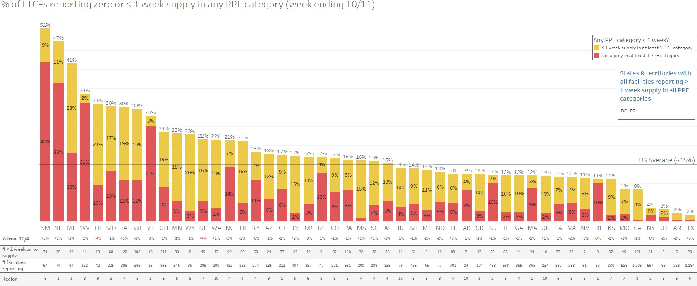
LTCFs: "No" or "less than 1 week" of supply in any PPE category, by State
DRAFT – PRE-DECISIONAL & DELIBERATIVE
PRELIMINARY
Remains driven by all
categories except for
gloves
N95 masks and eye protection appear to be key pain points
6 LTCFs reporting no or < 1 week of supply in all categories
∆ legend
≤ ±3%
> +3%
< -3%
Includes CMS and non-CMS facilities. NHSN reports only one response per facility per week. Supplies status field composed of responses from current and one-week supply questions,
methodology in appendix. Source: NHSN LTCF COVID-19 Supplies module – all long-term care facilities (week ending 9/27)
15
DATA IS PROVISIONAL UNTIL OFFICIALLY RELEASED FROM CDC – FOR INTERNAL USE ONLY (FIUO) – FOR OFFICIAL USE ONLY (FOUO) – SENSITIVE BUT UNCLASSIFIED (SBU)

Slide 4
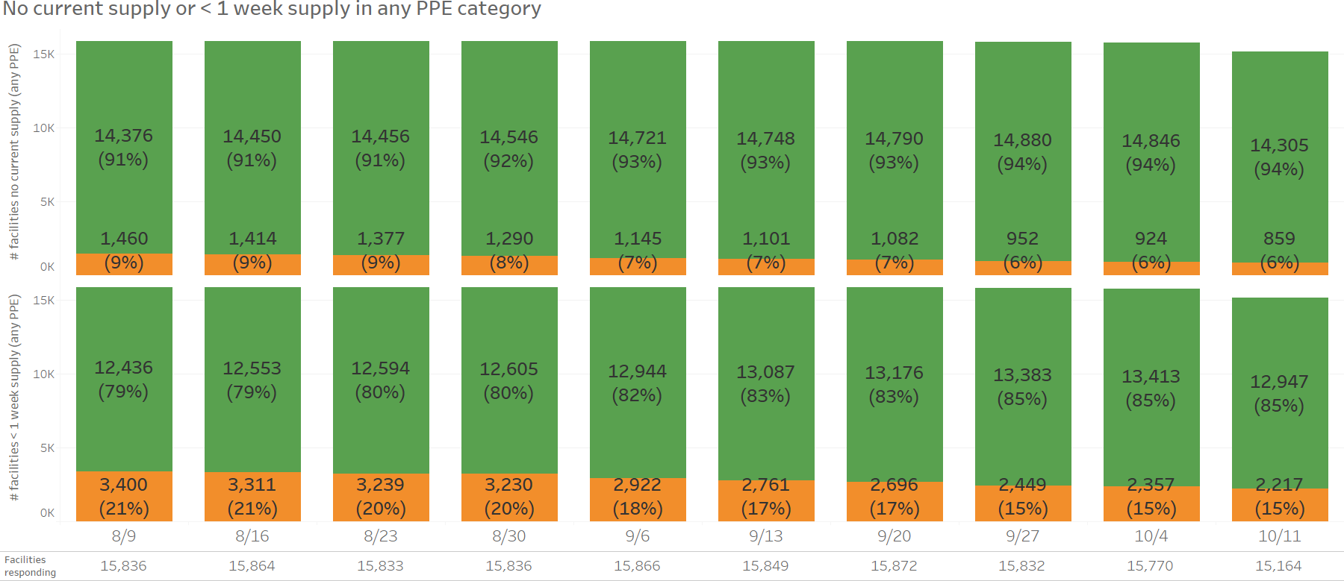


LTCFs: U.S. overall supply status, last 10 weeks any PPE category
DRAFT – PRE-DECISIONAL & DELIBERATIVE
PRELIMINARY
Q: Do you currently have any supply?
Q: Do you have enough for one week?
% reporting low supply higher in Aug
Includes CMS and non-CMS facilities. NHSN reports only one response per facility per week.
Relatively stable / improving in last ~8 weeks
Source: NHSN LTCF COVID-19 Supplies module – all long-term care facilities (weeks ending 7/26 – 9/27)
16
DATA IS PROVISIONAL UNTIL OFFICIALLY RELEASED FROM CDC – FOR INTERNAL USE ONLY (FIUO) – FOR OFFICIAL USE ONLY (FOUO) – SENSITIVE BUT UNCLASSIFIED (SBU)

Slide 5
DRAFT – PRE-DECISIONAL & DELIBERATIVE
PRELIMINARY – DATA TO BE VALIDATED
Number of LTCF reporting "no supply" or "less than one-week supply" has broadly been declining but remains elevated for N95s and gowns, in particular
N95 Surgical masks Eye protection Gowns Gloves
1,989
1,918
(12.6%) _{(12.2%)}
1,812
1,155
(7.3%)
1,121
(7.1%)
(11.9%)
1,049
(6.9%)
1,408
(8.9%)
1,263
(8.0%)
1,346
(8.5%)
1,263
1,181
(7.5%)
1,125
1,136
(7.2%)
(8.3%)
1,073
(6.8%)
1,011
(6.7%)
645
(4.1%)
(7.4%)
570
(3.6%)
529
(3.5%)
611
(3.9%)
821
768
549
(3.5%)
699
834
(5.3%)
797
(5.1%)
(5.2%) _{(4.9%)} 503 (4.6%) | 593 | 579
(3.3%) | (3.7%) | (3.7%)
533
(3.5%)
763
(5.0%)
618
(3.9%)
611
(3.9%)
596
(3.9%)
525
(3.3%)
 | 498 (3.1%) |  | 494 (3.1%)
 | 95 (0.6%) |  | 85
 |  |  | (0.5%)
524
(3.3%)
508
(3.4%)
587
(3.7%)
578
(3.7%)
564
(3.7%)
443
(2.9%)
For week ending
# of responses
90
(0.6%)
27-Sep 4-Oct 11-Oct
27-Sep 4-Oct 11-Oct
27-Sep
4-Oct
11-Oct
27-Sep
4-Oct
11-Oct
27-Sep
4-Oct
11-Oct
15,832 15,770 15,164
Same # of responses across categories (Percentages in bars represent % of total n)
Less than 1 week supply
No Supply

Slide 7
DRAFT – PRE-DECISIONAL & DELIBERATIVE
PRELIMINARY – DATA TO BE VALIDATED
Facilities that have "no supply" in one category likely have issues across multiple categories
N95
(n = 763)
763
Surgical masks
(n = 596)
596 596 596
Eye protection
(n = 508)
508 508 508
13 23 31
495 485 477
763
763
763
596
508
184
268
221
17
111
66
522
436
579
542
485
530
495
692
579
160
71
9
74
₈ 72
Unique to N95
"No supply" "No supply" "No supply" "No supply" in surgical in eye in gowns in gloves
masks protection
Unique to "No supply" "No supply" "No supply" "No supply"
Unique to "No supply" "No supply" "No supply" "No supply"
surgical in n95 masks
in eye protection
Gloves
(n = 90)
90
in gowns in gloves
eye in n95 protection
in surgical in gowns in gloves masks
Gowns
(n = 564)
564
How to interpret these charts
There are 508 LTCFs that have no supply in eye protection
Of those 508, 495 also have no supply in n95, 485 have no supply in surgical masks, 477 in gowns, and 72 in gloves
576
564
564
90
90
90
34
542
34
530
87
489
19
16
18
15
477
71
74
72
75
14
15
75
Unique to gowns
"No supply" "No supply" "No supply" "No supply" in n95 in surgical in eye in gloves
masks protection
Unique to gloves
"No supply" "No supply" "No supply" "No supply"
Did not report "No supply" for this category Reported "no supply" for this category
in n95
in surgical in eye in gowns masks protection

Slide 8
Back-up

Slide 9
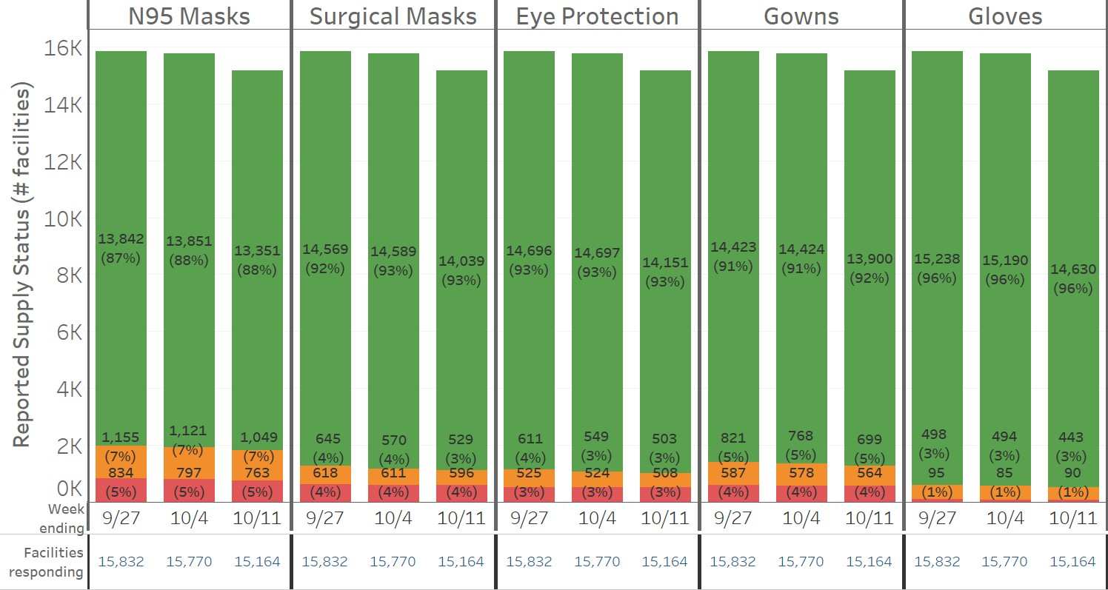

DRAFT – PRE-DECISIONAL & DELIBERATIVE
PRELIMINARY
LTCFs: U.S. overall supply status, by PPE category
Source
Supplies status inferred from two separate questions: current and one-week supply.
Methodology in appendix.
Current and one- week supply status
Stable or slightly decreasing % and # of facilities reporting < 1 week or no supply in last three weeks
Expected ~500
facility drop in
respondents – will fill in by next week
Includes CMS and non-CMS facilities. NHSN reports only one response per facility per week. Supplies status field composed of responses from current and one-week supply questions,
methodology in appendix. Source: NHSN LTCF COVID-19 Supplies module – all long-term care facilities (weeks ending 9/20-10/4)
14
DATA IS PROVISIONAL UNTIL OFFICIALLY RELEASED FROM CDC – FOR INTERNAL USE ONLY (FIUO) – FOR OFFICIAL USE ONLY (FOUO) – SENSITIVE BUT UNCLASSIFIED (SBU)

