Slide 1
Social distancing can be fun!
How a small family-owned, seasonal ice cream shop made social distancing fun.

Slide 2
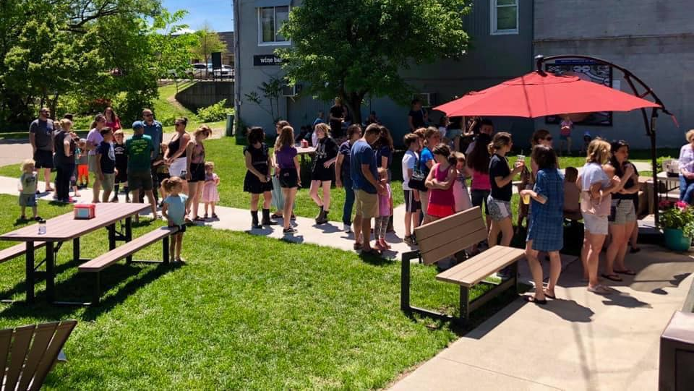
What the line normally looks like

Slide 3
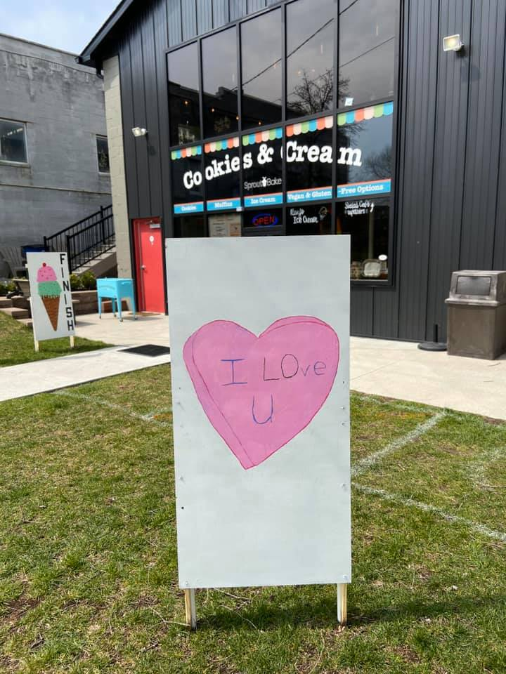
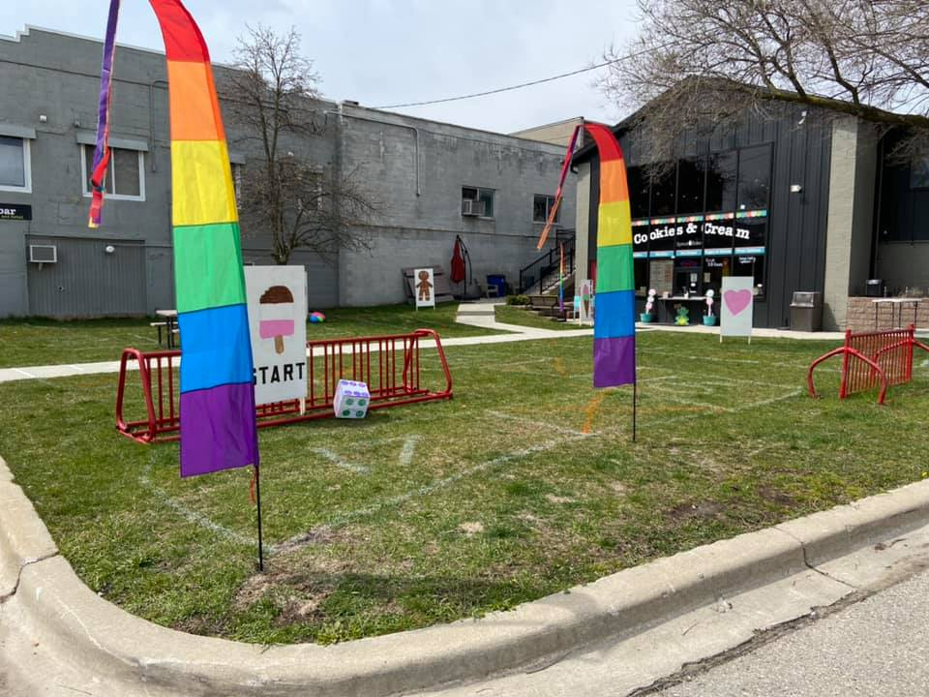
Candy Land game board painted on grass to provide social distancing. Don’t stand in a square with an orange X.

Slide 4
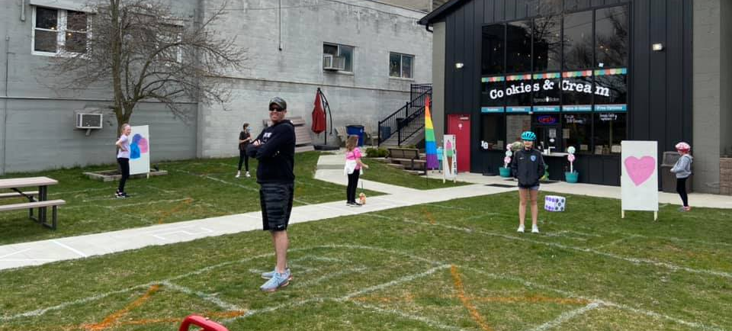
Everyone standing on a numbered square, providing safe social distancing!

Slide 5
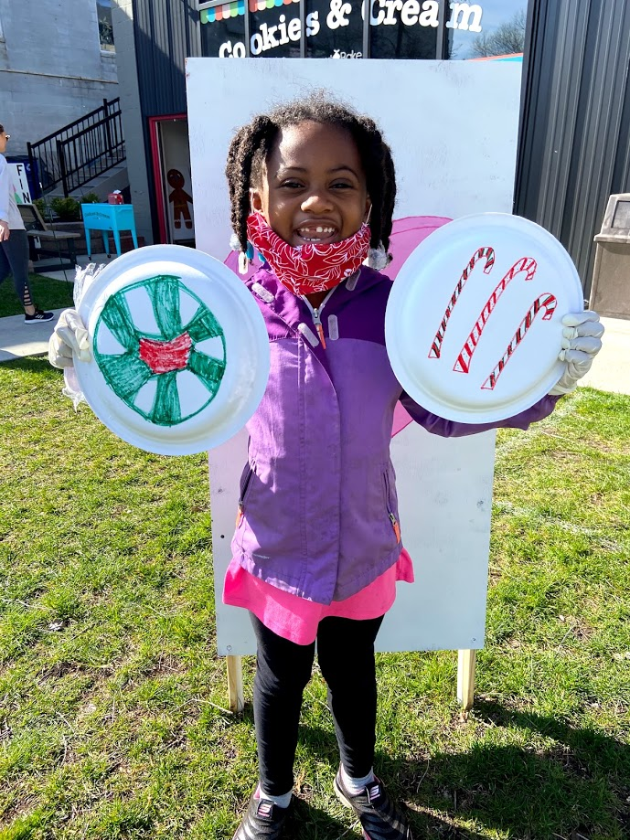
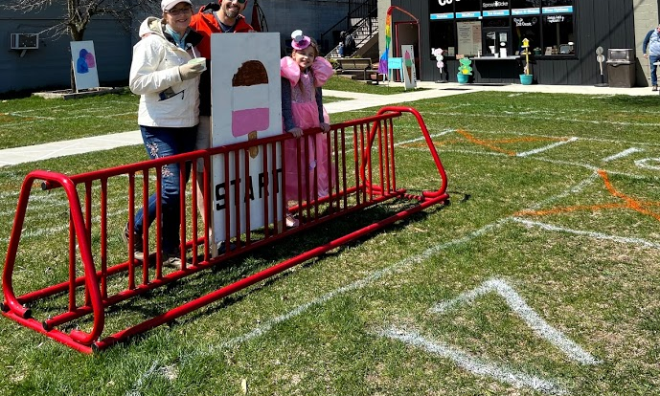
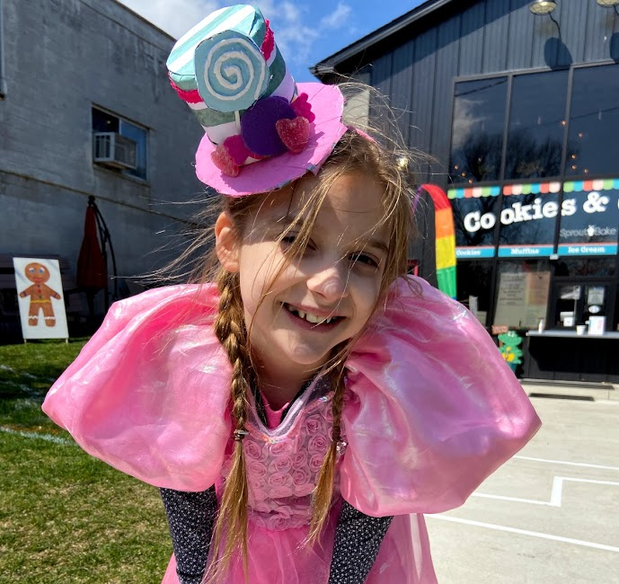
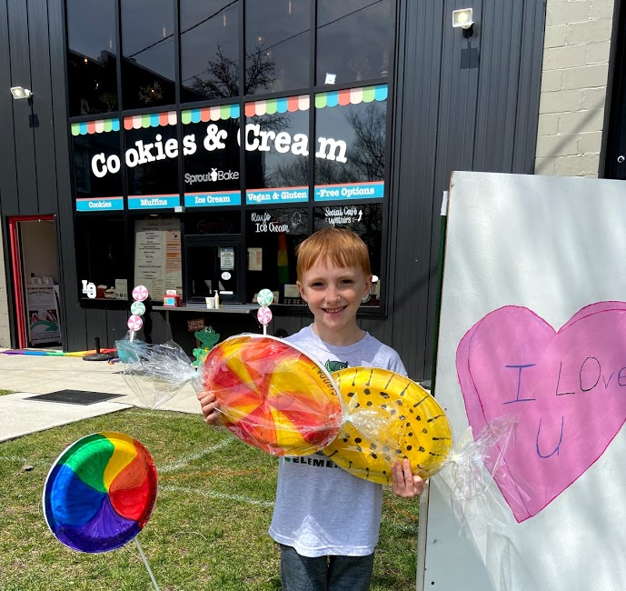
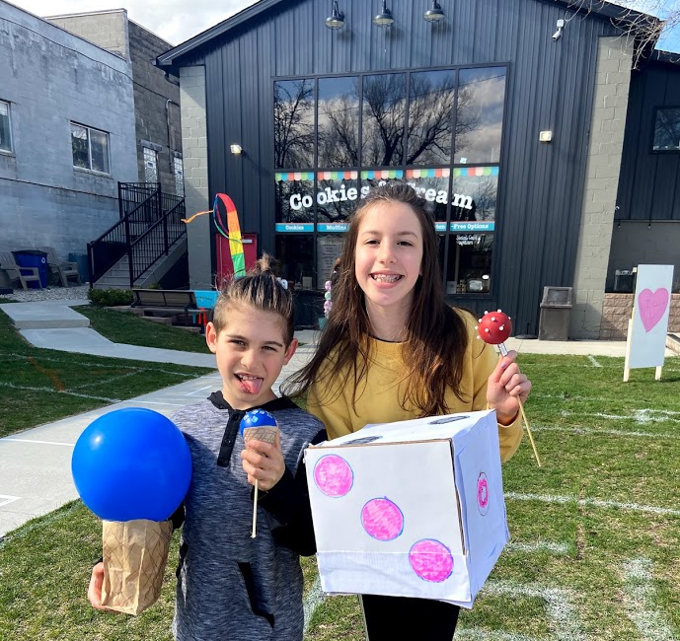
Kids get a free ice cream if they add decorations to the game!

