Slide 1
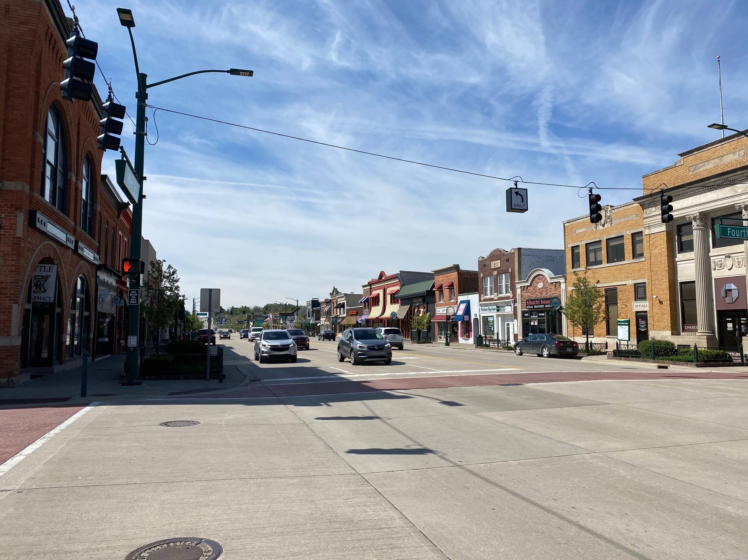
Rebooting your business in safe mode Vol. 5 – June 9, 2020
LAMBERT LAW Co-Sponsor
407 6th Street, Suite A
Rochester, MI 48307
(248) 642-7774
Brad@lambertplc.com

Slide 2
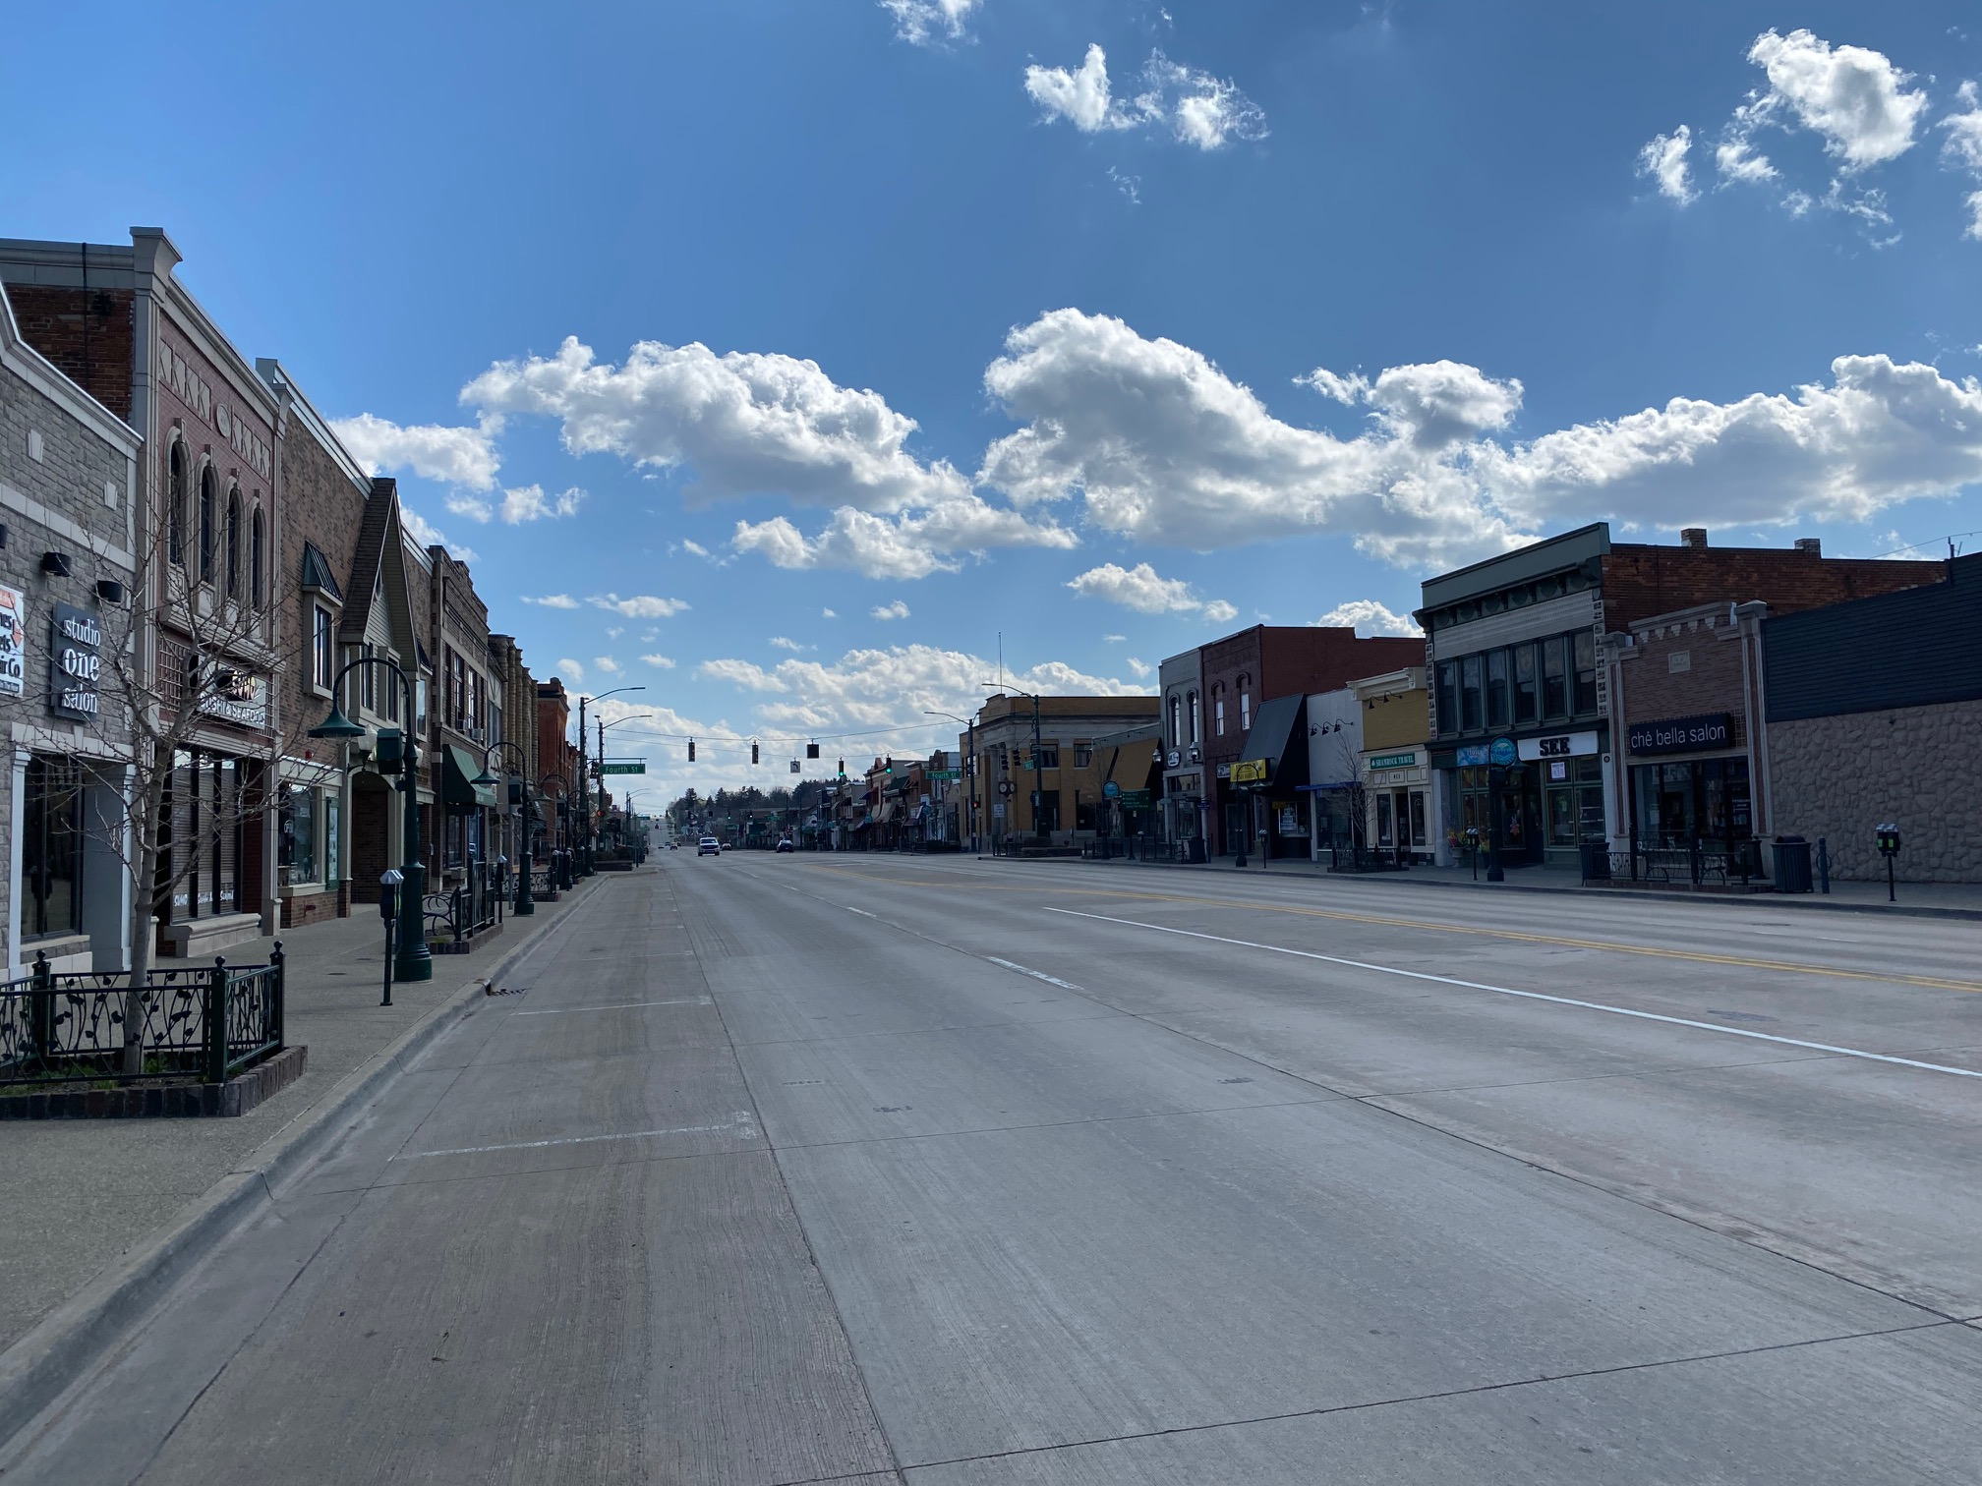
Topics Reviewed May 12 – June 2, 2020
Four Risk Categories
Preparedness Response Plan
Cautious Objector
Close vs. Incidental Contact
Operational Controls
Enhanced Enforcement
New Openings
Common Misconceptions

Slide 3

Topics for Week 5 – June 9, 2020
Updates – Almost everyone open
Details and sectors
Contact Tracing
New Restrictions
Court Decisions
Legal Challenges to Come

Slide 4
Relevant authorities
Governor’s Executive Orders
EO 36 – Work Policies
EO 76 – Unemployment
EO 114 – Health and Safety Measures
EO 115– Open/Close Order
OSHA Guidance 3990-03 2020
Legal Authorities
Family Medical Leave Act
Families First Coronavirus Relief Act
Michigan Paid Medical Leave Act

Slide 5
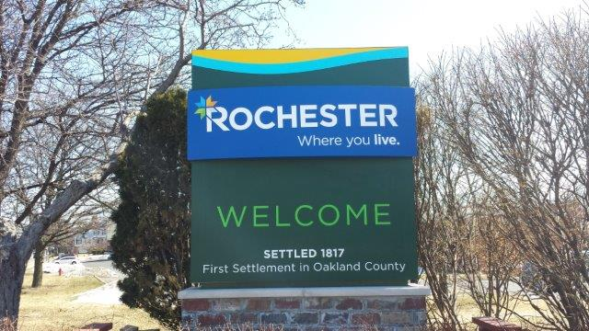
Reopening Revisions – EO 115
Salons, Personal Care Open 6.15
Only closed facilities Statewide
Residential, Travel and Troop Camps
Sectors Closed other than MI Sections 6 & 8
Gyms and Fitness Centers
Casinos, Theatres, Entertainment
No General Travel Restrictions
Social Gatherings
50 people indoors
250 people outdoors
500 in stadiums and arenas

Slide 6

Contact Tracing
New item for Three Economic Sectors
In-Home Services
Appointment Record
Bad fit
Salons and Personal Care
Gyms and Fitness Centers
Serious Rights implications
Tracking at Government insistence
Tracking people who are not sick
Could have broader implications

Slide 7

Other Notable Restrictions
In-Home Services (EO 114 ¶10)
Job site screening
Ask about COVID-19 in home; gloves
Salons and Personal Services
Customer face mask requirements
No self-service refreshments
Discard magazines
Gyms and Fitness Centers
Workout stations – 10 feet or barriers
Reduce class sizes
Open windows and circulation
Enforcement Nightmare – need “inside” help

Slide 8

Pending Legal Developments
Owosso Barber Case – Manke
Court of Appeals Ordered Shop Closed
Supreme Court Reversed
Mostly procedural; not the Final Word
Legislature’s Case
Still at Court of Appeals
Supreme Court Denied Fast Track Bypass
Refusal is puzzling, inexplicable
Attempts at explaining it are weak
Executive Orders will become OSHA, etc. Regulations
The OSHA restrictions apparently apply to Regions 6 and 8

Slide 9

Hidden Legal Perils
Employee and Customer Legal Claims
Regulatory Overload/Concerns
Inevitable Legal Conflicts
Orders will conflict with reality
Orders will conflict with other laws
Customer Variances – New Divisions
To Mask or Not to Mask
Cleaning Protocols

Slide 10

Updates and New Developments
The Fate of Masks and Face Coverings
Standards and prospects for full reopening
Resources and planning
Telecommuting and Expense Reimbursements

Slide 11
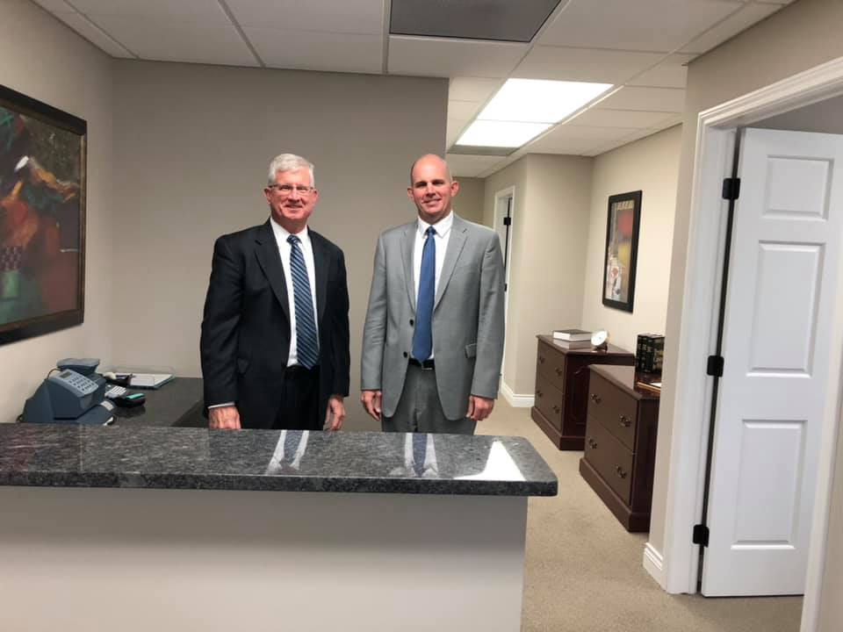
LAMBERT LAW LEGAL SERVICES
Employment Law
Real Estate
Business and Commercial
Personal Injury (Dan)
Estate Planning and Probate
Intellectual property
Litigation in these disciplines

Slide 12
CITED AUTHORITIES
Governor Whitmer Executive Order Page
https://www.michigan.gov/whitmer/0,9309,7-387-90499_90705---,00.html
OSHA Guidance https://www.osha.gov/Publications/OSHA3990.pdf
HIPAA https://www.cdc.gov/phlp/publications/topic/hipaa.html
MI OSHA https://www.michigan.gov/leo/0,5863,7-336-78421_11407---,00.html
Family and Medical Leave Act
https://www.opm.gov/policy-data-oversight/pay-leave/leave-administration/fact-sheets/family-and-medical-leave/

