Slide 1
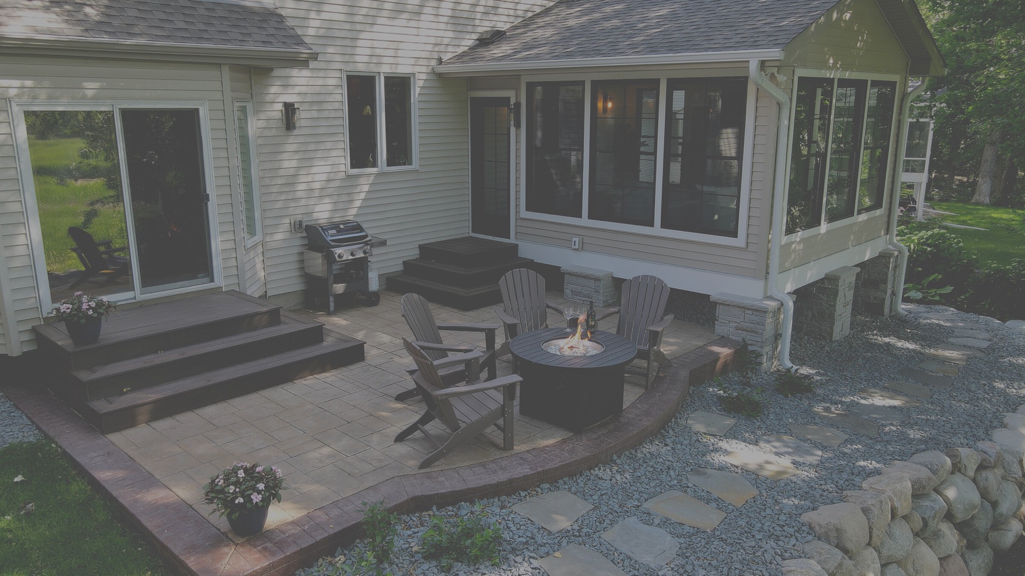
COTY AWARDS 2023
RESIDENTIAL EXTERIOR
$100,000 - $200,000
Project cost: $118,954
Project completion:10/05/21

Slide 2
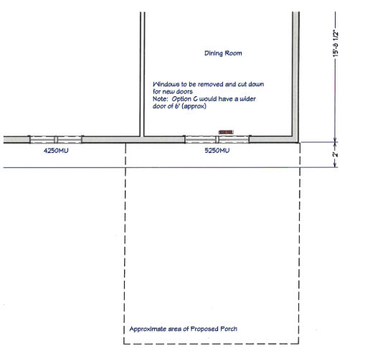
FLOOR PLAN
BEFORE

Slide 3
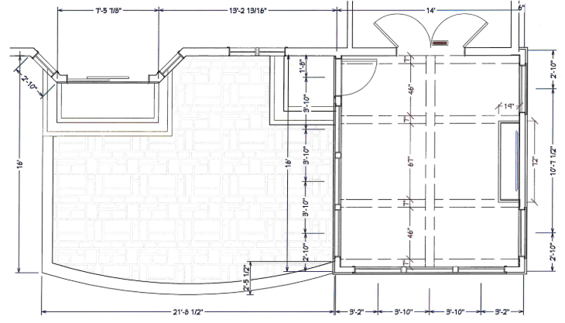
FLOOR PLAN
AFTER

Slide 4
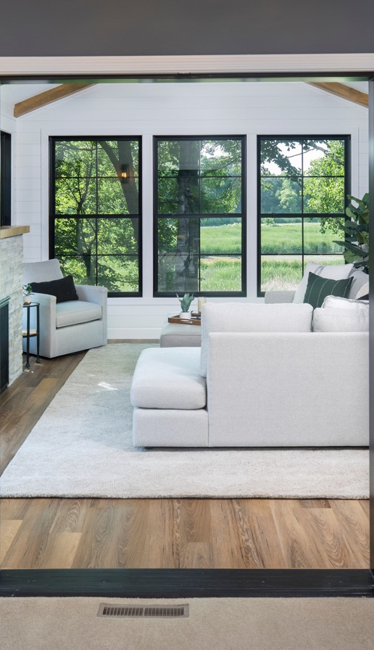
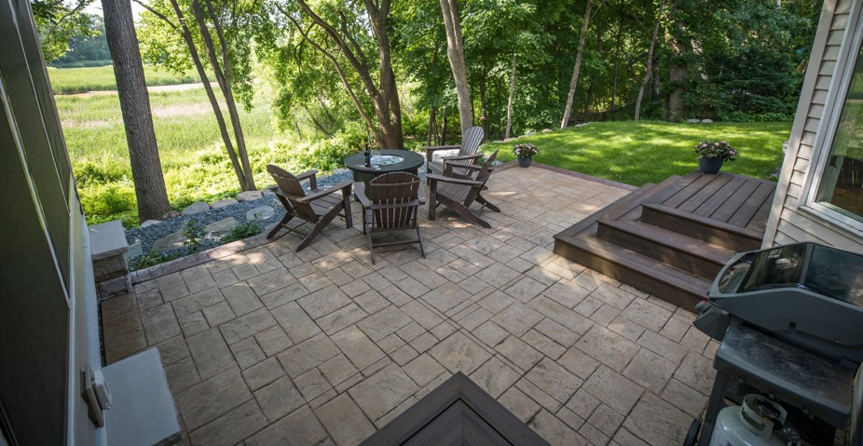
PROJECT DESCRIPTION
With the joy of hosting family gatherings and admiring the peaceful beauty of the four seasons, this home went through a remarkable transformation with an exterior addition renovation. A landscaped outdoor patio and the addition of a new sunroom provides an new oasis for a new chapter of outdoor entertainment.
The window design of the new additions showcases the beauty of the newly landscaped yard and introduces a rich abundance of natural lighting overlooking the lakeside view.
RESIDENTIAL EXTERIOR
RENOVATION
With a stone fireplace for the winter, a wooden beam-designed ceiling, and a beautiful stained and stamped patio, the extension of this home's outdoor space offers a new chapter for enjoying the outdoors through all seasons.

Slide 5
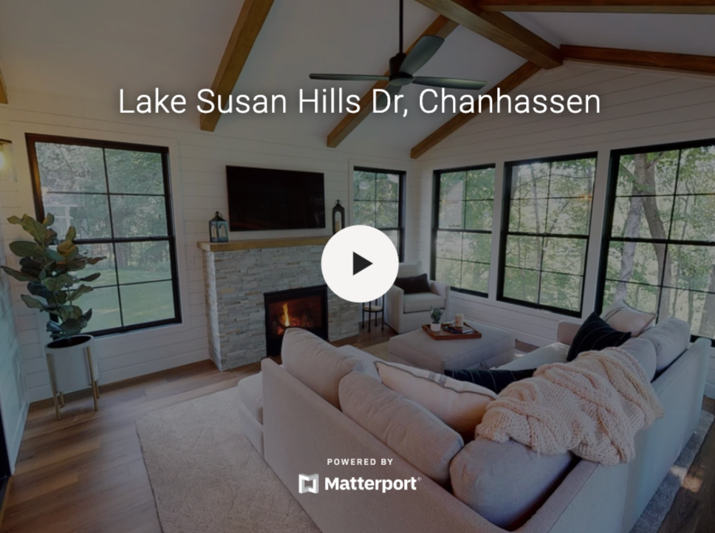
MATTERPORT
www.my.matterport.com/show/?m=Y71s1Sg8mxL

Slide 6
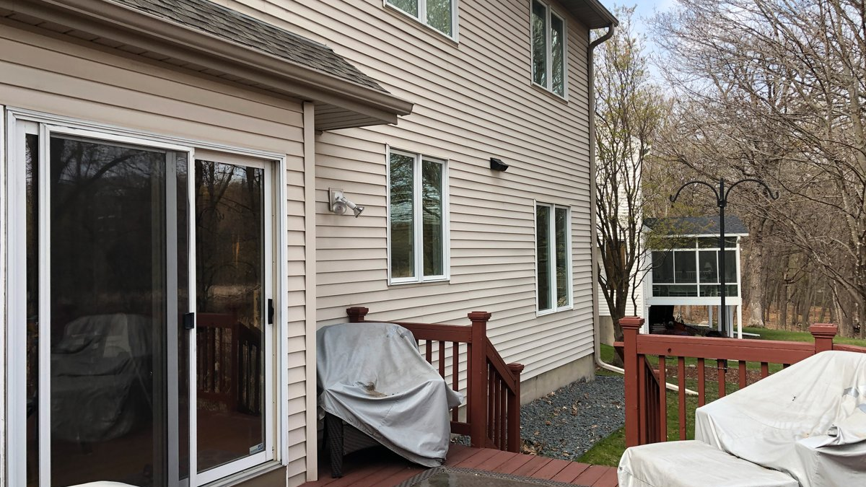
WHAT HAPPENED HERE?
CLIENT EXTERIOR NEEDS:
  Exterior Renovation for Family Events
  Addition of Outdoor Patio and Sunroom
  A New Space to Accommodate Outdoor Activities
  OPENED UP KITCHEN
  REMOVED WALL
  ADDED WALL CURVE TO CABINETRY
BEFORE

Slide 7
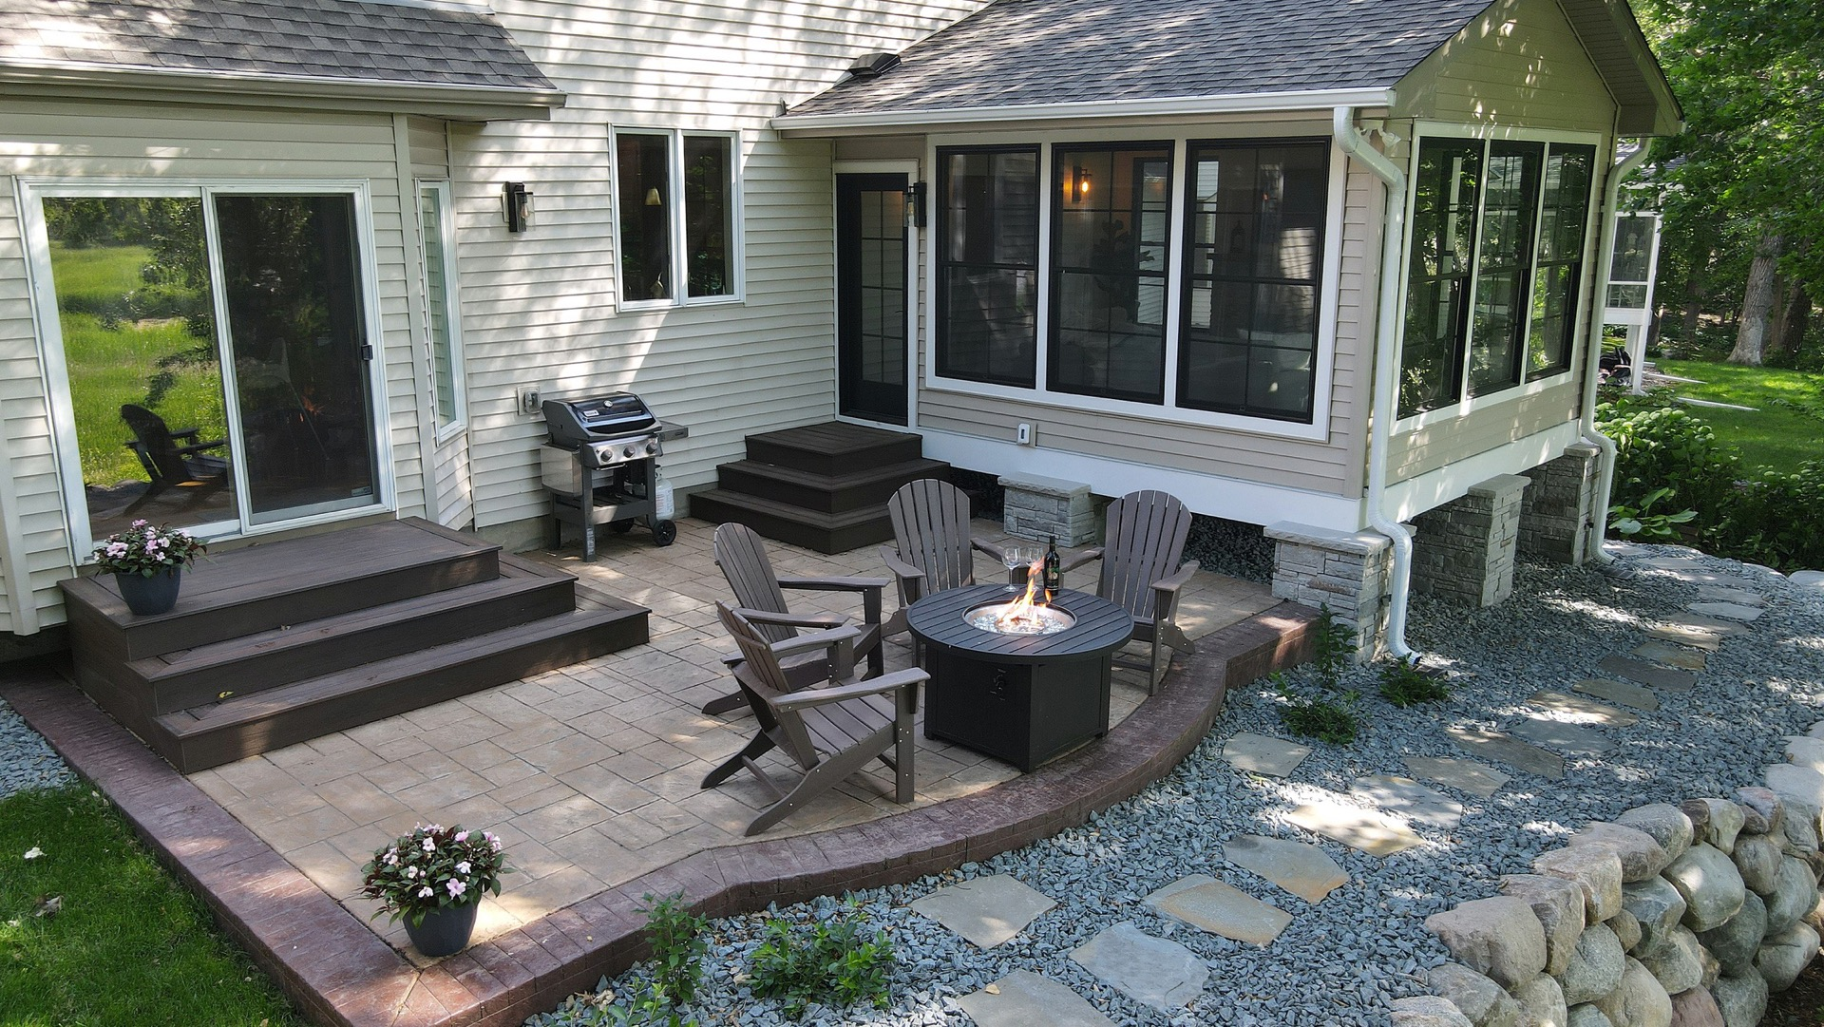
WHAT HAPPENED HERE?
  Addition of a 14x16 3-season Insulated Sunroom
  Boulder Retaining Walls and Stone Columns
  Landscape of Exterior Services
AFTER

Slide 8
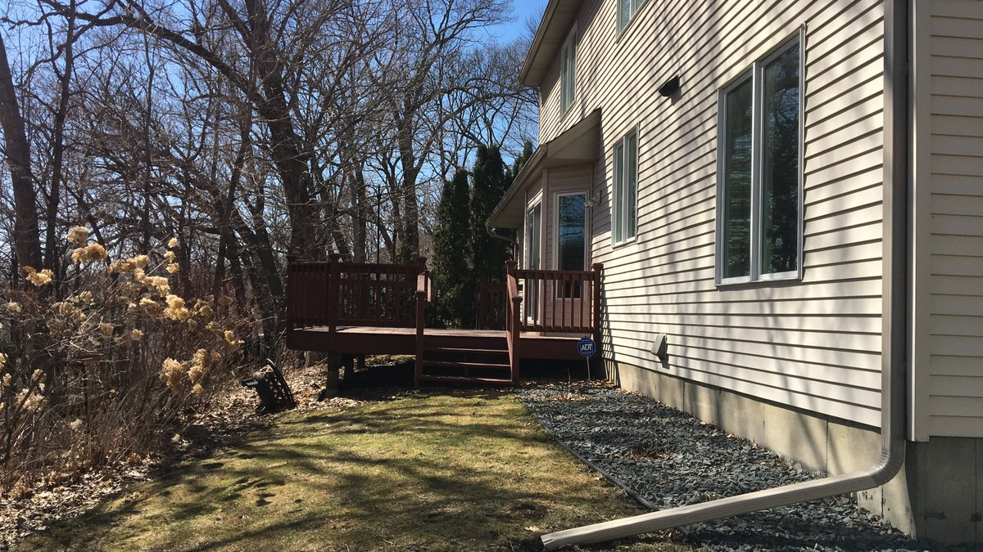
BEFORE

Slide 9
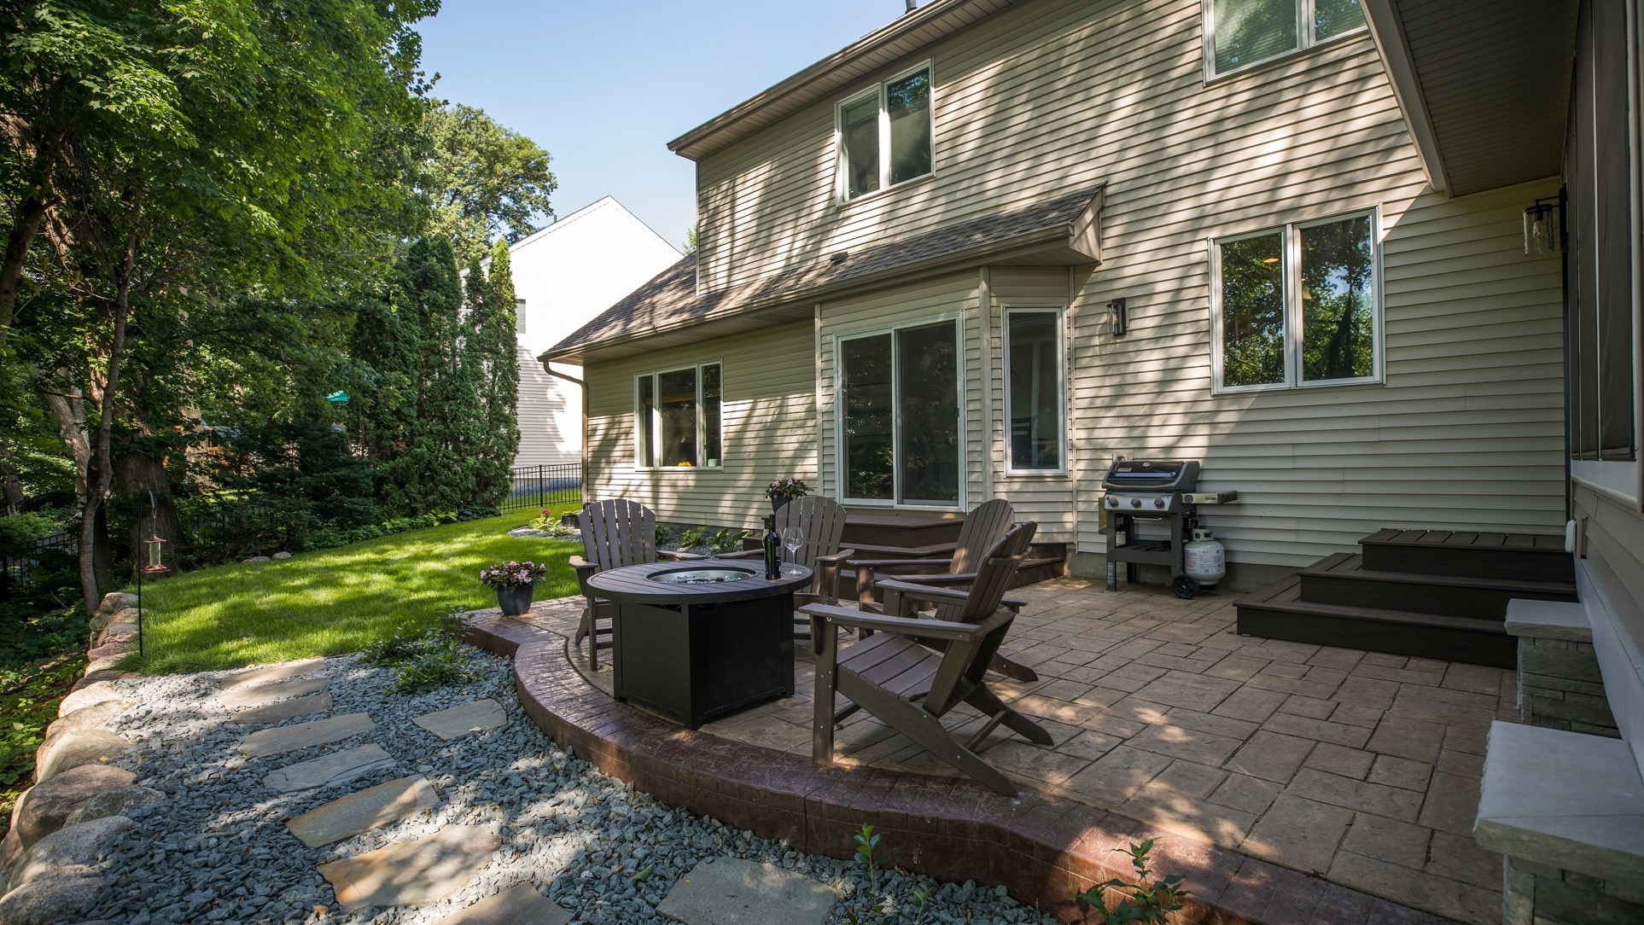
AFTER

Slide 10
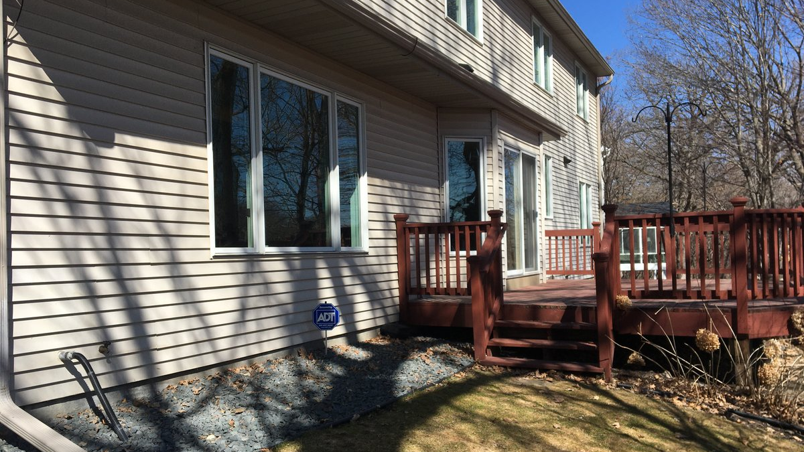
BEFORE

Slide 11
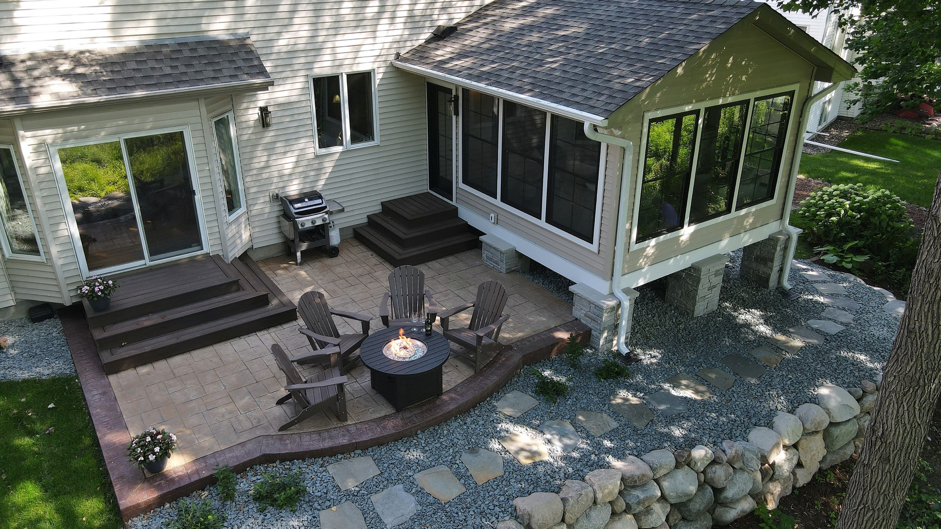
AFTER

Slide 12
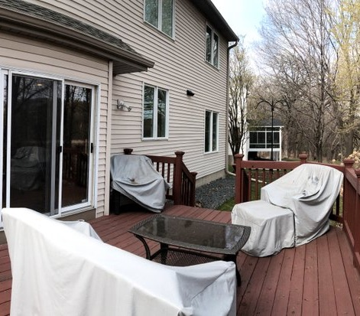
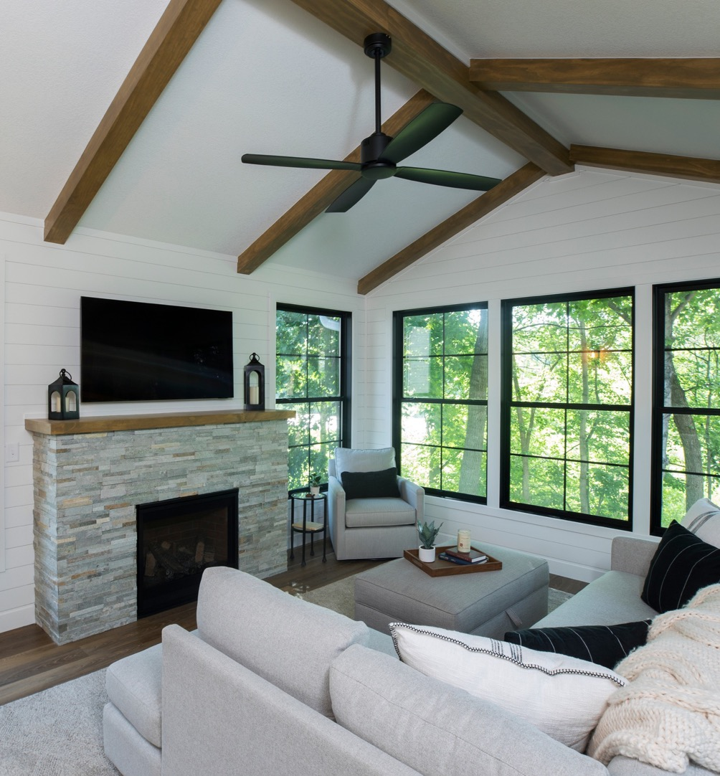
BEFORE
AFTER

Slide 13
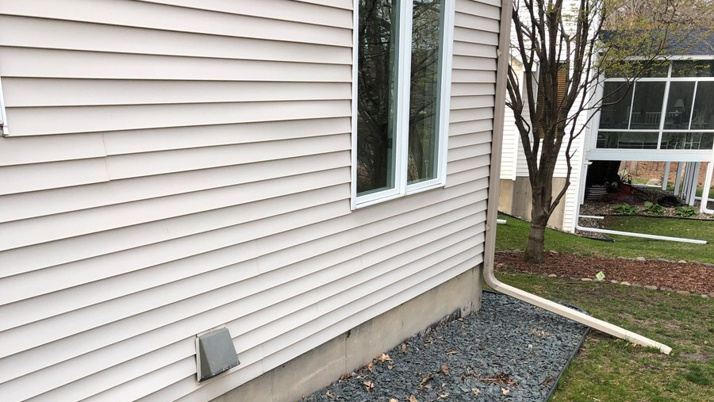
BEFORE

Slide 14
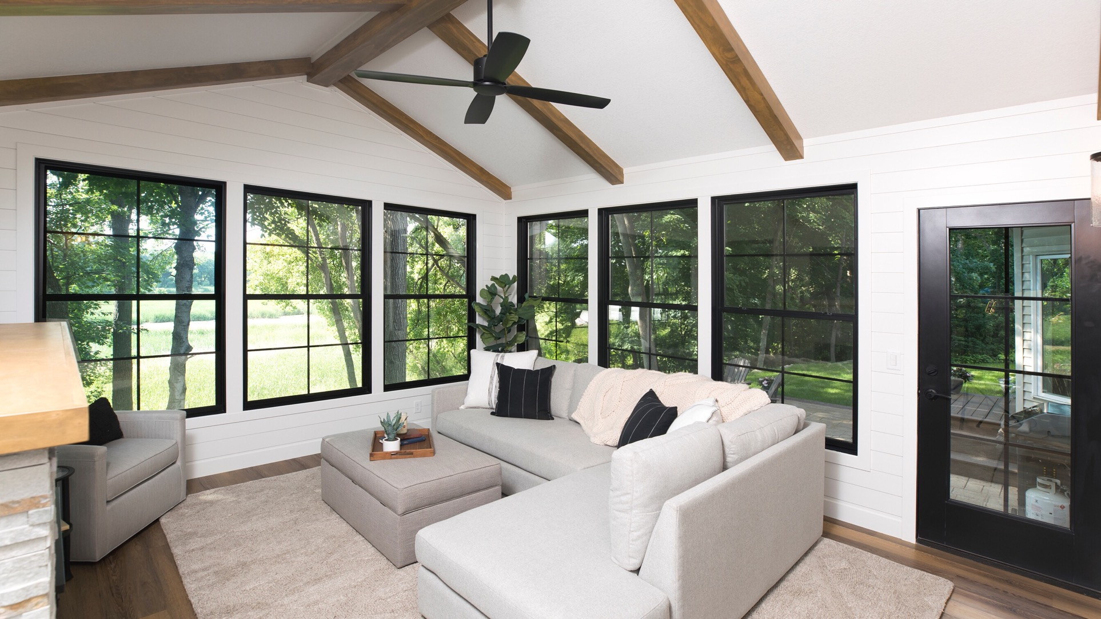
AFTER

Slide 15
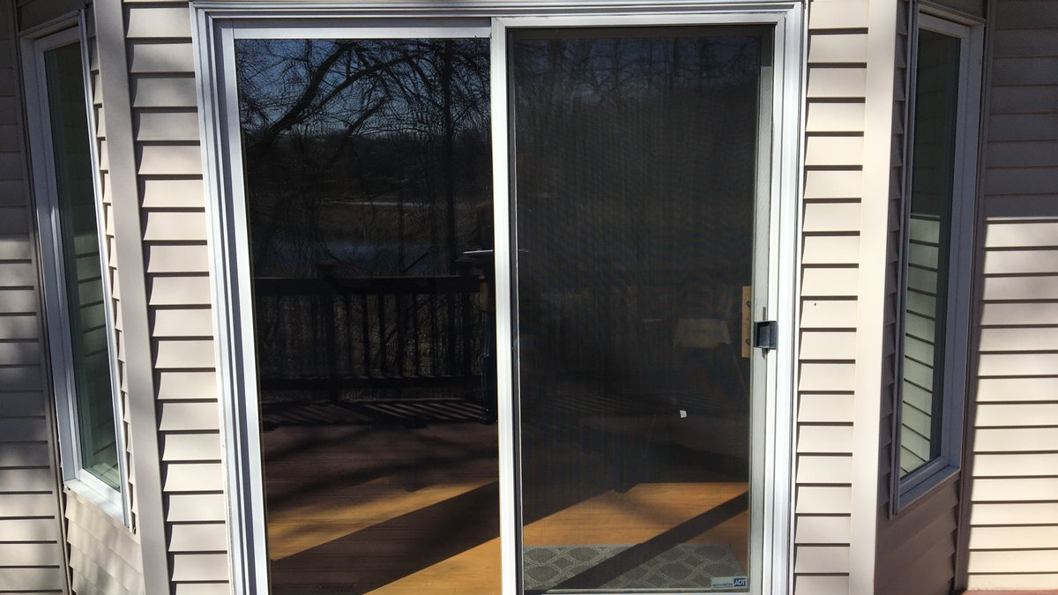
BEFORE

Slide 16
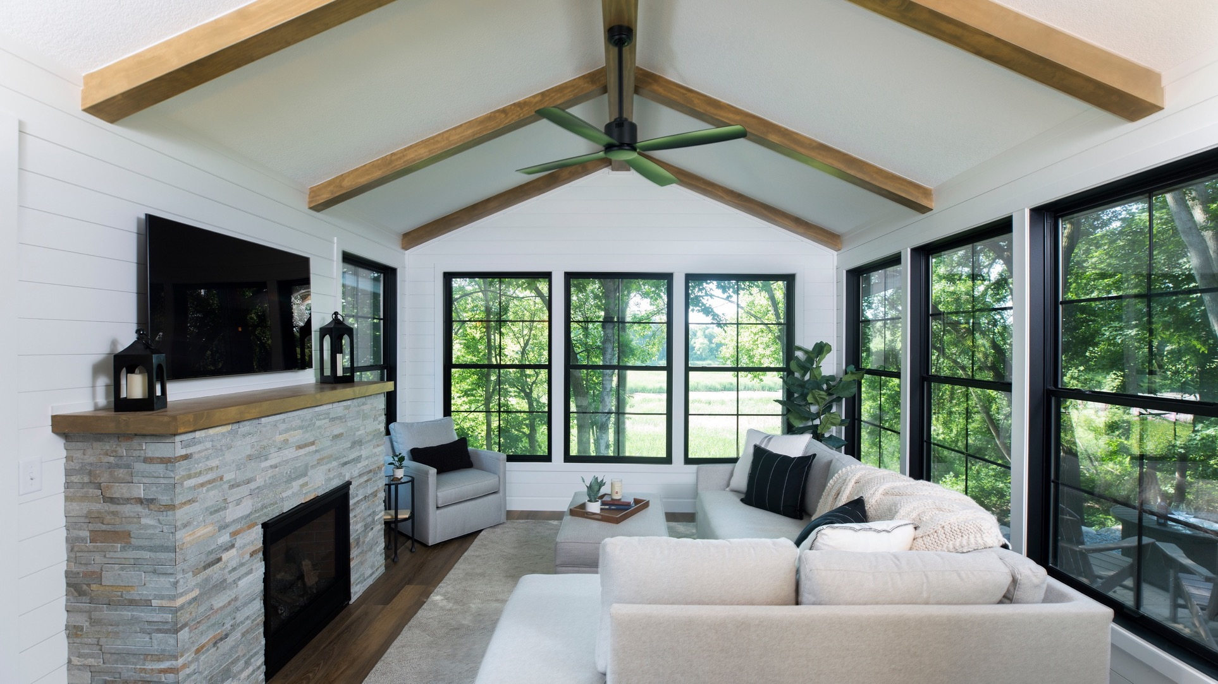
AFTER

Slide 17
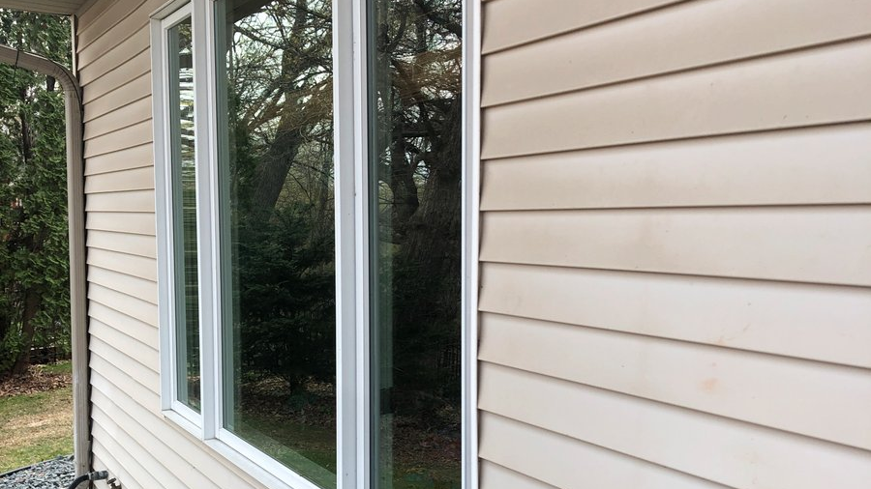
BEFORE

Slide 18
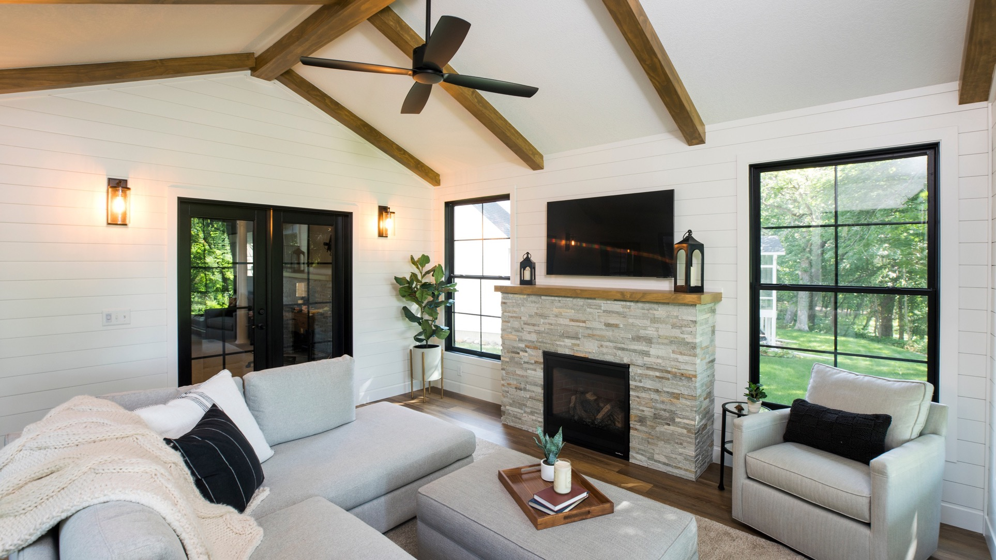
AFTER

Slide 19
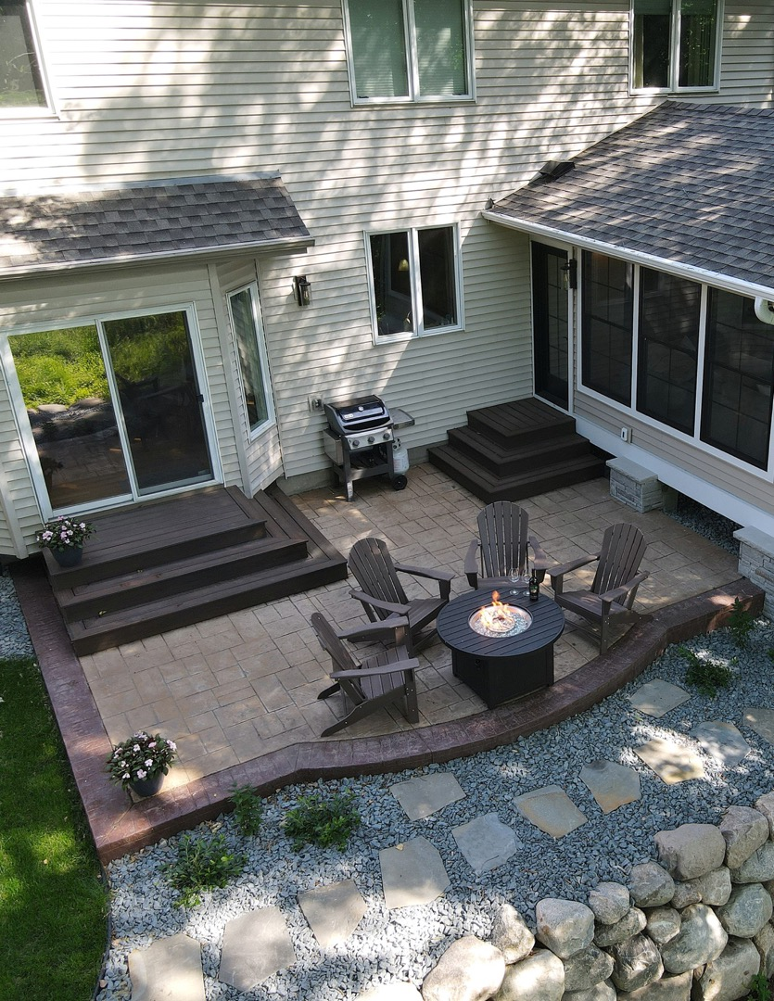
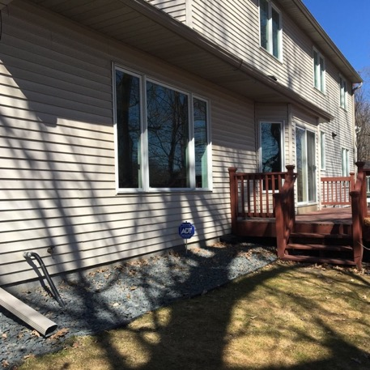
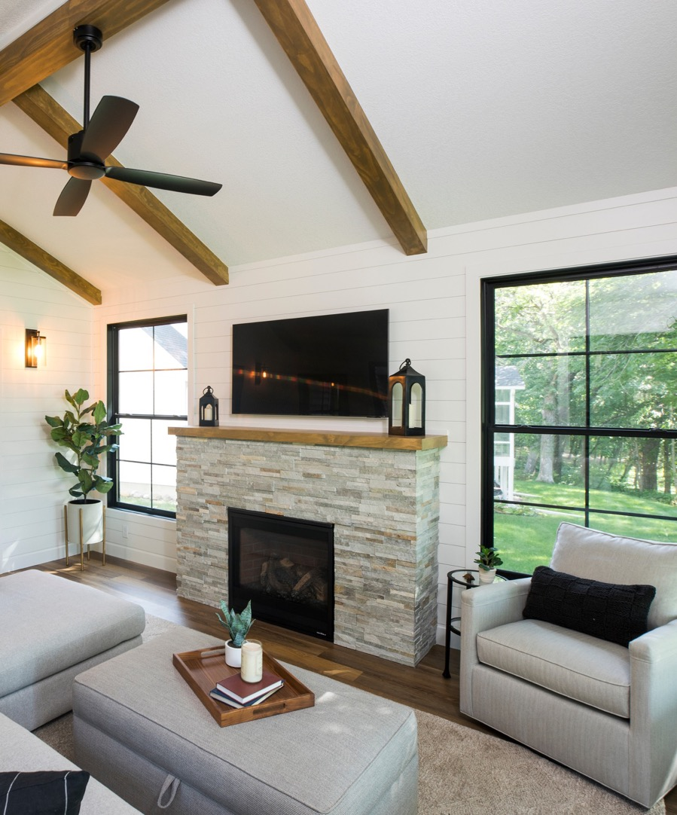
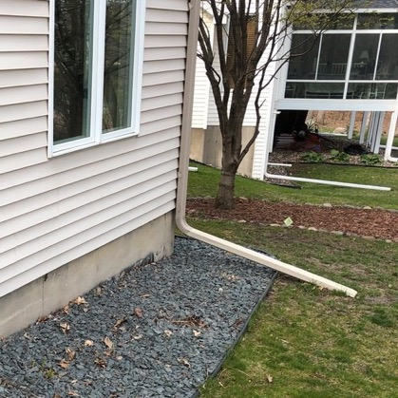
BEFORE
EXTERIOR ADDITION_
BEFORE

Slide 20
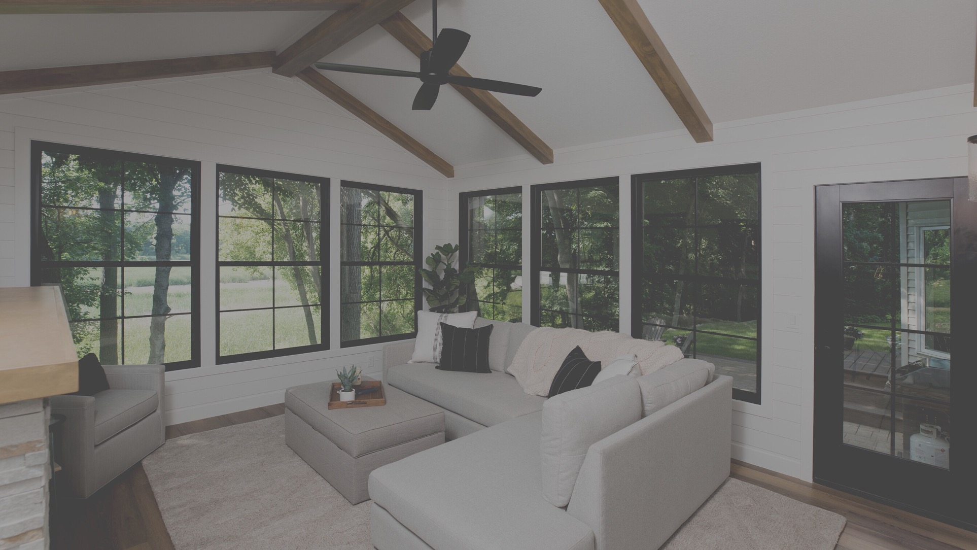
COTY AWARDS 2023
THANK YOU
Project cost: $118,954
Project completion:10/05/21

